Slide 1
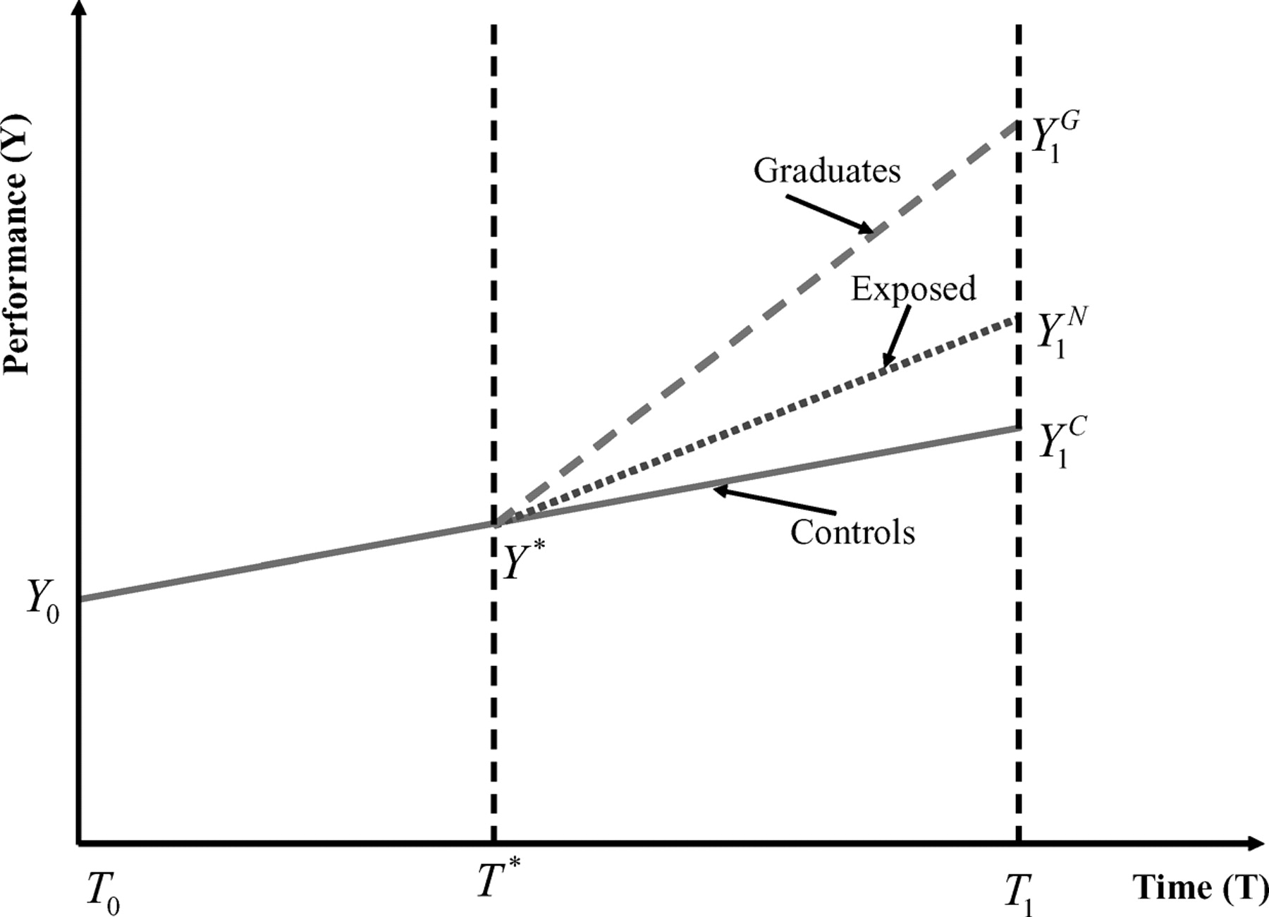
Figure 1 The evolution of performance over time
Notes:
Figure 1 The evolution of performance over time
Unless provided in the caption above, the following copyright applies to the content of this slide:

