Slide 1
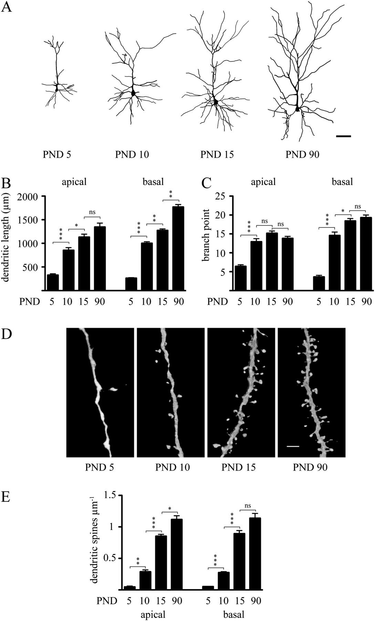
Figure 1. Dendritic arbor and spine development of layer 2/3 pyramidal neurons in the SSC. (A) Representative ...
Notes:
Figure 1. Dendritic arbor and spine development of layer 2/3 pyramidal neurons in the SSC. (A) Representative Neurolucida reconstructions of LY-injected pyramidal neurons in layer 2/3 of the SSC at PNDs 5, 10, 15, and 90 showing the temporal evolution of dendritic arborization pattern and spinogenesis during the first three postnatal months. (B) Quantitative analysis describing the temporal evolution of apical and basal dendritic lengths, and (C) branching points. (D) Representative confocal images (3D volume rendering) showing the temporal evolution of dendritic spine density on apical dendritic shafts of layer 2/3 pyramidal neurons. (E) Quantitative analysis of the temporal evolution of dendritic spine density on second order apical and basal dendritic shafts. Results are expressed as mean ± standard error of mean, n = 3 animals per age group. A total of 8–12 injected cells per age group were randomly selected for arbor analysis. A total of 2580 spines for apical and 2631 spines for basal dendrites were counted to determine spine density. One-way ANOVA with Bonferroni post hoc test was used to assess statistical differences between age groups either in apical or in basal dendrites. *P < 0.05; **P < 0.01; ***P < 0.001 compared with the dendritic arborization (B–C) or spine density (E) of the previous age group. PND: postnatal day scale bar: 100 μm in A; 6 μm in D; ns, nonsignificant difference.
Unless provided in the caption above, the following copyright applies to the content of this slide: © The Author 2012. Published by Oxford University Press. All rights reserved. For permissions, please e-mail: journals.permissions@oup.com

Slide 2
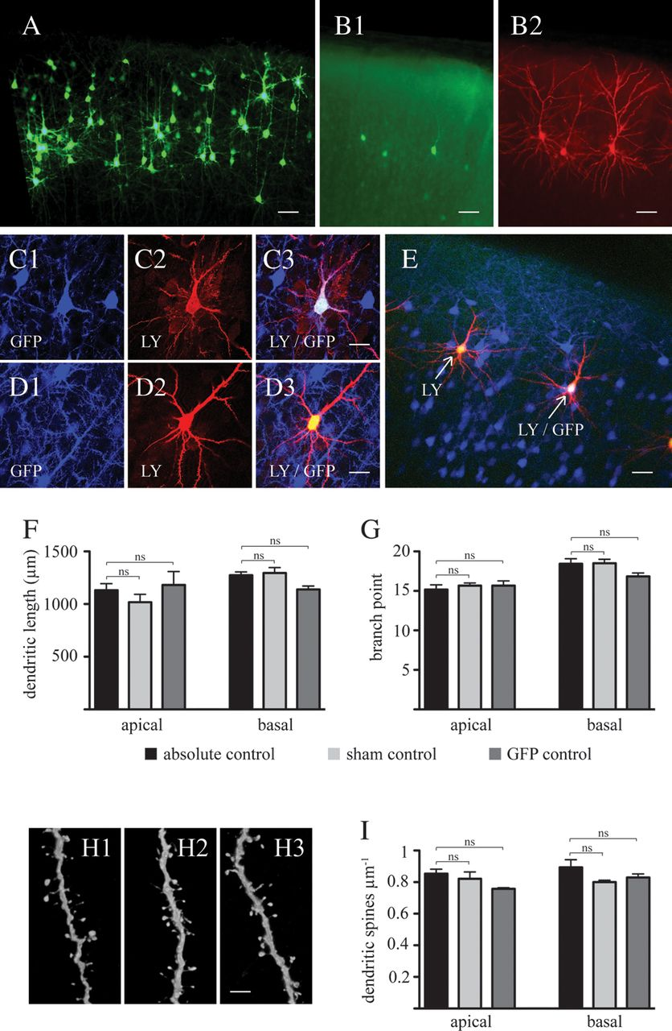
Figure 2. In utero electroporation of enhanced green fluorescent protein at gestational day 17.5 labels of layer 2/3 ...
Notes:
Figure 2. In utero electroporation of enhanced green fluorescent protein at gestational day 17.5 labels of layer 2/3 pyramidal neurons without affecting physiological patterns of dendritic arbor and spine development. (A) Low-magnification micrographs, following immunohistochemistry with an antibody against EGFP, showing the presence of labeled layer 2/3 pyramidal neurons in the SSC at PND 15. (B) Detailed dendritic arbor architecture of EGFP-expressing cells (B1, without antibody-induced enhancement of fluorescence intensity) can be revealed by iontophoretic injections of LY into these cells (B2). (C) Injection of LY into EGFP-positive (C1: EGFP, C2: LY, and C3: colocalization) and into (D) EGFP-negative cells (D1: EGFP, D2: LY, and D3: colocalization) allows detection and analysis of adjacent control and electroporated cells in the same microenvironment (E). Quantitative analysis of dendritic length (F) and branch points (G) at PND 15 reveals no difference in gross dendritic arbor architecture between absolute controls (i.e., neurons from nonelectroporated animals), sham controls (i.e., nonelectroporated cells from animals which underwent the electroporation procedure), and electroporated cells. (H) Representative micrographs of dendritic spines (H1: absolute control, H2: sham control, H3: EGFP-expressing group), and (I) quantitative analysis of spine density demonstrate no difference between these three groups. Results are expressed as mean ± standard error of mean, n = 3 animals per experimental group. A total of 8–12 injected cells per experimental group were randomly selected for arbor analysis. A total of 3183 spines for apical and 3298 spines for basal dendrites were counted to determine spine density. One-way ANOVA with Bonferroni post hoc test was used to assess statistical differences between age groups either in apical or in basal dendrites. EGFP, enhanced green fluorescent protein; ns, nonsignificant difference; Scale bars: A–B, E: 100 μm; C–D: 40 μm; H: 6 μm.
Unless provided in the caption above, the following copyright applies to the content of this slide: © The Author 2012. Published by Oxford University Press. All rights reserved. For permissions, please e-mail: journals.permissions@oup.com

Slide 3
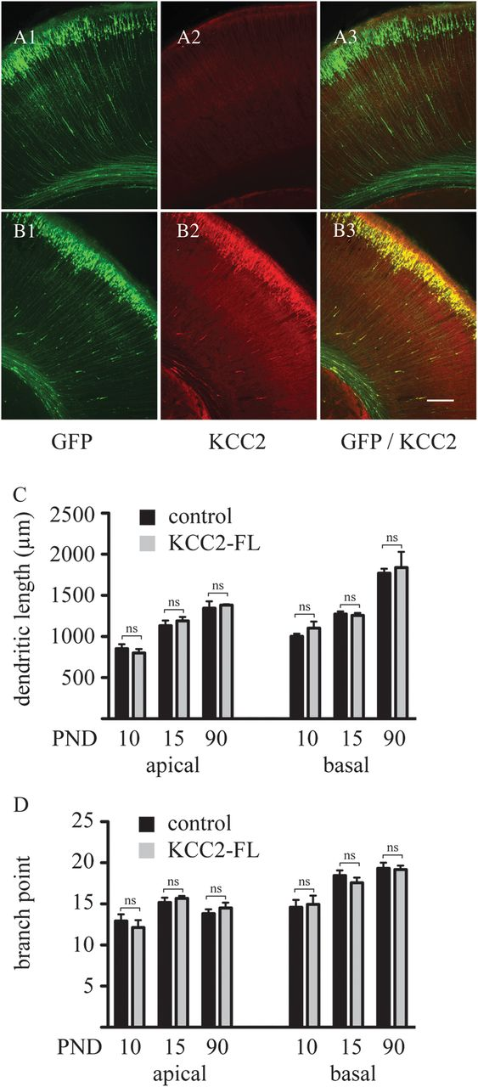
Figure 3. In utero coelectroporation of EGFP and KCC2 does not affect dendritic arbor development of layer 2/3 ...
Notes:
Figure 3. In utero coelectroporation of EGFP and KCC2 does not affect dendritic arbor development of layer 2/3 pyramidal neurons. In contrast to the electroporation of GFP alone (A), coelectroporation of EGFP and the KCC2 transporter (B) leads to a strong expression of KCC2 in the vast majority of EGFP-positive cells. Quantitative analysis of dendritic length (C) and branch points (D) shows no effect of KCC2 on the development of gross dendritic structure. Controls represent nonelectroporated LY-injected cells from the same animals, where KCC2 was electroporated. Results are expressed as mean ± standard error of mean, n = 3 animals per experimental group. A total of 8–12 injected cells per experimental group were randomly selected for arbor analysis. Within the same developmental age groups, Student's t-test was used to examine statistical differences between treatment groups. EGFP, enhanced green fluorescent protein. ns: nonsignificant difference. Scale bar: 100 μm.
Unless provided in the caption above, the following copyright applies to the content of this slide: © The Author 2012. Published by Oxford University Press. All rights reserved. For permissions, please e-mail: journals.permissions@oup.com

Slide 4
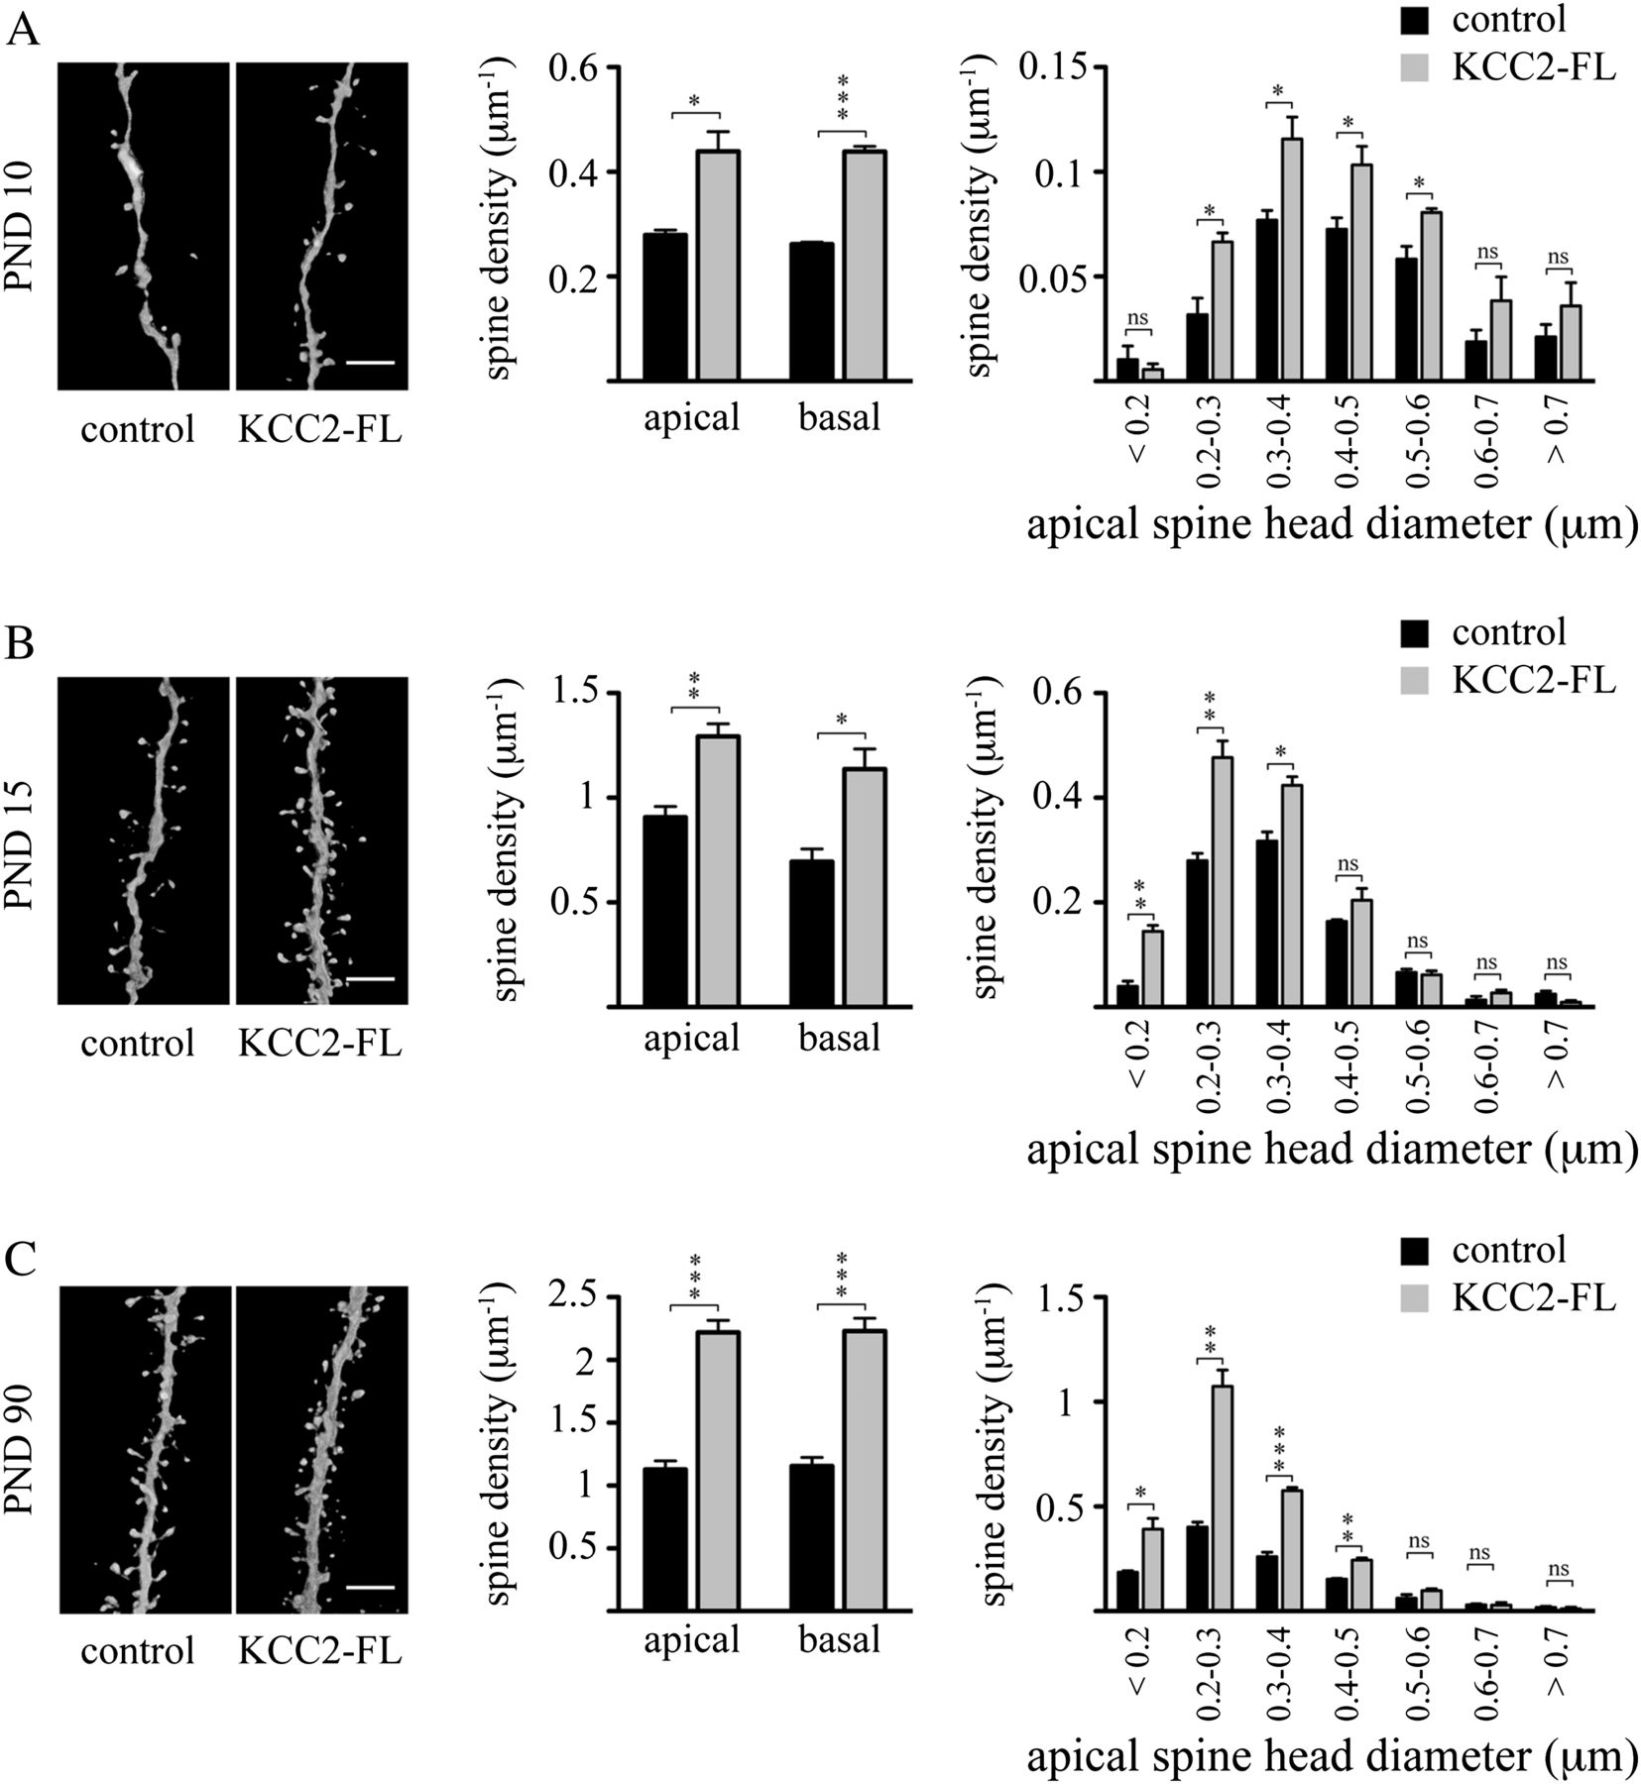
Figure 4. Premature expression of KCC2 increases dendritic spine densities. Representative confocal images (left ...
Notes:
Figure 4. Premature expression of KCC2 increases dendritic spine densities. Representative confocal images (left panels) together with quantitative analyses of apical and basal spine densities (middle panels) as well as spine head diameters (right panels) on PNDs 10 (A), 15 (B), and 90 (C) reveal that KCC2 induces a significant increase in the dendritic spine density at all these developmental stages. Three animals per age group were used to determine spine density for each experimental condition. Controls represent nonelectroporated LY-injected cells from the same animals where KCC2 was electroporated. Results are expressed as mean ± standard error of mean, n = 3 animals per group. A total of 5165 spines in controls and of 7543 spines in the KCC2 group was counted to determine spine densities. Within the same developmental age group, Student's t-test was used to examine statistical differences between treatment groups. *P < 0.05; **P < 0.01; ***P < 0.001 compared with the apical spine density of the control group at the same developmental stage. KCC2-FL, full length KCC2; ns, nonsignificant difference. Scale bar: 6 μm.
Unless provided in the caption above, the following copyright applies to the content of this slide: © The Author 2012. Published by Oxford University Press. All rights reserved. For permissions, please e-mail: journals.permissions@oup.com

Slide 5
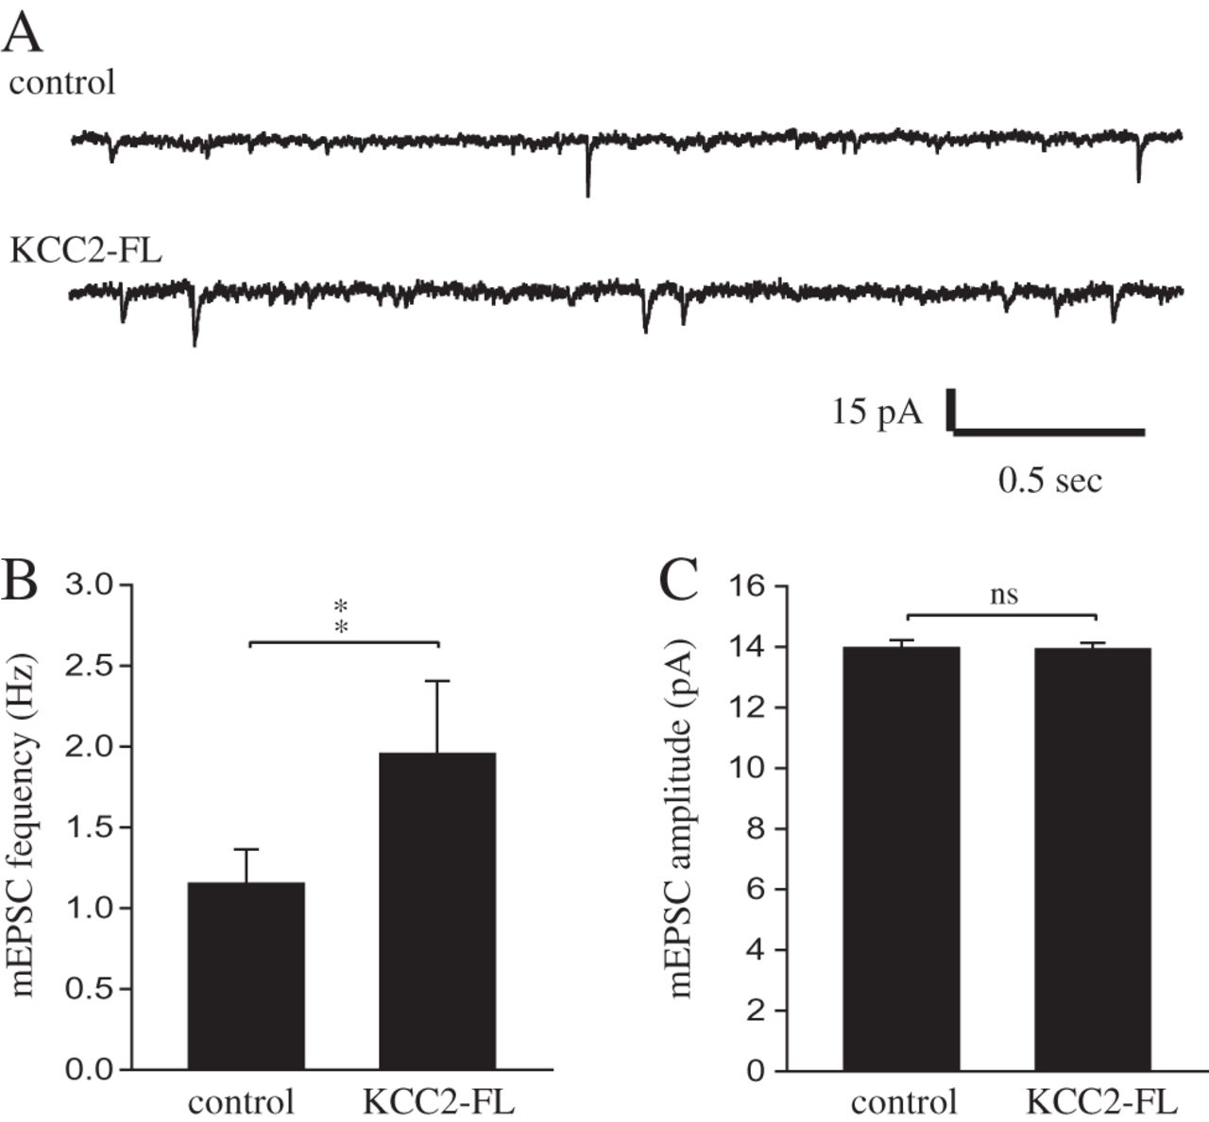
Figure 5. In utero electroporation of KCC2 leads to an increase in the frequency of miniature excitatory currents. (A) ...
Notes:
Figure 5. In utero electroporation of KCC2 leads to an increase in the frequency of miniature excitatory currents. (A) Traces showing recordings of mEPSCs in non-EGFP-positive (control) and KCC2-FL/EGFP-positive (KCC2-FL) neurons. KCC2-FL neurons (n = 12) display a higher frequency (B) but not amplitude (C) of mEPSCs in comparison to control neurons (n = 12). Data are presented as mean ± standard error of mean. Controls represent nonelectroporated cells from the same animals where KCC2 was electroporated. **P < 0.01; ns, nonsignificant difference.
Unless provided in the caption above, the following copyright applies to the content of this slide: © The Author 2012. Published by Oxford University Press. All rights reserved. For permissions, please e-mail: journals.permissions@oup.com

Slide 6
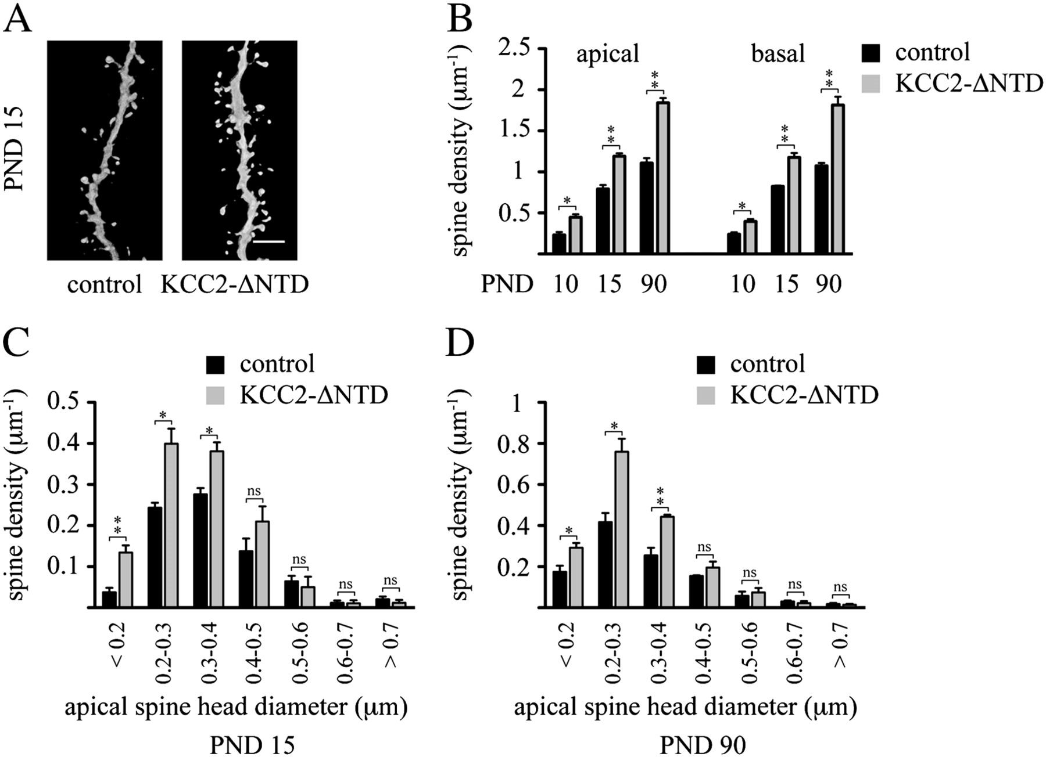
Figure 6. Effect of the non–chloride-extruding deletion construct, KCC2-ΔNTD, on dendritic spinogenesis. (A) ...
Notes:
Figure 6. Effect of the non–chloride-extruding deletion construct, KCC2-ΔNTD, on dendritic spinogenesis. (A) Representative confocal images (3D volume rendering) showing the impact of the expression of the N-terminal deleted, non–chloride-extruding mutation of the KCC2 transporter on dendritic spinogenesis at PND 15. Quantitative analysis of spine densities (B) as well as spine head diameters on PND 15 (C) and PND 90 (D). Three animals per age group were used to determine spine density for each experimental condition. Controls represent nonelectroporated, LY-injected cells from the same animals, where KCC2-ΔNTD was electroporated. Results are expressed as mean ± standard error of mean, n = 3 animals per group. A total of 4928 spines in controls and of 6762 spines in the KCC2-ΔNTD group was counted to determine spine densities. Within the same developmental age group, Student's t-test was used to examine statistical differences between treatment groups. *P < 0.05; **P < 0.01; ***P < 0.001 compared with the apical spine density of the control group at the same developmental stage. KCC2-ΔNTD, N-terminal deleted form of KCC2; ns, nonsignificant difference. Scale bar: 6 μm.
Unless provided in the caption above, the following copyright applies to the content of this slide: © The Author 2012. Published by Oxford University Press. All rights reserved. For permissions, please e-mail: journals.permissions@oup.com

Slide 7
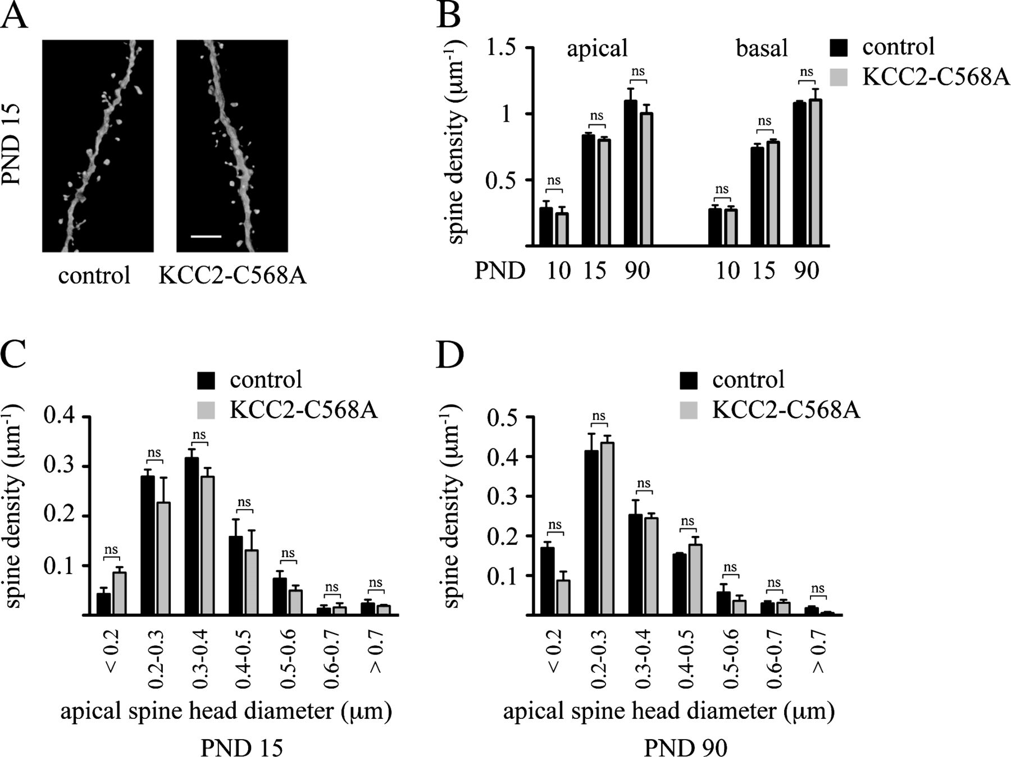
Figure 7. Expression of the KCC2-C568A mutant does not impair dendritic spinogenesis. (A) Representative confocal ...
Notes:
Figure 7. Expression of the KCC2-C568A mutant does not impair dendritic spinogenesis. (A) Representative confocal images (3D volume rendering) showing the impact of the KCC2-C568A mutant on dendritic spinogenesis at PND 15. Quantitative analysis of spine densities (B) as well as spine head diameters on PND 15 (C) and PND 90 (D). Three animals per age group were used to determine spine density for each experimental condition. Controls represent nonelectroporated LY-injected cells from the same animals, where KCC2-C568A was electroporated. Results are expressed as mean ± standard error of mean, n = 3 animals per group. A total of 3427 spines in controls and of 3502 spines in the KCC2-C568A group was counted to determine spine densities. Within the same developmental age group, Student's t-test was used to examine statistical differences between treatment groups. Scale bar: 6 μm. ns: nonsignificant difference.
Unless provided in the caption above, the following copyright applies to the content of this slide: © The Author 2012. Published by Oxford University Press. All rights reserved. For permissions, please e-mail: journals.permissions@oup.com

Slide 8
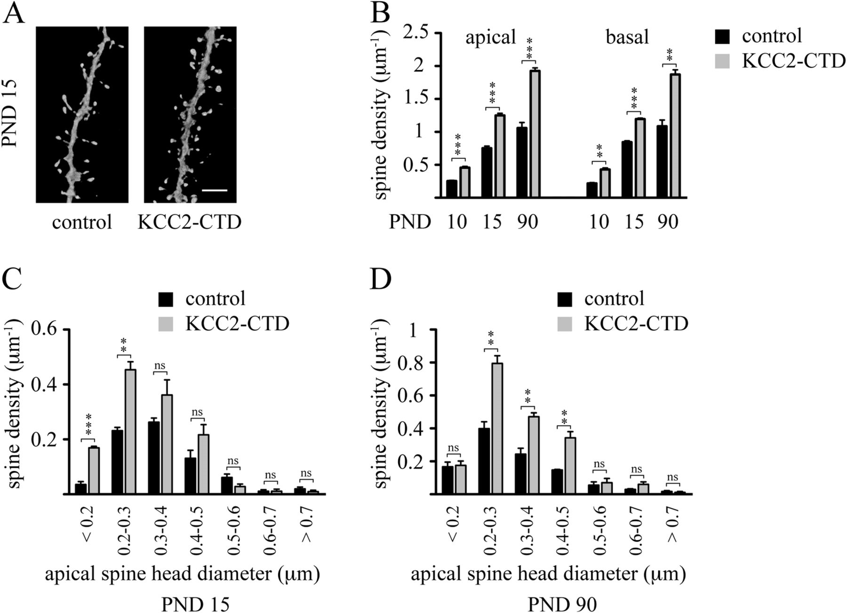
Figure 8. Expression of the C-terminal domain of KCC2 (KCC2-CTD) also increases dendritic spine densities. (A) ...
Notes:
Figure 8. Expression of the C-terminal domain of KCC2 (KCC2-CTD) also increases dendritic spine densities. (A) Representative confocal images (3D volume rendering) showing the impact of the expression of the C-terminal form of KCC2 on dendritic spinogenesis at PND 15. Quantitative analysis of spine density (B) as well as spine head diameter on PND 15 (C) and PND 90 (D). Three animals per age group were used to determine spine density for each experimental condition. Controls represent nonelectroporated LY-injected cells from the same animals, where KCC2-CTD was electroporated. Results are expressed as mean ± standard error of mean, n = 3 animals per group. A total of 5174 spines in controls and of 7276 spines in the KCC2-CTD group was counted to determine spine densities. Within the same developmental age group, Student's t-test was used to determine statistical difference between treatment groups. *P < 0.05; **P < 0.01; ***P < 0.001 compared with the apical spine density of the control group at the same developmental stage. KCC2-CTD, C-terminal form of KCC2. Scale bar: 6 μm. ns, nonsignificant difference.
Unless provided in the caption above, the following copyright applies to the content of this slide: © The Author 2012. Published by Oxford University Press. All rights reserved. For permissions, please e-mail: journals.permissions@oup.com

