Slide 1
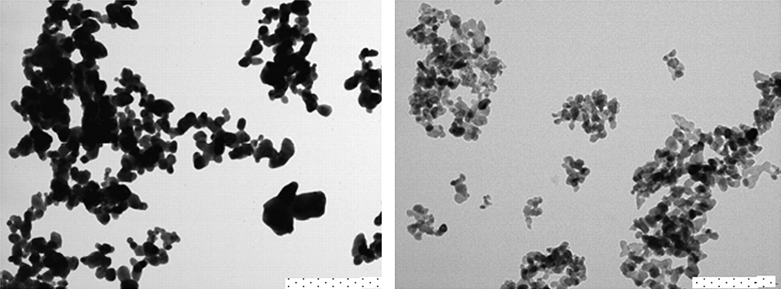
FIG. 1. Transmission electron microscopy (TEM) images of the two types of ZnO particles used in the sunscreens. For ...
Notes:
FIG. 1. Transmission electron microscopy (TEM) images of the two types of ZnO particles used in the sunscreens. For the bulk particles (image on left), the scale bar on the lower right-hand side is 1000 nm, and for the nanoparticles (image on right), the bar is 200 nm.
Unless provided in the caption above, the following copyright applies to the content of this slide: © The Author 2010. Published by Oxford University Press on behalf of the Society of Toxicology. All rights reserved. For permissions, please email: journals.permissions@oxfordjournals.org

Slide 2
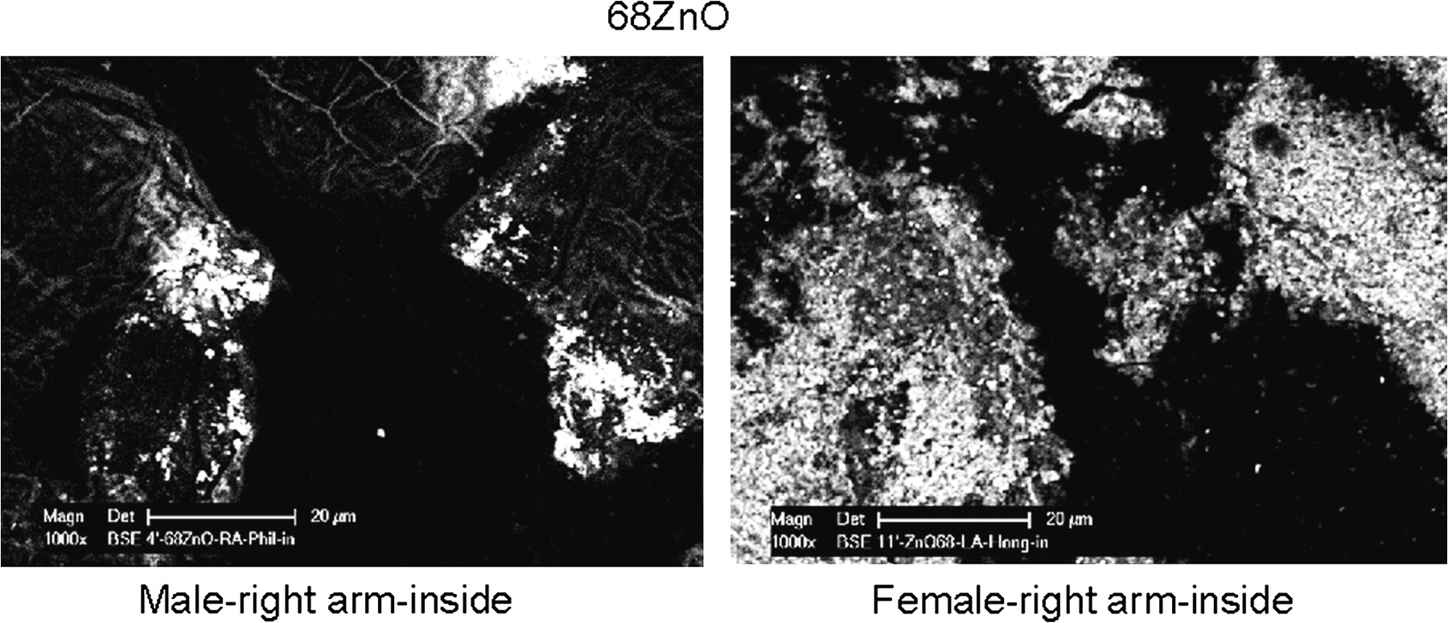
FIG. 2. Scanning electron microscope (SEM) images illustrating the character of the nanoparticle sunscreen on the ...
Notes:
FIG. 2. Scanning electron microscope (SEM) images illustrating the character of the nanoparticle sunscreen on the skin of two subjects using a skin tape–stripping method. The scale bars are 20 μm.
Unless provided in the caption above, the following copyright applies to the content of this slide: © The Author 2010. Published by Oxford University Press on behalf of the Society of Toxicology. All rights reserved. For permissions, please email: journals.permissions@oxfordjournals.org

Slide 3
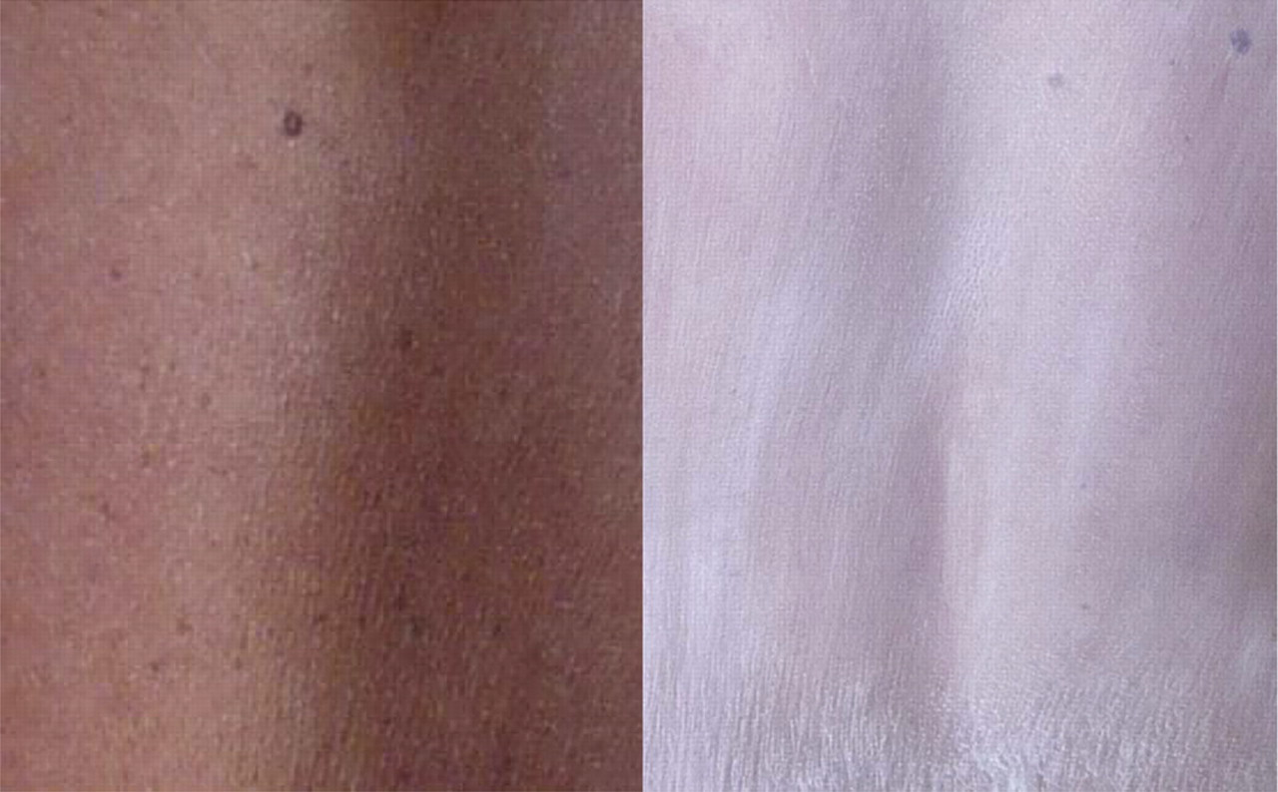
FIG. 3. Appearance on the skin of the two sunscreen formulations after the sixth application at the beach. The ...
Notes:
FIG. 3. Appearance on the skin of the two sunscreen formulations after the sixth application at the beach. The left-hand image is for a female subject who had nano sunscreen applied to her back, whereas the right-hand image is for a male who had sunscreen with larger particles applied. The transparency of the sunscreen on the female indicates that there is little agglomeration of the ZnO nanoparticles.
Unless provided in the caption above, the following copyright applies to the content of this slide: © The Author 2010. Published by Oxford University Press on behalf of the Society of Toxicology. All rights reserved. For permissions, please email: journals.permissions@oxfordjournals.org

Slide 4
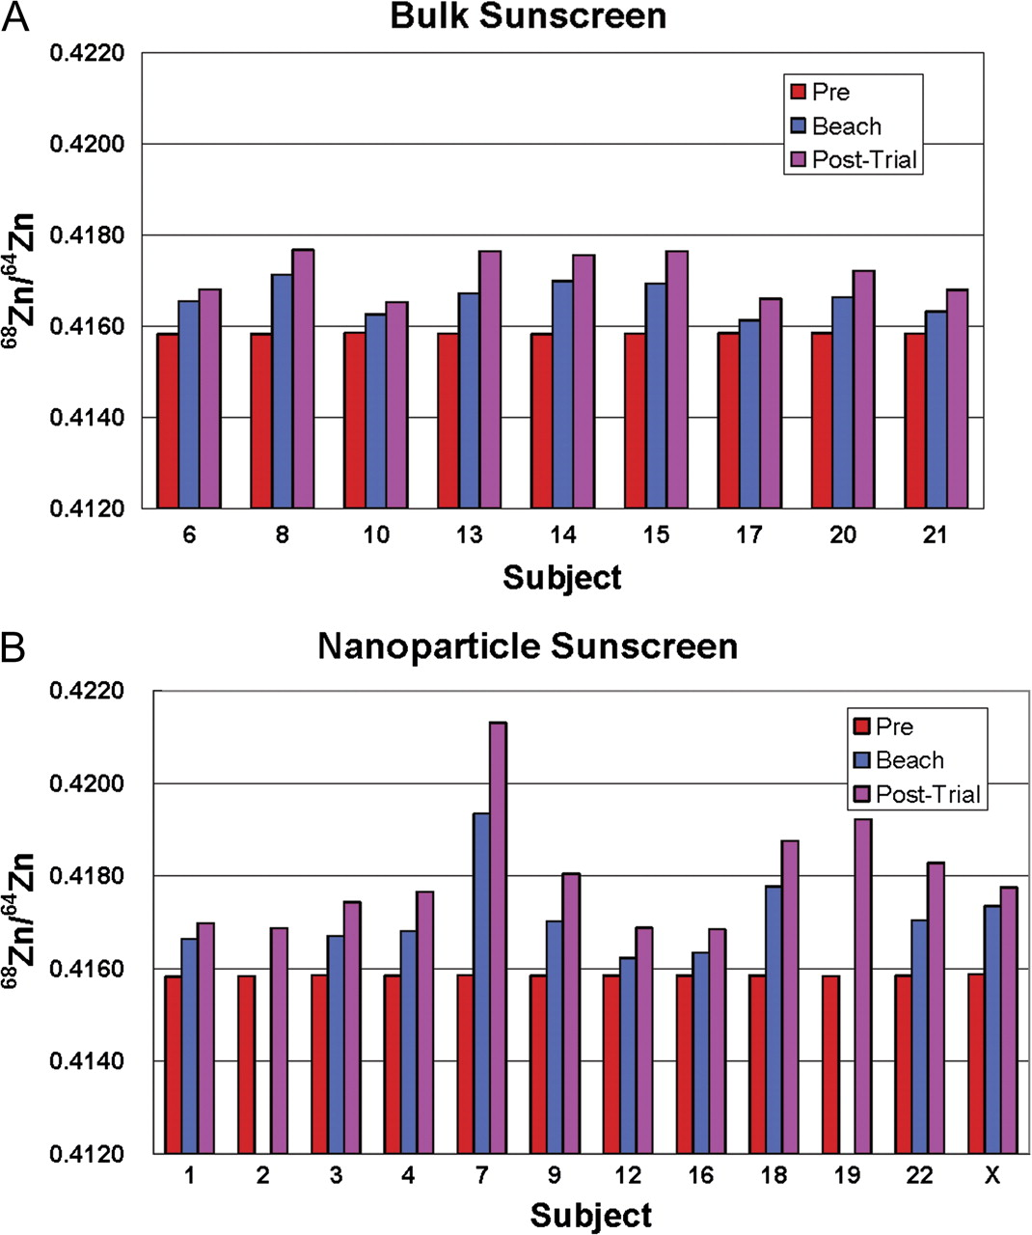
FIG. 4. (A) and (B) Bar graphs showing the ratio ⁶⁸Zn/⁶⁴Zn in blood from subjects on whose ...
Notes:
FIG. 4. (A) and (B) Bar graphs showing the ratio 68Zn/64Zn in blood from subjects on whose backs bulk or nano sunscreen was applied. The before exposure data (red bars) illustrate the uniformity in 68Zn/64Zn ratios prior to sunscreen application, reflecting the isotopic composition of naturally occurring Zn. Increases in the ratio evident in all subjects at end of the beach exposure phase (blue bars) and 6 days post-exposure (pink) are due to skin penetration of 68Zn from the sunscreens. “X” represents the person who applied both sunscreens; her data were not included in the statistical analyses.
Unless provided in the caption above, the following copyright applies to the content of this slide: © The Author 2010. Published by Oxford University Press on behalf of the Society of Toxicology. All rights reserved. For permissions, please email: journals.permissions@oxfordjournals.org

Slide 5
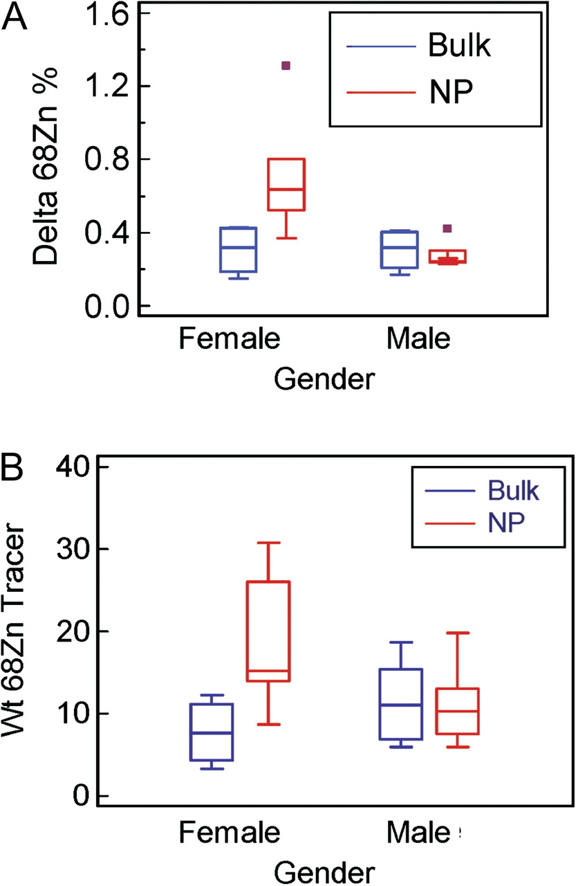
FIG. 5. (A) and (B) Box plots for Δ⁶⁸Zn% and amount of ⁶⁸Zn tracer (micrograms) in blood ...
Notes:
FIG. 5. (A) and (B) Box plots for Δ68Zn% and amount of 68Zn tracer (micrograms) in blood samples for subjects, showing significantly higher Δ68Zn% and amounts of 68Zn tracer for females in the nano group (NP) compared with females in the bulk group but no difference between the nano and bulk groups for males. Data for subject 7 (the outlier) are included in the analyses. The data are for the post-exposure sampling.
Unless provided in the caption above, the following copyright applies to the content of this slide: © The Author 2010. Published by Oxford University Press on behalf of the Society of Toxicology. All rights reserved. For permissions, please email: journals.permissions@oxfordjournals.org

Slide 6
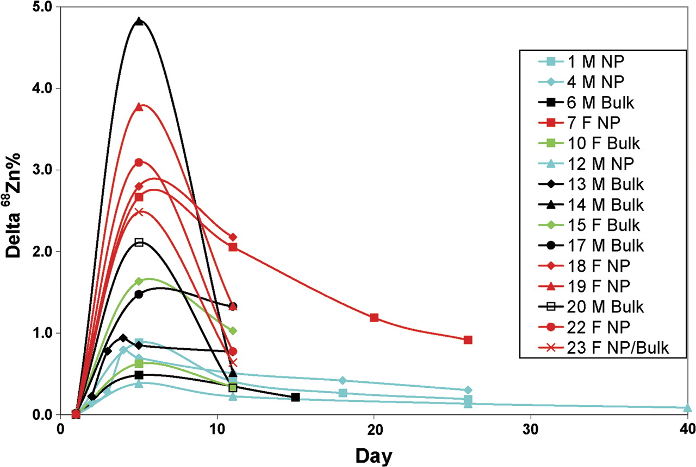
FIG. 6. Changes in Δ⁶⁸Zn% for urine samples. All values peak at the end of the beach exposure phase (day ...
Notes:
FIG. 6. Changes in Δ68Zn% for urine samples. All values peak at the end of the beach exposure phase (day 5) and thereafter show a decrease over time. The red lines are for female subjects administered nano sunscreen. The Δ68Zn% values for five subjects (2, 3, 8, 9, and 16) at day 5 range up to 35, and for subject 21, the value was 330. Urine samples for all 20 subjects were collected up to 6 days post-exposure; samples from six subjects were collected at various times out to 40 days post-exposure.
Unless provided in the caption above, the following copyright applies to the content of this slide: © The Author 2010. Published by Oxford University Press on behalf of the Society of Toxicology. All rights reserved. For permissions, please email: journals.permissions@oxfordjournals.org

Slide 7
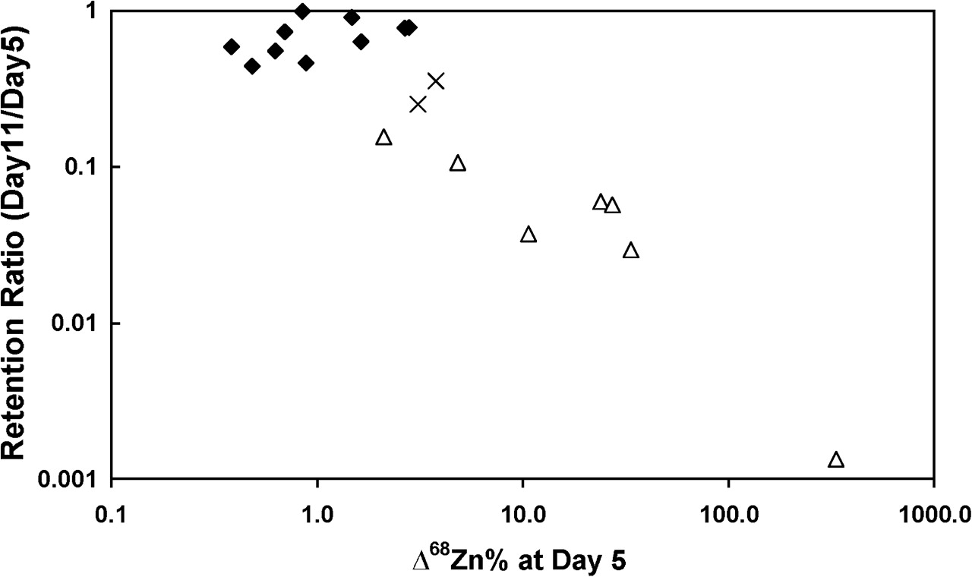
FIG. 7. Plot of log(retention ratios) versus log(peak Δ⁶⁸Zn%) to evaluate possible urine contamination ...
Notes:
FIG. 7. Plot of log(retention ratios) versus log(peak Δ68Zn%) to evaluate possible urine contamination with 68Zn from the sunscreen. Data for samples with minimal contamination (♦) lie on a line with a slope of approximately zero. For urine samples significantly affected by contamination (Δ), the data define a linear function with a negative slope of around −1. The two data points (marked X) in between the above groups do not affect the statistical outcomes.
Unless provided in the caption above, the following copyright applies to the content of this slide: © The Author 2010. Published by Oxford University Press on behalf of the Society of Toxicology. All rights reserved. For permissions, please email: journals.permissions@oxfordjournals.org

Slide 8
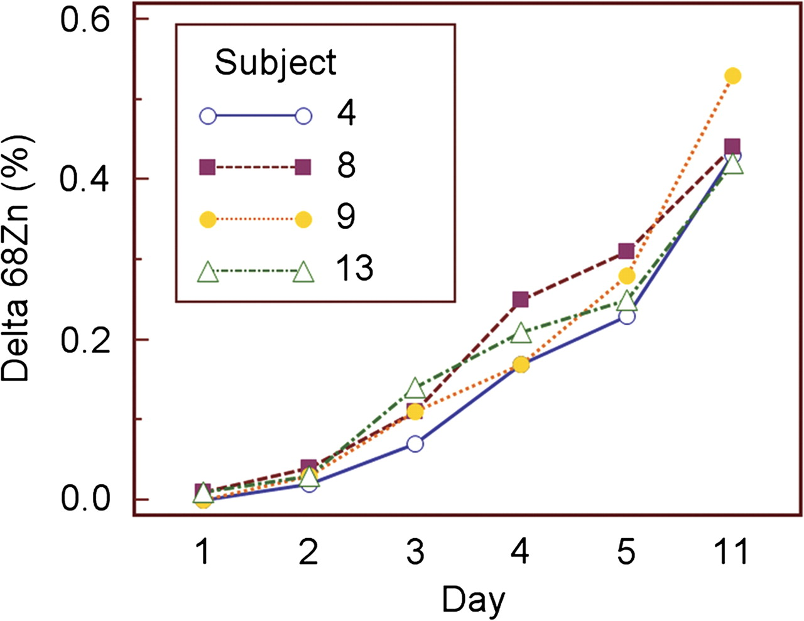
FIG. 8. Δ⁶⁸Zn% results for daily blood sampling collected at about 3 P.M. showing a linear increase with ...
Notes:
FIG. 8. Δ68Zn% results for daily blood sampling collected at about 3 P.M. showing a linear increase with dose over the 5 days of sunscreen application for subjects 4, 8, 9, and 13. Note the nonlinear scale for the x-axis. Individual lines of best fit to the data from day 1 to day 5 have squared Pearson correlation coefficients (R2) of 0.95–0.96. Detection of the 68Zn tracer from the sunscreen was found from day 2.
Unless provided in the caption above, the following copyright applies to the content of this slide: © The Author 2010. Published by Oxford University Press on behalf of the Society of Toxicology. All rights reserved. For permissions, please email: journals.permissions@oxfordjournals.org

