Slide 1
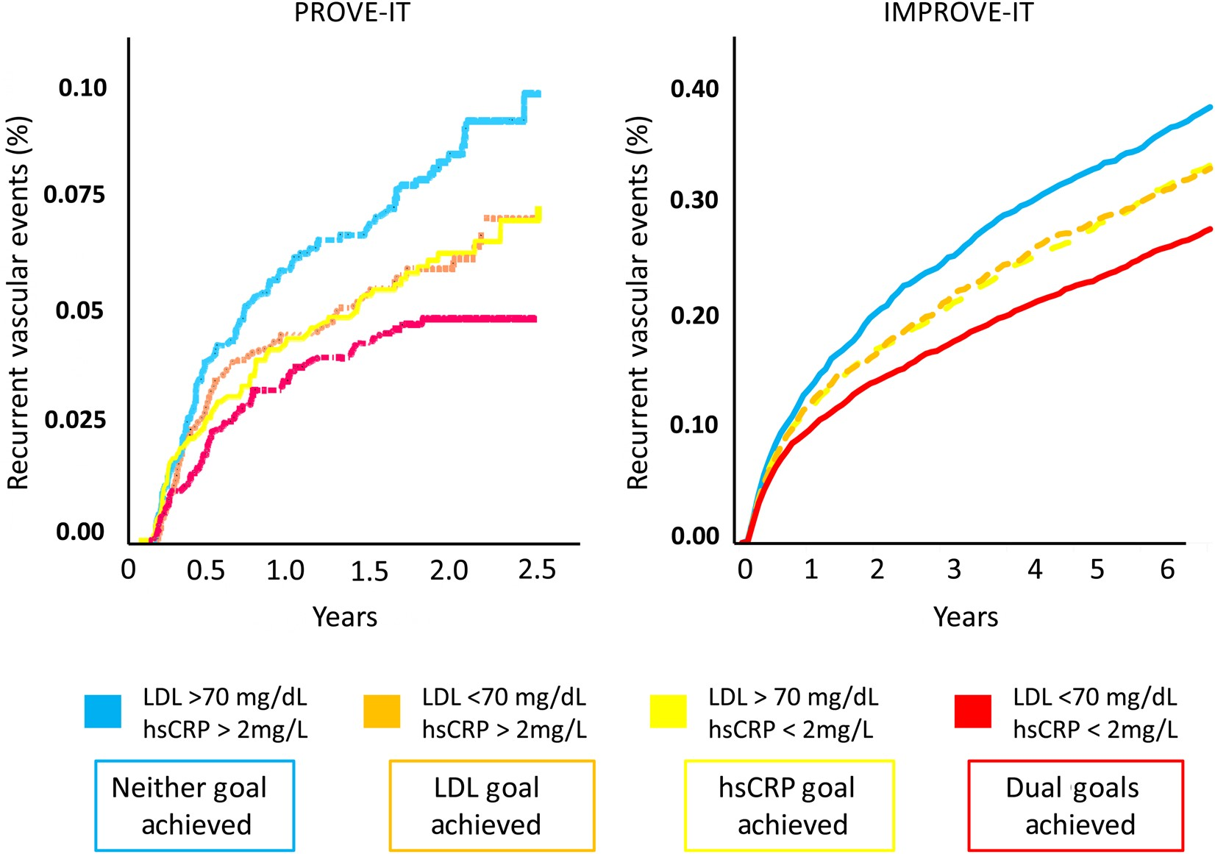
Figure 1 Recurrent cardiovascular event rates according to whether or not trial participants achieved the ‘dual goals’ ...
Notes:
Figure 1 Recurrent cardiovascular event rates according to whether or not trial participants achieved the ‘dual goals’ of LDL reduction (<1.8 mmol/L [<70 mg/dL]) and hsCRP reduction (<2 mg/L) following initiation of statin therapy (PROVE-IT, left) or the combination of statin therapy and ezetimibe (IMPROVE-IT, right). Data from Ridker et al.5 (PROVE-IT) and Bohula et al.12 (IMPROVE-IT).
Unless provided in the caption above, the following copyright applies to the content of this slide: Published on behalf of the European Society of Cardiology. All rights reserved. © The Author 2016. For permissions please email: journals.permissions@oup.com.

Slide 2
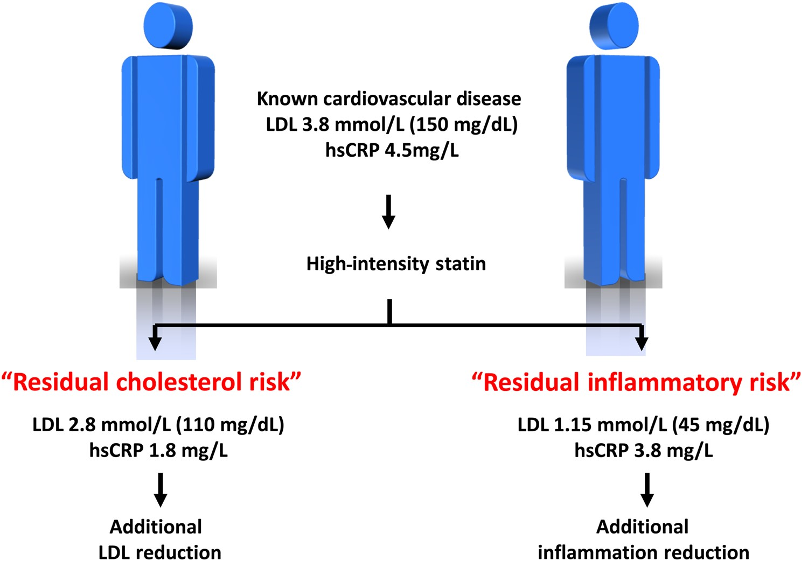
Figure 2 Differential secondary prevention treatment options for statin-treated patients with ‘Residual Inflammatory ...
Notes:
Figure 2 Differential secondary prevention treatment options for statin-treated patients with ‘Residual Inflammatory Risk’ when compared with ‘Residual Cholesterol Risk’.
Unless provided in the caption above, the following copyright applies to the content of this slide: Published on behalf of the European Society of Cardiology. All rights reserved. © The Author 2016. For permissions please email: journals.permissions@oup.com.

