Slide 1
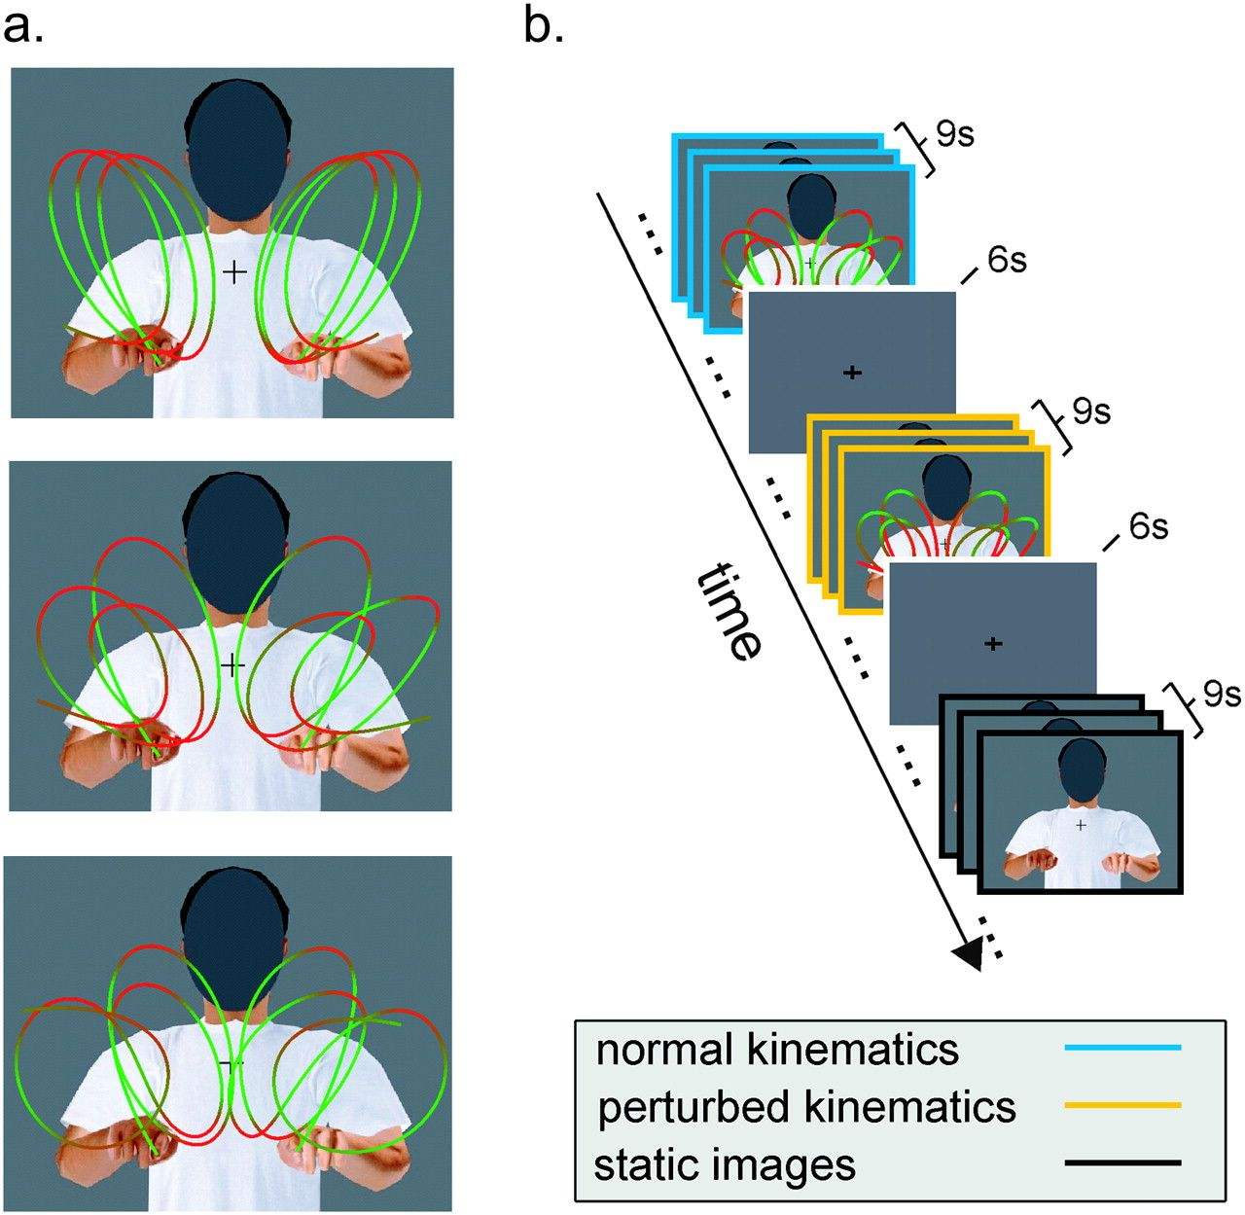
Figure 1. Biological motion stimuli and experimental paradigm. (a) Stimuli consisted of computer-generated animations ...
Notes:
Figure 1. Biological motion stimuli and experimental paradigm. (a) Stimuli consisted of computer-generated animations depicting a person executing 3 types of curvilinear movements (roughly resembling the trigrams lll, lee, and leo) with both hands in the air. Hand trajectories were obtained by motion capturing of a human subject. In one set of stimuli (normal), the movements of the animated avatar were the original recorded movements and thus complied with the normal human kinematic laws of motion. A second set of stimuli (perturbed) was created from the first one by means of nonlinear time warping in order to destroy compliance with the two-thirds power law. The different colors along the trajectories represent the instantaneous hand velocity, with hues of red indicating points of lower velocity and hues of green indicating points of higher velocity. A third set of stimuli consisted of static snapshots of the animations (static). In all stimuli, the face was occluded to minimize face-related neuronal activity. Each stimulus lasted for 3 s. (b) Example of an experimental session. Each scanning session consisted of a sequence of trials of 9 s during which 3 visual stimuli were shown consecutively followed by a 6 s fixation interval. During each 9 s trial, only stimuli of one type (normal, perturbed, or static) were shown. Trials were presented in a counterbalanced manner.
Unless provided in the caption above, the following copyright applies to the content of this slide: © The Author 2009. Published by Oxford University Press. All rights reserved. For permissions, please e-mail: journals.permissions@oxfordjournals.org

Slide 2
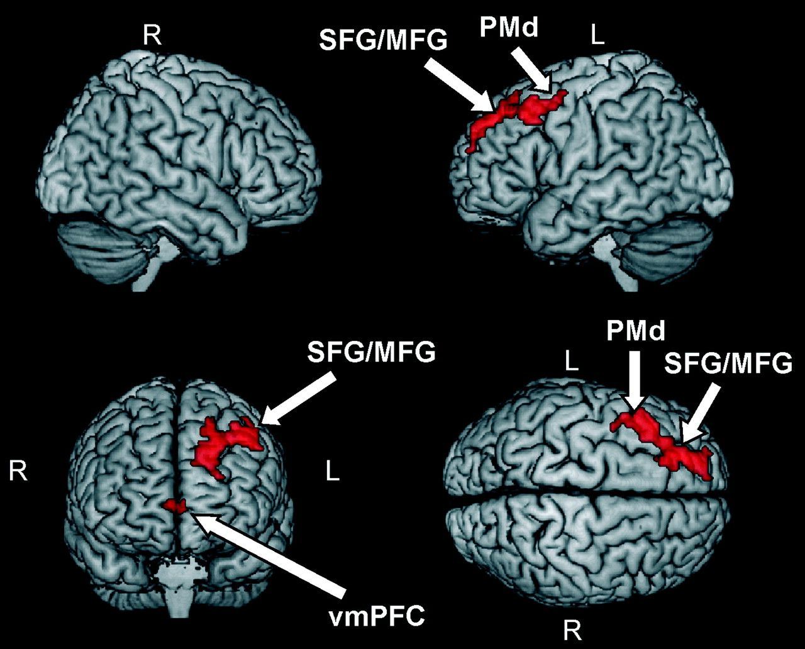
Figure 2. Brain areas showing higher BOLD responses during observation of human movements complying with normal ...
Notes:
Figure 2. Brain areas showing higher BOLD responses during observation of human movements complying with normal kinematic laws of motion (see Table 1). Activations were thresholded at P < 0.001 (uncorrected) at the single-voxel level and at P < 0.05 (corrected) at the cluster level. Abbreviations: superior frontal gyrus (SFG), middle frontal gyrus (MFG), premotor dorsal (PMd), and ventromedial prefrontal cortex (vmPFC).
Unless provided in the caption above, the following copyright applies to the content of this slide: © The Author 2009. Published by Oxford University Press. All rights reserved. For permissions, please e-mail: journals.permissions@oxfordjournals.org

Slide 3
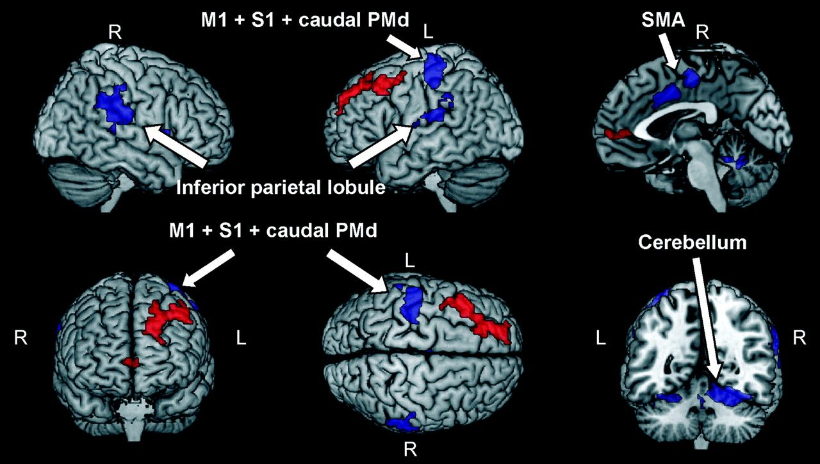
Figure 3. Brain areas showing higher BOLD response during trials containing button presses versus trials containing no ...
Notes:
Figure 3. Brain areas showing higher BOLD response during trials containing button presses versus trials containing no button press (blue regions). Activations were thresholded at P < 0.001 (uncorrected) at the single-voxel level and at P < 0.05 (corrected) at the cluster level. Abbreviations: primary motor cortex (M1), dorsal premotor cortex (PMd), primary sensory cortex (S1), and supplementary motor area (SMA). Brain areas that in the main experiment exhibited higher level of BOLD response for human movements complying with the two-thirds power law are plotted in red for comparison purposes (see also Fig. 2).
Unless provided in the caption above, the following copyright applies to the content of this slide: © The Author 2009. Published by Oxford University Press. All rights reserved. For permissions, please e-mail: journals.permissions@oxfordjournals.org

Slide 4
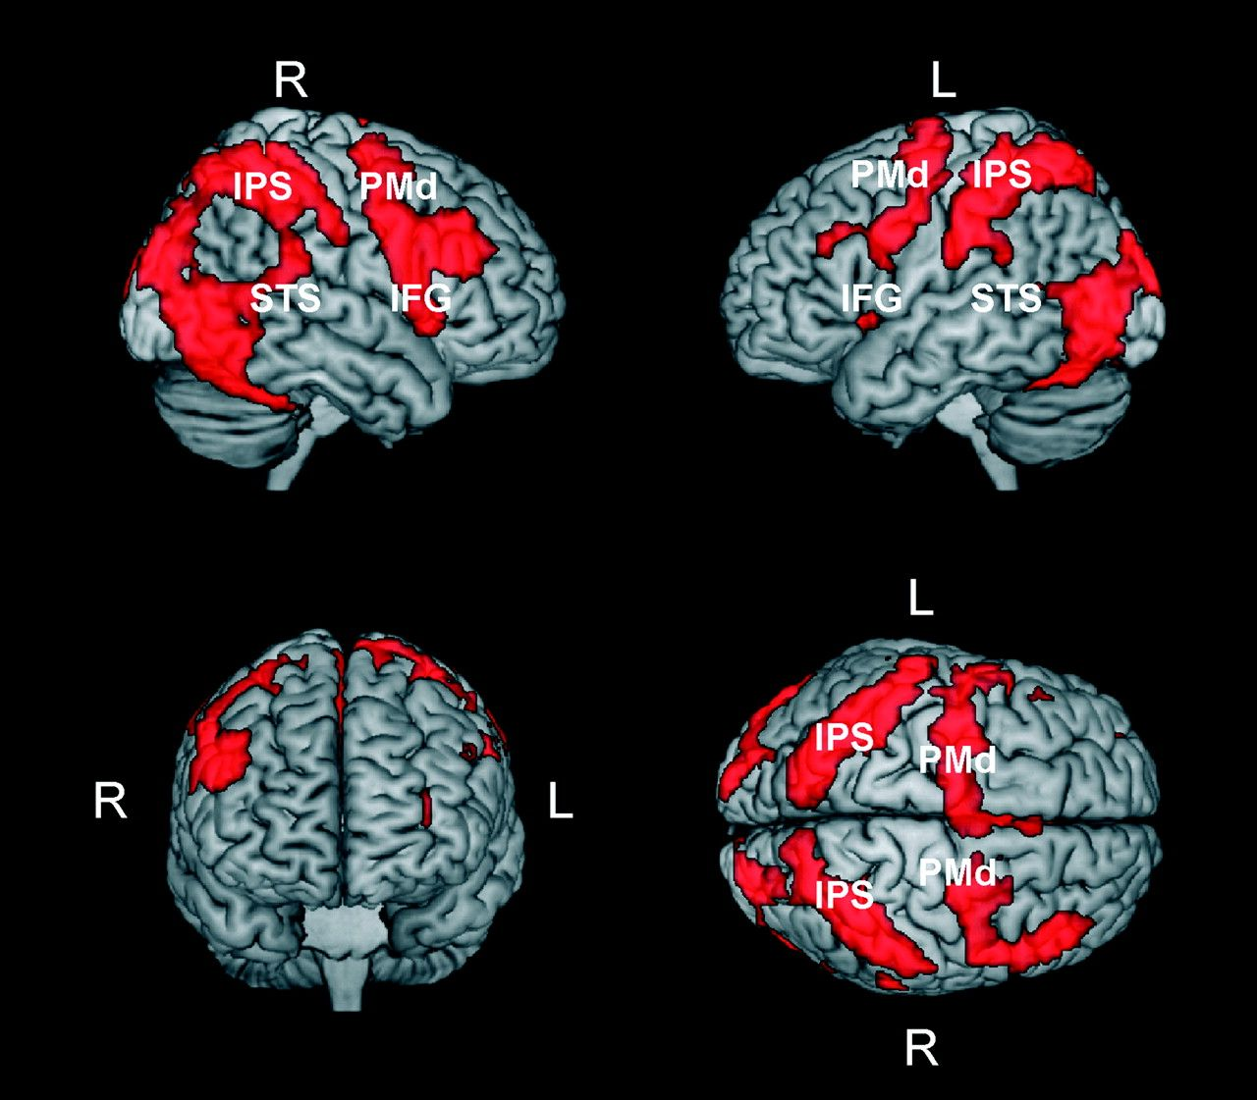
Figure 4. Brain areas activated by human movements independent of their compliance with normal kinematic laws of ...
Notes:
Figure 4. Brain areas activated by human movements independent of their compliance with normal kinematic laws of motion. The activation patterns in the figure were obtained by masking the contrast perturbed > baseline with the contrast normal > baseline. Prior to masking, activations in both contrasts were thresholded at P < 0.001 (uncorrected) at the voxel level and at P < 0.05 (corrected) at the cluster level. Abbreviations: PMd, premotor dorsal; IPS, intraparietal sulcus; STS, superior temporal sulcus; IFG, inferior frontal gyrus).
Unless provided in the caption above, the following copyright applies to the content of this slide: © The Author 2009. Published by Oxford University Press. All rights reserved. For permissions, please e-mail: journals.permissions@oxfordjournals.org

