Slide 1
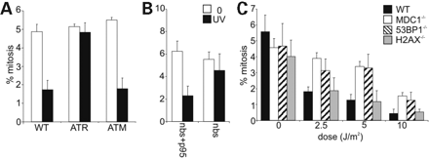
Figure 1. (A) G2/M arrest 1.5 h after UV in the presence of aphidicolin (APH) is dependent on ATR and XP-A. Control ...
Notes:
Figure 1. (A) G2/M arrest 1.5 h after UV in the presence of aphidicolin (APH) is dependent on ATR and XP-A. Control (WT), ATR-Seckel syndrome (ATR), A-T (AT) or XP-A (XP-A) LBLs were untreated or treated with 5 Jm−2, incubated for 1.5 h with APH and the percent mitotic cells (MI, mitotic index) estimated. (B) Nbs is required for UV-induced replication-independent G2/M arrest. Cells were untreated or irradiated as in (A) but with 3 Jm−2 UV. Cells with defective Nbs1 (nbs) fail to activate G2/M arrest. NBS cells corrected with full-length Nbs1 (nbs+p95) displayed normal G2/M arrest. (C) 53BP1 and MDC1 but not H2AX are required for UV-induced replication-independent G2/M arrest. Control (MDC1+/+), MDC1 null (MDC1−/−), 53BP1 null (53BP1−/−) or H2AX null (H2AX−/−) MEFs were untreated or treated as in (A).
Unless provided in the caption above, the following copyright applies to the content of this slide: © The Author 2008. Published by Oxford University Press. All rights reserved. For Permissions, please email: journals.permissions@oxfordjournals.org

Slide 2
Figure 2. (A) Nbs constructs used. (B) Expression of Nbs1 and Mre11 by IF. (C) The N-terminus of Nbs is required for ...
Notes:
Figure 2. (A) Nbs constructs used. (B) Expression of Nbs1 and Mre11 by IF. (C) The N-terminus of Nbs is required for replication-independent G2/M arrest. Cells were untreated or irradiated with 3 Jm−2, incubated for 1.5 h in the presence of APH and the MI counted. Cells lacking the Nbs1 N-terminus (nbs+FR5) fail to activate G2/M arrest. NBS cells corrected with an Nbs1 fragment lacking the C-terminal (nbs+652), or lacking only the ATM interacting region (nbs+dATM), or Nbs1 mutated in two phosphorylation sites (nbs+PP) displayed normal G2/M arrest. Results with Nbs and Nbs+p95 cells are shown in Fig. 1B. (D) The Nbs1 N-terminus is dispensable for G2/M checkpoint arrest following IR. Cells were untreated or irradiated with the indicated dose of IR, incubated for 1.5 h in the presence of APH and% mitotic cells (MI) counted.
Unless provided in the caption above, the following copyright applies to the content of this slide: © The Author 2008. Published by Oxford University Press. All rights reserved. For Permissions, please email: journals.permissions@oxfordjournals.org

Slide 3
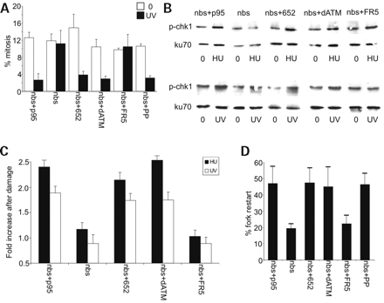
Figure 3. (A) The N-terminus of Nbs is required for the G2/M checkpoint after UV. The cells indicated were untreated or ...
Notes:
Figure 3. (A) The N-terminus of Nbs is required for the G2/M checkpoint after UV. The cells indicated were untreated or irradiated with 3 Jm−2, incubated for 5 h in the presence of Nocodazole (no APH) and the MI counted. (B) Chk1 phosphorylation is dependent on the Nbs1 N-terminus after UV or HU treatment. Cells were treated with HU (1 mm) or UV (5 Jm−2) and 2 h later samples prepared for western blotting using α-p-Chk1 antibodies. (C) Quantification of (B). Western blots were performed as in (B) and at least three blots quantified by ImageQuant software. (D) The N-terminal of Nbs is required for recovery from replication stalling. Replication forks were pulse labelled with CldU and then arrested by treating with APH. Prior to removal of APH, cells were treated with IdU so that fork progression after replication stalling can be visualized. After removal of APH, cells recovered for 10 min. Restart represented the overlap of CldU (red) and IdU (green) labelling.
Unless provided in the caption above, the following copyright applies to the content of this slide: © The Author 2008. Published by Oxford University Press. All rights reserved. For Permissions, please email: journals.permissions@oxfordjournals.org

Slide 4
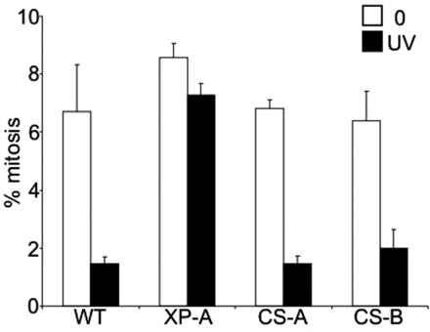
Figure 4. XP-A but not CS-A or CS-B cells are defective in replication- independent G2/M arrest. Control (WT), XP-A, ...
Notes:
Figure 4. XP-A but not CS-A or CS-B cells are defective in replication- independent G2/M arrest. Control (WT), XP-A, Cockayne syndrome A or B (CS-A, CS-B) transformed fibroblasts were untreated or treated with 5 Jm−2, incubated for 1.5 h and the% mitotic cells estimated.
Unless provided in the caption above, the following copyright applies to the content of this slide: © The Author 2008. Published by Oxford University Press. All rights reserved. For Permissions, please email: journals.permissions@oxfordjournals.org

