Slide 1
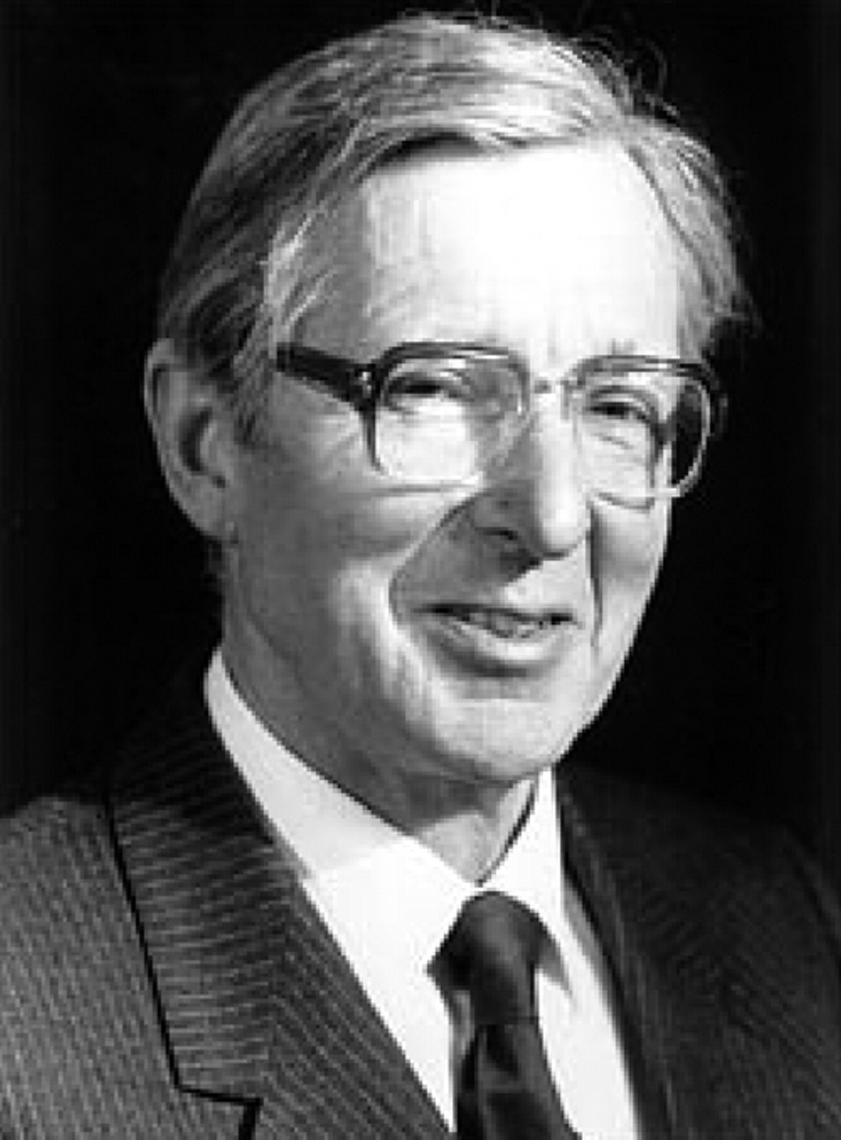
Figure 1 Dr Aubrey Leatham.
Notes:
Figure 1 Dr Aubrey Leatham.
Unless provided in the caption above, the following copyright applies to the content of this slide: Published on behalf of the European Society of Cardiology. All rights reserved. © The Author 2010. For permissions please email: journals.permissions@oxfordjournals.org.

Slide 2
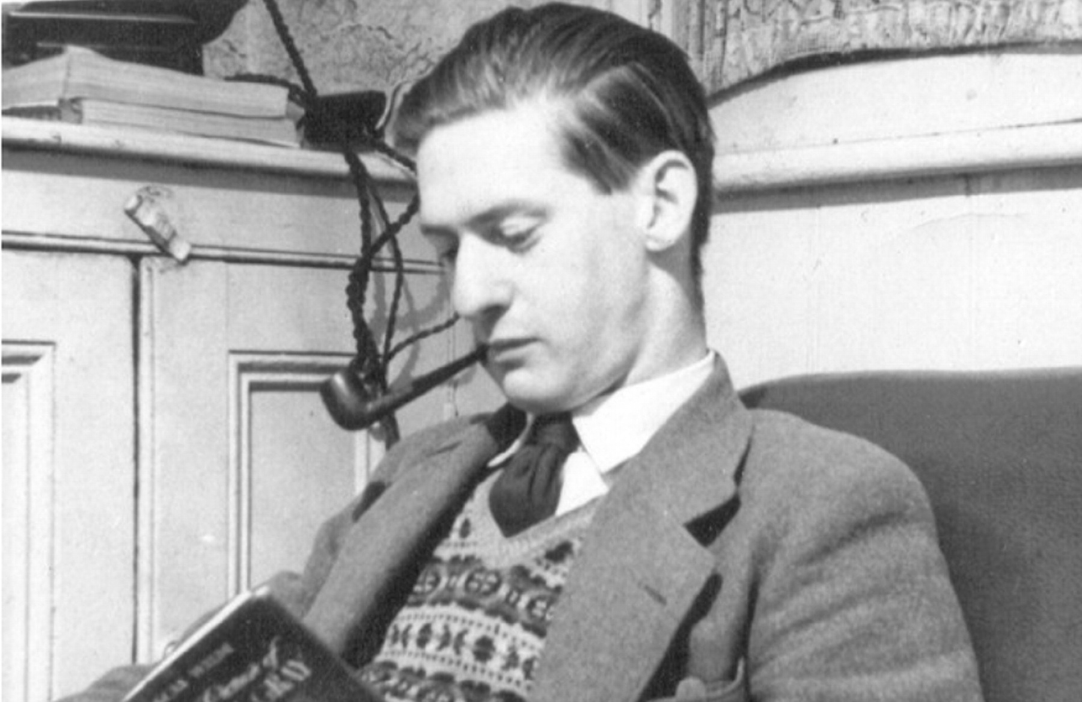
Figure 2 Mr Geoffrey Davies.
Notes:
Figure 2 Mr Geoffrey Davies.
Unless provided in the caption above, the following copyright applies to the content of this slide: Published on behalf of the European Society of Cardiology. All rights reserved. © The Author 2010. For permissions please email: journals.permissions@oxfordjournals.org.

Slide 3
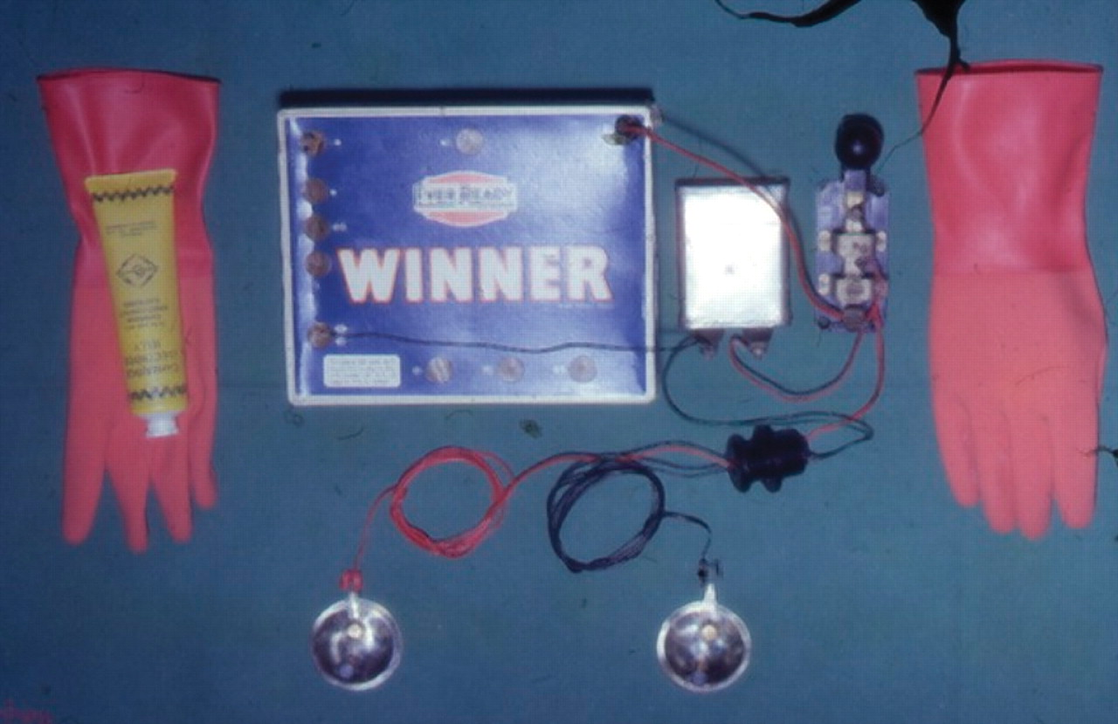
Figure 3 Components of the first pacemaker built by Aubrey Leatham and Geoff Davies.
Notes:
Figure 3 Components of the first pacemaker built by Aubrey Leatham and Geoff Davies.
Unless provided in the caption above, the following copyright applies to the content of this slide: Published on behalf of the European Society of Cardiology. All rights reserved. © The Author 2010. For permissions please email: journals.permissions@oxfordjournals.org.

Slide 4
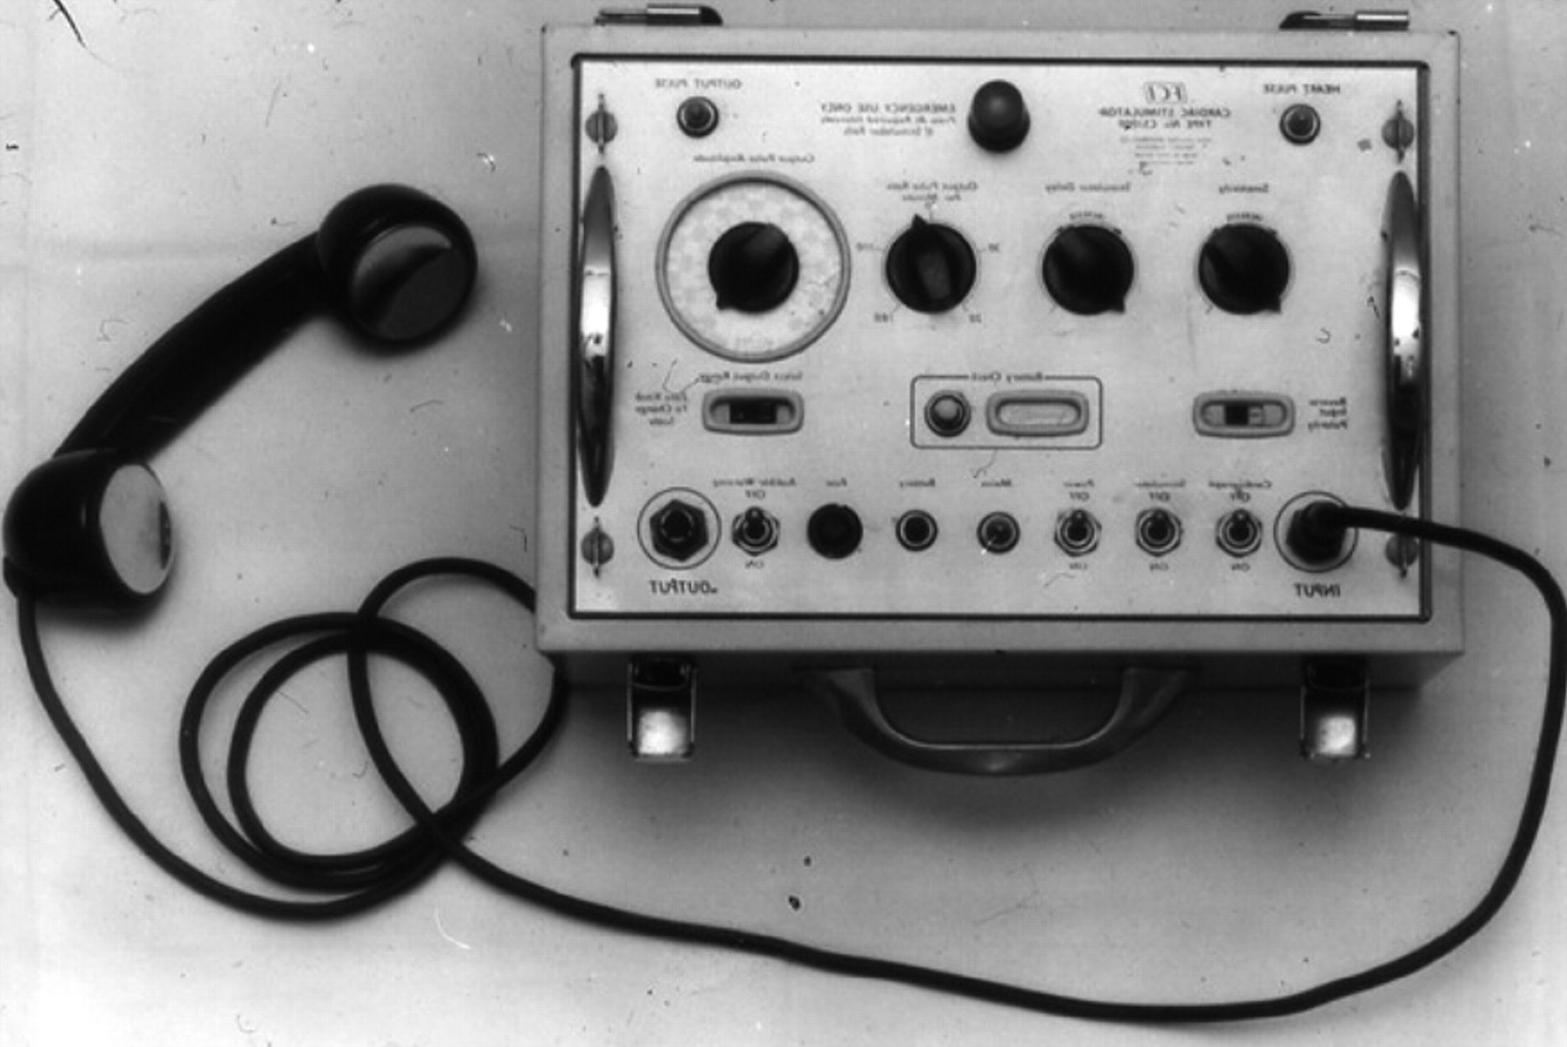
Figure 4 External transcutaneous pacemaker built by Geoff Davies.
Notes:
Figure 4 External transcutaneous pacemaker built by Geoff Davies.
Unless provided in the caption above, the following copyright applies to the content of this slide: Published on behalf of the European Society of Cardiology. All rights reserved. © The Author 2010. For permissions please email: journals.permissions@oxfordjournals.org.

Slide 5
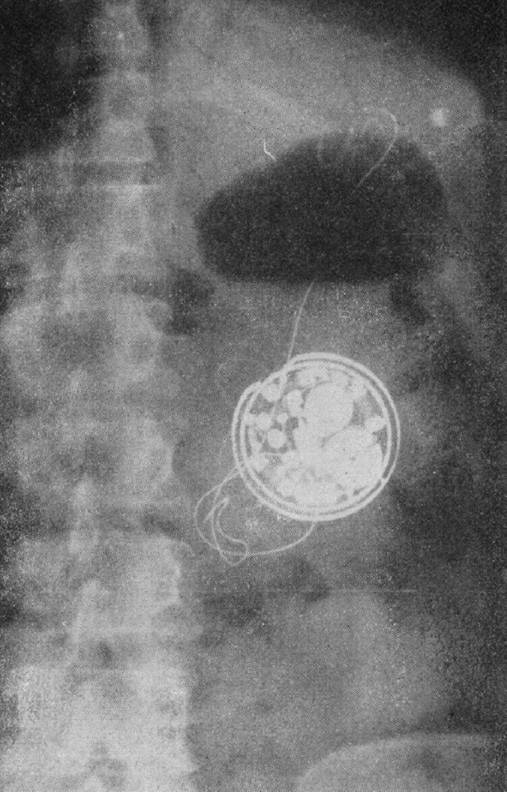
Figure 5 X-ray of first pacemaker implanted in the UK and reported by Leatham in 1961.
Notes:
Figure 5 X-ray of first pacemaker implanted in the UK and reported by Leatham in 1961.
Unless provided in the caption above, the following copyright applies to the content of this slide: Published on behalf of the European Society of Cardiology. All rights reserved. © The Author 2010. For permissions please email: journals.permissions@oxfordjournals.org.

