Slide 1
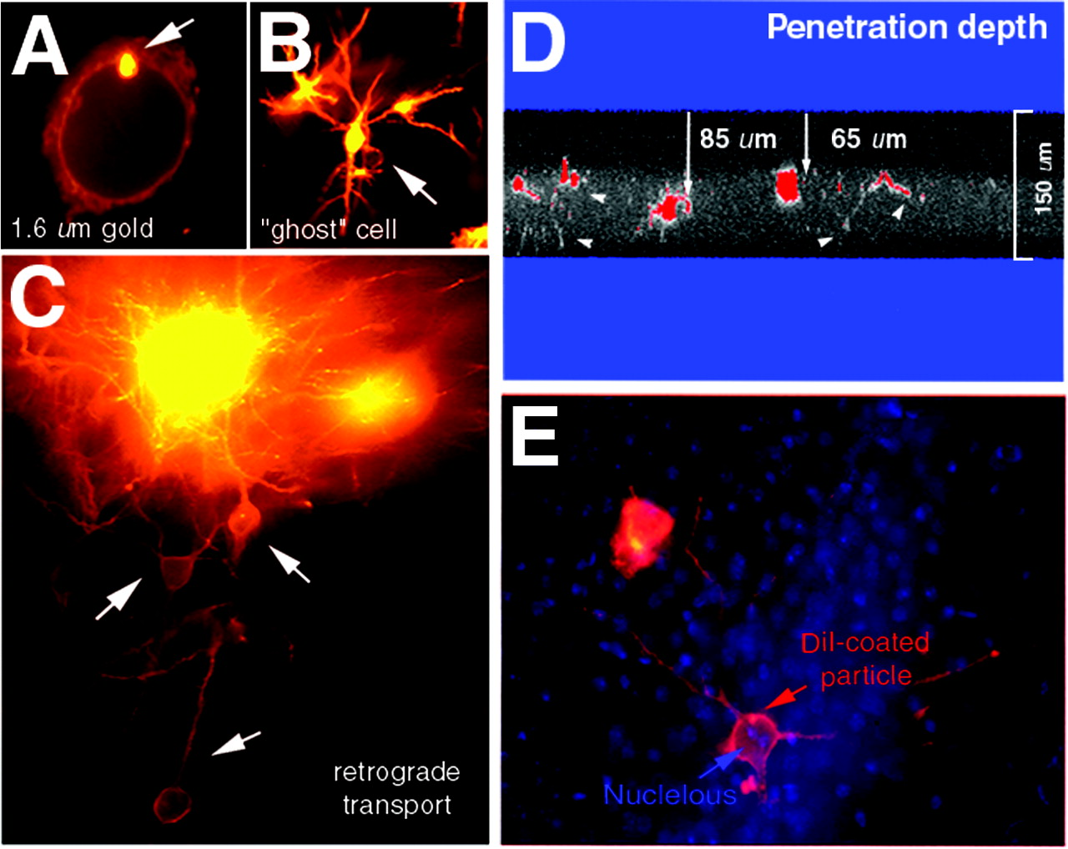
Figure 1. (A) Gold particle (1.6 µm) in the soma visualized immediately following diOlistic delivery. (B) ...
Notes:
Figure 1. (A) Gold particle (1.6 µm) in the soma visualized immediately following diOlistic delivery. (B) Ectopic loading of gold particles in the soma, which produces a ‘ghost’ neuron adjacent to target neurons. (C) Clumping of loaded particles in the neuropil results in retrograde transport of DiI, which makes it extremely difficult to discriminate the origins (somata) of these overlapped dendritic processes. (D) Penetration of DiI-coated particles in the fixed section 15 min after diOlistic shooting. Two particles were found at depths of 65 and 85 µm. Note the transport of DiI in dendritic processes (arrowheads). The optical thickness was restricted to 150 µm, devoid of the remaining portion of the section. Monochrome CLSM image was pseudo-colored with glow-scale image processing to highlight neuronal processes. (E) High-resolution morphology of an individual neuron (blue: Hoechst-stained nuclei; red: DiI-coated particles and dendritic spines). It was noted that the DiI-coated particle was located within the soma.
Unless provided in the caption above, the following copyright applies to the content of this slide:

Slide 2
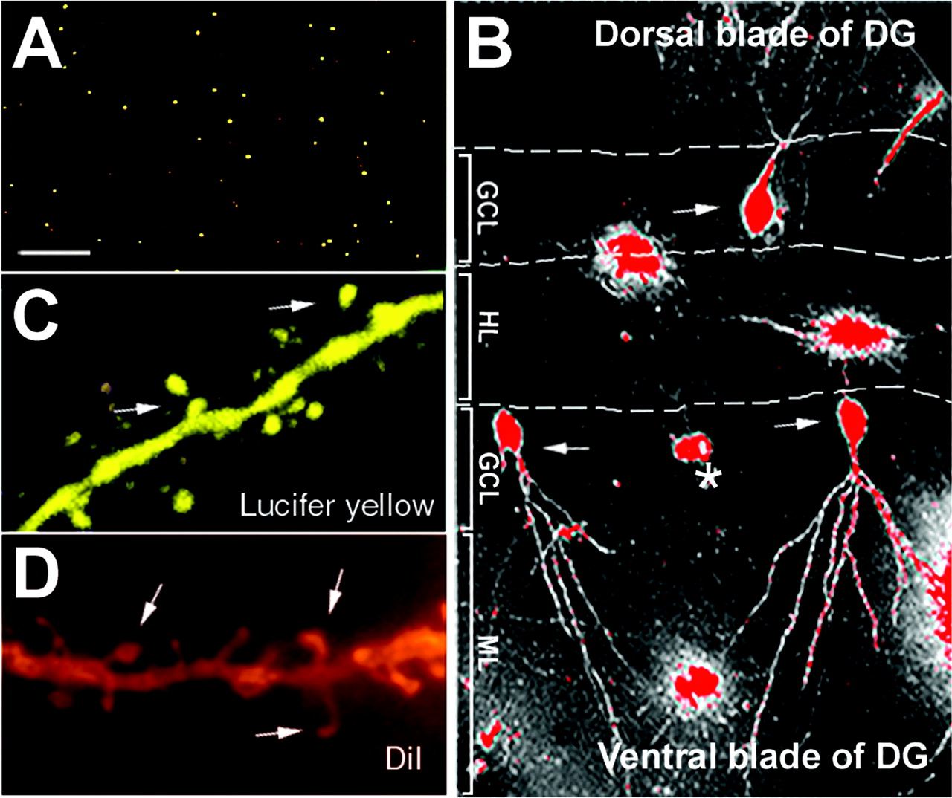
Figure 2. (A) Optimized dispersion of DiI-coated particles following delivery. The distance between ...
Notes:
Figure 2. (A) Optimized dispersion of DiI-coated particles following delivery. The distance between particles, on average, varied between 75 and 100 µm (see detail in text). (B) Multiple cells were concurrently labeled in the dentate gyrus of hippocampus following diOlistic shooting. The inter-particle distance among three-labeled somata was ∼80 µm. Note the neuron in the middle position did not contain labeled processes (asterisk). (C, D) Comparison of spine density labeled by Lucifer yellow (LY) and DiI. Note that some spines appear detached from the dendritic trunks labeled by LY (arrows). Abbreviations: GCL, the granule cell layer; ML, the molecular layer; HL: hilus.
Unless provided in the caption above, the following copyright applies to the content of this slide:

Slide 3
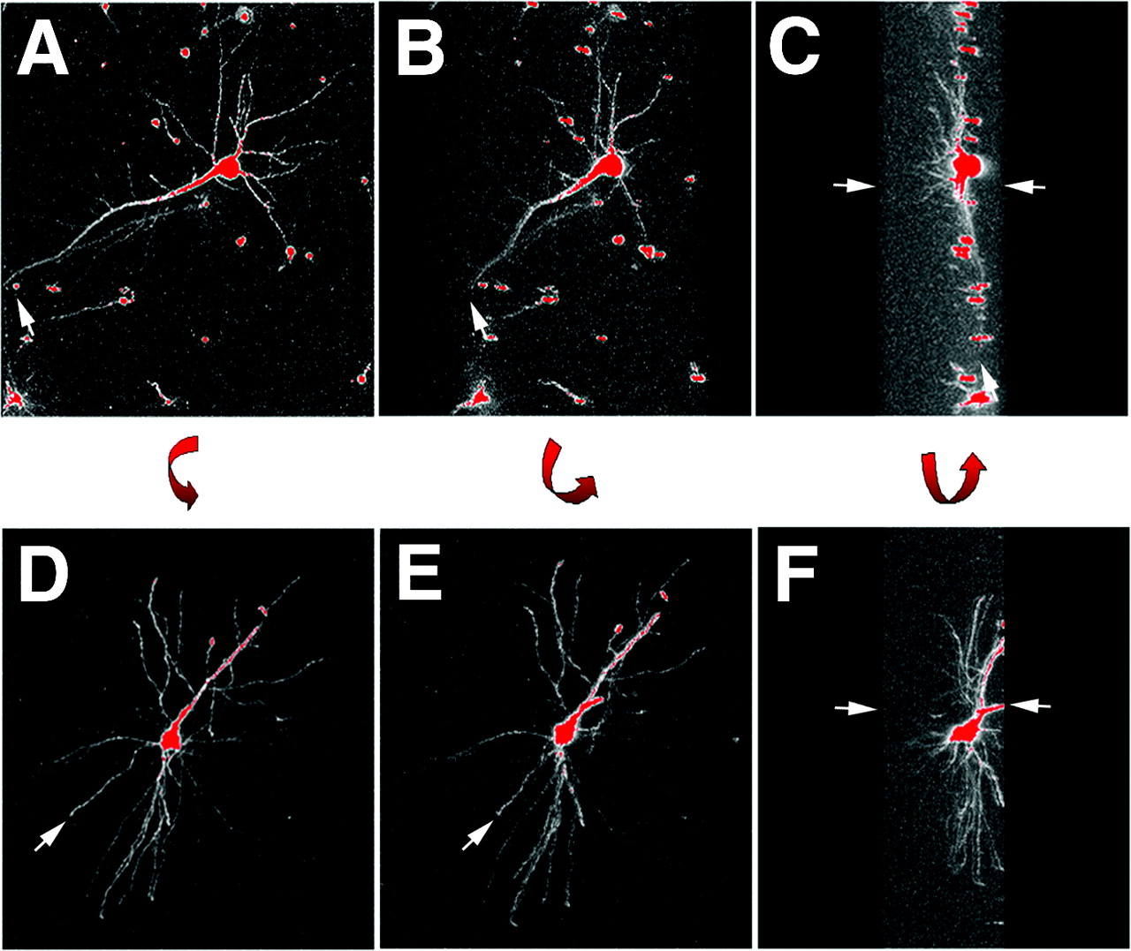
Figure 3. Morphological criteria of diOlistic sampling. (A, B, C) Selection of a pyramidal neuron with ...
Notes:
Figure 3. Morphological criteria of diOlistic sampling. (A, B, C) Selection of a pyramidal neuron with complete transport of DiI in dendritic processes. Arrows indicate the tapering of DiI in most the distal dendrites. Lateral view of the images was used to verify the full dendritic profile (arrows in C). (D, E, F) Exclusion of a neuron with amputated dendritic processes. Incomplete transport of DiI was revealed in D and E (arrows). Lateral view reveals amputated apical dendrite (arrows in F).
Unless provided in the caption above, the following copyright applies to the content of this slide:

Slide 4
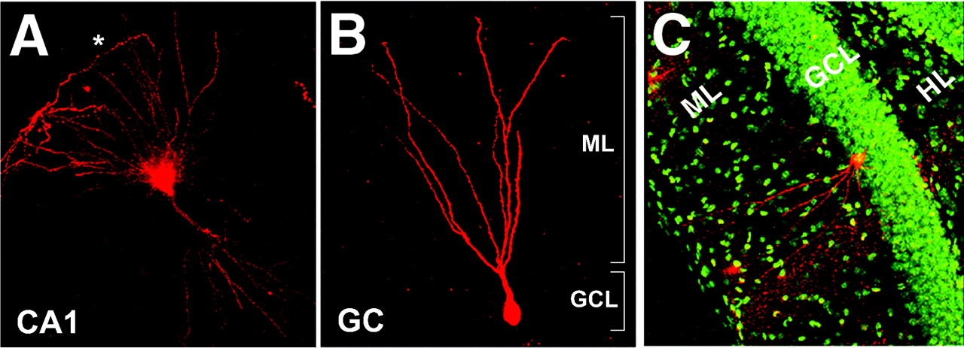
Figure 4. DiOlistically labeled neurons with full 3-D visualization of dendritic trees. (A) A pyramidal cell ...
Notes:
Figure 4. DiOlistically labeled neurons with full 3-D visualization of dendritic trees. (A) A pyramidal cell of the dorsal portion of the CA1 was found to extend basal dendrites to the pia surface (asterisk). (B) A dentate granule cell with fully labeled dendritic trees in the molecular layer (ML). Note that the soma was located in a relatively deep position of the granule cell layer (GCL). (C) Spatial correlations of the dentate ML and the dendritic arbors of labeled granule cell. See Supplementary Material movies 1–3 for 360° rotations of image stacks.
Unless provided in the caption above, the following copyright applies to the content of this slide:

Slide 5
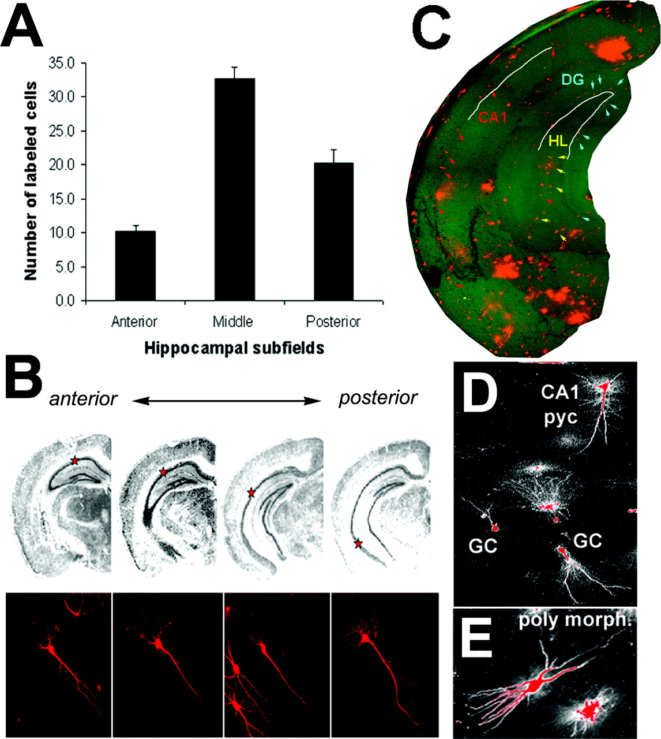
Figure 5. (A) Distribution of diOlistically loaded pyramidal neurons in the A–P axis of the CA1. The ...
Notes:
Figure 5. (A) Distribution of diOlistically loaded pyramidal neurons in the A–P axis of the CA1. The anterior, middle, and posterior portion of the hippocampus were divided based on Hof et al. (2000), each of which was composed of four serial sections. The middle level contained a relatively larger portion than the remainder of the CA1. (B) The heterogeneity of diOlistically loaded pyramidal neurons in the CA1 of the hippocampus. Note the difference in dendritic morphology of pyramidal cells relative to their anatomical locations. (C) The montage image of the hippocampus following multiple diOlistic shootings. Arrows indicate specific cell types of the hippocampus (red: CA1 pyramidal cells; blue: granule cells; yellow: polymorphic cells). (D, E) Pyramidal, granule, and polymorphic cells were concurrently labeled in the same section as shown in C. The color contrast of CLSM images was adjusted using Zeiss PASCAL software. Abbreviations: DG, dentate gyrus; GC, granule cell; HL, hilus; PYC, pyramidal cell; polymorph., polymorphic cell.
Unless provided in the caption above, the following copyright applies to the content of this slide:

Slide 6
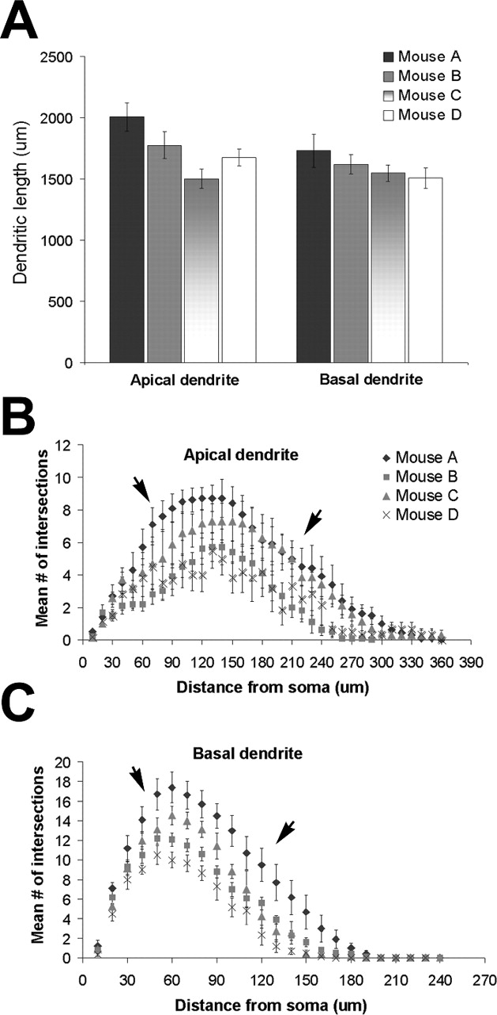
Figure 6. Quantitative analyses of CA1 pyramidal cells of 90-day-old male C57 mice (n = 4). For each animal, ...
Notes:
Figure 6. Quantitative analyses of CA1 pyramidal cells of 90-day-old male C57 mice (n = 4). For each animal, 10 cells were reconstructed using Neurolucida and subsequently quantified using NeuroExplorer. (A) Dendrograms. There was a significant difference in total length of both apical and basal dendrites among these animals (P < 0.05). (B) Sholl analysis. In apical dendrites, a peak of dendritic intersections was found at a distance of 65–215 µm from the soma, whereas in basal dendrites, the peak was found at a distance of 50–135 µm from the soma. It was noted that the number of dendritic intersections varied significantly among the four mice (P < 0.05). Significant differences were found in both apical and basal dendrites, at the distance of 65–215 and 50–135 µm from soma, respectively (P < 0.05; see detail in text).
Unless provided in the caption above, the following copyright applies to the content of this slide:

Slide 7
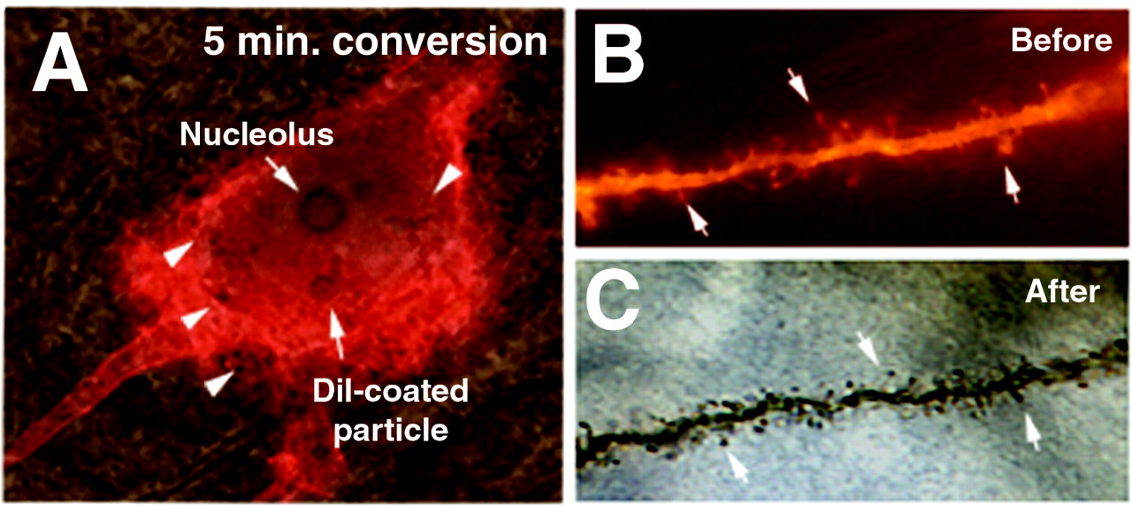
Figure 7. High-throughput photoconversion protocol. (A) Validation of the efficiency of CCC. It was noted ...
Notes:
Figure 7. High-throughput photoconversion protocol. (A) Validation of the efficiency of CCC. It was noted that the cytoplasm contained DAB reaction products 5 min after commencement of photoconversion. (B) Comparison of the distribution of dendritic spines before and after photoconversion. The distribution of dendritic spines of the two images appears similar (arrows).
Unless provided in the caption above, the following copyright applies to the content of this slide:

Slide 8
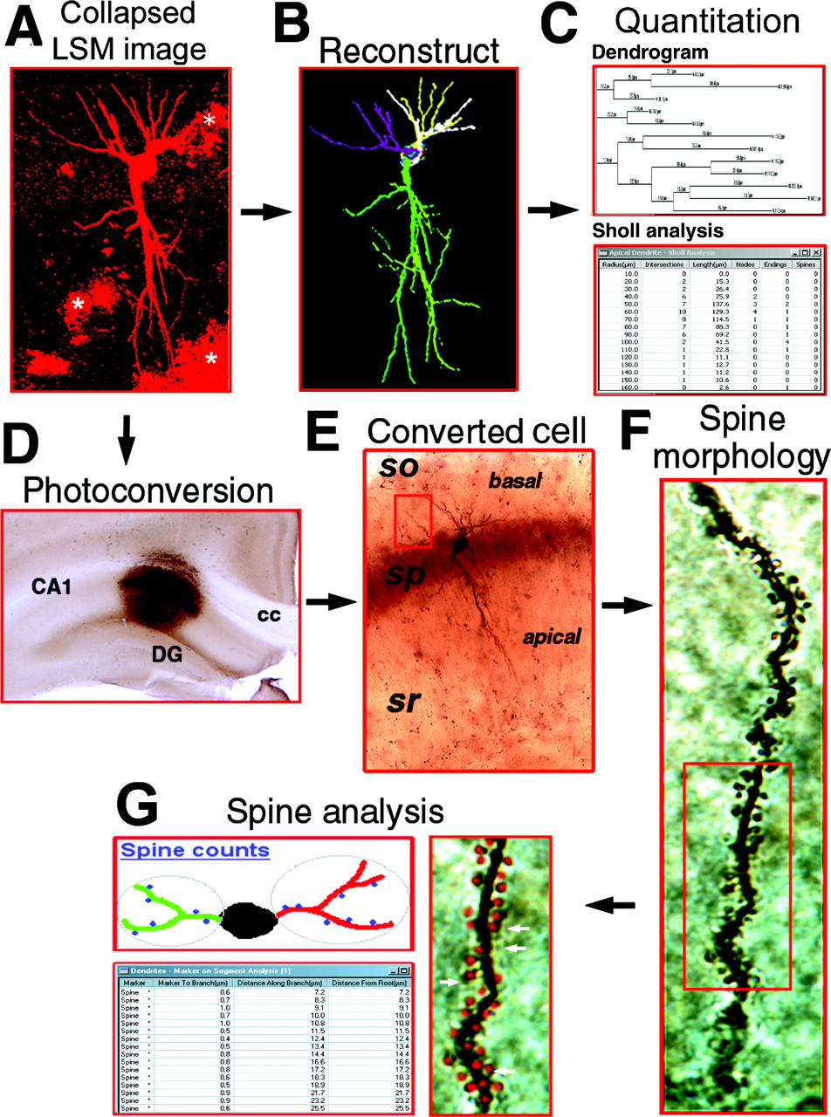
Figure 8. Photoconversion of a CLSM-imaged pyramidal cell. (A) A collapsed CLSM image of a diOlistically ...
Notes:
Figure 8. Photoconversion of a CLSM-imaged pyramidal cell. (A) A collapsed CLSM image of a diOlistically labeled pyramidal cell with fully labeled dendrites. Asterisks indicate surrounding DiI clusters, which do not interfere with visualization of the dendritic trees. (B) Neuron reconstructed using Neurolucida. (C) Quantitation, including dendrogram (upper panel) and Sholl analyses (lower panel). Note that the data of B and D were derived from the pilot study shown in Figure 6. (D) Low magnification view (2.5×) of a photoconverted tissue slab. Note the high background of the converted area. (E) A photoconverted pyramidal cell. The suboptimal resolution of the cell was due to the optical limitation of image acquisition in a 250 µm section. It was noted that the dendritic geometry of the converted pyramidal cell appeared similar to that of the collapsed CLSM and reconstructed images (see A and B). The box indicates one of the basal dendrites. (F) High resolution of spine morphology. The shapes of the spines are clearly visualized using a light microscope. (G) Spine analysis. The spine counting (red dots and arrows) is conducted using Neurolucida. Abbreviations: cc, corpus callosum; sp, stratum pyramidale; so, stratum oriens; sr, stratum radiatum.
Unless provided in the caption above, the following copyright applies to the content of this slide:

