Slide 1
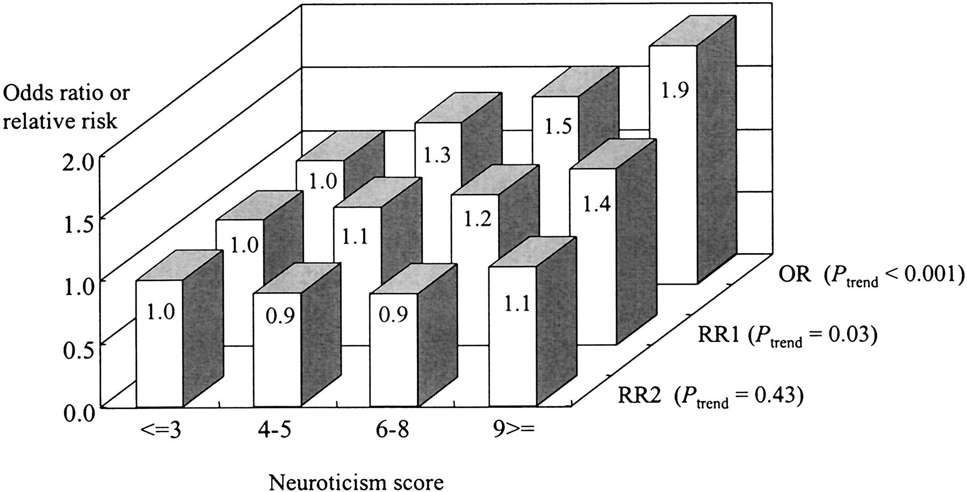
Fig. 1. Association between neuroticism and the risk of total cancer, according to study design (retrospective or ...
Notes:
Fig. 1. Association between neuroticism and the risk of total cancer, according to study design (retrospective or prospective) and duration of follow-up (in the prospective analyses). Cut points for the neuroticism scores were chosen to divide the population into four groups as similar in size as possible. For all analyses, the referent group was the group in the lowest category of neuroticism score. OR denotes odds ratio estimated from the retrospective analysis using as the endpoint 671 prevalent cases of cancer at the baseline (Ptrend<.001). RR1 denotes relative risk estimated from the prospective analysis using as the endpoint 320 incident cases of cancer diagnosed in the first 3 years of follow-up (Ptrend = .03). RR2 denotes relative risk estimated from the prospective analysis using as the endpoint 666 incident cases of cancer diagnosed in the 4th through the 7th years of follow-up, that is, excluding cancer cases diagnosed in the first 3 years of follow-up (Ptrend = 0.43). All ORs and RRs have been adjusted for sex, age, cigarette smoking (never smoked, smoked in the past, currently smoking 1–19 cigarettes per day, or currently smoking ⩾20 cigarettes per day), alcohol consumption (never drank alcohol, drank in the past, currently drinking ⩽22.7 g of alcohol per day, or currently drinking ⩾22.8 g of alcohol per day), body mass index in kg/m2 (⩽18.4, 18.5–24.9, or ⩾25.0); education (in school until up to age 15 years, age 16–18 years, or age 19 years or older), and family history of cancer (presence or absence in first-degree relatives).
Unless provided in the caption above, the following copyright applies to the content of this slide: © Oxford University Press

