Slide 1
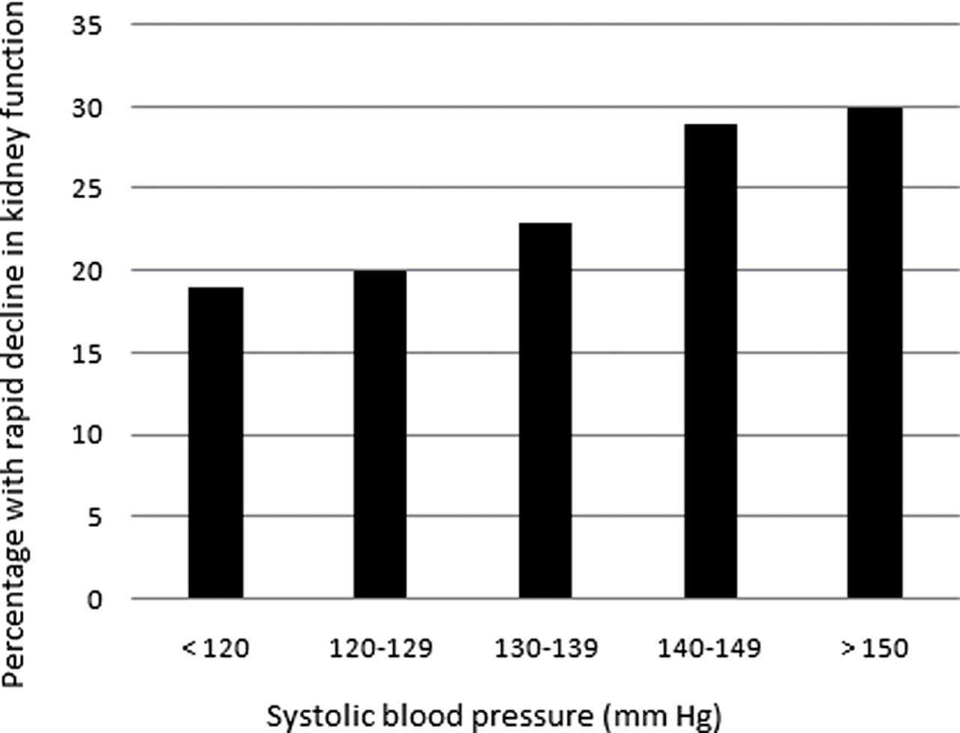
Figure 1. Rates of rapid decline of kidney function across systolic blood pressure categories.
Notes:
Figure 1. Rates of rapid decline of kidney function across systolic blood pressure categories.
Unless provided in the caption above, the following copyright applies to the content of this slide: © American Journal of Hypertension, Ltd 2013. All rights reserved. For Permissions, please email: journals.permissions@oup.com

Slide 2
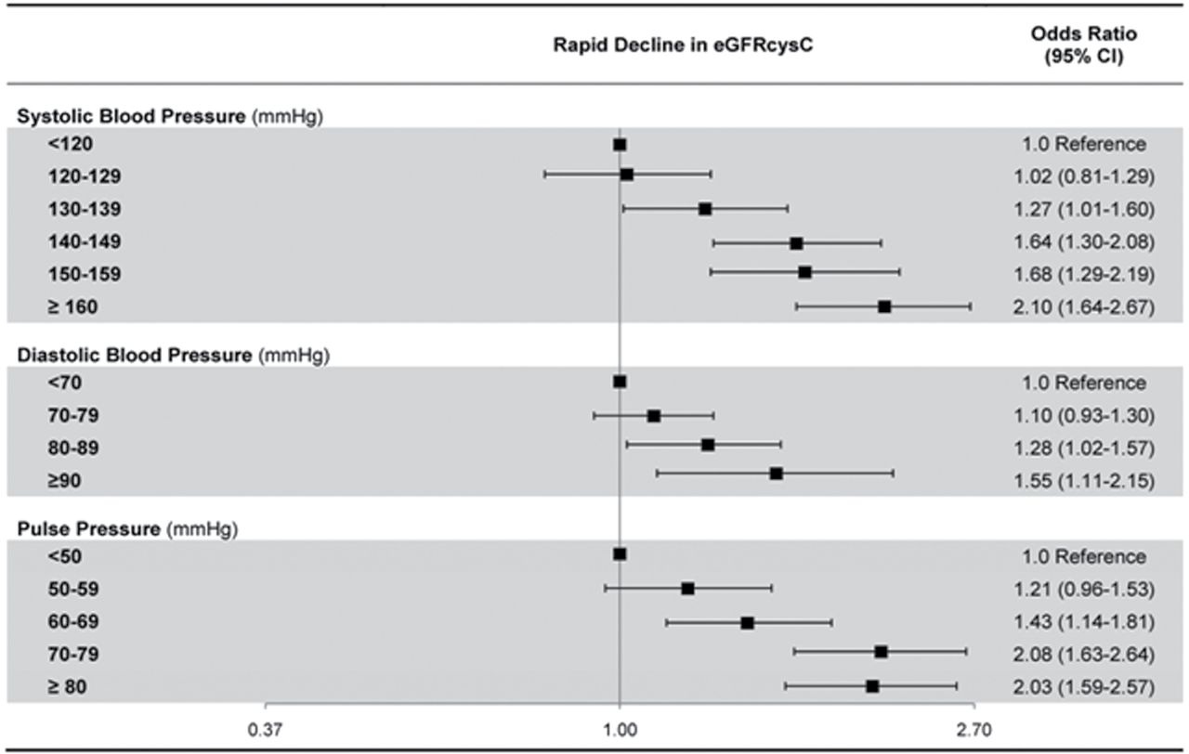
Figure 2. Adjusted association of blood pressure categories with rapid decline in eGFR_{cys}.
Notes:
Figure 2. Adjusted association of blood pressure categories with rapid decline in eGFRcys.
Unless provided in the caption above, the following copyright applies to the content of this slide: © American Journal of Hypertension, Ltd 2013. All rights reserved. For Permissions, please email: journals.permissions@oup.com

