Slide 1
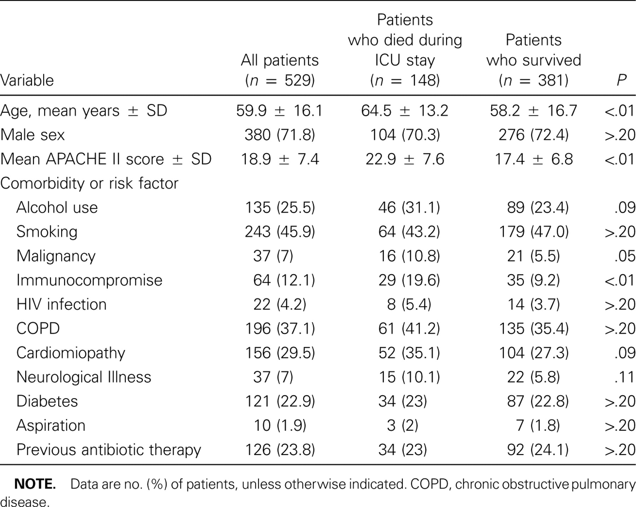
Table 1 Epidemiological characteristics of 529 patients with severe community-acquired pneumonia admitted to 33 ...
Notes:
Table 1 Epidemiological characteristics of 529 patients with severe community-acquired pneumonia admitted to 33 intensive care units (ICUs) in Spain.
Unless provided in the caption above, the following copyright applies to the content of this slide: © 2005 by the Infectious Diseases Society of America

Slide 2
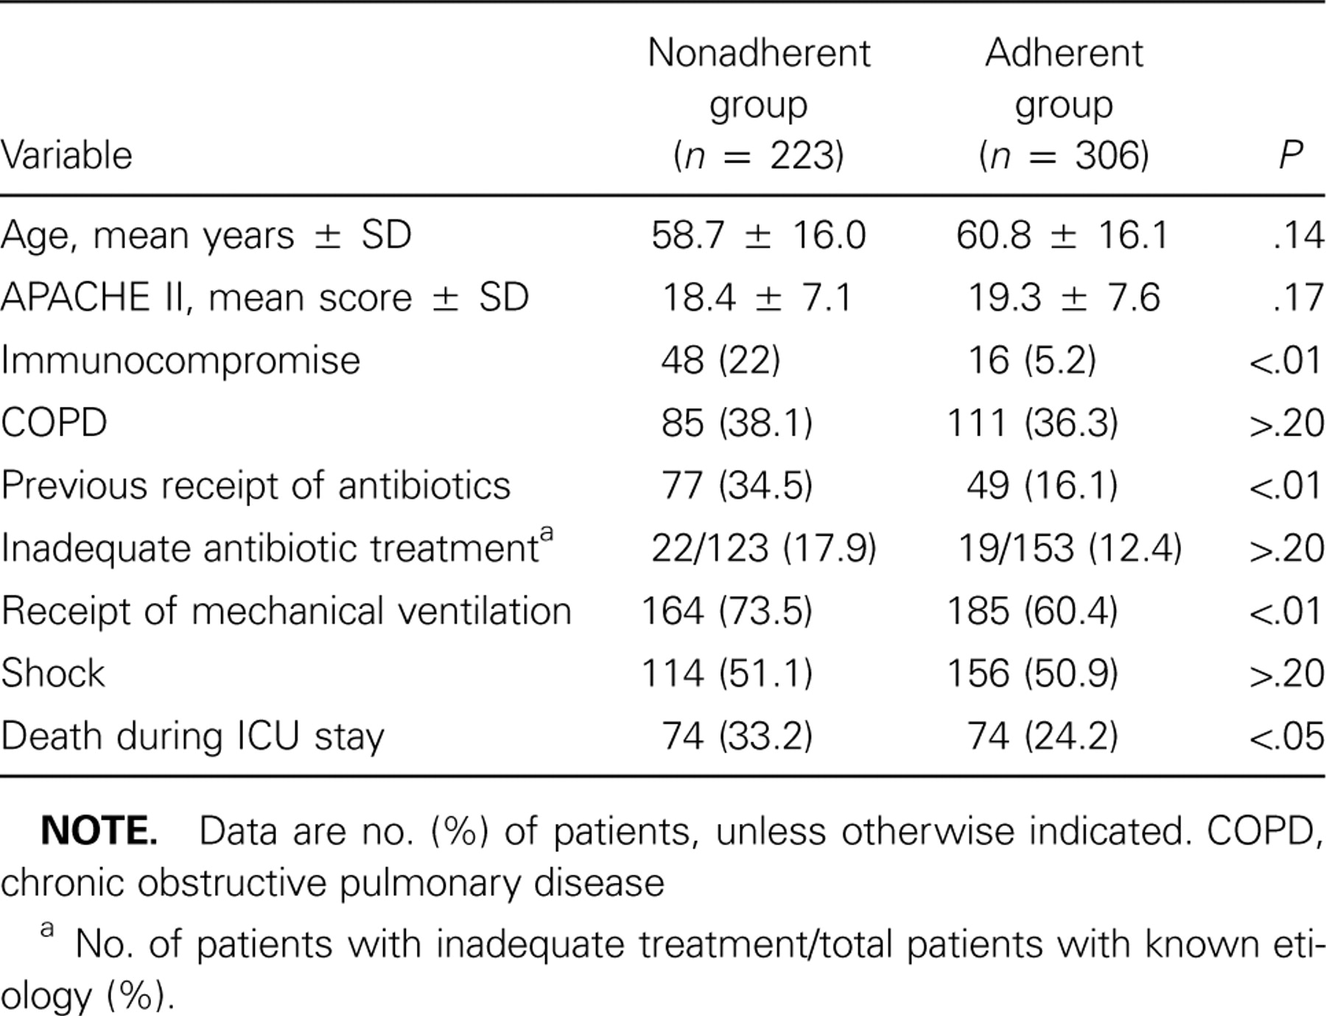
Table 2 Factors associated with nonadherence to Infectious Diseases Society of America guidelines in 529 patients ...
Notes:
Table 2 Factors associated with nonadherence to Infectious Diseases Society of America guidelines in 529 patients with severe community-acquired pneumonia.
Unless provided in the caption above, the following copyright applies to the content of this slide: © 2005 by the Infectious Diseases Society of America

Slide 3
Table 3 Antibiotic treatment for 529 patients admitted to the intensive care unit (ICU) with severe ...
Notes:
Table 3 Antibiotic treatment for 529 patients admitted to the intensive care unit (ICU) with severe community-acquired pneumonia.
Unless provided in the caption above, the following copyright applies to the content of this slide: © 2005 by the Infectious Diseases Society of America

Slide 4
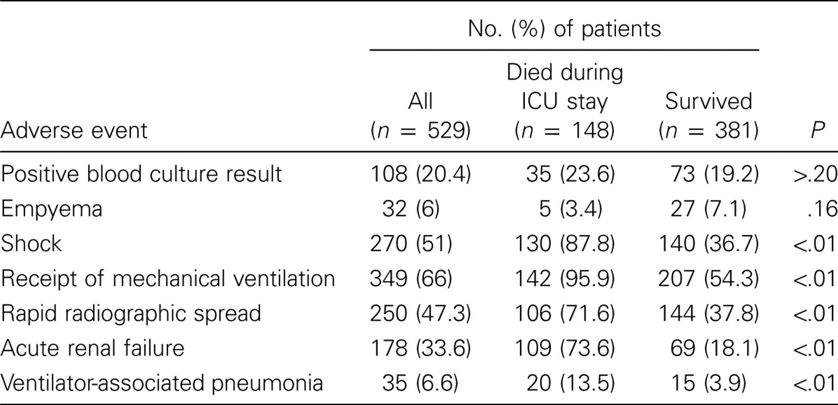
Table 4 Adverse events occurring during intensive care unit (ICU) stay for 529 patients with severe ...
Notes:
Table 4 Adverse events occurring during intensive care unit (ICU) stay for 529 patients with severe community-acquired pneumonia.
Unless provided in the caption above, the following copyright applies to the content of this slide: © 2005 by the Infectious Diseases Society of America

Slide 5
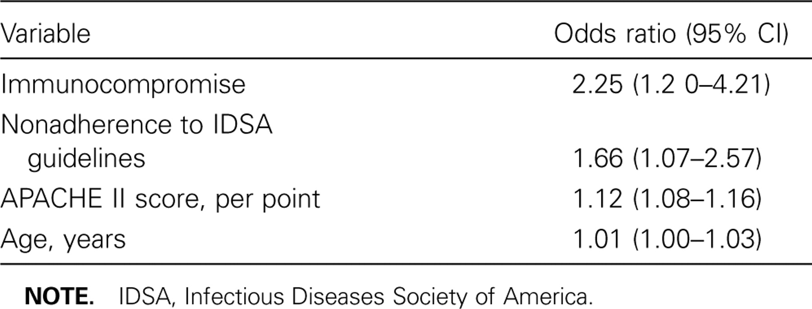
Table 5 Logistic regression analysis of evaluable variables at intensive care unit (ICU) admission associated with ...
Notes:
Table 5 Logistic regression analysis of evaluable variables at intensive care unit (ICU) admission associated with death during ICU stay.
Unless provided in the caption above, the following copyright applies to the content of this slide: © 2005 by the Infectious Diseases Society of America

Slide 6
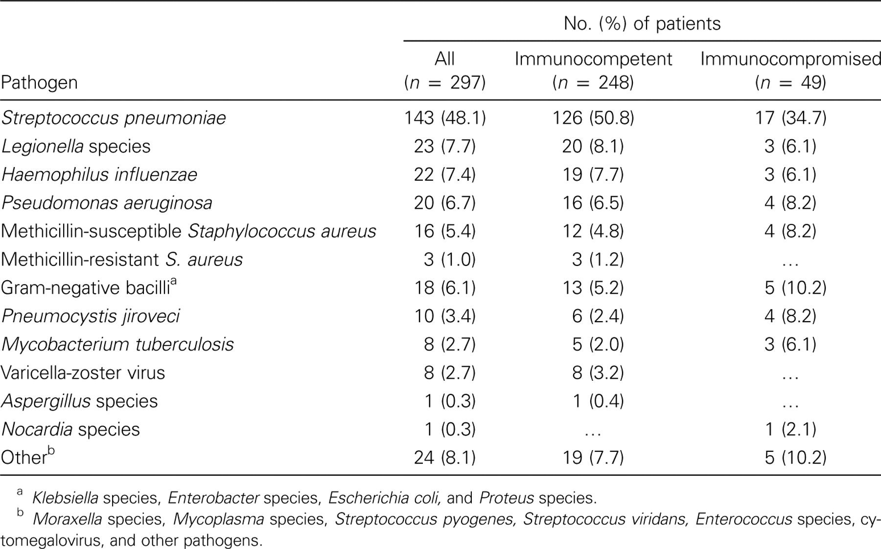
Table 6 Etiological findings for 276 patients with severe community-acquired pneumonia and microbiological ...
Notes:
Table 6 Etiological findings for 276 patients with severe community-acquired pneumonia and microbiological documentation of etiology.
Unless provided in the caption above, the following copyright applies to the content of this slide: © 2005 by the Infectious Diseases Society of America

Slide 7
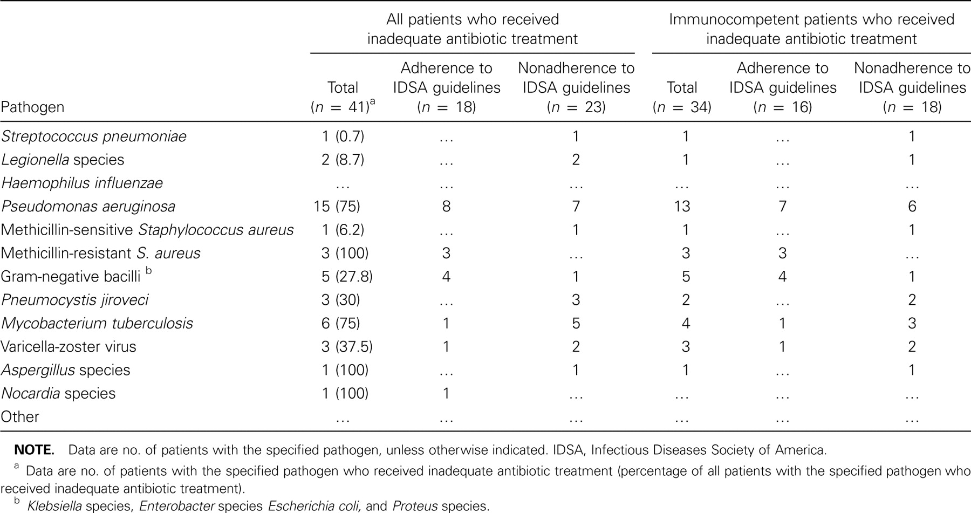
Table 7 Etiology of episodes of severe community-acquired pneumonia in patients who received inadequate antibiotic ...
Notes:
Table 7 Etiology of episodes of severe community-acquired pneumonia in patients who received inadequate antibiotic treatment.
Unless provided in the caption above, the following copyright applies to the content of this slide: © 2005 by the Infectious Diseases Society of America

Slide 8
Table 8 Logistic regression analysis of variables associated with severe community-acquired pneumonia due to ...
Notes:
Table 8 Logistic regression analysis of variables associated with severe community-acquired pneumonia due to Pseudomonas aeruginosa.
Unless provided in the caption above, the following copyright applies to the content of this slide: © 2005 by the Infectious Diseases Society of America

