Slide 1
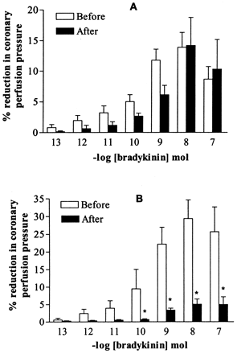
Fig. 1 Effect of aprotinin at 125 (A) and 250 kIU/ml (B) on the bradykinin-induced coronary vasodilator response. ...
Notes:
Fig. 1 Effect of aprotinin at 125 (A) and 250 kIU/ml (B) on the bradykinin-induced coronary vasodilator response. Results are expressed as the percentage of reduction in coronary perfusion pressure from basal values. Data are shown as the mean±S.E.M. *P<0.01 after versus before; n = 8.
Unless provided in the caption above, the following copyright applies to the content of this slide: Copyright © 2002, European Society of Cardiology

Slide 2
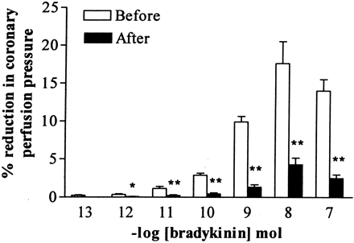
Fig. 2 Effect of l-NAME (0.1 mM) on the bradykinin-induced coronary vasodilator response. Results are expressed as ...
Notes:
Fig. 2 Effect of l-NAME (0.1 mM) on the bradykinin-induced coronary vasodilator response. Results are expressed as the percentage of reduction in coronary perfusion pressure from basal values. Data are shown as the mean±S.E.M. *P<0.01 or **P<0.001 after versus before; n = 7.
Unless provided in the caption above, the following copyright applies to the content of this slide: Copyright © 2002, European Society of Cardiology

Slide 3
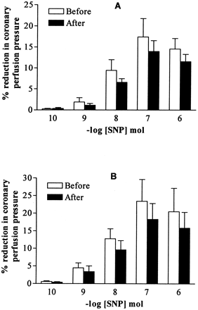
Fig. 3 Effect of aprotinin at 125 (A) and 250 kIU/ml (B) on the sodium nitroprusside (SNP)-induced coronary ...
Notes:
Fig. 3 Effect of aprotinin at 125 (A) and 250 kIU/ml (B) on the sodium nitroprusside (SNP)-induced coronary vasodilator response. Results are expressed as the percentage of reduction in coronary perfusion pressure from basal values. Data are shown as the mean±S.E.M.; n = 6. P>0.05.
Unless provided in the caption above, the following copyright applies to the content of this slide: Copyright © 2002, European Society of Cardiology

Slide 4
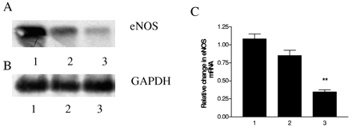
Fig. 4 Representative Southern blots of eNOS transcripts (A) and GAPDH transcripts (B) amplified from control CMEC ...
Notes:
Fig. 4 Representative Southern blots of eNOS transcripts (A) and GAPDH transcripts (B) amplified from control CMEC (lane 1) and 125 or 250 kIU/ml aprotinin-treated CMEC (lanes 2 and 3, respectively) and histogram (C) showing changes in eNOS mRNA in rat CMEC before and after aprotinin treatments following normalisation with respect to the levels of GAPDH levels (n = 4). **P<0.01.
Unless provided in the caption above, the following copyright applies to the content of this slide: Copyright © 2002, European Society of Cardiology

Slide 5
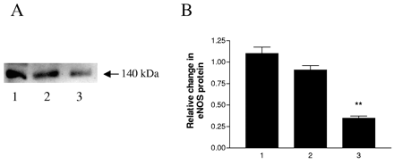
Fig. 5 Western blot showing expression of eNOS protein in cultured rat CMEC (lane 1) and 125 (lane 2) and 250 kIU/ml ...
Notes:
Fig. 5 Western blot showing expression of eNOS protein in cultured rat CMEC (lane 1) and 125 (lane 2) and 250 kIU/ml (lane 3) aprotinin-treated CMEC. Similar results were obtained in four different experiments. **P<0.01.
Unless provided in the caption above, the following copyright applies to the content of this slide: Copyright © 2002, European Society of Cardiology

