Slide 1
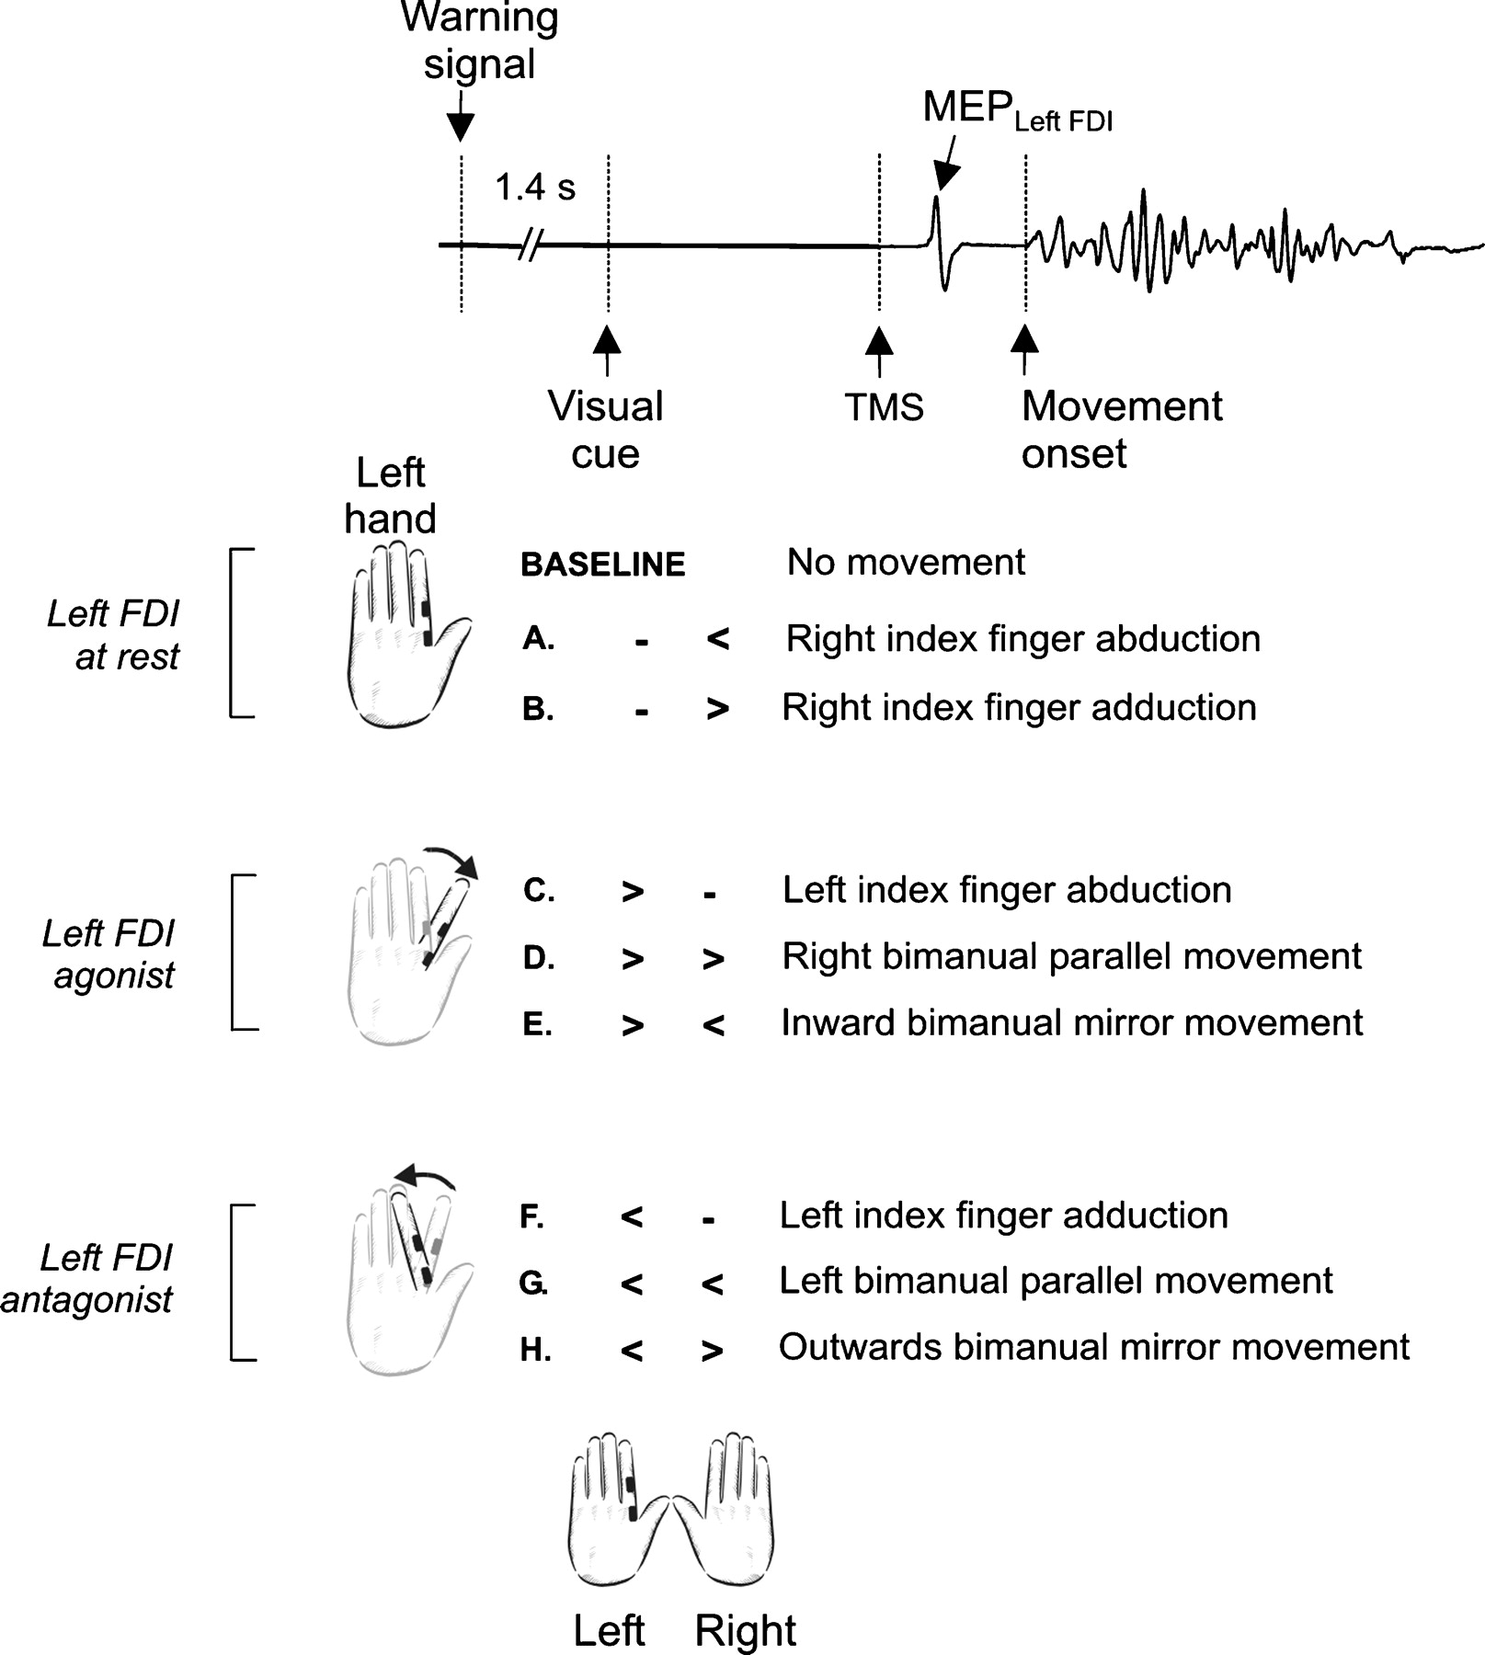
Figure 1. Upper trace: Time course of a single trial. A warning signal was followed after a period of 1.4 s by one of ...
Notes:
Figure 1. Upper trace: Time course of a single trial. A warning signal was followed after a period of 1.4 s by one of the eight visual cues (A–H). Subjects were instructed to move the index finger(s) according to the arrows' directions. TMS was applied ∼70 ms before the movement onset determined in each individual. Note that the left FDI remained at rest in conditions A and B, acted as an agonist in conditions C through E, and acted as an antagonist in conditions F through H. In the baseline condition, TMS was applied 1.4 s after the warning signal in the absence of any visual cue. TMS = transcranial magnetic stimulation; FDI = first dorsal interosseus muscle; MEP = motor evoked potential.
Unless provided in the caption above, the following copyright applies to the content of this slide: Cerebral Cortex V 15 N 5 © Oxford University Press 2004; all rights reserved

Slide 2
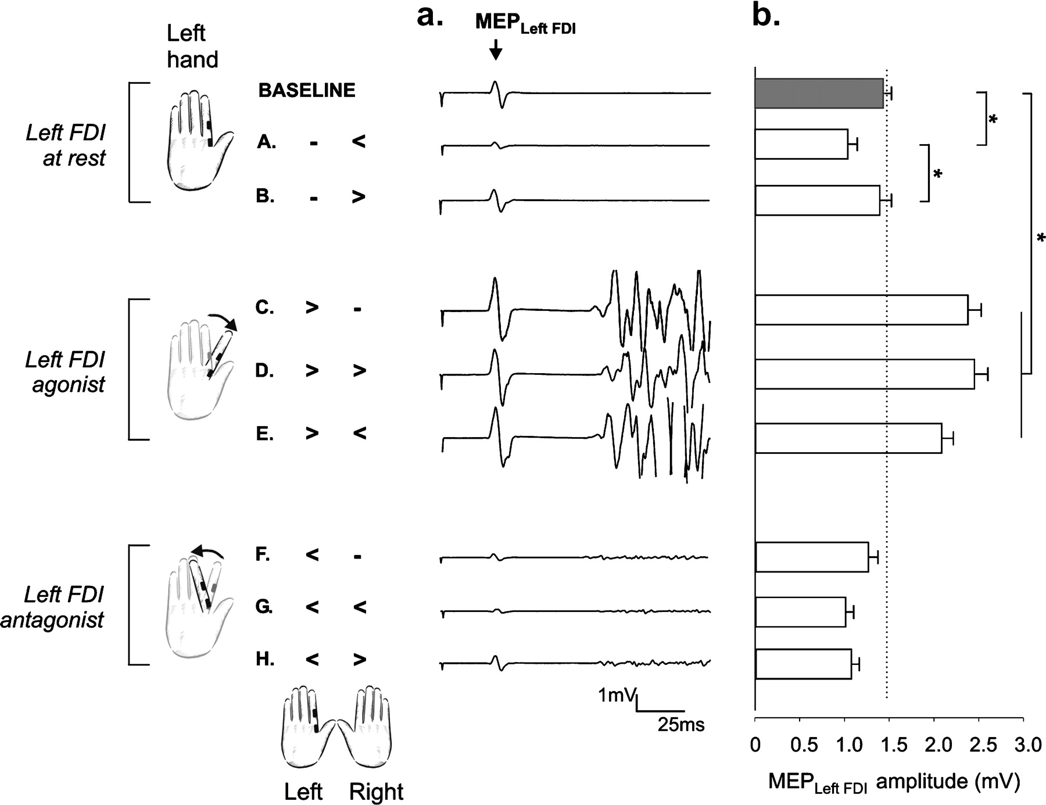
Figure 2. (a) Individual subject's data depicting responses from the left FDI in all conditions. The amplitude of ...
Notes:
Figure 2. (a) Individual subject's data depicting responses from the left FDI in all conditions. The amplitude of MEPLeft FDI changed according to the direction of the left or right index finger movements. MEPLeft FDI were recorded for each movement condition and compared to the amplitude of MEPLeft FDI recorded in the baseline condition (in the absence of a movement). (b) Changes in corticospinal (CS) excitability were studied ∼70 ms before movement onset in all subjects. Histograms represent the mean and SE of the MEPLeft FDI amplitude for each condition and for all trials of the eight subjects. In trials with unilateral right index finger movements (A, B), MEPLeft FDI amplitude was modulated depending on the movement direction. Specifically, trials with right index finger abduction (− <) led to a smaller MEPLeft FDI amplitude in the absence of changes in trials with right index finger adduction (− >). In trials with the left FDI acting as an agonist to the intended movements (C–E), the amplitude of MEPLeft FDI was significantly higher than in the baseline condition, irrespective of the unilateral or bilateral involvement. In contrast, in trials with the left FDI acting as an antagonist to the intended movement (F-H), MEPLeft FDI amplitude tended to be smaller. (A) right index finger abduction (− ); (C) left index finger abduction (> −); (D) right bimanual parallel movement (> >); (E) inward bimanual mirror movement (> <); (F) left index finger adduction (< −);(G) left bimanual parallel movement (< <); (H) outwards bimanual mirror movement (); MEPLeft FDI = Motor Evoked Potential recorded from the left first dorsal interosseus (FDI). *P < 0.05.
Unless provided in the caption above, the following copyright applies to the content of this slide: Cerebral Cortex V 15 N 5 © Oxford University Press 2004; all rights reserved

Slide 3
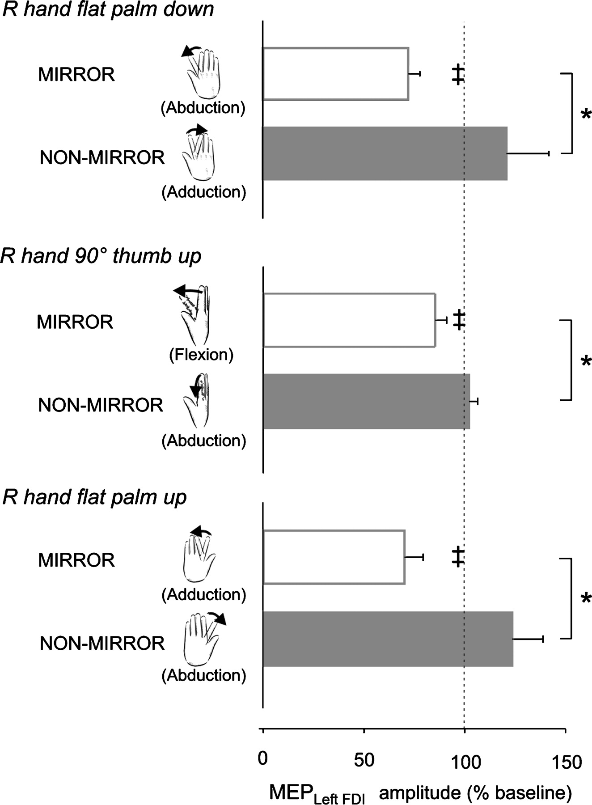
Figure 3. To study the influence of right index finger movement direction and right index finger muscle involvement on ...
Notes:
Figure 3. To study the influence of right index finger movement direction and right index finger muscle involvement on MEPLeft FDI amplitude, we evaluated the influence of placing the right hand in different positions (‘flat palm down’ in eight subjects, ‘90° thumb up’ in seven and ‘flat palm up’ in five) while the left hand was maintained ‘flat palm down’. Right index finger abduction mirrors the action of L FDI when the right hand is ‘flat palm down’, but not when it is ‘90° thumb up’ or ‘flat palm up’. Histograms represent the mean and SE of the normalised MEPLeft FDI. Note that mirror right index finger movements led to smaller MEPLeft FDI amplitudes in the three hand positions regardless of muscle involvement (e.g. right index finger abduction only acted as mirror with the R hand flat palm down). R = right. MEPLeft FDI = motor evoked potential recorded from the left first dorsal interosseus (FDI). ‡P < 0.05 when compared to baseline, *P < 0.05.
Unless provided in the caption above, the following copyright applies to the content of this slide: Cerebral Cortex V 15 N 5 © Oxford University Press 2004; all rights reserved

Slide 4
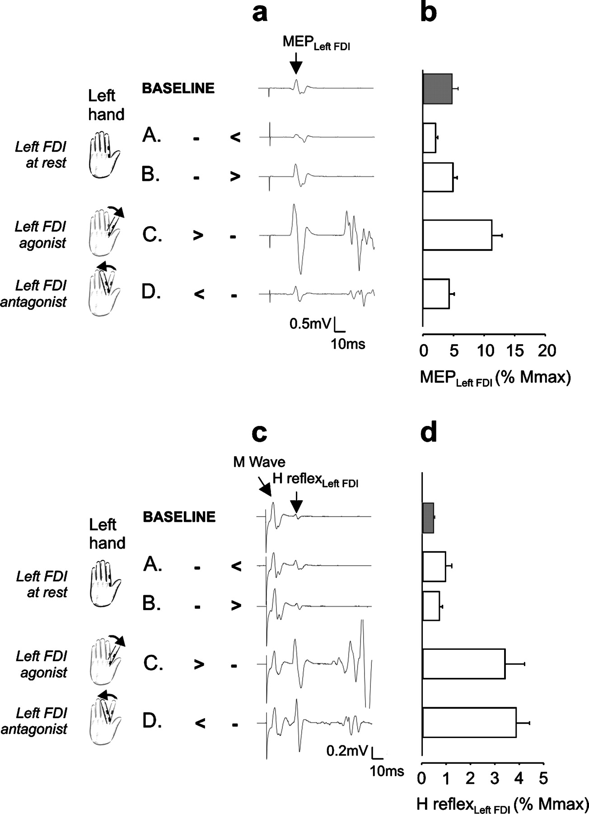
Figure 4. Representative traces (a, c) and average (b, d) MEP_{Left FDI} (a, b) and H reflex_{Left FDI} ...
Notes:
Figure 4. Representative traces (a, c) and average (b, d) MEPLeft FDI (a, b) and H reflexLeft FDI (c, d) recorded during the pre-movement period in the only subject with recordable H reflexes. MEP amplitudes in (b) are expressed as % of Mmax. The amplitude of MEPLeft FDI varied according to the action of the left or right FDI (a): it increased before a movement in which the left FDI acted as an agonist (aC, > −) and decreased before a movement in which the opposite homonymous muscle (right FDI) acted as an agonist (aA, − <). H reflexLeft FDI (c, d) remained unaffected by any movement of the opposite index finger (cA − ) and increased before a movement of the left index finger (cC > −, cD < −), whatever the action of left FDI in the movement. (A) right index finger abduction (− ); (C) left index finger abduction (> −); (D) left index finger adduction (< −). MEPLeft FDI = motor evoked potential recorded in the first dorsal interosseus (FDI). *P < 0.05.
Unless provided in the caption above, the following copyright applies to the content of this slide: Cerebral Cortex V 15 N 5 © Oxford University Press 2004; all rights reserved

