Slide 1
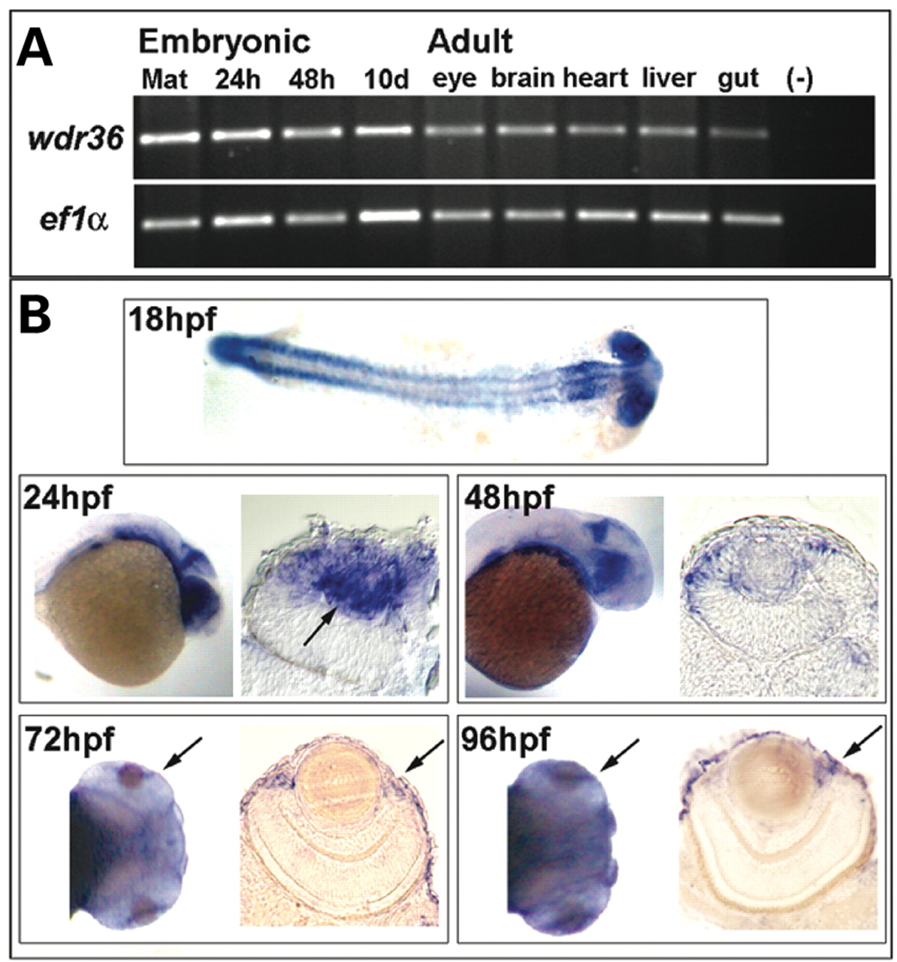
Figure 1. Expression of wdr36 . ( A ) Expression analysis by RT–PCR showed wdr36 transcript was present at all ...
Notes:
Figure 1. Expression of wdr36 . ( A ) Expression analysis by RT–PCR showed wdr36 transcript was present at all embryonic stages and in all adult tissues analyzed, including maternal (Mat) contributions. ( B ) By in situ hybridization, highly proliferative tissues showed enrichment of wdr36 . At 18 hpf, enriched expression was found in the eye, CNS and somites. At 24 hpf, intense expression localized to the eye, the midbrain–hindbrain boundary in the CNS and the gut. Thin sections of the eye showed high levels of expression in the developing lens (arrow) and ciliary marginal zone (CMZ). Enriched expression continued to become restricted at 48 hpf. In ocular tissue at 72 and 96 hpf, enriched expression is localized to the CMZ (arrows).
Unless provided in the caption above, the following copyright applies to the content of this slide: © The Author 2008. Published by Oxford University Press. All rights reserved. For Permissions, please email: journals.permissions@oxfordjournals.org

Slide 2
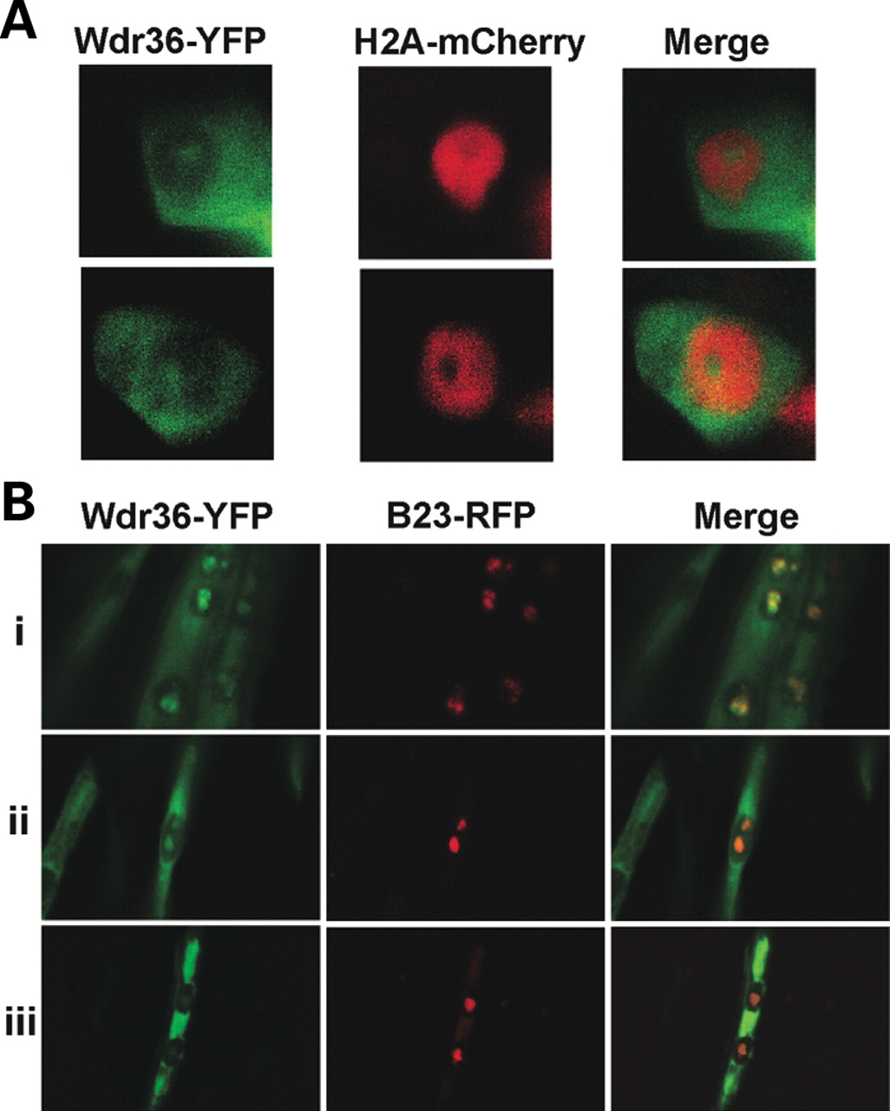
Figure 2. Sub-cellular localization of Wdr36. ( A ) Expression of Wdr36-YFP and Histone2A-mCherry indicated ...
Notes:
Figure 2. Sub-cellular localization of Wdr36. ( A ) Expression of Wdr36-YFP and Histone2A-mCherry indicated localization of Wdr36–YFP to the cytoplasm and a sub-nuclear structure void of chromatin. ( B ) Three co-expression examples (i–iii) of Wdr36-YFP and B23-RFP, a nucleolar marker. Co-localization of Wdr36-YFP and B23-RFP was found within the nucleolus. Variable levels of cytoplasmic and nucleolar Wdr36-YFP expression were observed.
Unless provided in the caption above, the following copyright applies to the content of this slide: © The Author 2008. Published by Oxford University Press. All rights reserved. For Permissions, please email: journals.permissions@oxfordjournals.org

Slide 3
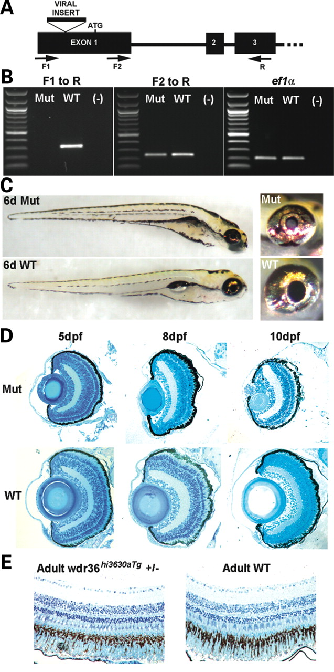
Figure 3. wdr36 viral insert mutant phenotypes. ( A ) Schematic of the first three exons of wdr36 showing location of ...
Notes:
Figure 3. wdr36 viral insert mutant phenotypes. ( A ) Schematic of the first three exons of wdr36 showing location of viral insert, start codon and primers used to assess transcript. ( B ) Analysis of wdr36 transcript in mutants by RT–PCR. Complete loss of transcript was found when amplifying across the viral insert (primers F1-R). Transcripts were still present when amplifying downstream of insert (F2-R), but levels were reduced. ef1α was used as a loading control. ( C ) Gross phenotype of 6 dpf wdr36 mutants and WT siblings. Small head and eye phenotypes were found, along with defects in gut development. Note the absence of an inflated swim bladder. Lens opacity was also observed with incident light illumination of the eye. ( D ) Histological examination of the eye during development. At 5 dpf, wdr36 mutant eyes were small but look grossly normal. Only a slight thickening of the lens epithelium and a reduced ciliary margin zone (CMZ) were observed. Mutant phenotypes progress during development, and at 8 dpf clear defects in the lens and CMZ remained. By 10 dpf, mutant larva showed severe lens degeneration and thinning of the retina, along with cells containing pyknotic nuclei. ( E ) Representative histological sections from 6-month-old heterozygous wdr36 –insert and WT sibling fish. No gross differences between the two conditions are observed.
Unless provided in the caption above, the following copyright applies to the content of this slide: © The Author 2008. Published by Oxford University Press. All rights reserved. For Permissions, please email: journals.permissions@oxfordjournals.org

Slide 4
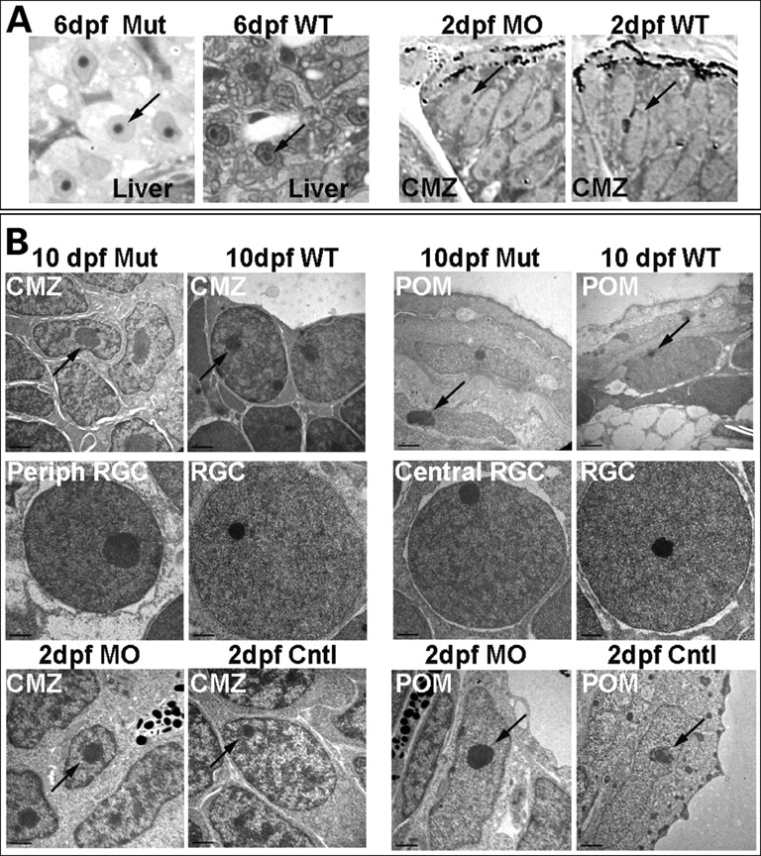
Figure 6. Nucleolar morphology following loss of Wdr36. ( A ) Light microscopy of liver cells from 6 dpf wdr36 mutants ...
Notes:
Figure 6. Nucleolar morphology following loss of Wdr36. ( A ) Light microscopy of liver cells from 6 dpf wdr36 mutants and WTs, and CMZ cells from 2 dpf wdr36 morphants and WTs. Note that with loss of Wdr36, nucleoli were larger, less in number per cell and were more centrally located compared with WT controls. ( B ) TEM images of nucleoli (arrows) from multiple cell types after loss of Wdr36 versus controls. Within the peripheral retina, mutant nucleoli in retinal ganglion cells were large and dysmorphic, while mutant nucleoli from the central retina were more normal in appearance. CMZ, ciliary marginal zone; POM, periocular mesenchyme; RGC, retinal ganglion cell.
Unless provided in the caption above, the following copyright applies to the content of this slide: © The Author 2008. Published by Oxford University Press. All rights reserved. For Permissions, please email: journals.permissions@oxfordjournals.org

Slide 5
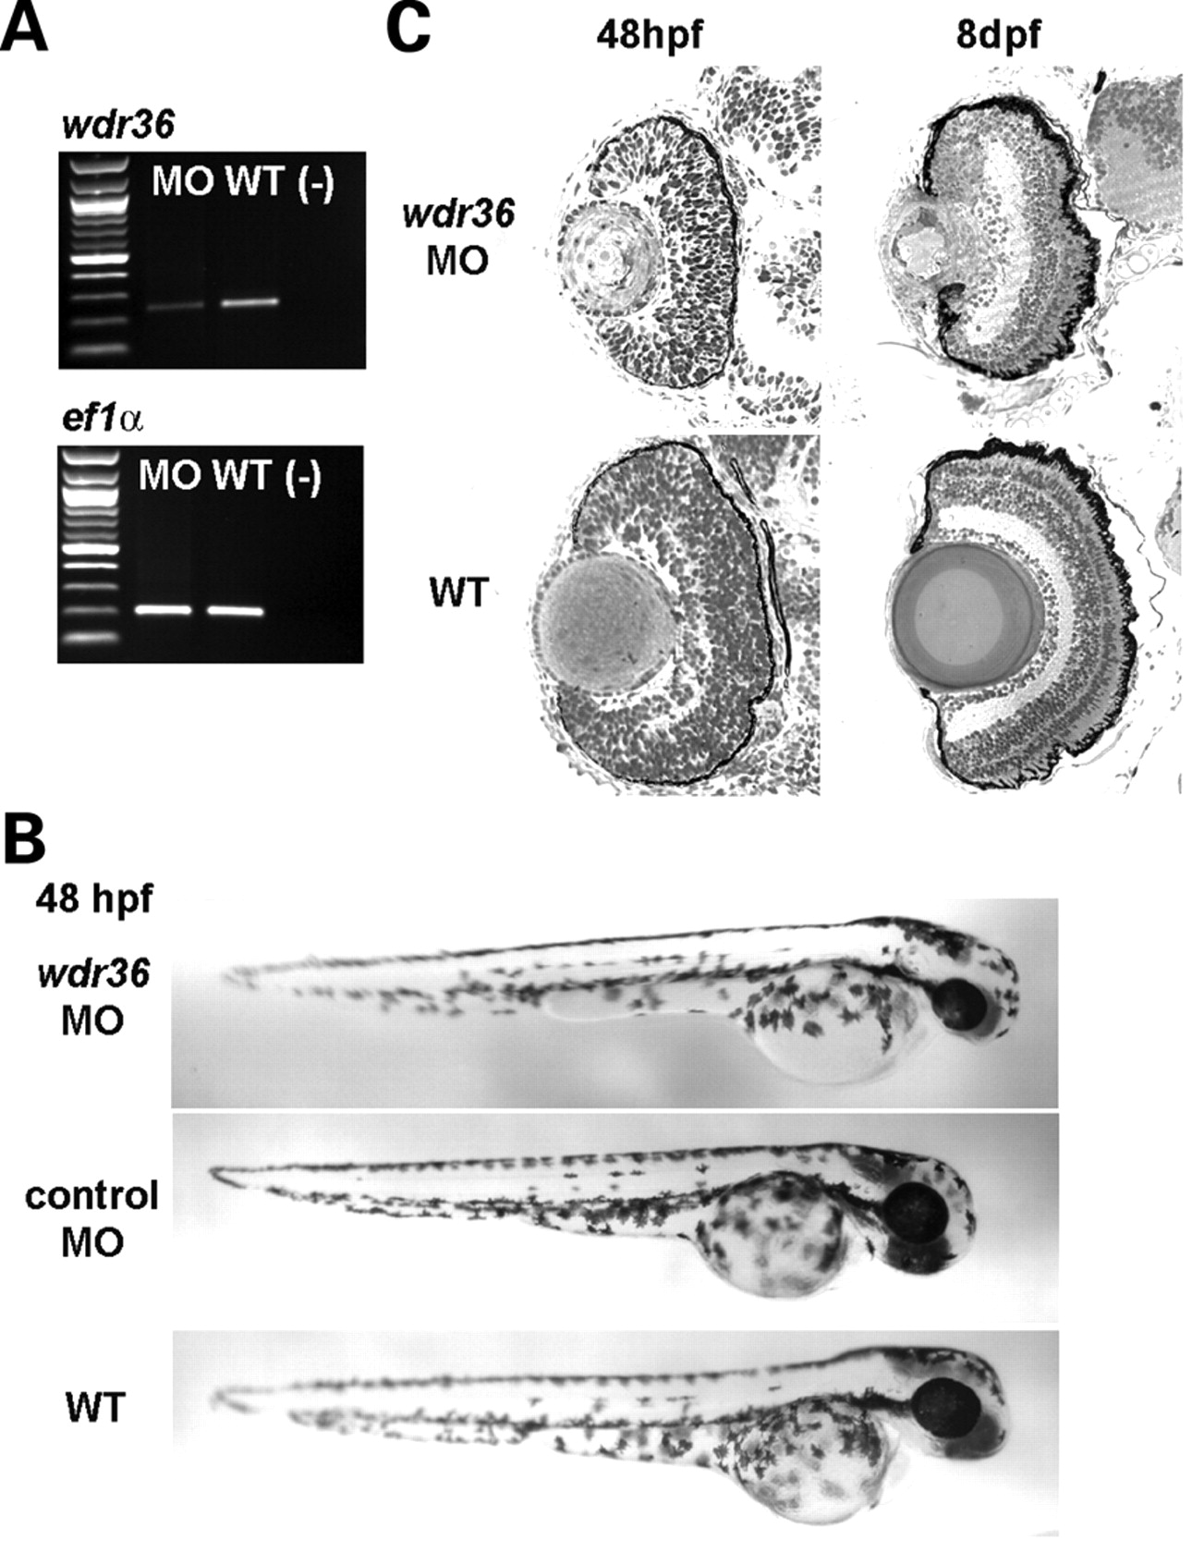
Figure 4. wdr36 morphant phenotypes. ( A ) RT–PCR analysis comparing wdr36 transcript from wdr36 morphants and WT ...
Notes:
Figure 4. wdr36 morphant phenotypes. ( A ) RT–PCR analysis comparing wdr36 transcript from wdr36 morphants and WT embryos. Reduced amounts of transcript are found following injection of the splice blocking MO. ( B ) Gross phenotypes of wdr36 morphants compared with control morphants and WT embryos at 48 hpf. A small head and eye phenotype were observed, similar to wdr36 mutants. ( C ) Histological analysis at 48 hpf revealed a delay in lamination. Like in the mutant, phenotypes were also progressive, as shown by the lens degeneration observed at 8 dpf in the wdr36 morphant.
Unless provided in the caption above, the following copyright applies to the content of this slide: © The Author 2008. Published by Oxford University Press. All rights reserved. For Permissions, please email: journals.permissions@oxfordjournals.org

Slide 6
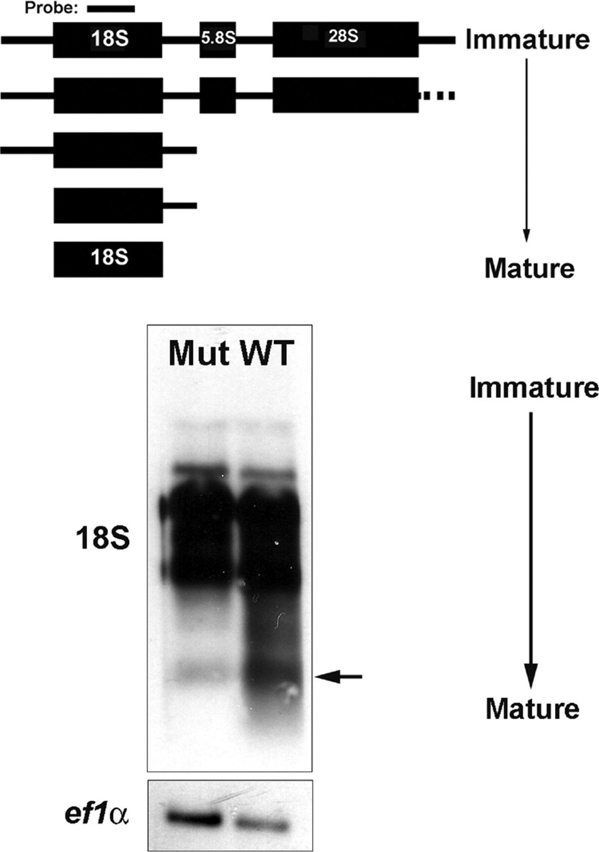
Figure 5. 18S rRNA processing in wdr36 mutants. ( A ) Model of 18S rRNA processing in zebrafish and location of the ...
Notes:
Figure 5. 18S rRNA processing in wdr36 mutants. ( A ) Model of 18S rRNA processing in zebrafish and location of the probe used for the northern blot. ( B ) Representative northern blot of 18S rRNA processing in 6 dpf wdr36 mutants and WTs. In WT, all products from immature to mature (arrow) are found. In contrast, only larger, immature transcripts were recovered from mutant embryos. A probe-recognizing ef1α was used as a loading control.
Unless provided in the caption above, the following copyright applies to the content of this slide: © The Author 2008. Published by Oxford University Press. All rights reserved. For Permissions, please email: journals.permissions@oxfordjournals.org

Slide 7
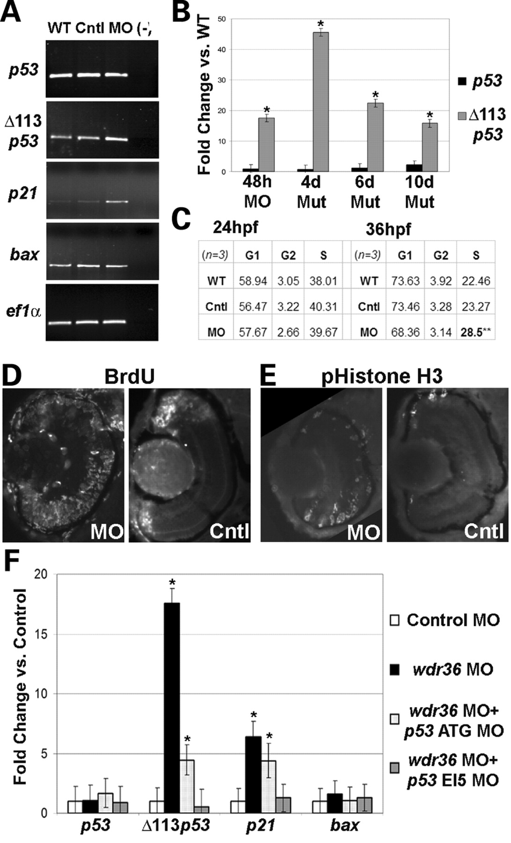
Figure 7. Activation of the p53 stress–response pathway with loss of Wdr36. ( A ) Semi-quantitative RT–PCR analysis of ...
Notes:
Figure 7. Activation of the p53 stress–response pathway with loss of Wdr36. ( A ) Semi-quantitative RT–PCR analysis of p53 , Δ113 p53, p21 and bax in 48 hpf wdr36 morphants versus control morphants and WTs. No changes were found in the levels of p53 or bax transcripts. Increased transcript levels were observed for both Δ113 p53 and p21. ef1α was used as a loading control. ( B ) Quantitative RT–PCR analysis of p53 and Δ113 p53 transcript levels in wdr36 mutants and morphants at specified ages. Moderately increased p53 levels were found only in 10 dpf wdr36 mutants. Increased Δ113 p53 levels were found in both mutants and morphants at all ages assayed. Error bars show standard error of the mean (* P < 0.02 versus control, Student’s t -test). ( C ) FACS analysis of cell cycle phases after Wdr36 loss. No change in the cell cycle was found at 24 hpf. At 36 hpf, wdr36 morphants showed a significant increase in the percentage of cells in S-phase. ( P < 0.03; Students t -test). ( D ) BrdU labeling of cells in S-phase after a 10 h pulse from 48 to 58 hpf. In control embryos, proliferating cells were limited to the CMZ, while in the wdr36 morphants more proliferating cells were present overall and were located throughout the retina. ( E ) phospho-Histone H3 staining of cells in M-phase. Proliferating cells in controls were localized to the CMZ, while more immunoreactive cells were found and were located across the retina in the wdr36 morphants. ( F ) Quantitative RT–PCR analysis of p53 , Δ113 p53, p21 and bax in 48 hpf wdr36 morphants +/− p53 MOs versus control morphants. No changes in p53 or bax transcript levels were found in any condition. The levels of both Δ113 p53 and p21 transcript levels were increased in wdr36 morphants, but this increase was partially rescued by co-injection of p53 ATG MO and fully rescued with co-injection of p53 EI5 MO. Error bars show standard error of the mean (* P < 0.02 versus control, Student’s t -test).
Unless provided in the caption above, the following copyright applies to the content of this slide: © The Author 2008. Published by Oxford University Press. All rights reserved. For Permissions, please email: journals.permissions@oxfordjournals.org

