Slide 1
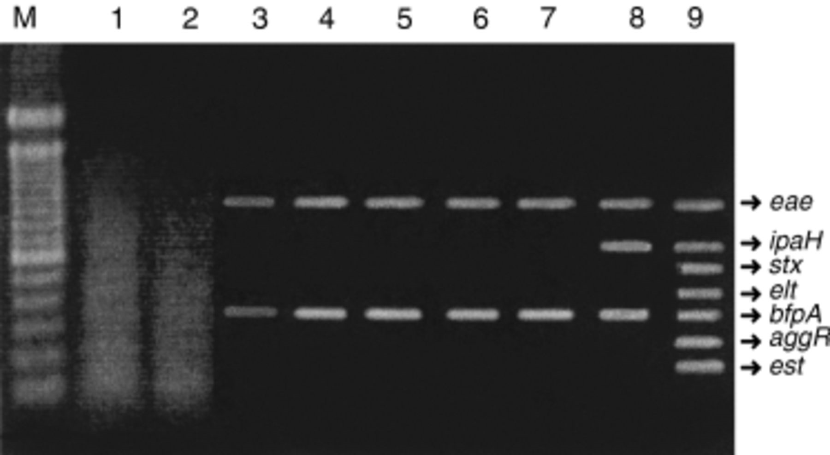
1 Sensitivity of multiplex PCR of EPEC E2348/69 (eae, bfpA) from a spiked stool sample. Lane M, DNA molecular ...
Notes:
1 Sensitivity of multiplex PCR of EPEC E2348/69 (eae, bfpA) from a spiked stool sample. Lane M, DNA molecular size markers (100-bp ladder); lane 1, nonspiked stool sample; lanes 2–7, dilutions from 102 to 107 CFU mL−1; lane 8, EPEC E2348/69 (eae, bfpA) and EIEC EDL1284; lane 9, positive control (DNA mix from the five prototype Escherichia coli: EPEC E2348/69 (eae, bfpA), EAEC O42 (aggR), ETEC H10407 (elt, est), EIEC EDL1284 (ipaH) and EHEC EDL931 (stx1, stx2, eae).
Unless provided in the caption above, the following copyright applies to the content of this slide: © 2007 Federation of European Microbiological Societies

Slide 2
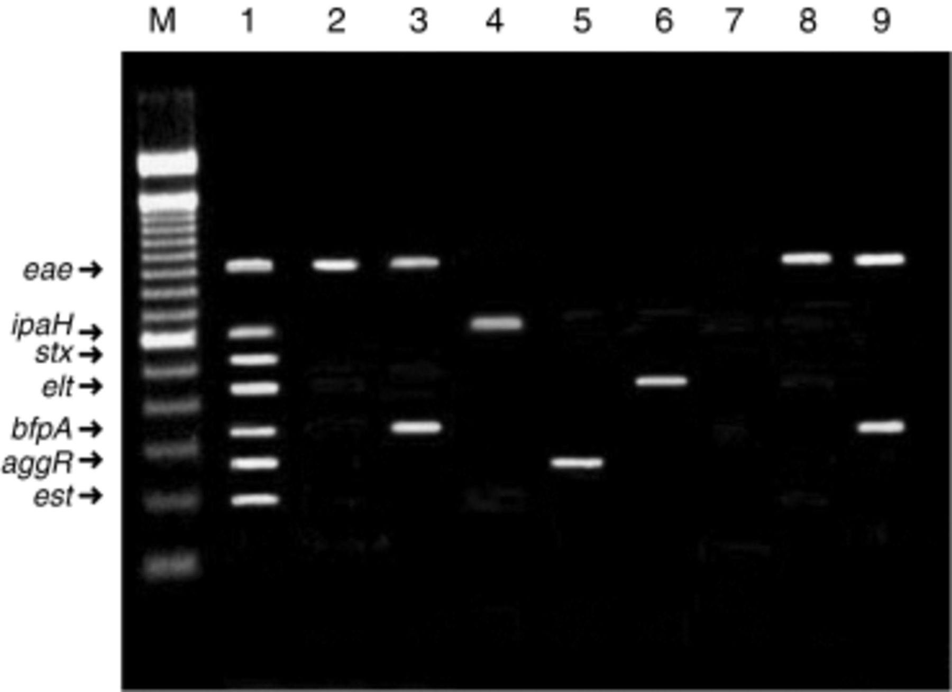
2 Multiplex PCR of clinical Escherichia coli isolates and stool samples. Lane M, DNA molecular size markers ...
Notes:
2 Multiplex PCR of clinical Escherichia coli isolates and stool samples. Lane M, DNA molecular size markers (100-bp ladder); lane 1, positive control (DNA mix from the five prototype E. coli): lane 2, EPEC HSP 7-1 (eae); lane 3, EPEC HSP 43-1 (eae and bfpA); lane 4, EIEC MA 245/5 (ipaH); lane 5, EAEC MA233-1 (aggR); lane 6, Shigella flexneri (ipaH); lane 7, negative control (E. coli DH5α); lanes 8 and 9, atypical and typical EPEC isolated from children with diarrhea.
Unless provided in the caption above, the following copyright applies to the content of this slide: © 2007 Federation of European Microbiological Societies

