Slide 1
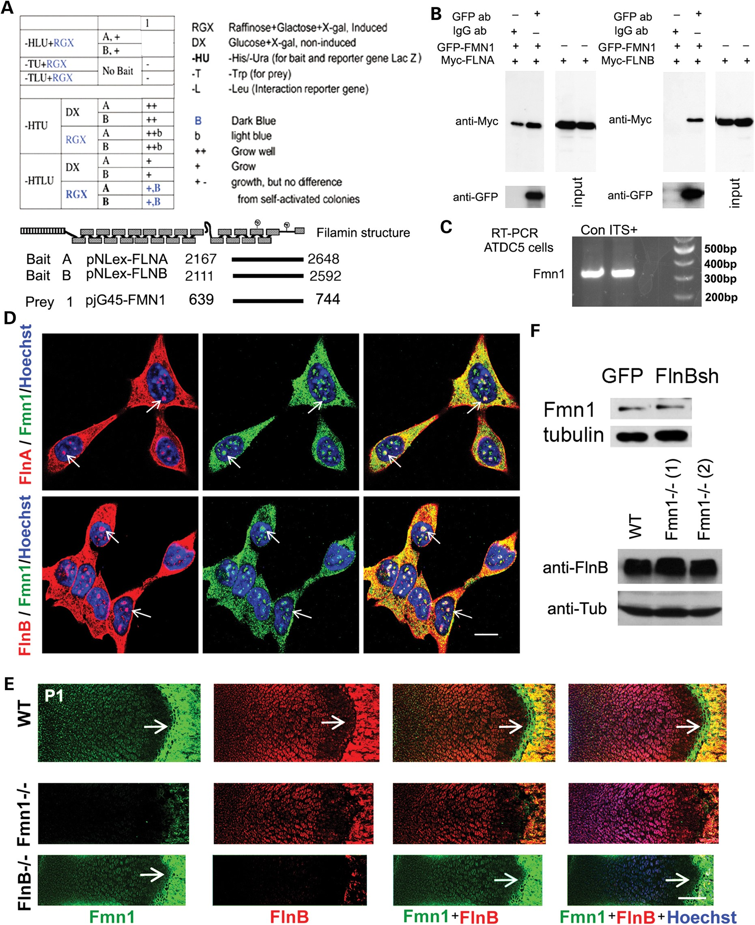
Figure 1. Filamin B interacts and co-localizes with Formin 1. (A) Yeast two-hybridization analysis shows that both ...
Notes:
Figure 1. Filamin B interacts and co-localizes with Formin 1. (A) Yeast two-hybridization analysis shows that both human Filamin A (FLNA) and Filamin B (FLNB) preys interact with Formin 1 (FMN1) bait. The fragments used for the interaction experiments are graphically shown. An interaction between the bait and prey is gauged by level of blue intensity generated through the X-gal reaction. (B) Immunoprecipitation analysis shows that GFP-tagged FMN1 can immunoprecipitate Myc-tagged FLNA and FLNB. C. RT-PCR shows Fmn1 mRNA expression in naïve ATDC5 cells and following induction of differentiation with ITS (insulin–transferrin–selenium). (D) FlnA-Fmn1 and FlnB-Fmn1 double staining shows that both FlnA-Fmn1 and FlnB-Fmn1 are highly co-localized in the cytoplasm, and in multiple nuclear foci (white arrows) in ATDC5 cells. (E) Fluorescent photomicrograph of P1 WT radial growth plate shows that Fmn 1 (Dylight488, fluoroscein) and FlnB (Dylight594, rhodamine) are widely expressed in chondrocytes across the proliferative, prehypertrophic and hypertrophic zones. Fmn1 expression is especially strong in chondrocytes along the growth plate–ossification border, generally at the end of the hypertrophic zone (white arrow). Fmn1 expression is significantly reduced at the border (white arrow) of the hypertrophic zone and region of ossification in the radial growth plate of P1 FlnB−/− mice. FlnB expression is not affected by loss of Fmn1−/−. (F) FlnB inhibition does not alter Fmn1 expression in stably transfected, null FlnB ATDC5 cell lines. Similarly, Fmn1 loss of function in chondrocytes does not show any change in FlnB expression. Scale bars = 20 μm for D and 200 μm for E.
Unless provided in the caption above, the following copyright applies to the content of this slide: © The Author 2014. Published by Oxford University Press. All rights reserved. For Permissions, please email: journals.permissions@oup.com

Slide 2
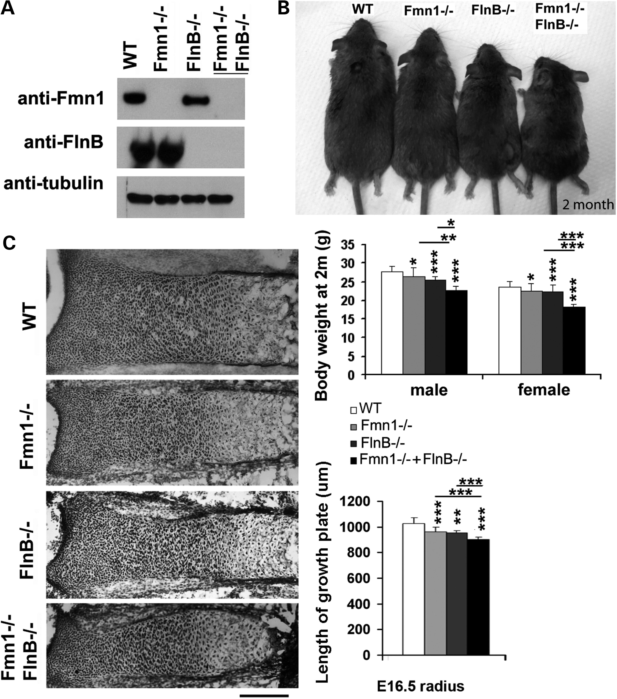
Figure 2. Fmn1–FlnB loss of function (Fmn1^{−/−} + FlnB^{−/−}) causes more significant shortening in ...
Notes:
Figure 2. Fmn1–FlnB loss of function (Fmn1−/− + FlnB−/−) causes more significant shortening in bone length and growth plate than single gene knockout. (A) Western blot demonstrates absence of Fmn1 and FlnB in the double-knockout mice. (B) Photograph of gross body sizes from WT and respective transgenic mice at 2 months of age. Changes in body weight are graphically summarized below. Body weight comparisons at this same age show a progressive decline with loss in Fmn1−/−, FlnB−/− and Fmn1−/− + FlnB−/− function, regardless of sex. (C) Longitudinal sections show a corresponding decrease in the lengths of the radial growth plates of Fmn1−/−, FlnB−/− and Fmn1−/− + FlnB−/− compared with WT mice at E16.5. Findings are graphically summarized to the right. Scale bar = 200 μm for (D) *P < 0.05, **P < 0.01, ***P 3 samples per group.
Unless provided in the caption above, the following copyright applies to the content of this slide: © The Author 2014. Published by Oxford University Press. All rights reserved. For Permissions, please email: journals.permissions@oup.com

Slide 3
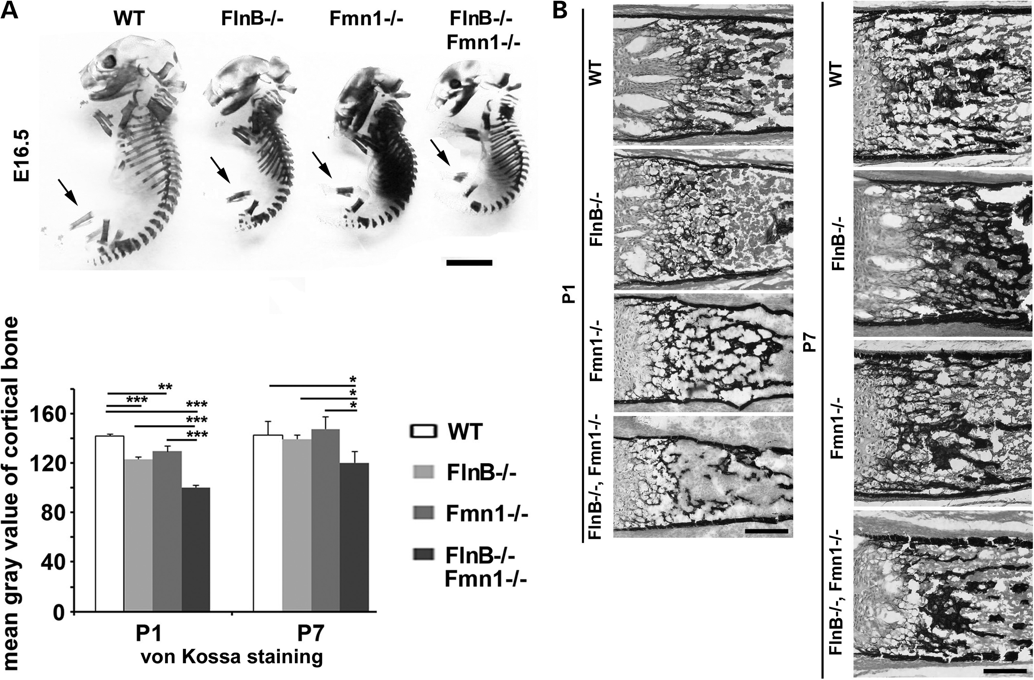
Figure 3. Fmn1–FlnB loss of function (Fmn1^{−/−} + FlnB^{−/−}) causes delayed bone calcification and ...
Notes:
Figure 3. Fmn1–FlnB loss of function (Fmn1−/− + FlnB−/−) causes delayed bone calcification and ossification in mice. (A) Low magnification photograph of Alizarin red (bone) staining for E16.5 mice skeletons. Alizarin red staining demonstrates a reduction in long bone length in mutant compared with WT mice (black arrows) with the greatest shortening seen in the Fmn1−/− + FlnB−/− double-knockout mice. (B) Brightfield photomicrographs of von Kossa staining of P1 and P7 radius show decreased silver phosphate deposition (black, counterstained with fast red) in Fmn1−/−, FlnB−/− and Fmn1−/− + FlnB−/− compared with WT mice, indicating delayed calcification in Fmn1−/− + FlnB−/−. The delay in calcification is more severe in the double null mice compared with the Fmn1−/− or FlnB−/− mice. Results are quantified by graph to the left and show differences in staining intensity of the cortical bones among these mice, as measured by mean gray value from Image J. Scale bar = 3.6 mm in A, and 200 μm in B.
Unless provided in the caption above, the following copyright applies to the content of this slide: © The Author 2014. Published by Oxford University Press. All rights reserved. For Permissions, please email: journals.permissions@oup.com

Slide 4
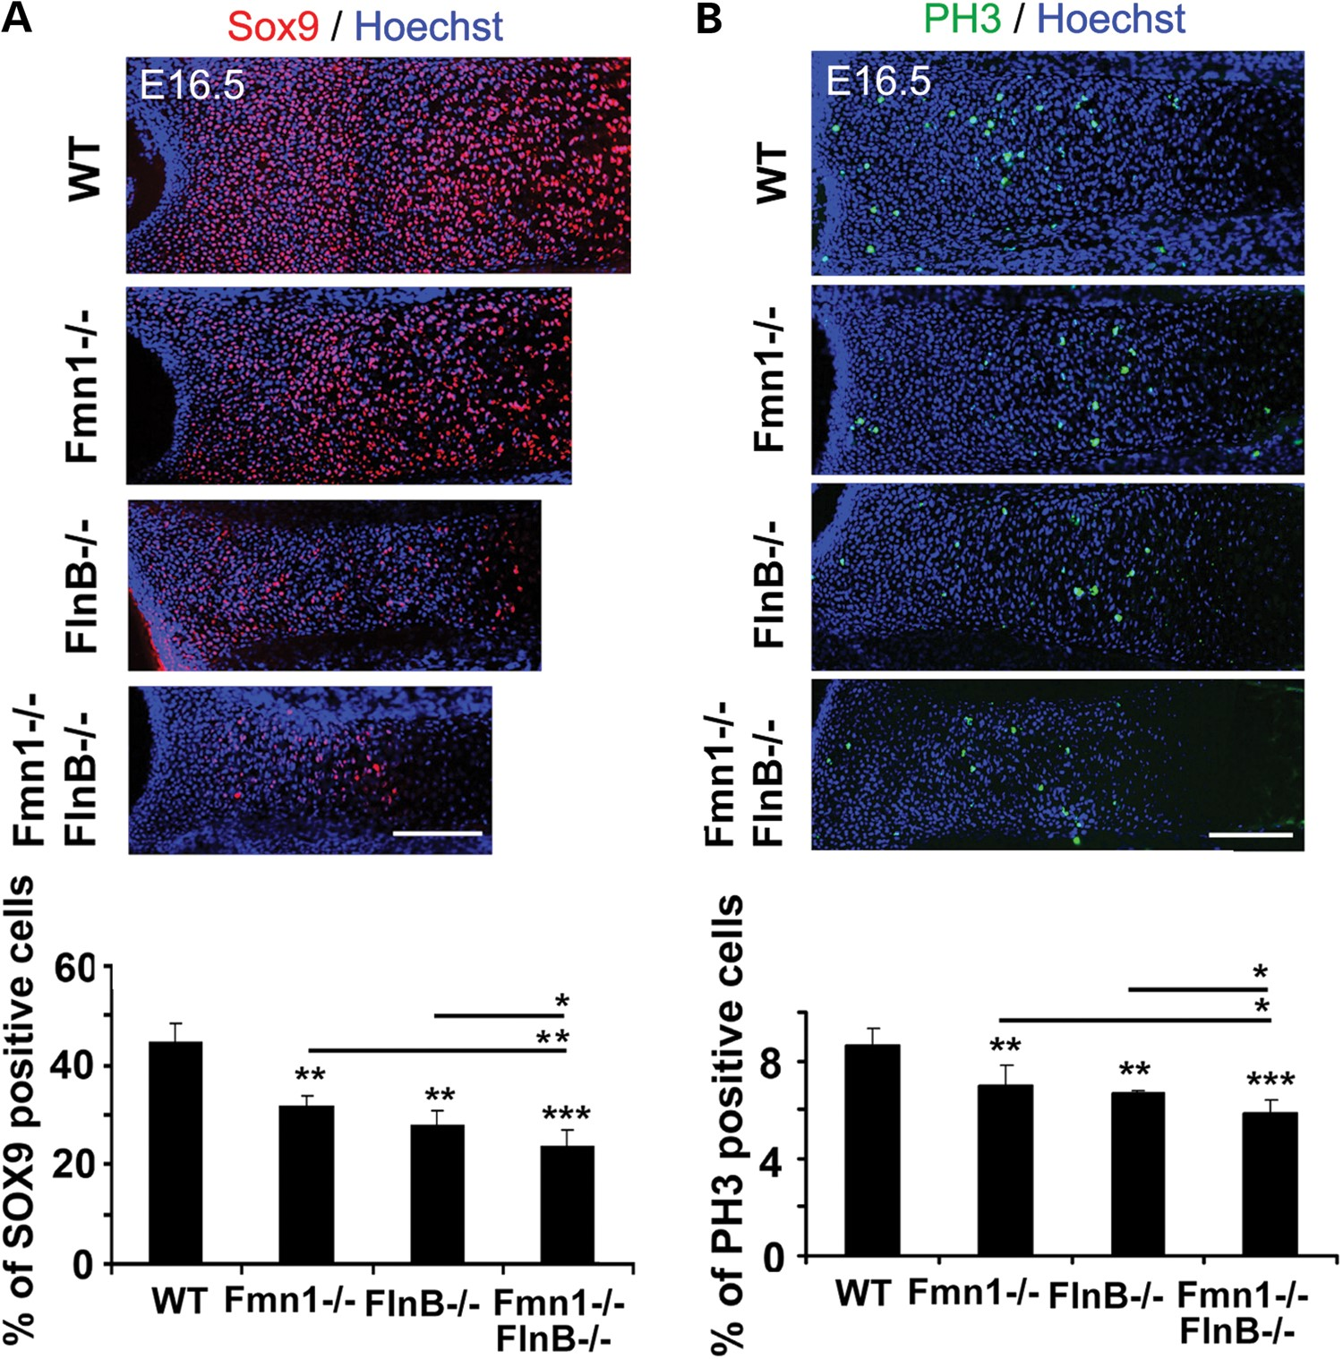
Figure 4. Fmn1–FlnB loss of function (Fmn1^{−/−} + FlnB^{−/−}) impairs chondrocyte proliferation in ...
Notes:
Figure 4. Fmn1–FlnB loss of function (Fmn1−/− + FlnB−/−) impairs chondrocyte proliferation in mice. (A) Fluorescent photomicrographs of Sox9 immunostaining (Dylight594, rhodamine) in E16.5 radius show that the number of Sox9+ chondrocytes in the proliferation and prehypertrophic zones is reduced in both Fmn1−/− and FlnB−/− mice. An even greater reduction in positively labeled cells is seen in the Fmn1−/− + FlnB−/− mice. Quantification is graphically summarized below. (B) Fluorescent photomicrographs of phospho-histone H3 immunostaining (PH3, Dylight488, fluoroscein) in E16.5 radius shows that the number of PH3+ chondrocytes is similarly reduced in both the Fmn1−/− and FlnB−/− mice. An even greater reduction in positively labeled cells is seen in the Fmn1−/− + FlnB−/− mice. Quantification is graphically summarized below. Scale bars = 200 μm. *P < 0.05, **P < 0.01, ***P = 3 samples per group.
Unless provided in the caption above, the following copyright applies to the content of this slide: © The Author 2014. Published by Oxford University Press. All rights reserved. For Permissions, please email: journals.permissions@oup.com

Slide 5
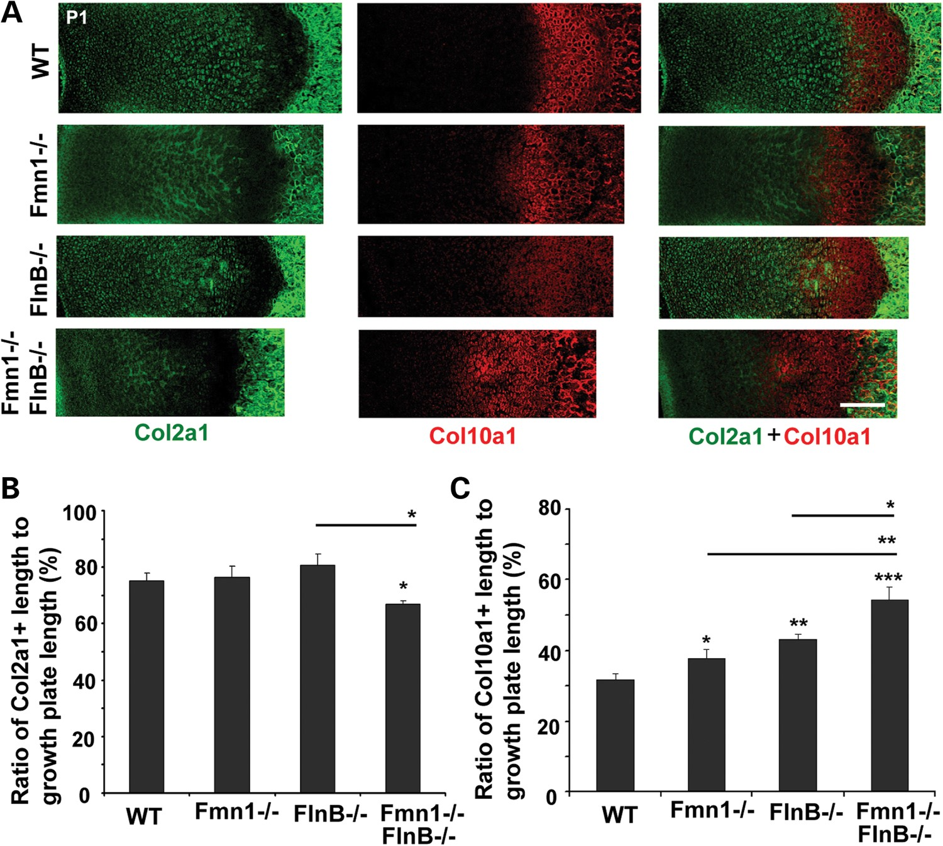
Figure 5. Fmn1–FlnB loss of function (Fmn1^{−/−} + FlnB^{−/−}) causes widening of the hypertrophic zone ...
Notes:
Figure 5. Fmn1–FlnB loss of function (Fmn1−/− + FlnB−/−) causes widening of the hypertrophic zone in the growth plate of long bones. (A) Fluorescent photomicrographs show collagen2 (Col2a1, Dylight488 fluoroscein) and collagen10 (Col10a1, Dylight594 rhodamine) double staining in P1 radius. The ratio of Col2a1+ width to the growth plate does not change much in Fmn1−/− mice and FlnB−/− mice but is significantly reduced in the Fmn1−/− + FlnB−/− double-knockout mice. Florescent photomicrographs for Col10a1+ immunostaining of the P1 radius, on the contrary, show progressively increased widening of the Fmn1−/− mice, FlnB−/− mice and Fmn1−/− + FlnB−/− double-knockout mice. (B) Quantitative analyses of the Col2a1 and Col10a1 immunostaining are graphically summarized. Scale bar in A = 200 μm. *P < 0.05, **P < 0.01, ***P < 0.001.
Unless provided in the caption above, the following copyright applies to the content of this slide: © The Author 2014. Published by Oxford University Press. All rights reserved. For Permissions, please email: journals.permissions@oup.com

Slide 6
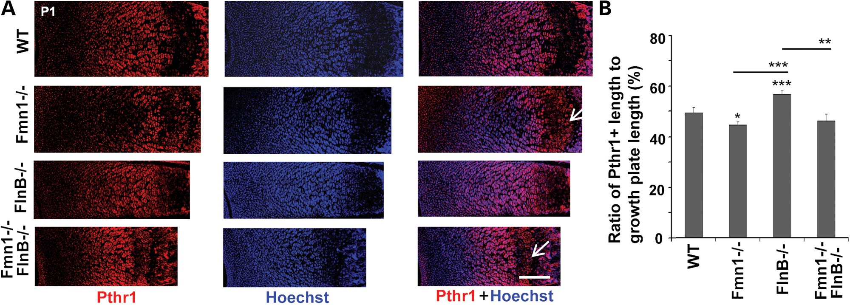
Figure 6. Fmn1 and FlnB differentially regulate the width of Pthr1⁺ prehypertrophic zones in the long bones ...
Notes:
Figure 6. Fmn1 and FlnB differentially regulate the width of Pthr1+ prehypertrophic zones in the long bones of knockout mice. (A) Fluorescent photomicrographs show that the width of the prehypertrophic zone as gauged by parathyroid hormone 1 receptor immunostaining (Pthr1, Dylight594 rhodamine) relative to the absolute growth plate length decreases in P1 Fmn1−/− mice, increases in FlnB−/− mice and displays no significant change in Fmn1−/− + FlnB−/− mice compared with wild-type mice. In addition, Pthr1+ immunostaining appears to be shifted to the right adjacent to the diaphysis (white arrows) in Fmn1−/− mice and Fmn1−/− + FlnB−/− mice, but not in FlnB−/− or WT mice. (B) The quantitative analyses are graphically summarized for the images in A. Scale bar in A = 200 μm. *P < 0.05, **P < 0.01, ***P = 3 samples per group.
Unless provided in the caption above, the following copyright applies to the content of this slide: © The Author 2014. Published by Oxford University Press. All rights reserved. For Permissions, please email: journals.permissions@oup.com

