Slide 1
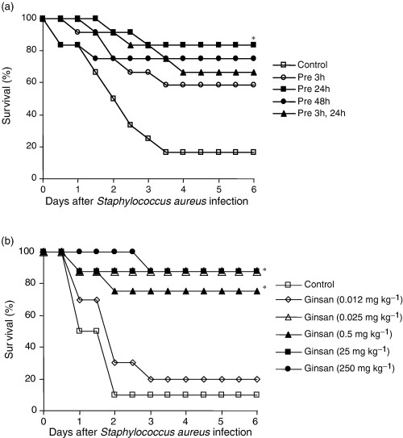
1 Protection of mice from Staphylococcus aureus-induced septic death by pre-treatment with ginsan. (a) The ...
Notes:
1 Protection of mice from Staphylococcus aureus-induced septic death by pre-treatment with ginsan. (a) The survival rates of S. aureus-infected mice were measured to determine the optimal time for the administration of ginsan before bacterial infection. The four groups of mice were administered with a single dose of ginsan (0.025 mg kg−1, intravenously) at 0, 3, 24, and 48 h before S. aureus infection (1.5 × 108 CFUs, intraperitoneally). The mice in the last group were given the same dose of ginsan twice at 3 and 24 h before S. aureus infection. *, P<0.003. (b) The survival rates of S. aureus-infected mice were measured to determine the optimal dose of ginsan. The mice were administered intravenously with various doses of ginsan at 24 h before bacterial infection; n=10–12 mice in each group. These data represent one of three repeated experiments that yielded similar results. *, P<0.003.
Unless provided in the caption above, the following copyright applies to the content of this slide: © 2005 Federation of European Microbiological Societies

Slide 2
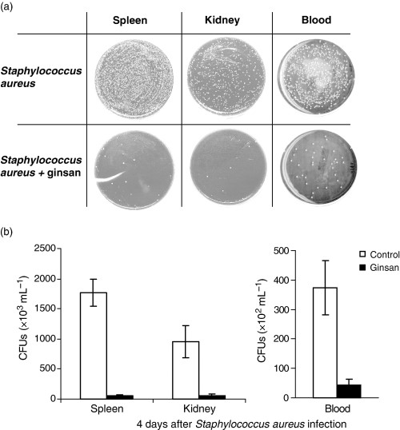
2 Enhanced bactericidal activity in Staphylococcus aureus-infected mice by pretreatment with ginsan. (a) Mice ...
Notes:
2 Enhanced bactericidal activity in Staphylococcus aureus-infected mice by pretreatment with ginsan. (a) Mice were treated with ginsan (0.025 mg kg−1, intravenously) 24 h before S. aureus infection (1.5 × 108 CFUs, intraperitoneally). The spleens, the kidneys, and blood were obtained from mice on day 4 after infection, and the bacteria in the organs were cultured for 20 h at 37°C on blood agar plates. (b) The number of bacteria in each sample was presented as CFUs mL−1. Significant antibacterial effect of ginsan on bacterial propagation was demonstrated in the three organs represented by P values of P<0.0001, 0.0004, and 0.0003 in the spleen, the kidney, and blood, respectively; n=5 mice in each group. These data represent one of three repeated experiments that yielded similar results. The data were expressed as mean±standard error of mean.
Unless provided in the caption above, the following copyright applies to the content of this slide: © 2005 Federation of European Microbiological Societies

Slide 3
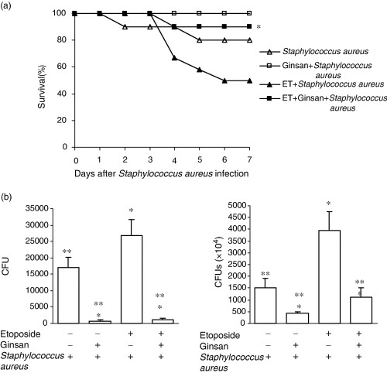
3 Monocytes/macrophages-mediated antibacterial activity in ginsan-treated septic mice. (a) The survival rates ...
Notes:
3 Monocytes/macrophages-mediated antibacterial activity in ginsan-treated septic mice. (a) The survival rates of mice that were treated with ginsan alone, etoposide alone, or etoposide plus ginsan before Staphylococcus aureus infection were determined. The mice were subcutaneously injected with etoposide (12.5 mg kg−1) once a day for three consecutive days to deplete monocytes/macrophages. One group of the etoposide-treated mice was infected with a sublethal dose of S. aureus (1.0 × 108 CFUs mL−1), while the other etoposide-treated group was treated with ginsan (0.025 mg kg−1, intravenously) 24 h before the bacterial infection. The survival rates of the mice were observed for 7 days. Mice treated with etoposide plus ginsan demonstrated a significantly enhanced bacterial clearance, compared to mice treated with etoposide alone; n=10 in each group. (b) The numbers of S. aureus were determined in ginsan-treated mice after pretreatment of etoposide. The spleens and the kidneys were obtained from S. aureus-infected mice on day 2 after bacterial infection. The results from one of three repeated experiments were presented. The data were expressed as mean±standard error of mean. (*, P<0.005 when compared with the mice that were infected with S. aureus, and **, P<0.003, when compared with the mice that were infected with S. aureus after etoposide-treatment); n=10–12 mice in each group.
Unless provided in the caption above, the following copyright applies to the content of this slide: © 2005 Federation of European Microbiological Societies

Slide 4
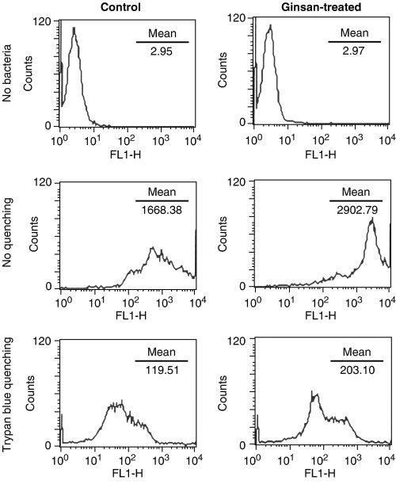
4 Enhanced phagocytic activity of macrophages for Staphylococcus aureus by pretreatment with ginsan. ...
Notes:
4 Enhanced phagocytic activity of macrophages for Staphylococcus aureus by pretreatment with ginsan. Ginsan-treated (0.1 µg mL−1) or nontreated macrophage cell line J774A.1 cells were incubated with heat-inactivated and fluorescein isothiocyanate-labeled S. aureus for 10 min at 4°C, and then for 30 min at 37°C. The nonspecific binding of bacteria was quenched by the treatment of cells with 0.2% trypan blue. The phagocytic activities of the cells were determined through fluorescence activated cell sorter analysis, and were measured by mean fluorescent intensity. The results from one of three repeated experiments were presented.
Unless provided in the caption above, the following copyright applies to the content of this slide: © 2005 Federation of European Microbiological Societies

Slide 5
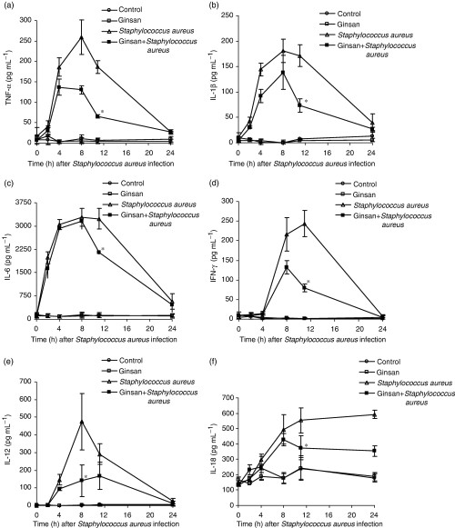
5 Reduction of inflammatory cytokines in ginsan-treated septic mice. The mice were divided into four groups: ...
Notes:
5 Reduction of inflammatory cytokines in ginsan-treated septic mice. The mice were divided into four groups: (i) the nontreated control group, (ii) the ginsan-treated group (0.025 mg kg−1, intravenously), (iii) the Staphylococcus aureus-infected group, and (iv) the ginsan-treated group (0.025 mg kg−1, intravenously), before infection with S. aureus. Sera were collected from mice at 0, 2, 4, 8, 11, and 24 h post-infection in each group. The concentrations of inflammatory cytokines, such as (a) tumor nercosis factor-α, (b) interleukin (IL)-1β, (c) IL-6, (d) interferon-γ, (e) IL-12 and (f) IL-18, were determined using enzyme-linked immunosorbent assay kits. The data were expressed as mean±standard error of mean (*, P<0.05). The results from one of three repeated experiments were presented; n=5–6 mice in each group.
Unless provided in the caption above, the following copyright applies to the content of this slide: © 2005 Federation of European Microbiological Societies

Slide 6
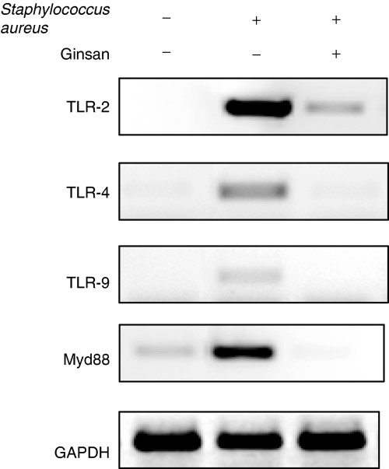
6 Ginsan-mediated suppression of Toll-like receptor (TLR)s and MyD88 in peritoneal macrophages stimulated with ...
Notes:
6 Ginsan-mediated suppression of Toll-like receptor (TLR)s and MyD88 in peritoneal macrophages stimulated with Staphylococcus aureus. Peritoneal macrophages (4 × 106 cells per well) of mice were pretreated with ginsan (0.1 µg mL−1) for 10 h, before being stimulated with heat-killed S. aureus (8 × 107 CFUs well−1) for 6 h at 37°C. The same number of peritoneal macrophages was cultured for 6 h at 37°C, with or without S. aureus. Reverse transcriptase polymerase chain reaction was conducted to evaluate the expression levels of TLR2, TLR4, and TLR9, as well as MyD88. Glyseraldehyde-3-phosphate dehydrogenase was used as a control gene. These results represent one of three repeated experiments.
Unless provided in the caption above, the following copyright applies to the content of this slide: © 2005 Federation of European Microbiological Societies

