Slide 1
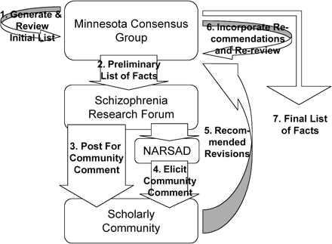
Fig. 1. Diagram of “What We Know, Revised List” (Table 1) Development and Revision Process.
Notes:
Fig. 1. Diagram of “What We Know, Revised List” (Table 1) Development and Revision Process.
Unless provided in the caption above, the following copyright applies to the content of this slide: © The Author 2009. Published by Oxford University Press on behalf of the Maryland Psychiatric Research Center. All rights reserved. For permissions, please email: journals.permissions@oxfordjournals.org.

