Slide 1
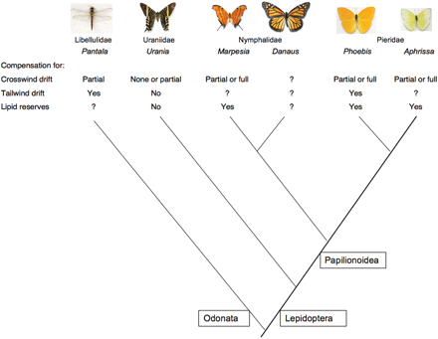
Fig. 1 Phylogenetic relationships among the migratory dragonfly, moth, and butterfly genera of interest, with a ...
Notes:
Fig. 1 Phylogenetic relationships among the migratory dragonfly, moth, and butterfly genera of interest, with a photograph of a representative species from each genus. Relationships of the genera within Nymphalidae are based on Wahlberg et al. (2003), and relationships among lepidopteran families are based on Wahlberg et al. (2005). Results from the compensation studies are summarized beneath each genus with a question mark indicating a need for future research in the designated taxon.
Unless provided in the caption above, the following copyright applies to the content of this slide: Published by Oxford University Press 2008.

Slide 2
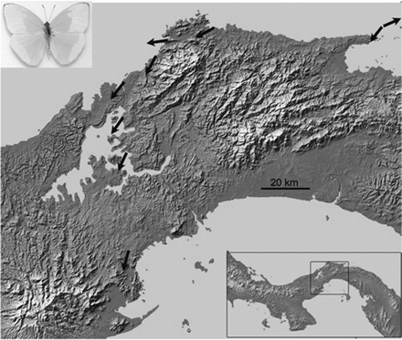
Fig. 2 The annual migration of Aphrissa butterflies across the Isthmus of Panama from the wet Atlantic coastal ...
Notes:
Fig. 2 The annual migration of Aphrissa butterflies across the Isthmus of Panama from the wet Atlantic coastal forest to the dry Pacific coastal forest. At each of 8 locations, arrows represent the mean orientations of butterflies (n > 20 at each location). Magnetic and geographic North are towards the top of the page. Inset: topographic map of Panama with the enlarged view of the isthmus and Lake Gatún designated by a rectangle. The depicted butterfly is a male A. statira.
Unless provided in the caption above, the following copyright applies to the content of this slide: Published by Oxford University Press 2008.

Slide 3
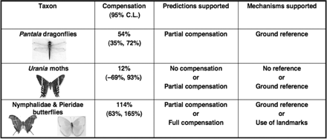
Fig. 3 Compensation for crosswind drift and its supportive mechanisms based on the 95% confidence intervals for ...
Notes:
Fig. 3 Compensation for crosswind drift and its supportive mechanisms based on the 95% confidence intervals for regression of change in heading versus change in angle of wind drift. Results for butterflies and moths are from Srygley et al. (1996), and those for dragonflies from Srygley (2003).
Unless provided in the caption above, the following copyright applies to the content of this slide: Published by Oxford University Press 2008.

Slide 4
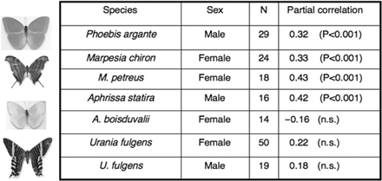
Fig. 5 Compensation of airspeed for lipid load following adjustment for body mass in butterflies and Urania moths. ...
Notes:
Fig. 5 Compensation of airspeed for lipid load following adjustment for body mass in butterflies and Urania moths. Results for butterflies are from Dudley and Srygley (2008), and those for moths from Dudley et al. (2002). The dorsal view of a representative species is depicted to the left of each genus.
Unless provided in the caption above, the following copyright applies to the content of this slide: Published by Oxford University Press 2008.

Slide 5
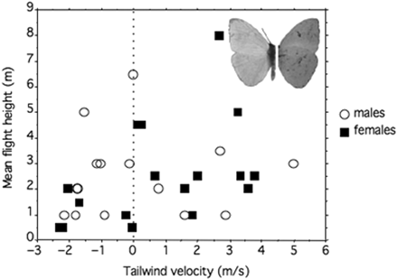
Fig. 4 Mean height above water relative to mean tailwind velocity for P. sennae males and females migrating over the ...
Notes:
Fig. 4 Mean height above water relative to mean tailwind velocity for P. sennae males and females migrating over the Caribbean Sea. The depicted butterfly is a P. sennae male showing the dorsal (left) and ventral (right) side of the wings.
Unless provided in the caption above, the following copyright applies to the content of this slide: Published by Oxford University Press 2008.

