Slide 1
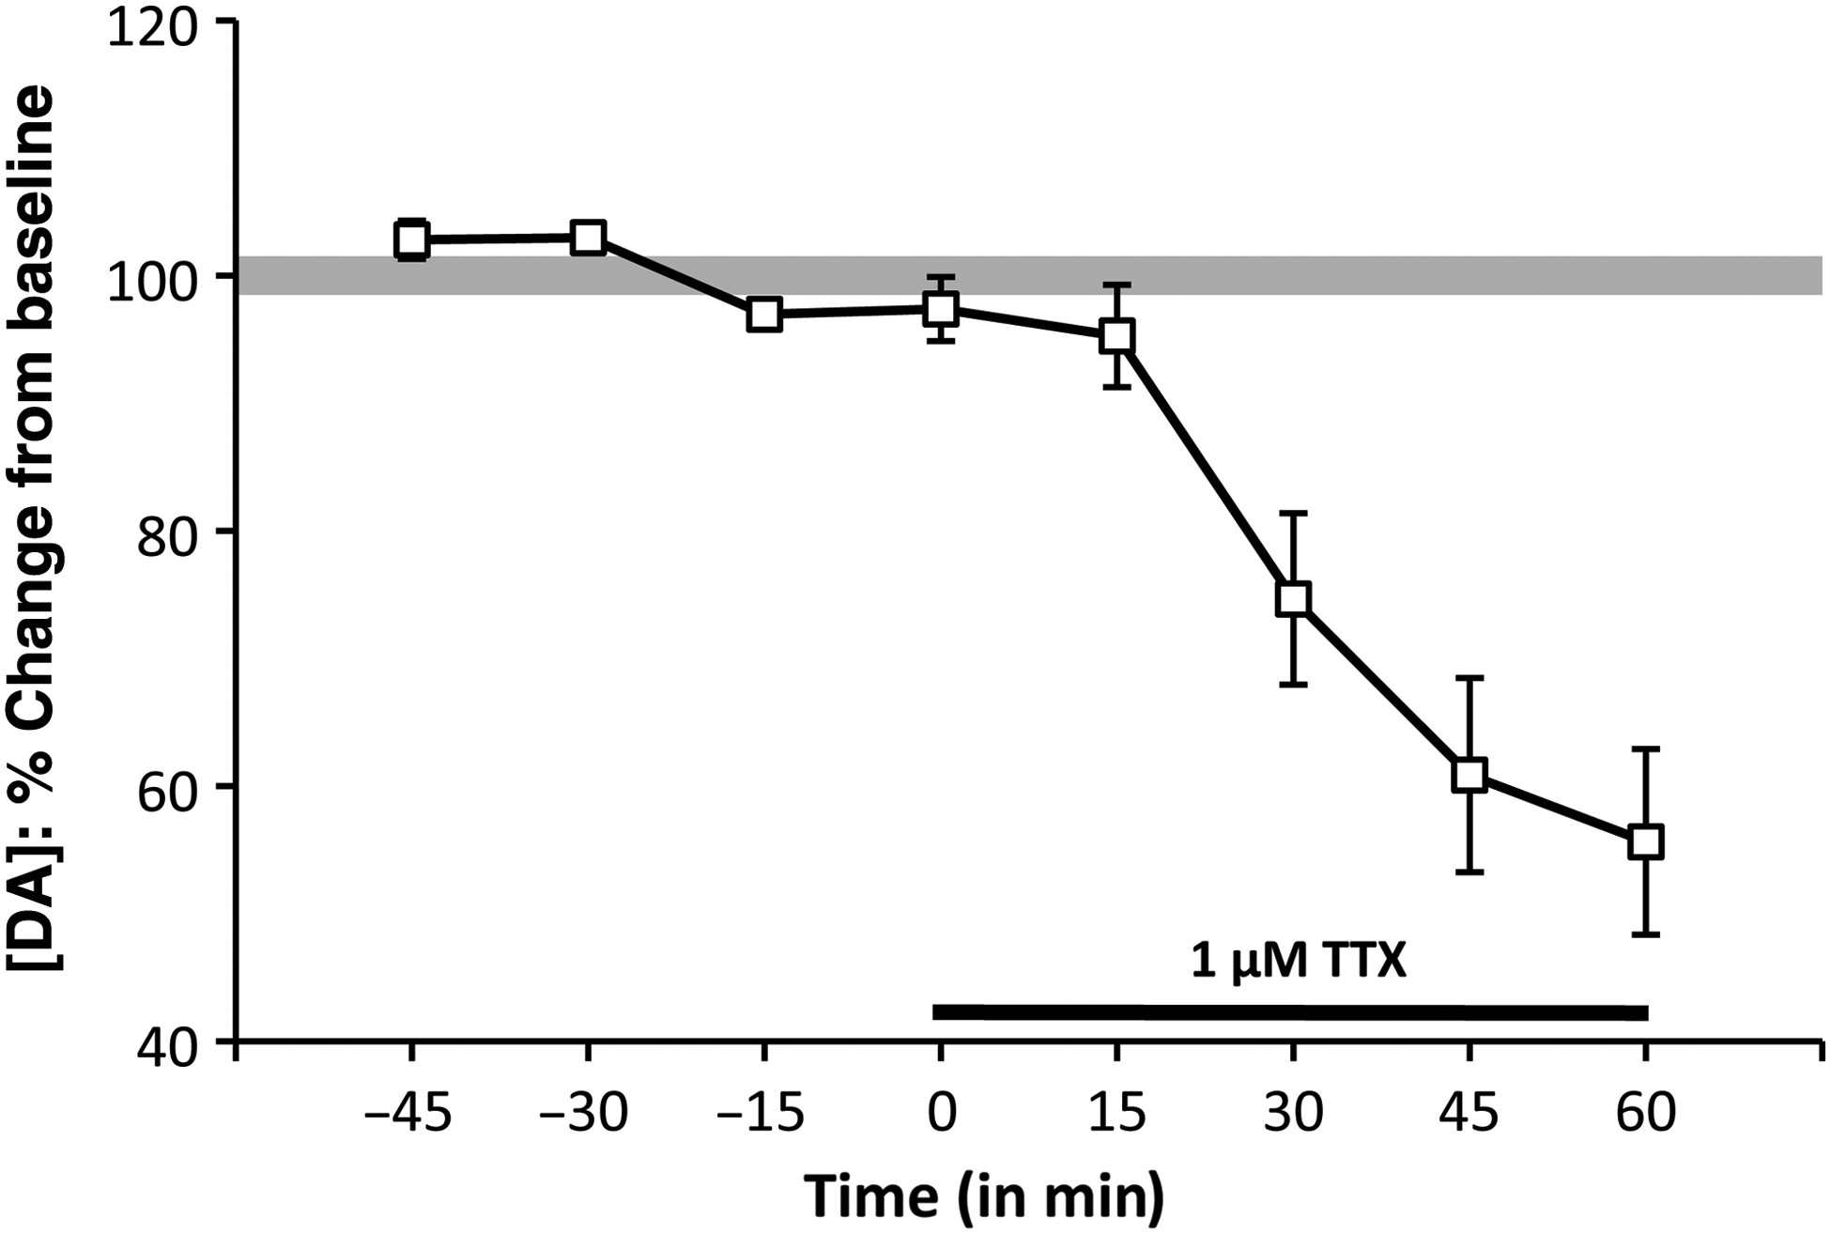
Figure 1. Timeline/line graph showing the effects of reverse dialysis application of 1 μM TTX on extracellular ...
Notes:
Figure 1. Timeline/line graph showing the effects of reverse dialysis application of 1 μM TTX on extracellular prefrontal DA levels, expressed as mean percent changes from baseline (±standard error of the mean) in male rats. The solid black line beneath the line graph marks the drug-infusion period. Following 15 min of drug application, PFC DA levels began to decrease and continued to do so for the 60-min TTX application period.
Unless provided in the caption above, the following copyright applies to the content of this slide: © The Author 2014. Published by Oxford University Press. All rights reserved. For Permissions, please e-mail: journals.permissions@oup.com

Slide 2
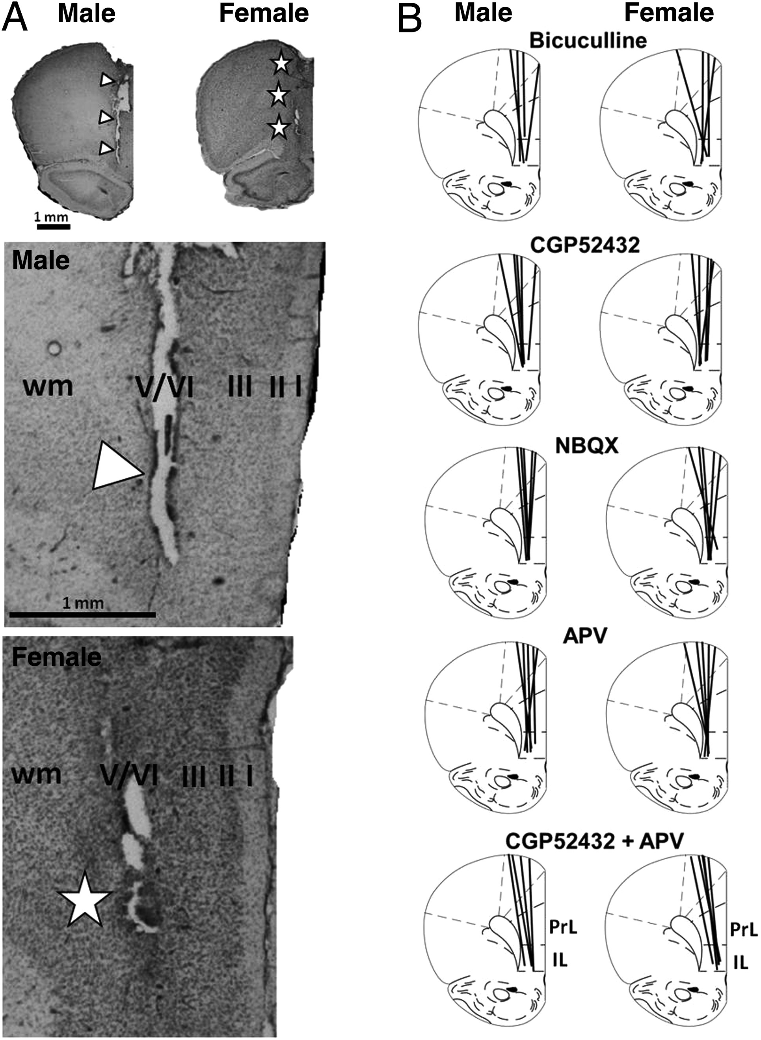
Figure 2. Representative photomicrographs (left panels, A) and line drawings (right panels, B) showing the locations of ...
Notes:
Figure 2. Representative photomicrographs (left panels, A) and line drawings (right panels, B) showing the locations of microdialysis probe tracks in relation to cytoarchitectonic areas of the prefrontal cortex in male and female rats. The tissue sections shown (A) are counterstained with cresyl violet. Visible damage from the probe tracks is identified by white triangles (male) and white stars (female). Higher power photomicrographs of these probe tracks show their relation to cortical layers (I–VI) and white matter (wm). Line drawings (B) and their cytoarchitectonic boundaries are as per plate 8 of the Paxinos and Watson rat atlas; the locations of microdialysis probe tracks are depicted as black lines. The antagonist drug study is identified above line drawing pairs. Scale bar = 1 mm. IL, infralimbic cortex; PrL, prelimbic cortex; wm, white matter
Unless provided in the caption above, the following copyright applies to the content of this slide: © The Author 2014. Published by Oxford University Press. All rights reserved. For Permissions, please e-mail: journals.permissions@oup.com

Slide 3
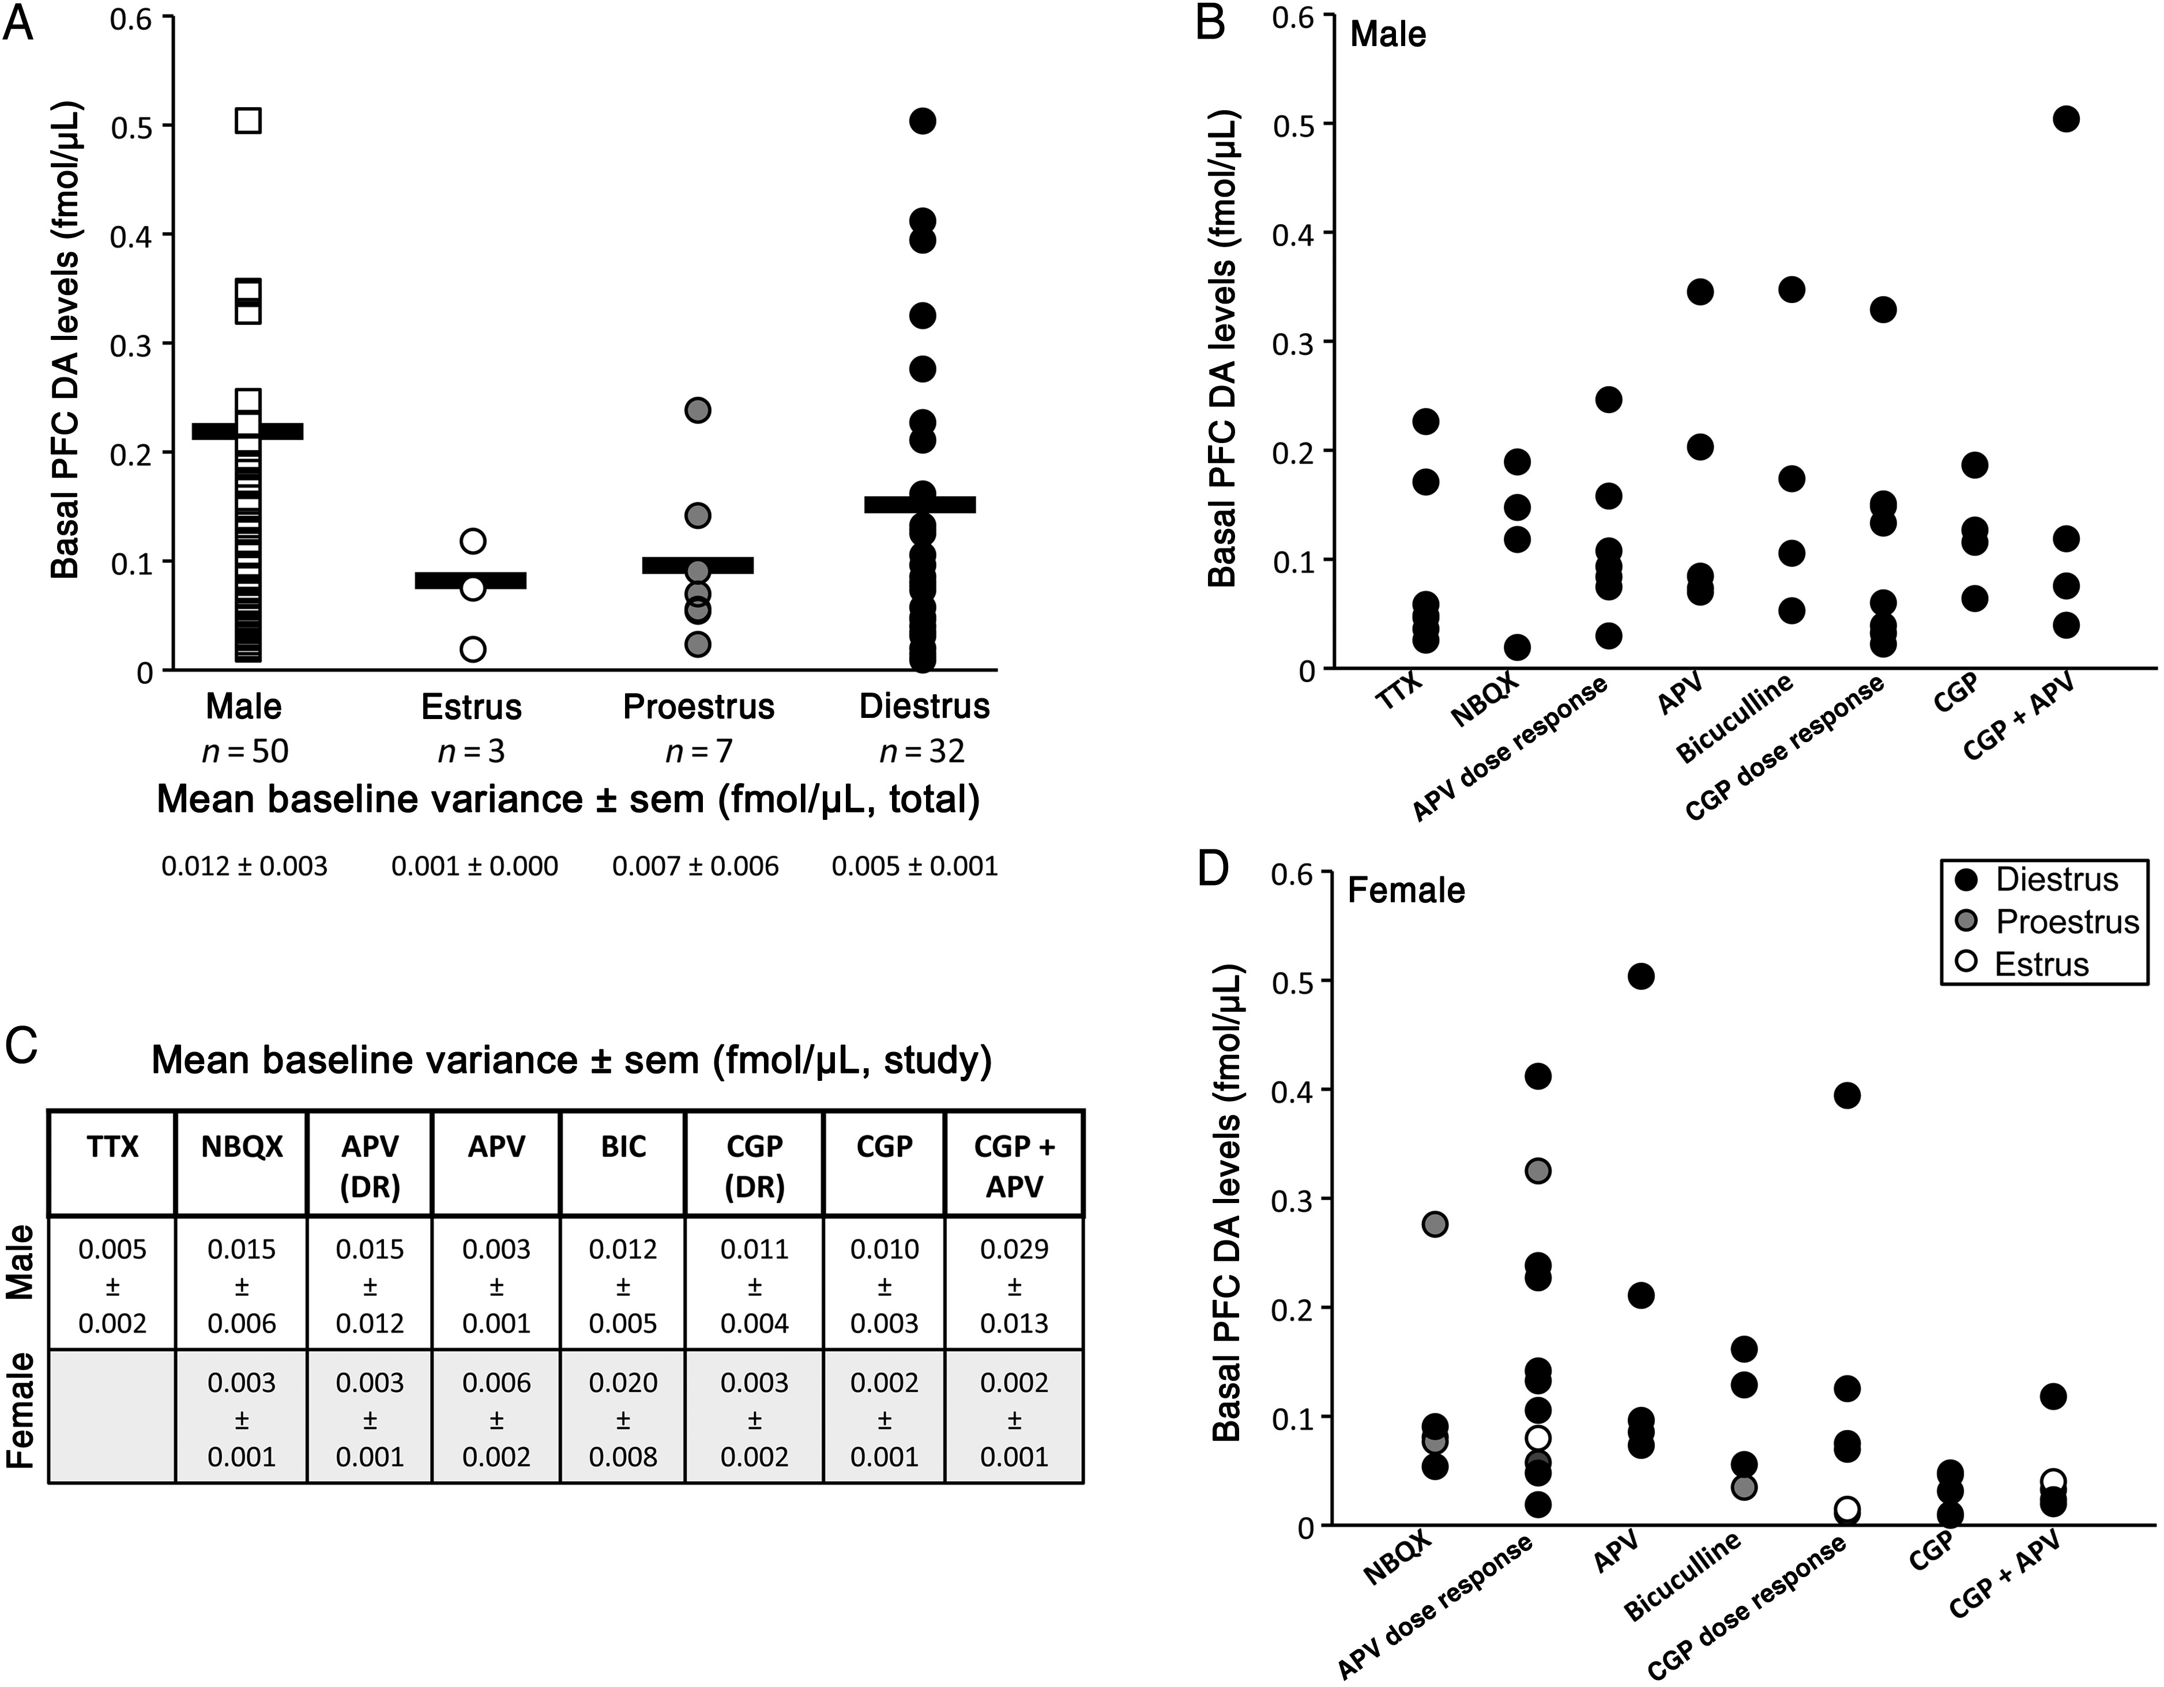
Figure 3. Scatter plots showing mean basal dopamine level concentrations (fmol/μL) measured from all individual ...
Notes:
Figure 3. Scatter plots showing mean basal dopamine level concentrations (fmol/μL) measured from all individual subjects included in this study (A). Data from males are shown in white squares; data from females are shown in circles and separated by estrous cycle stage—estrus (open circles), proestrus (grey circles), and diestrus (black circles, A). Group means are depicted by horizontal black bars (A). No significant differences were found in basal dopamine levels among any of these groups in comparisons in which males were compared with a single combined pool of all female subjects. Scatter plots showing mean basal dopamine level concentrations (fmol/µL) in individual male (B) and female (D) subjects separated by the drug study. Mean baseline variance, that is, the average difference between actual baseline measurements and mean basal dopamine level (±SEM, fmol/μL) for each animal, are also shown for total numbers of animal subjects (A) and separated by the drug study (C).
Unless provided in the caption above, the following copyright applies to the content of this slide: © The Author 2014. Published by Oxford University Press. All rights reserved. For Permissions, please e-mail: journals.permissions@oup.com

Slide 4
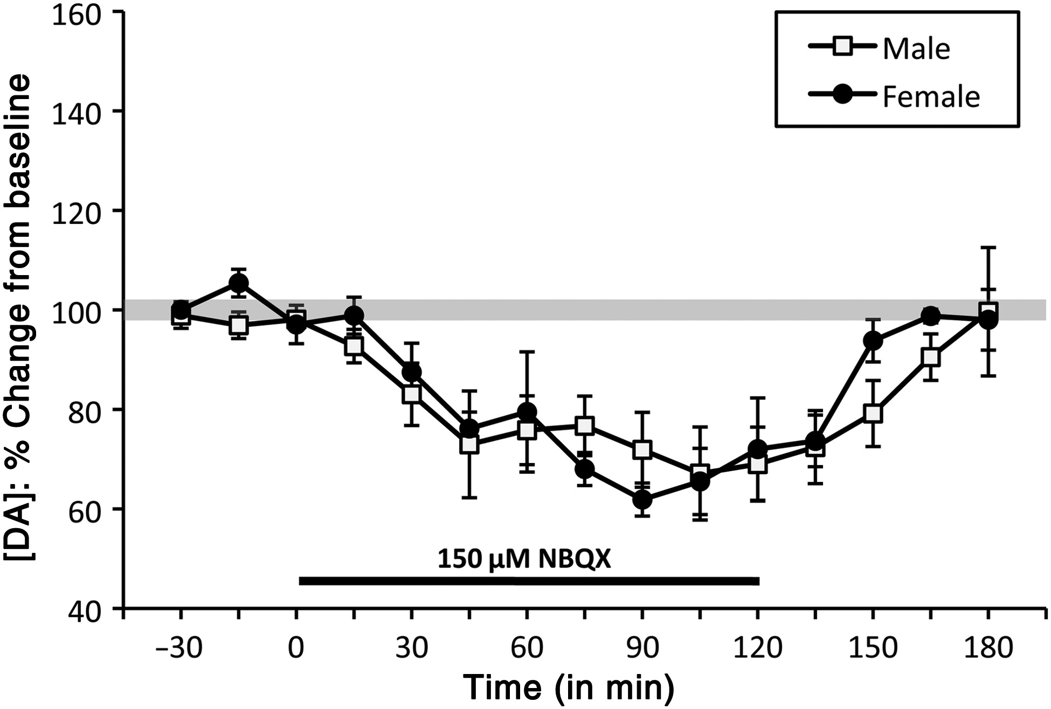
Figure 4. Timeline/line graphs showing the effects of reverse dialysis application of NBQX on extracellular prefrontal ...
Notes:
Figure 4. Timeline/line graphs showing the effects of reverse dialysis application of NBQX on extracellular prefrontal DA levels expressed as mean percent change from baseline (±standard error of the mean) in male (white squares) and female (black circles) rats. The solid black line beneath the line graphs marks the drug infusion period. In both sexes, NBQX application decreased in prefrontal DA levels within 30 min.
Unless provided in the caption above, the following copyright applies to the content of this slide: © The Author 2014. Published by Oxford University Press. All rights reserved. For Permissions, please e-mail: journals.permissions@oup.com

Slide 5
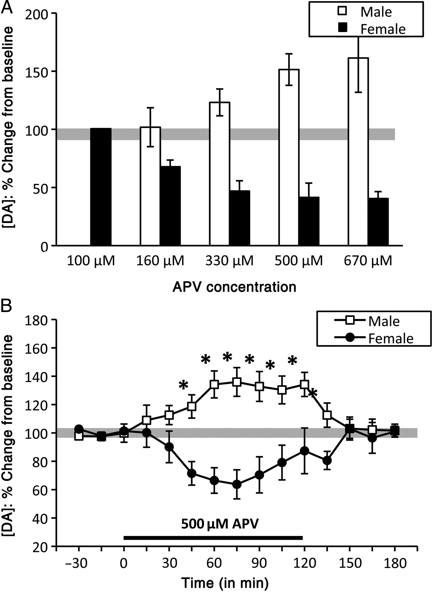
Figure 5. Bar graphs (A) showing opposite, dose-dependent effects of APV on extracellular prefrontal DA in male (white ...
Notes:
Figure 5. Bar graphs (A) showing opposite, dose-dependent effects of APV on extracellular prefrontal DA in male (white bars) and female (black bars) rats across a range of drug concentrations. APV at 100 and 160 μM had no effects on prefrontal DA levels in females (black bars) or males (grey bars), respectively. At higher doses, APV progressively increased prefrontal DA levels in males, and decreased prefrontal DA levels in females. In both sexes, maximum drug effects on extracellular DA levels were achieved at 500 μM APV. (B) Timeline/line graphs showing the effects of 500 μM APV on extracellular prefrontal DA levels, expressed as mean percent change from baseline (±standard error of the mean) in male (white squares) and female (black circles) rats. The solid black line beneath the line graphs in B marks the drug-infusion period. Infusion of 500 μM APV rapidly increased DA levels in males, but decreased DA levels in females. Asterisks identify the time points where DA levels in males and females were significantly different from each other (P < 0.05).
Unless provided in the caption above, the following copyright applies to the content of this slide: © The Author 2014. Published by Oxford University Press. All rights reserved. For Permissions, please e-mail: journals.permissions@oup.com

Slide 6
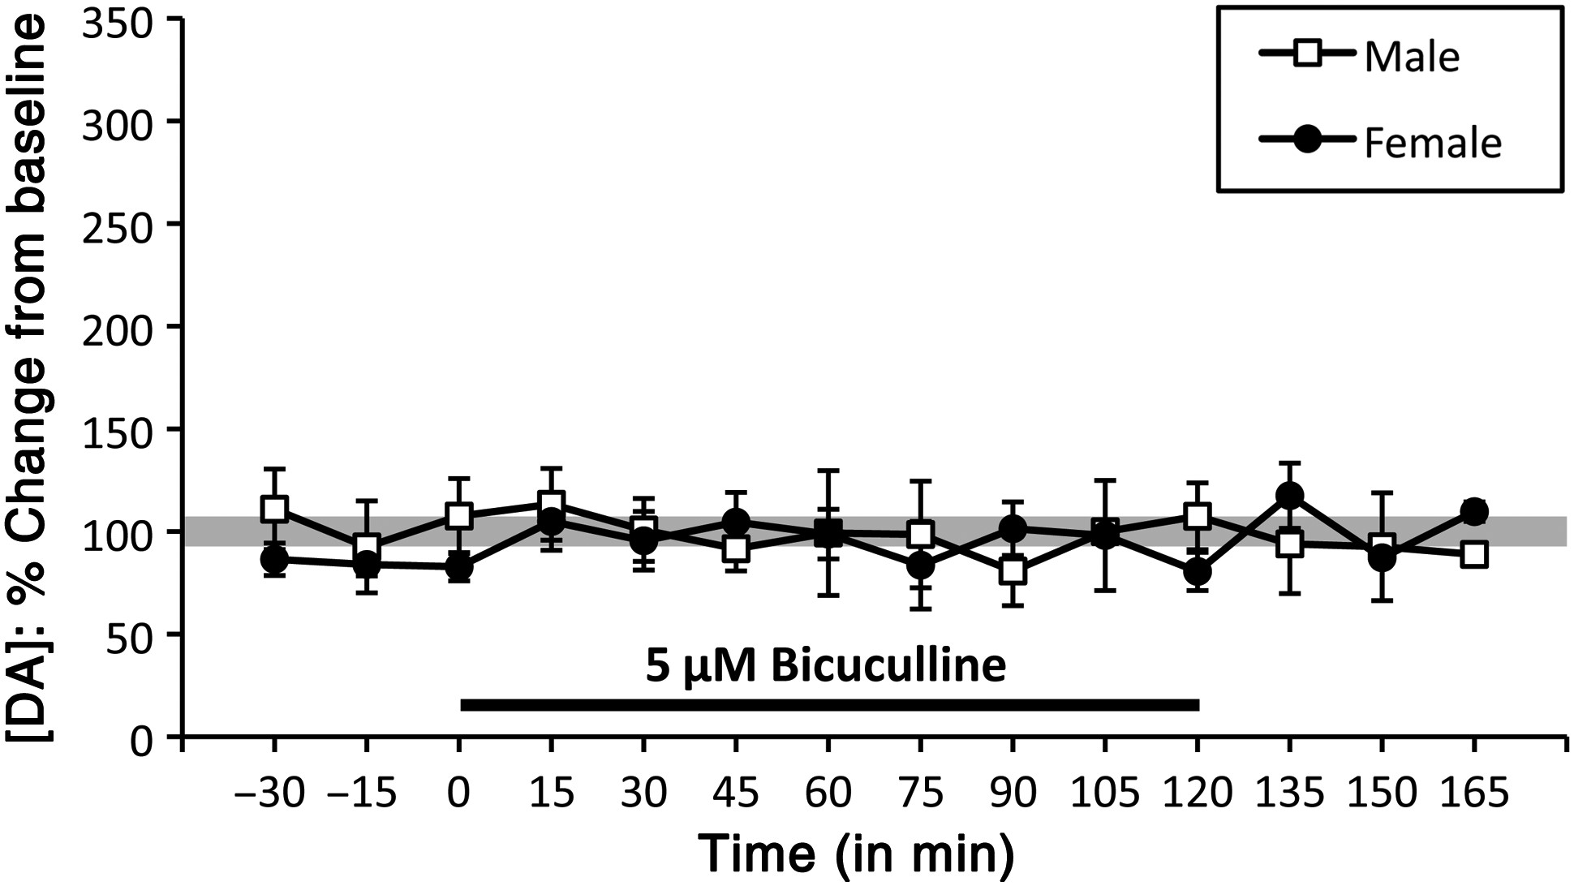
Figure 6. Timeline/line graphs showing the effects of reverse dialysis application of 5 μM bicuculline on extracellular ...
Notes:
Figure 6. Timeline/line graphs showing the effects of reverse dialysis application of 5 μM bicuculline on extracellular prefrontal DA levels, expressed as mean percent changes from baseline (±standard error of the mean) in male (white squares) and female (black circles) rats. The solid black line beneath the line graphs marks the drug-infusion period. Bicuculline did not have any significant effects on DA concentration in either males or females at the 5-μM concentration, the highest concentration to be administered without inducing seizure activity in any animal subjects.
Unless provided in the caption above, the following copyright applies to the content of this slide: © The Author 2014. Published by Oxford University Press. All rights reserved. For Permissions, please e-mail: journals.permissions@oup.com

Slide 7
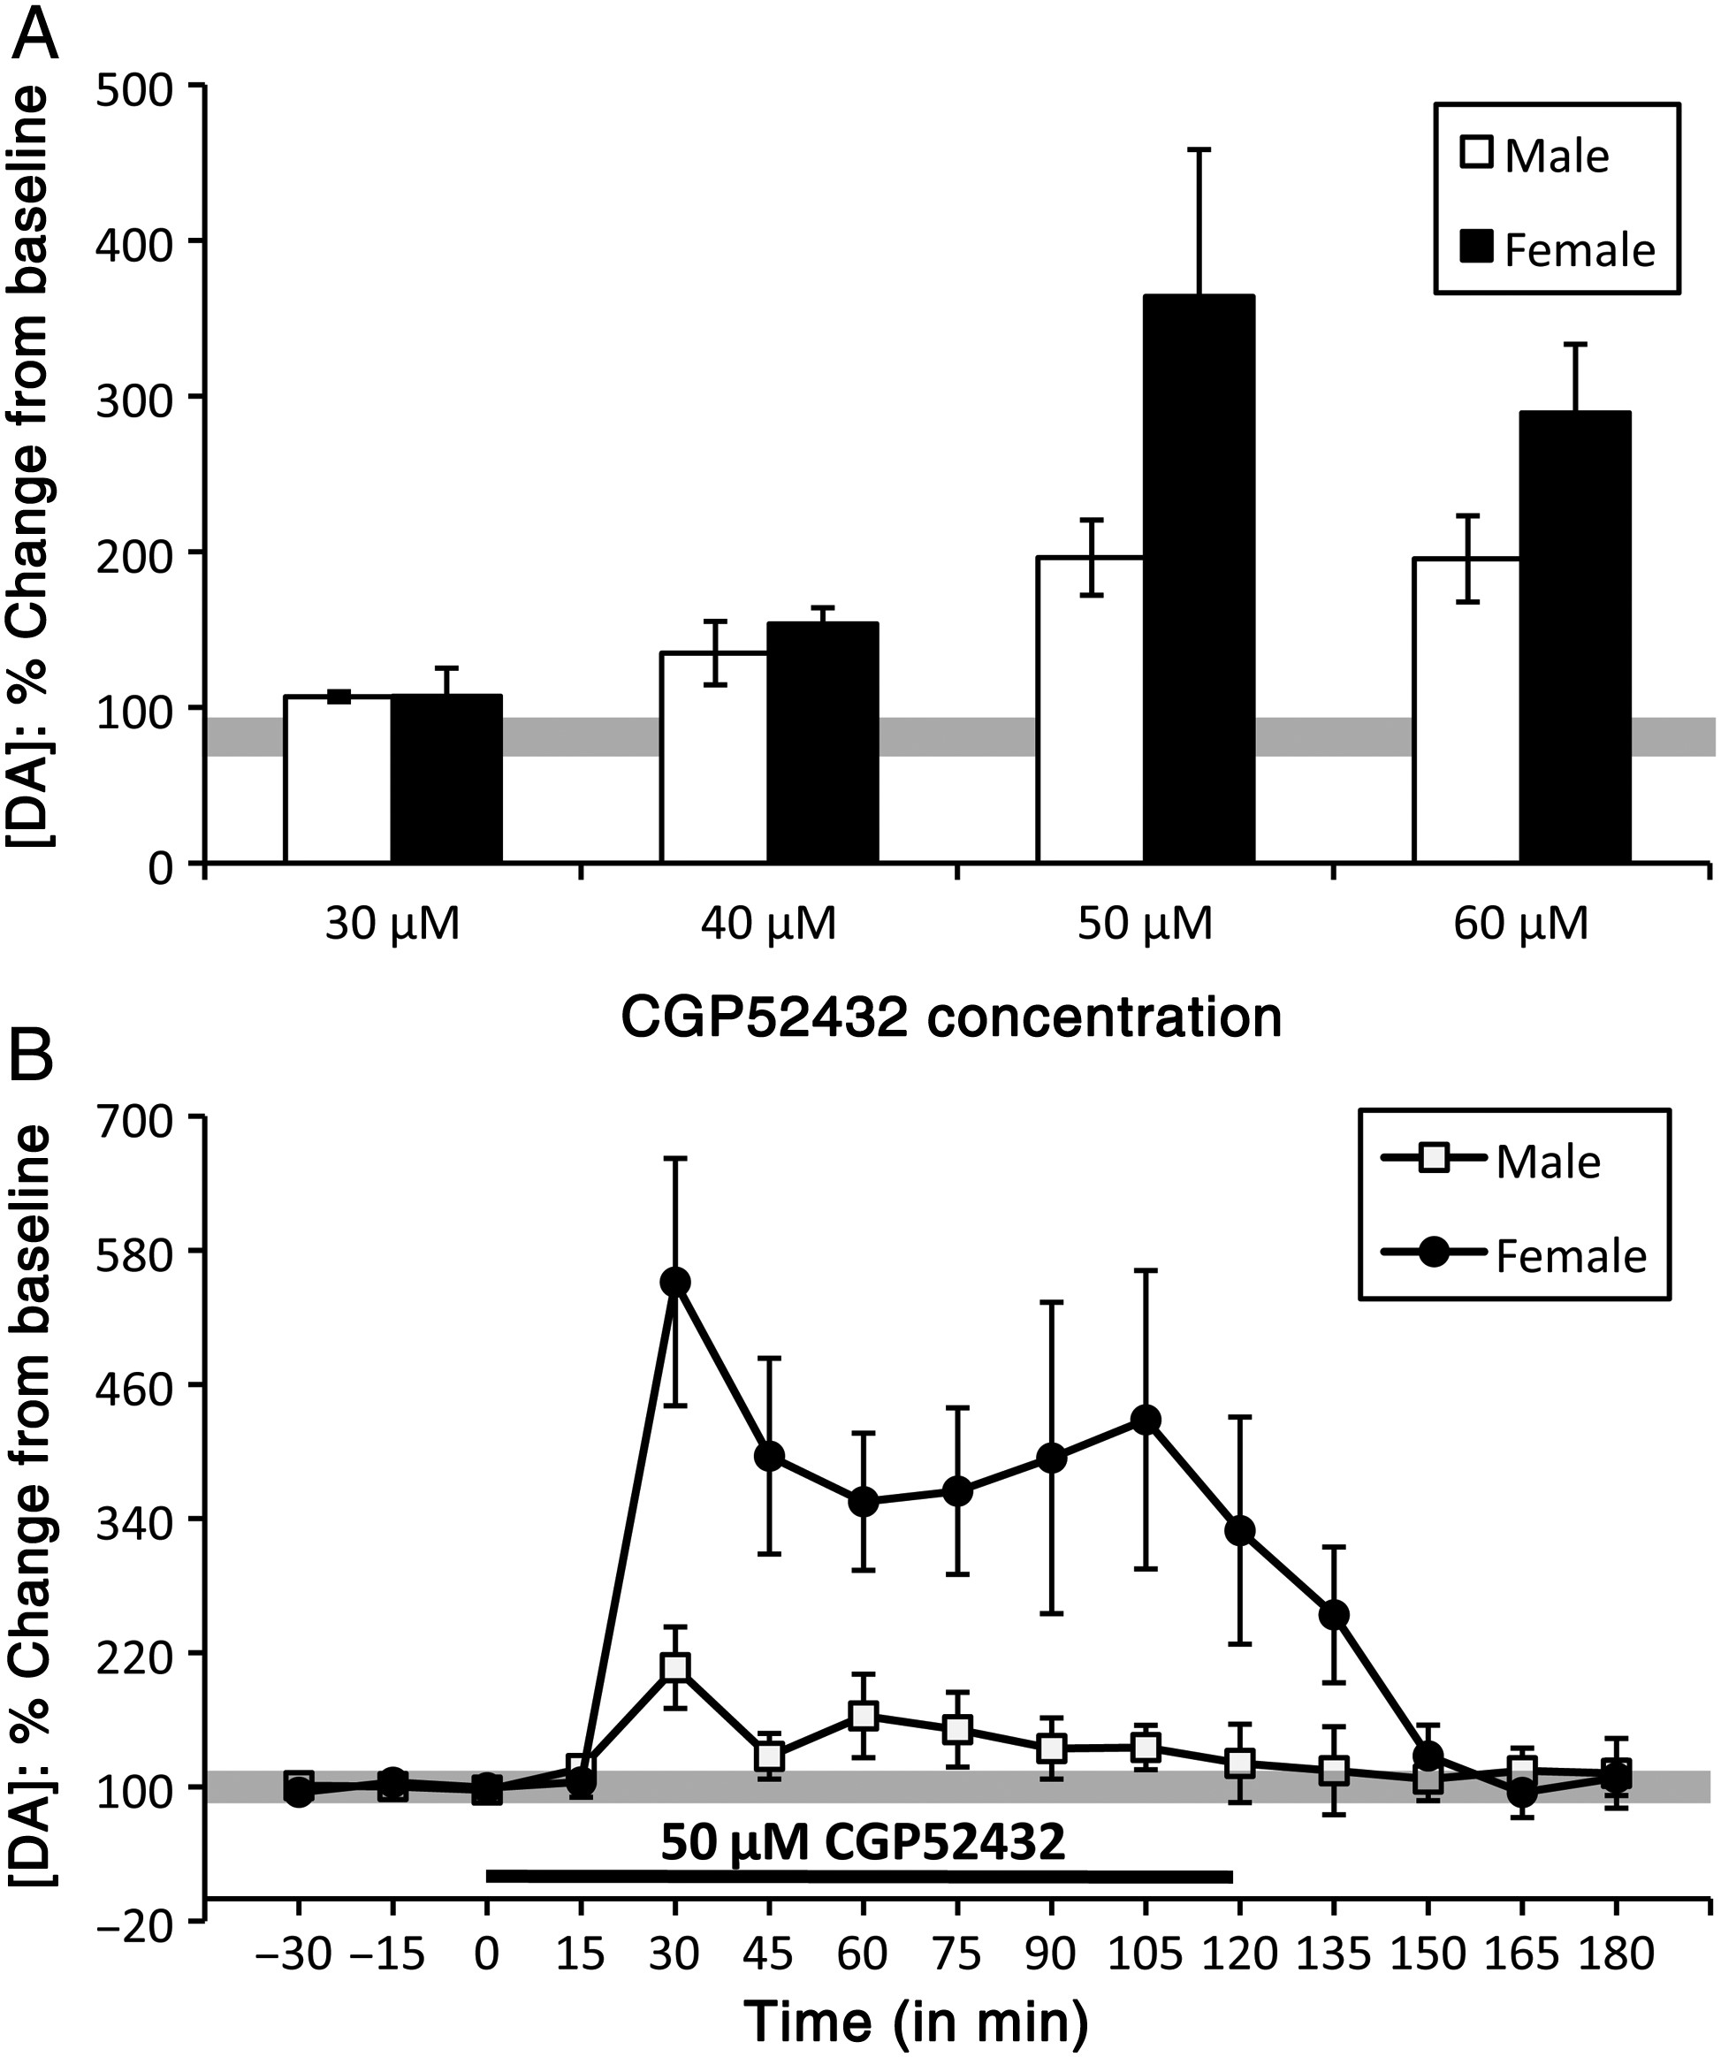
Figure 7. Bar graphs (A) showing the maximum effects of CGP52432 on extracellular prefrontal DA at different drug ...
Notes:
Figure 7. Bar graphs (A) showing the maximum effects of CGP52432 on extracellular prefrontal DA at different drug concentrations. Timeline/line graphs (B) showing the effects of reverse dialysis application effects of CGP52432 on extracellular prefrontal DA levels, expressed as mean percent change from baseline (±standard error of the mean) in male (white) and female (black) rats. The solid black line beneath the line graphs in B marks the drug-infusion period. (A) In both sexes, the lowest concentration of CGP52432 (30 μM) had no effect on extracellular DA levels and maximal, seizure-free effects were reached at the 50-μM concentration. (B) Within 30 min of application, CGP52432 (50 μM) increased in prefrontal DA levels in males (white squares) and more so in females (black circles).
Unless provided in the caption above, the following copyright applies to the content of this slide: © The Author 2014. Published by Oxford University Press. All rights reserved. For Permissions, please e-mail: journals.permissions@oup.com

Slide 8
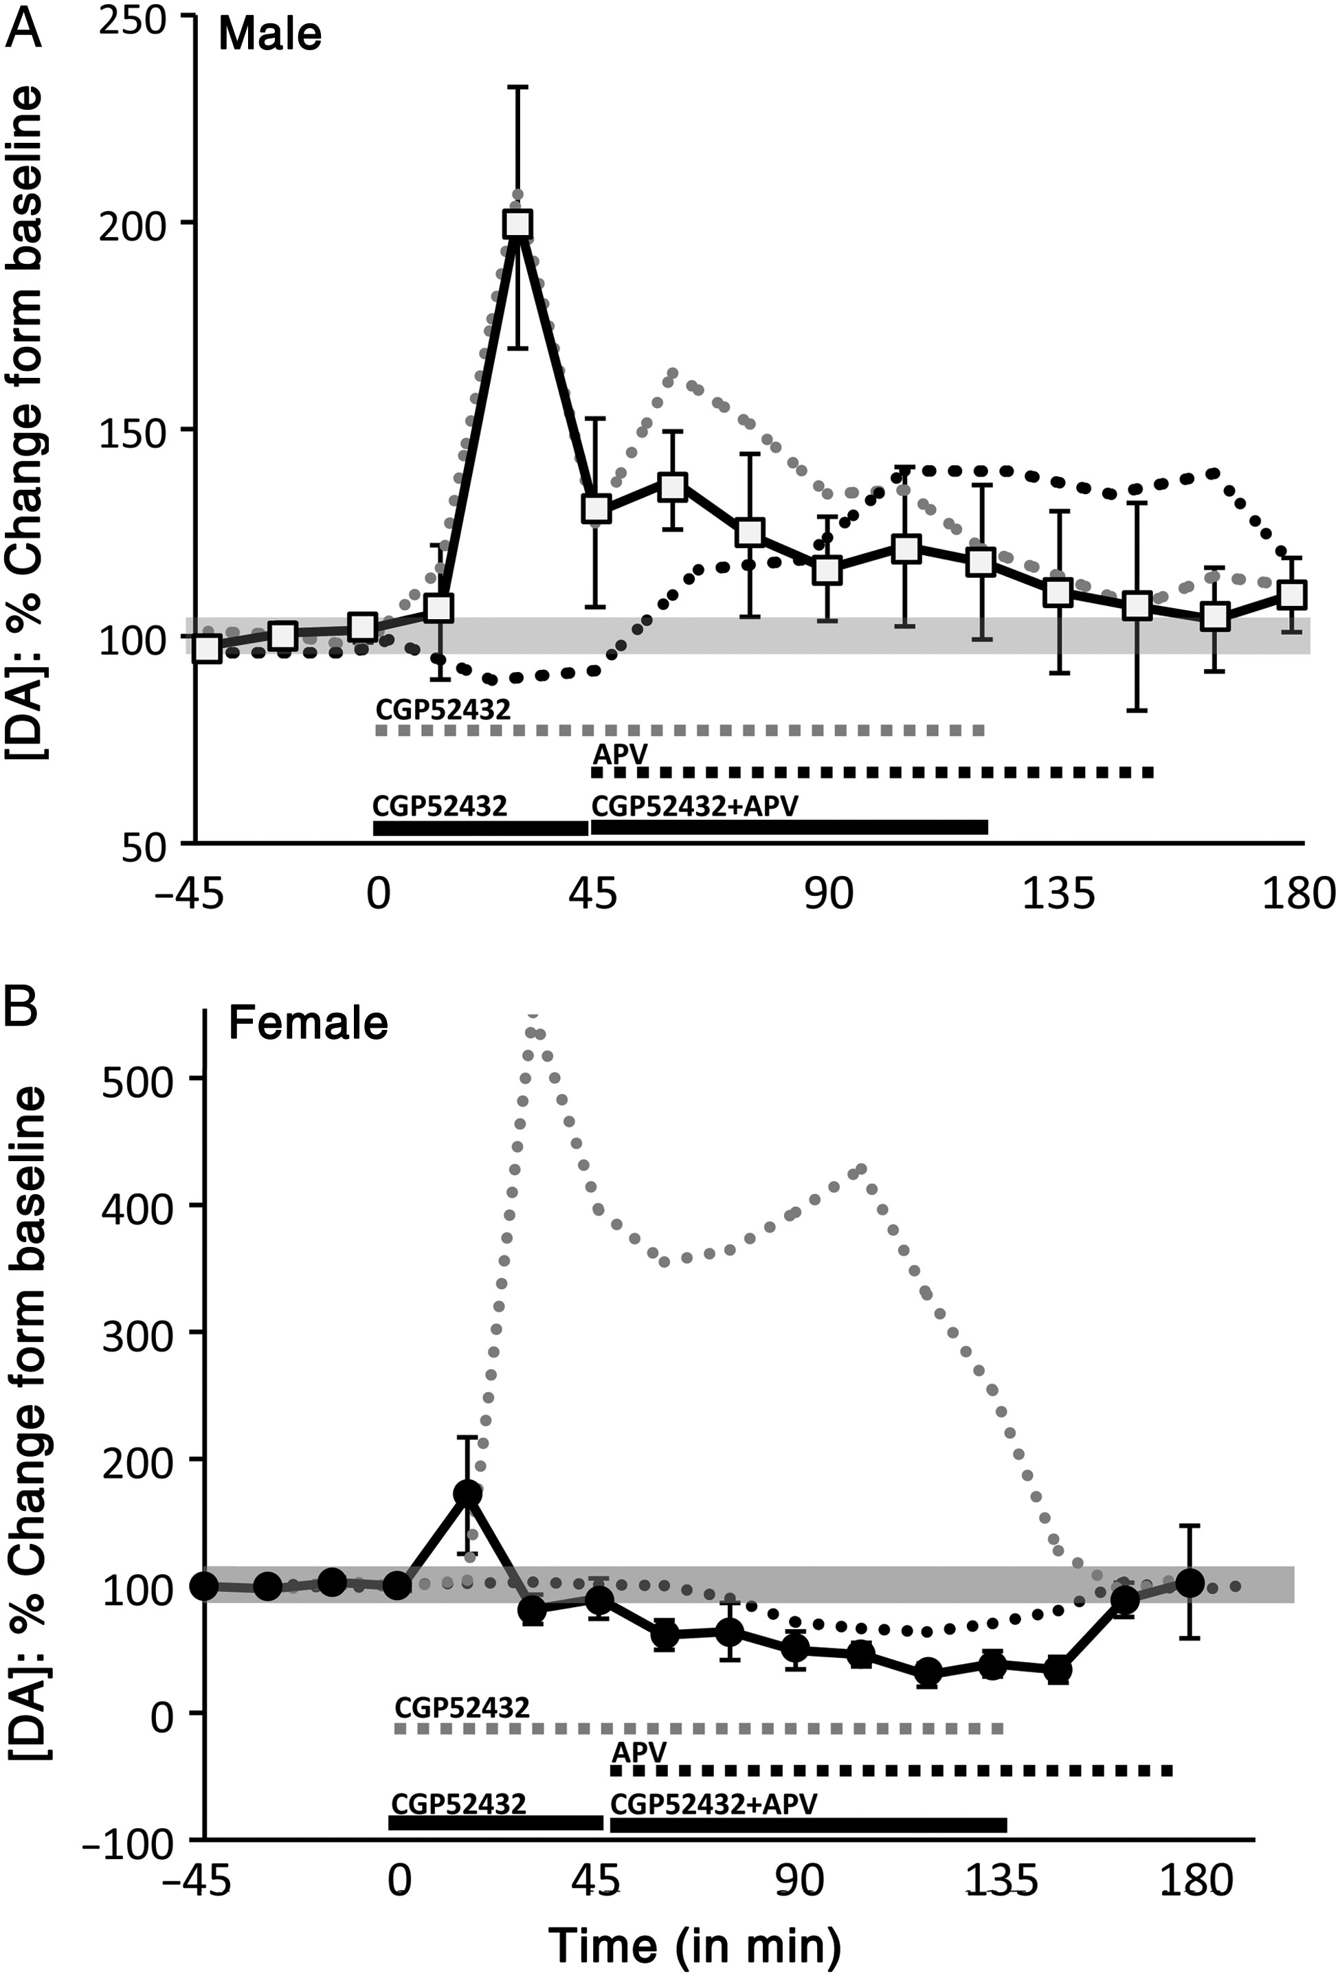
Figure 8. Timelines/line graphs showing the effects of reverse dialysis infusion of CGP52432 followed by co-infusion of ...
Notes:
Figure 8. Timelines/line graphs showing the effects of reverse dialysis infusion of CGP52432 followed by co-infusion of CGP52432 and APV (black line) on extracellular prefrontal DA levels, expressed as mean percent change from baseline (±standard error of the mean) in (A) male (white square) and (B) female (black circle) rats. For reference, the effects of infusion of CGP52432 (gray dashed line) and APV (black dashed line) alone are also graphed. (A) In males, initial infusion of CGP52432 alone increased extracellular DA levels as expected (gray dashed line), while the subsequent addition of APV to the infusate failed to increase DA levels as would be expected from APV infusion alone (medium gray dashed line). Rather, DA levels continued to decline as in conditions of CGP52432 infusion alone (gray dashed line). (B) In females, initial infusion of CGP52432 alone also produced expected increases in extracellular DA levels (light gray dashed line). However, the subsequent addition of APV to the infusate decreased DA to depressed levels that were similar to those evoked by APV alone (black dashed line), and that were markedly different from the elevated PFC DA levels associated with CGP52432 infusion (light gray dashed lines).
Unless provided in the caption above, the following copyright applies to the content of this slide: © The Author 2014. Published by Oxford University Press. All rights reserved. For Permissions, please e-mail: journals.permissions@oup.com

