Slide 1
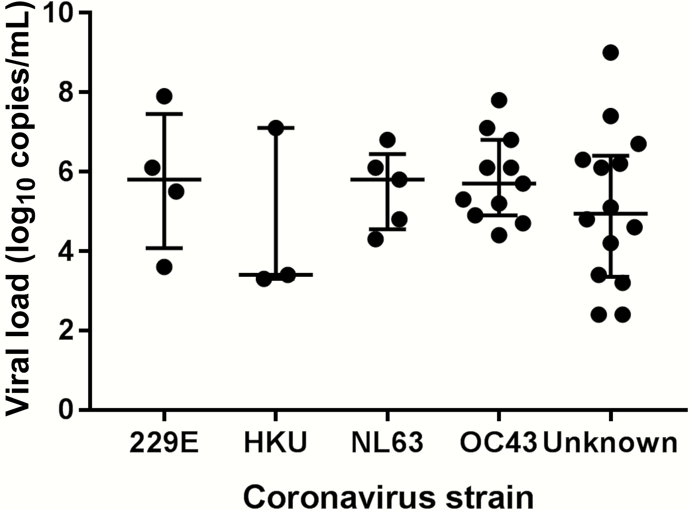
Figure 2. Viral load of human coronavirus in bronchoalveolar lavage samples. The bars indicate median values and first ...
Notes:
Figure 2. Viral load of human coronavirus in bronchoalveolar lavage samples. The bars indicate median values and first and third quartiles.
Unless provided in the caption above, the following copyright applies to the content of this slide: © The Author 2017. Published by Oxford University Press for the Infectious Diseases Society of America. All rights reserved. For permissions, e-mail: journals.permissions@oup.com.

Slide 2
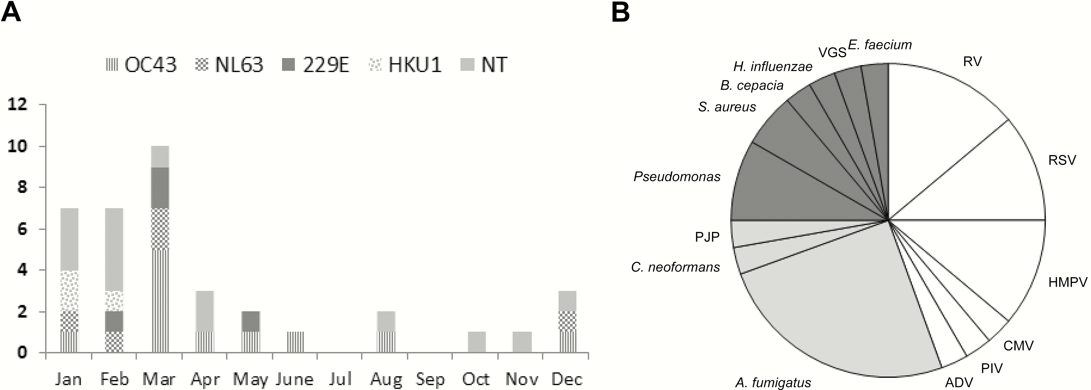
Figure 1. A, Human coronavirus strain. Seasonal distribution of human coronavirus lower respiratory tract disease ...
Notes:
Figure 1. A, Human coronavirus strain. Seasonal distribution of human coronavirus lower respiratory tract disease (LRTD). B, Respiratory copathogens in human coronavirus LRTD. Each color indicates category of copathogen as follows: white (viruses), gray (fungi), and dark gray (bacteria). Respiratory viral copathogens were detected in 12 patients, fungal copathogens were detected in 10 patients, and bacterial copathogens were detected in 8 patients. The number of patients (n = 30) with other respiratory copathogens does not equal the sum of detections for each respiratory copathogen (n = 36) owing to codetections of multiple copathogens in some subjects.Abbreviations: ADV, adenovirus; A. fumigutus, Aspergillus fumigatus; B. cepacia, Burkholderia cepacia; CMV, cytomegalovirus; C. neoformans, Cryptococcus neoformans; E. faecium, Enterococcus faecium; H. influenzae, Haemophilus influenzae; HMPV, human metapnuemovirus; NT, nontypeable strain due to unavailable sample; P. aeruginosa, Pseudomonas aeruginosa; PIV, parainfluenza virus; PJP, Pneumocystis jirovecii; RSV, respiratory syncytial virus; RV, rhinovirus; S. aureus, Staphylococcus aureus; VGS, Viridans group streptococci.
Unless provided in the caption above, the following copyright applies to the content of this slide: © The Author 2017. Published by Oxford University Press for the Infectious Diseases Society of America. All rights reserved. For permissions, e-mail: journals.permissions@oup.com.

Slide 3
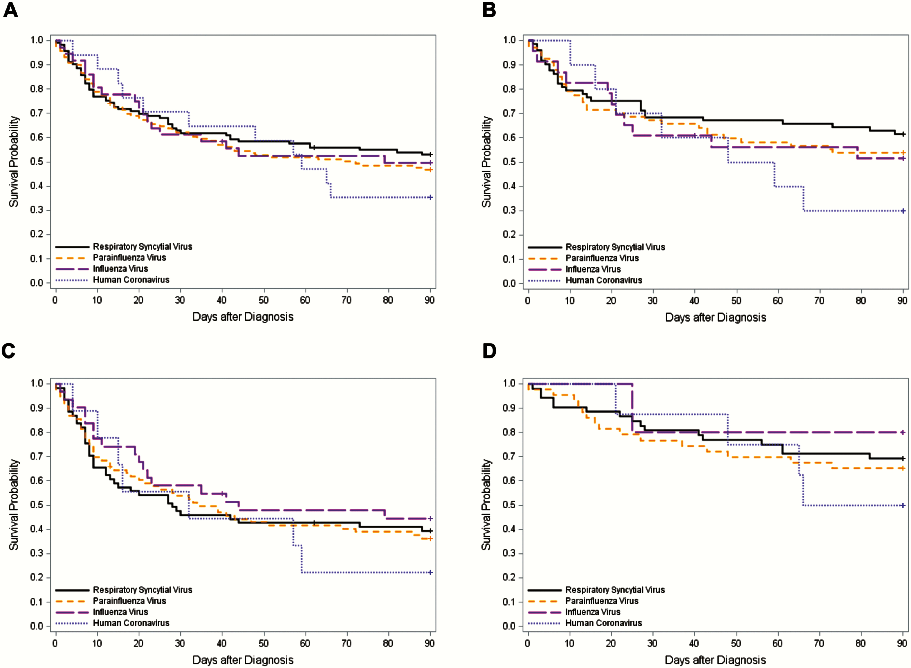
Figure 3. Kaplan-Meier overall survival curve by day 90 after diagnosis of lower respiratory tract disease without ...
Notes:
Figure 3. Kaplan-Meier overall survival curve by day 90 after diagnosis of lower respiratory tract disease without respiratory viral copathogens according to respiratory virus classification in hematopoietic cell transplant recipients. A, Kaplan-Meier overall survival curve in overall cohort (n = 286) (log-rank test, P = .78). B, Kaplan-Meier overall survival curve in patients without other copathogens (n = 173) (log-rank test, P = .47). C, Kaplan-Meier overall survival curve in patients with oxygen requirement at diagnosis (n = 178) (log-rank test, P = .78). D, Kaplan-Meier overall survival curve in patients without oxygen requirement at diagnosis (n = 108) (log-rank test, P = .78).
Unless provided in the caption above, the following copyright applies to the content of this slide: © The Author 2017. Published by Oxford University Press for the Infectious Diseases Society of America. All rights reserved. For permissions, e-mail: journals.permissions@oup.com.

