Slide 1
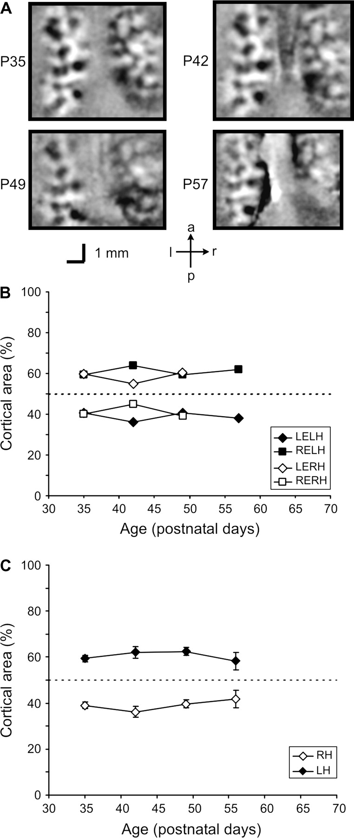
Figure 1. Ocular dominance distribution in normal control kittens. (A) OD maps obtained through the left eye of kitten ...
Notes:
Figure 1. Ocular dominance distribution in normal control kittens. (A) OD maps obtained through the left eye of kitten 842. The animal was first imaged on P35. Subsequent imaging sessions were carried out at P42, P49 and P57. Both cortical hemispheres are shown (image orientation, see arrows below). Each ocular dominance map represents a ratio map of left-eye (black) versus right-eye (white) responses. Scale bars, 1 mm. (B) Cortical areas dominated by the left eye (LE) and right eye (RE), respectively, in the left (LH) and right hemispheres (RH). Because of the reduced signal quality, the right hemisphere was not analysed quantitatively for P57. (C) The average area of V1 (in %) dominated by the right eye for a group of three normal control kittens that were repeatedly imaged at weekly intervals over a 3 week period. Open diamonds represent results for the right (ipsilateral) and filled diamonds results for the left (contralateral) hemisphere. Error bars represent SEM.
Unless provided in the caption above, the following copyright applies to the content of this slide: © The Author 2005. Published by Oxford University Press. All rights reserved. For permissions, please e-mail: journals.permissions@oupjournals.org

Slide 2
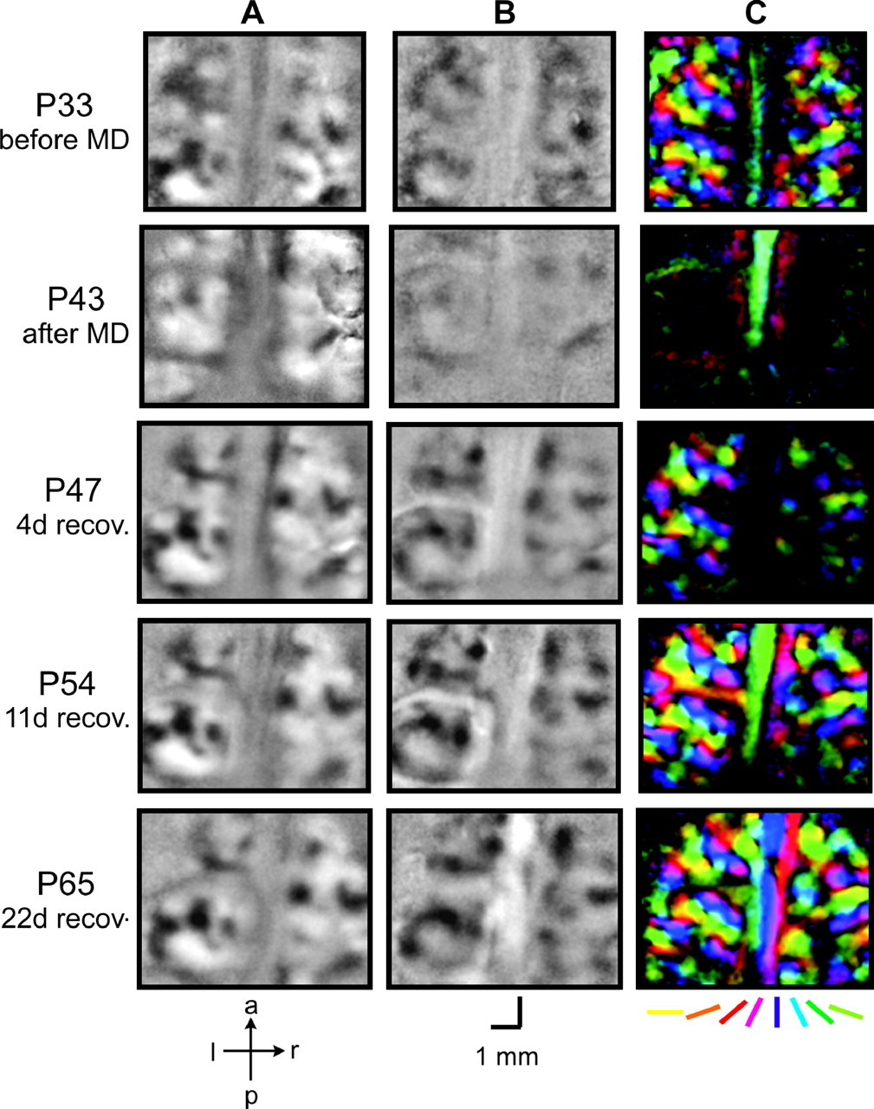
Figure 2. Ocular dominance maps (A), 0° iso-orientation maps (B) and overall orientation preference maps (C) obtained ...
Notes:
Figure 2. Ocular dominance maps (A), 0° iso-orientation maps (B) and overall orientation preference maps (C) obtained through the deprived (right) eye of MDR kitten 282. The animal was monocularly deprived in the right eye from P33 until P43. Subsequent imaging sessions were carried out at P47, P54 and P65. Both cortical hemispheres are shown (image orientation, see arrows below column A). Each ocular dominance map (A) represents a ratio map of right-eye (black) versus left-eye (white) responses. Each iso-orientation map (B) represents the response through the right eye to a horizontal grating, divided by the response to a blank screen of the same mean luminance. Each pseudo-colour orientation map (C) displays preferred orientation on a pixel-by-pixel basis, as indicated by the colour code below. Note that OD territory, single-orientation responses and orientation preference are all severely affected by MD (P33 versus P 43) but recover remarkably fast (P47, P54 and P65). The small artefact in the OD map seen on the right hemisphere on P43 was excluded from the quantitative analysis, as were the blood vessel artefacts seen on the left hemisphere on P47, P54 and P65. Scale bars, 1 mm.
Unless provided in the caption above, the following copyright applies to the content of this slide: © The Author 2005. Published by Oxford University Press. All rights reserved. For permissions, please e-mail: journals.permissions@oupjournals.org

Slide 3
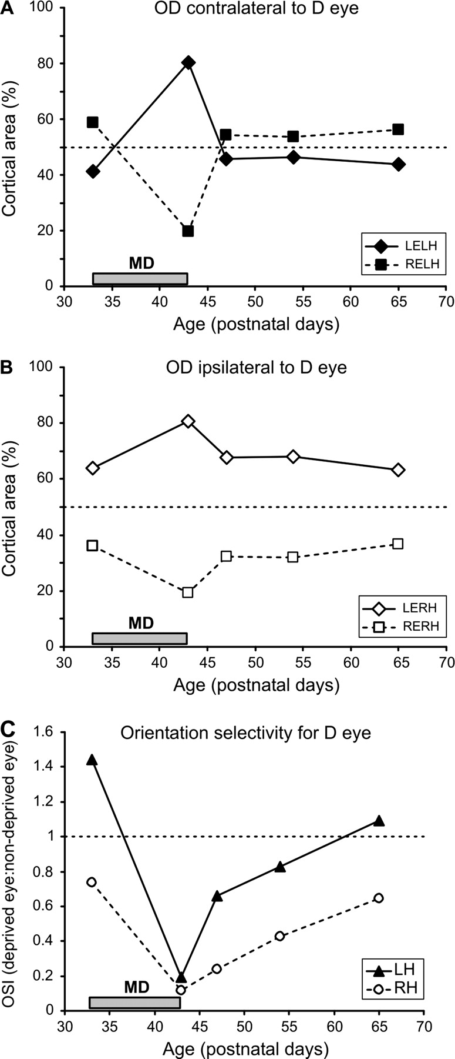
Figure 3. Cortical areas dominated by the two eyes in the left hemisphere, contralateral to the deprived eye (A) and in ...
Notes:
Figure 3. Cortical areas dominated by the two eyes in the left hemisphere, contralateral to the deprived eye (A) and in the right hemisphere, ipsilateral to the deprived eye (B), and relative orientation selectivity of responses through the right versus left eye (C), for kitten 282. This animal was deprived of vision in the right eye from P33 to P43 (grey bars near the abscissa). In (A) and (B), results for the right (deprived) eye (RE) are represented by squares linked with dashed lines, those for the left (non-deprived) eye (LE) by diamonds linked with solid lines (see insets). In (C), results for the left hemisphere (LH) are plotted as triangles linked with solid lines, those for the right hemisphere (RH) as circles linked with dashed lines.
Unless provided in the caption above, the following copyright applies to the content of this slide: © The Author 2005. Published by Oxford University Press. All rights reserved. For permissions, please e-mail: journals.permissions@oupjournals.org

Slide 4
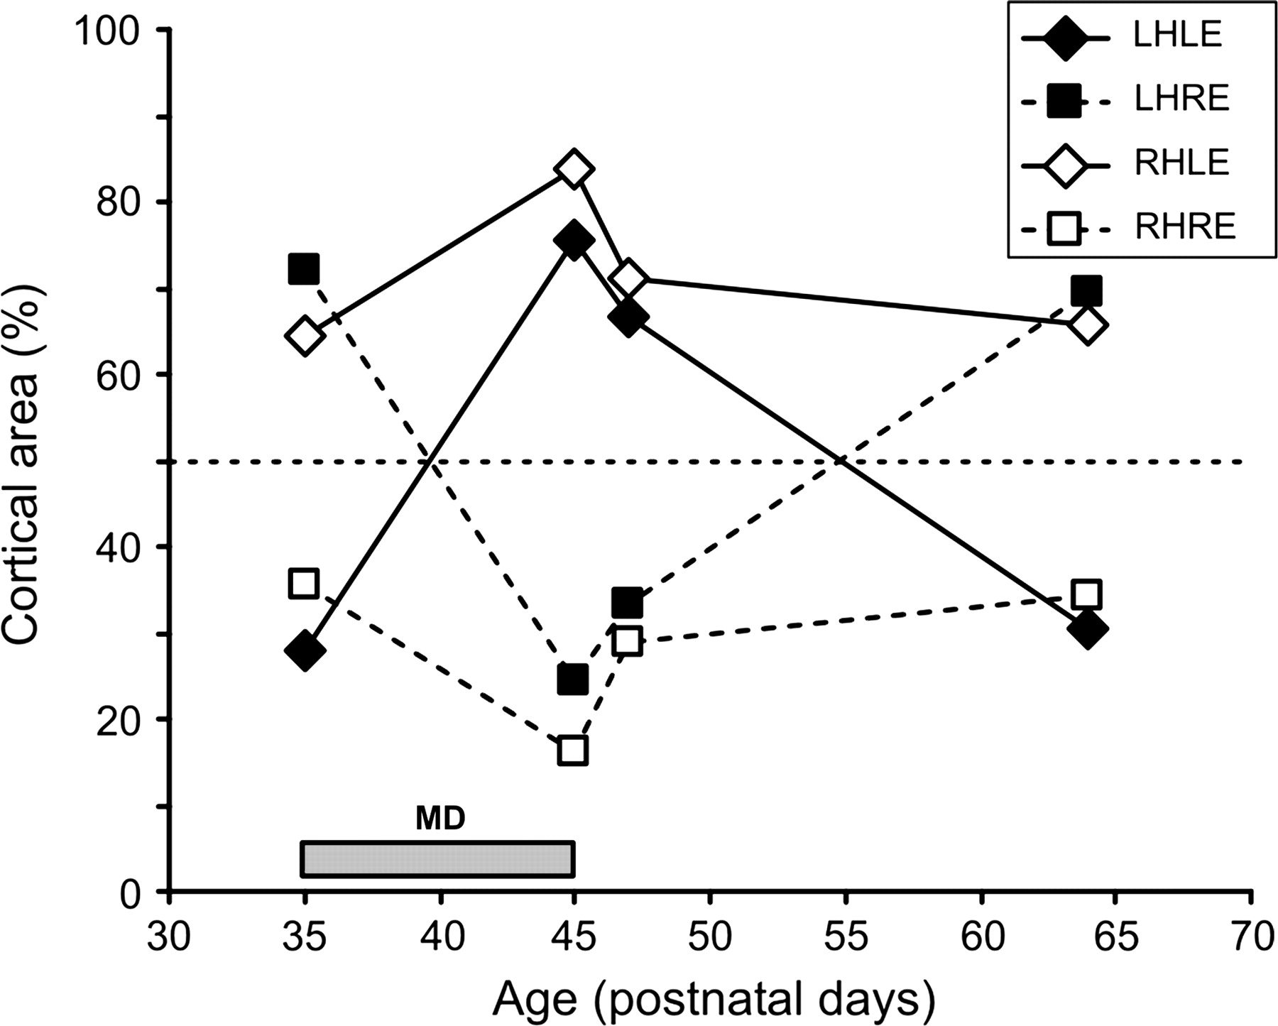
Figure 4. Cortical areas dominated by the left eye (diamonds linked with solid lines) and the right eye (squares linked ...
Notes:
Figure 4. Cortical areas dominated by the left eye (diamonds linked with solid lines) and the right eye (squares linked with dashed lines) in the left hemisphere (filled symbols) and in the right hemisphere (open symbols), for kitten 070. This animal was deprived of vision in the right eye from P35 to P45 (grey bar near the abscissa). It was then reassessed on P47, after just 2 days of recovery, and again at P64. Note that recovery of right-eye territory is incomplete at P47.
Unless provided in the caption above, the following copyright applies to the content of this slide: © The Author 2005. Published by Oxford University Press. All rights reserved. For permissions, please e-mail: journals.permissions@oupjournals.org

Slide 5
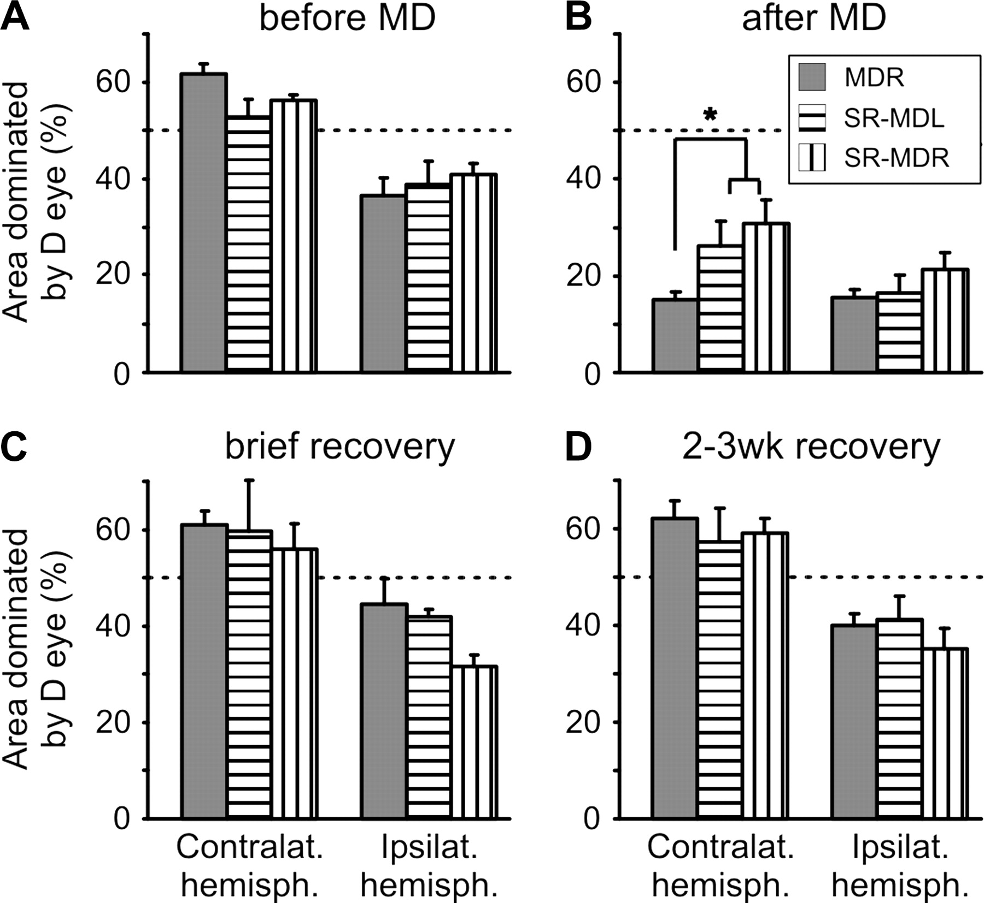
Figure 5. Average cortical area dominated by the deprived eye in each hemisphere, plotted for all three experimental ...
Notes:
Figure 5. Average cortical area dominated by the deprived eye in each hemisphere, plotted for all three experimental groups and time points. Results are shown for MD-only animals, kittens with strabismus and MD in opposite eyes and animals with strabismus and MD in the same eye (shading, see inset), immediately before MD (A), immediately after MD (B), after a brief recovery period of 3–4 days (C) and after 2–3 weeks of recovery (D). Error bars represent 1 SEM. The asterisk (*) denotes a significant difference between the MD-only group and the combined S-MD groups immediately after the MD period (B).
Unless provided in the caption above, the following copyright applies to the content of this slide: © The Author 2005. Published by Oxford University Press. All rights reserved. For permissions, please e-mail: journals.permissions@oupjournals.org

Slide 6
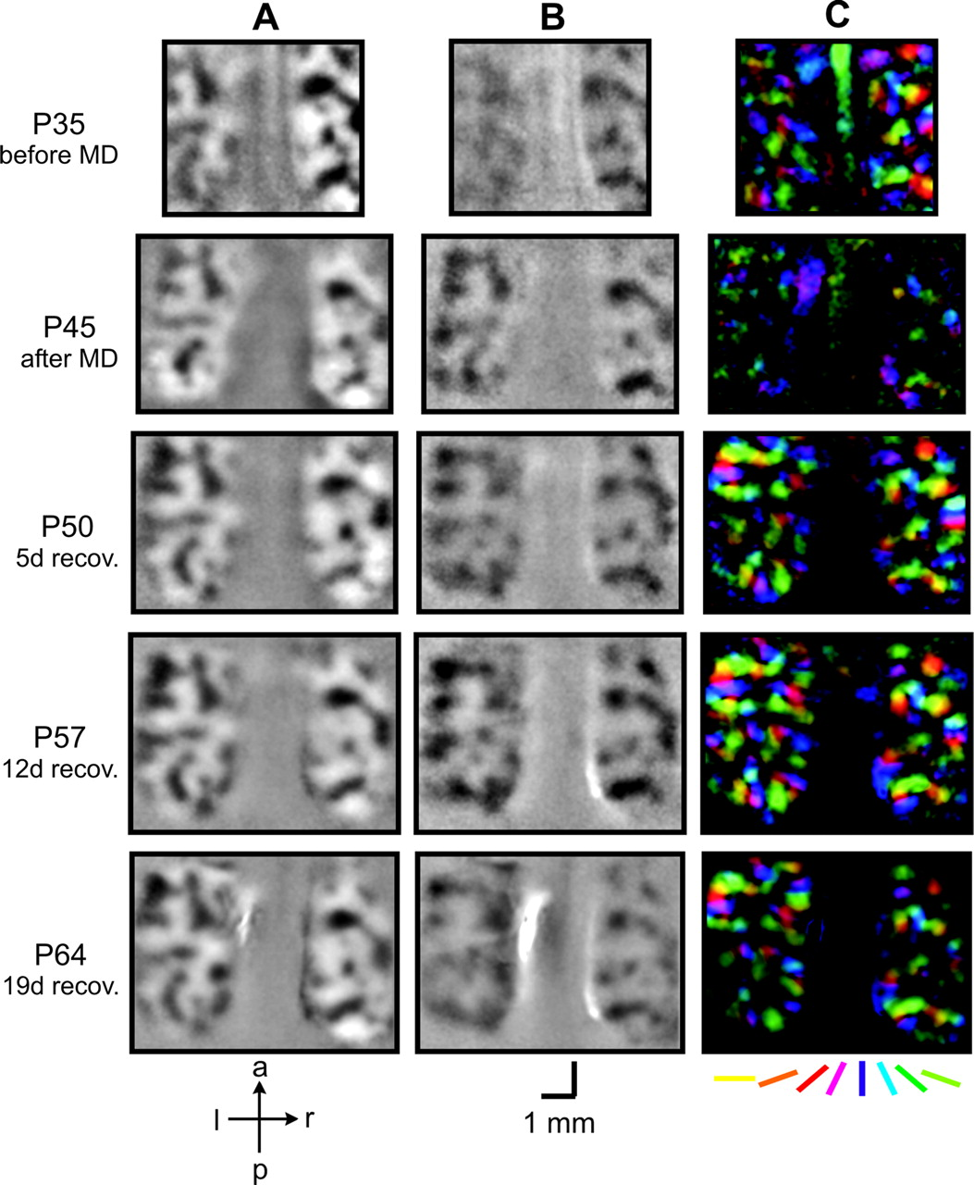
Figure 6. Ocular dominance maps (A), 0° iso-orientation maps (B) and overall orientation preference maps (C) obtained ...
Notes:
Figure 6. Ocular dominance maps (A), 0° iso-orientation maps (B) and overall orientation preference maps (C) obtained through the deprived (right) eye of SR-MDR kitten 065. In this animal, the right eye was made strabismic at P21. The kitten was then monocularly deprived in the same eye from P35 until P45. Subsequent imaging sessions were carried out at P50, P57 and P64. Both cortical hemispheres are shown (image orientation, see arrows below column A). Each ocular dominance map (A) represents a ratio map of right-eye (black) versus left-eye (white) responses. Each iso-orientation map (B) represents the response through the right eye to a horizontal grating, divided by the response to a blank screen of the same mean luminance. Each pseudo-colour orientation map (C) displays preferred orientation on a pixel-by-pixel basis, as indicated by the colour code below. Varying map sizes are the result of slight differences in regions of interest chosen at the different time points. Note that deprived-eye responses are preserved to an unusually large extent immediately after MD, especially in the left hemisphere, contralateral to the deprived eye, as seen in the OD map (A) and iso-orientation map (B). However, orientation selectivity is not preserved, as evidenced by the almost blank orientation preference map at P45 (C). Scale bars, 1 mm.
Unless provided in the caption above, the following copyright applies to the content of this slide: © The Author 2005. Published by Oxford University Press. All rights reserved. For permissions, please e-mail: journals.permissions@oupjournals.org

Slide 7
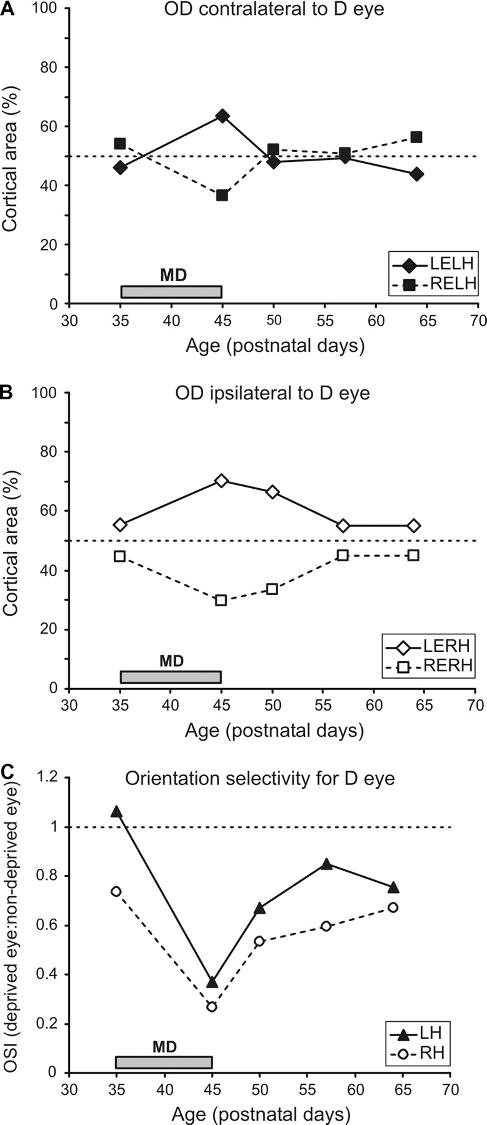
Figure 7. Cortical areas dominated by the two eyes in the left hemisphere, contralateral to the deprived eye (A) and in ...
Notes:
Figure 7. Cortical areas dominated by the two eyes in the left hemisphere, contralateral to the deprived eye (A) and in the right hemisphere, ipsilateral to the deprived eye (B), and relative orientation selectivity of responses through the right versus left eye (C), for kitten 065. This animal was strabismic in the right eye from P21, and then deprived of vision in the same eye from P35 to P45 (grey bars near the abscissa). In (A) and (B), results for the right (deprived) eye (RE) are are represented by squares linked with dashed lines, those for the left (non-deprived) eye (LE) by diamonds linked with solid lines (see insets). In (C), results for the left hemisphere (LH) are plotted as triangles linked with solid lines, those for the right hemisphere (RH) as circles linked with dashed lines.
Unless provided in the caption above, the following copyright applies to the content of this slide: © The Author 2005. Published by Oxford University Press. All rights reserved. For permissions, please e-mail: journals.permissions@oupjournals.org

Slide 8
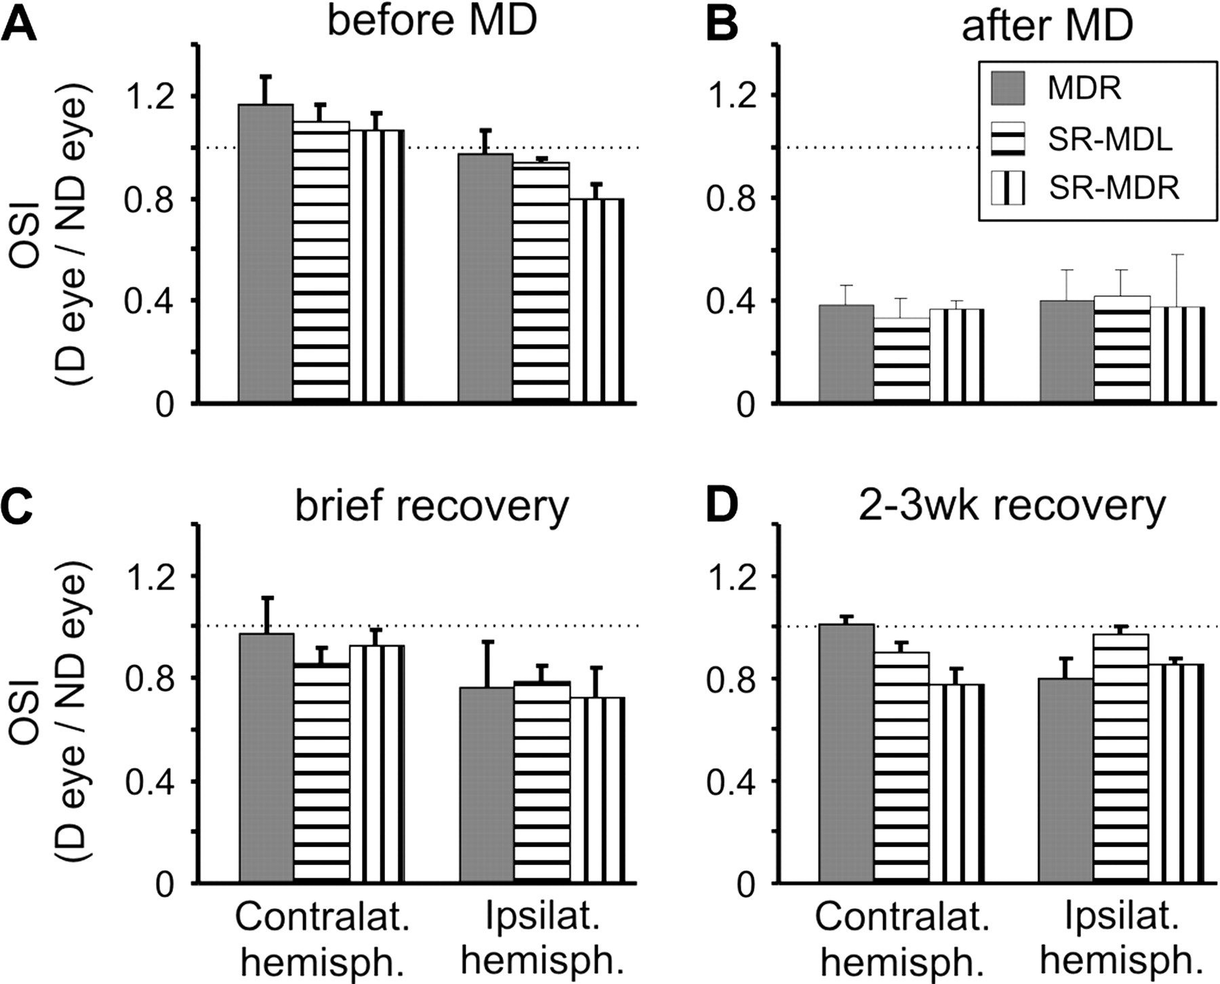
Figure 8. Average orientation selectivity of responses through the deprived eye in each hemisphere, plotted for all ...
Notes:
Figure 8. Average orientation selectivity of responses through the deprived eye in each hemisphere, plotted for all three experimental groups and time points. Results are shown for MD-only animals, kittens with strabismus and MD in opposite eyes and animals with strabismus and MD in the same eye (shading, see inset), immediately before MD (A), immediately after MD (B), after a brief recovery period of 3–4 days (C) and after 2–3 weeks of recovery (D). Orientation selectivity is displayed as OSI for deprived-eye responses (see Materials and Methods) relative to responses through the non-deprived eye. Error bars represent 1 SEM.
Unless provided in the caption above, the following copyright applies to the content of this slide: © The Author 2005. Published by Oxford University Press. All rights reserved. For permissions, please e-mail: journals.permissions@oupjournals.org

Slide 9
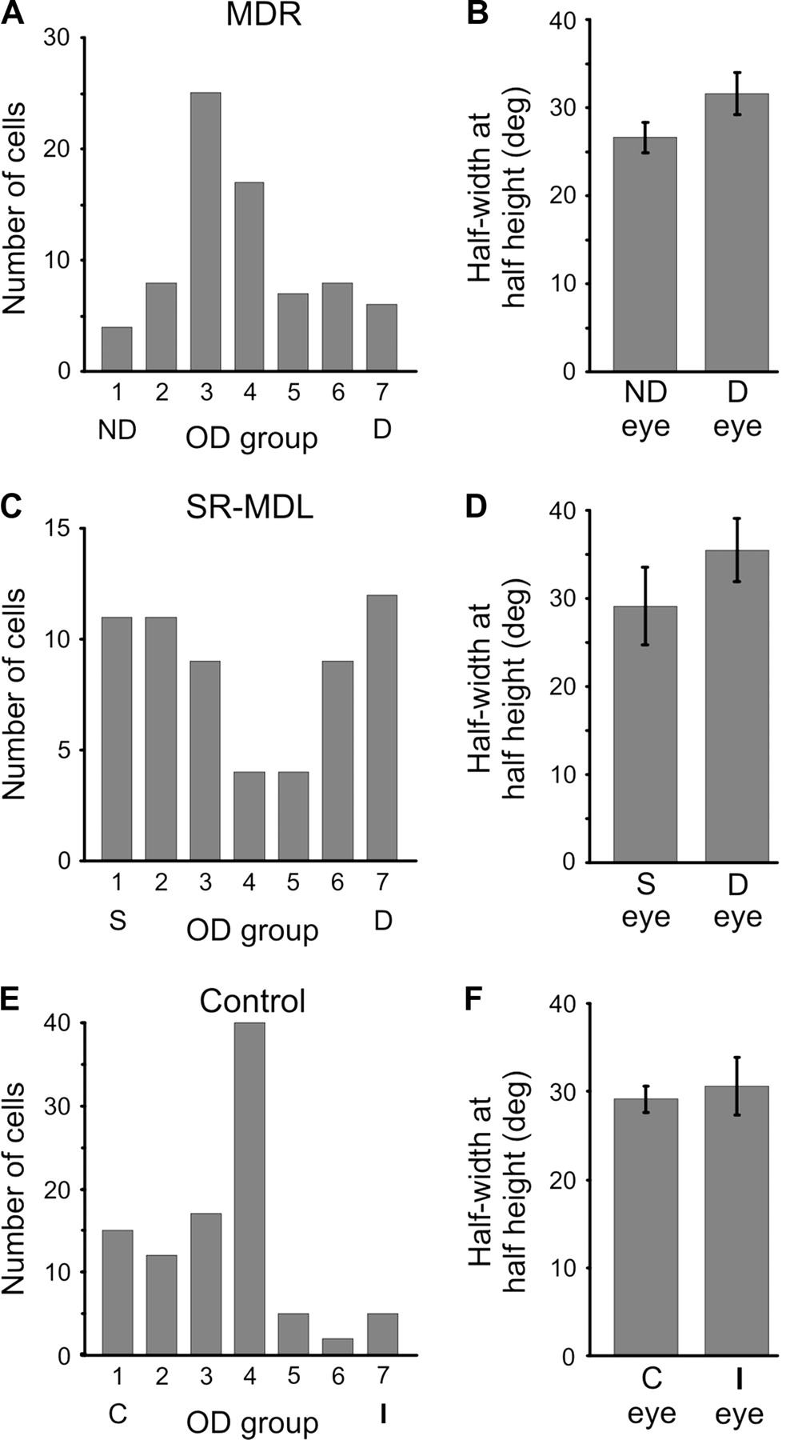
Figure 9. Ocular dominance (A, C, E) and orientation selectivity (B, D, F) of single cells recorded from V1 of MD-only ...
Notes:
Figure 9. Ocular dominance (A, C, E) and orientation selectivity (B, D, F) of single cells recorded from V1 of MD-only kittens (A, B), from kittens with strabismus prior to MD (C, D) and from age-matched normal control animals (E, F). Histograms represent data from 78 neurons recorded in two MD-only kittens, 60 neurons recorded in two SR-MDL kittens and 96 cells from control kittens. In each case, data were pooled from both cortical hemispheres. Based on the ratio of responses to left-eye versus right-eye stimulation, cells were classified in seven OD groups (Hubel and Wiesel, 1962). For greater clarity, results are displayed such that cells responding exclusively to the deprived eye (D) are denoted OD7, those responding only through the non-deprived eye (ND) or the surgically deviated eye (S) as OD1 (A, C). Orientation selectivity of cells dominated by the deprived eye (D), the non-deprived (ND) or strabismic eye (S), or the contralateral (C) or ipsilateral (I) eye in case of the controls animals, is shown as mean half-width at half height of tuning curves; error bars = 1 SEM (B, D, F).
Unless provided in the caption above, the following copyright applies to the content of this slide: © The Author 2005. Published by Oxford University Press. All rights reserved. For permissions, please e-mail: journals.permissions@oupjournals.org

Slide 10
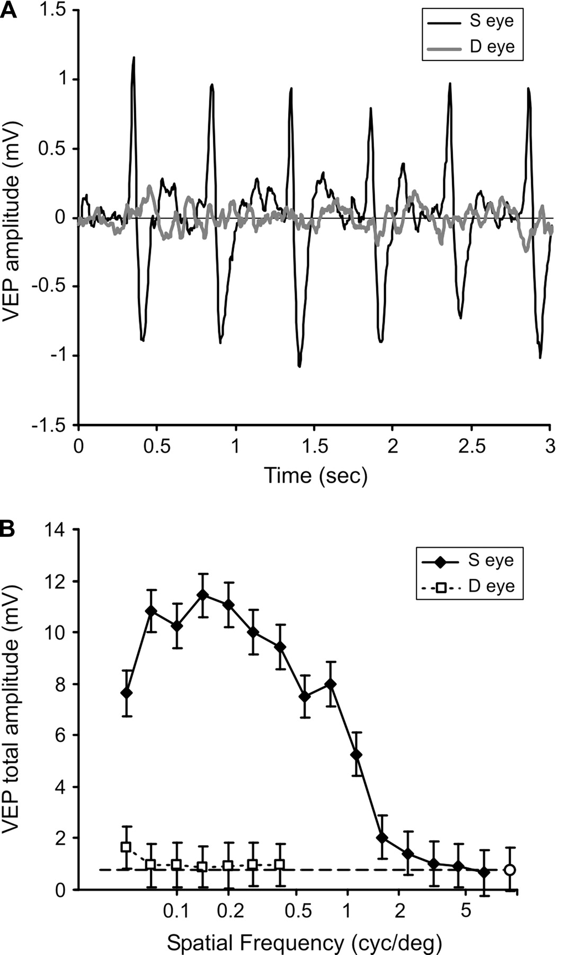
Figure 10. VEPs recorded in SR-MDL kitten 280. This animal had a strabismus induced in the right eye on P21. It had the ...
Notes:
Figure 10. VEPs recorded in SR-MDL kitten 280. This animal had a strabismus induced in the right eye on P21. It had the left eye deprived on P33 and reopened on P45, when data shown were recorded from V1 of the right hemisphere, contralateral to the deprived eye. (A) VEPs averaged over 20 presentations of a contrast-reversing grating of 0.14 cycles/deg shown to either the strabismic (S) eye (black trace) or the deprived (D) eye (grey trace). (B) Total VEP amplitude is plotted versus grating spatial frequency for stimulation of the strabismic eye (filled diamonds, solid lines) and the deprived eye (open squares, dotted lines). The response to a blank screen is given by the open circle symbol and the dashed line. Error bars, 1 SEM.
Unless provided in the caption above, the following copyright applies to the content of this slide: © The Author 2005. Published by Oxford University Press. All rights reserved. For permissions, please e-mail: journals.permissions@oupjournals.org

Slide 11
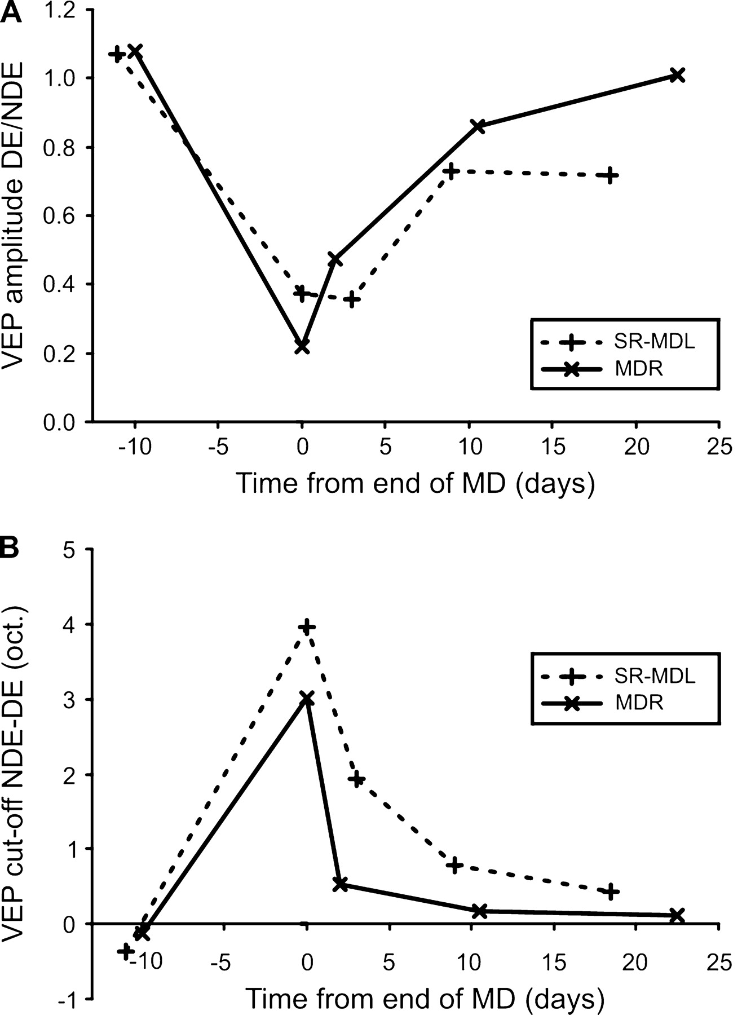
Figure 11. Comparison of VEP amplitudes (A) and cut-off frequencies (B) for MD kittens and for kittens with strabismus ...
Notes:
Figure 11. Comparison of VEP amplitudes (A) and cut-off frequencies (B) for MD kittens and for kittens with strabismus and MD in opposite eyes. Since deprivation was not always carried out on exactly the same postnatal day, data are plotted against time from the end of the MD period. In (A), the ratio between the maximal VEP amplitudes for the deprived and non-deprived eyes is shown. In (B), the difference between high-frequency cut-offs for the deprived and non-deprived eyes is plotted in octaves. Both graphs represent mean values for both cortical hemispheres obtained from two animals; results from MD-only animals are plotted as X symbols linked with solid lines and results from SR-MD as + symbols linked with dotted lines (see inset).
Unless provided in the caption above, the following copyright applies to the content of this slide: © The Author 2005. Published by Oxford University Press. All rights reserved. For permissions, please e-mail: journals.permissions@oupjournals.org

