Slide 1
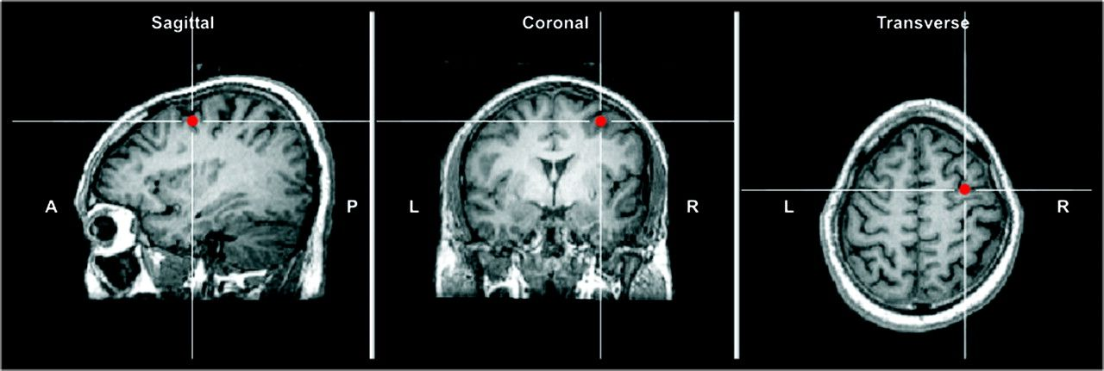
Figure 1. Location of right FEF TMS site for one representative subject. The anatomical site of stimulation for right ...
Notes:
Figure 1. Location of right FEF TMS site for one representative subject. The anatomical site of stimulation for right FEF (shown here) is indicated by the line intersection in the sagittal (rightmost panel), coronal (middle panel), and transverse (leftmost panel) sections of T1-weighted MRI. The coil was placed tangential to the skull with the handle pointing backward parallel to the midline. Left and right FEF sites were identified based on a previous review of the several brain imaging studies of the activation foci for FEF (Paus 1996) that reported the average anatomical Talairach coordinates: left FEF (x = −32; y = −2; z = 46) and right FEF (x = 32; y = −2; z = 47).
Unless provided in the caption above, the following copyright applies to the content of this slide: © The Author 2009. Published by Oxford University Press. All rights reserved. For permissions, please e-mail: journals.permissions@oxfordjournals.org

Slide 2
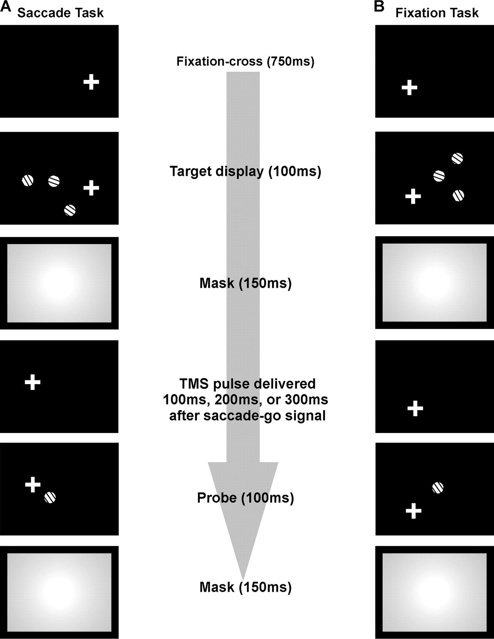
Figure 2. General experimental paradigm of TMS study. (A) In the Saccade Task subjects fixated on the fixation-cross ...
Notes:
Figure 2. General experimental paradigm of TMS study. (A) In the Saccade Task subjects fixated on the fixation-cross while the target display was briefly presented containing either a lone target or a target accompanied by a random number of distracters (i.e., total set-size of target + distracters was 1 to 6, or 8). Following the mask, subjects moved their eyes to the new location of fixation-cross. In TMS trials, TMS pulses were time-locked to the onset of the second fixation-cross. Pulses were delivered either 100, 200, or 300 ms after the second fixation-cross was presented. After the saccade a probe was presented (100 ms) at the same location as the target. Subjects were required to indicate how the probe's orientation differed relative to the target's orientation. (B) The Fixation Task was the same as the Saccade Task except that subjects were required to maintain eye fixation through target display and probe presentations. The fixation-cross remained fixed in the same position throughout the trial. Again, TMS pulses were delivered at one of the 3 time intervals relative to the onset of the second fixation-cross in TMS trials. This figure is slightly adapted from our previous TMS study of the parietal cortex (Prime et al. 2008).
Unless provided in the caption above, the following copyright applies to the content of this slide: © The Author 2009. Published by Oxford University Press. All rights reserved. For permissions, please e-mail: journals.permissions@oxfordjournals.org

Slide 3
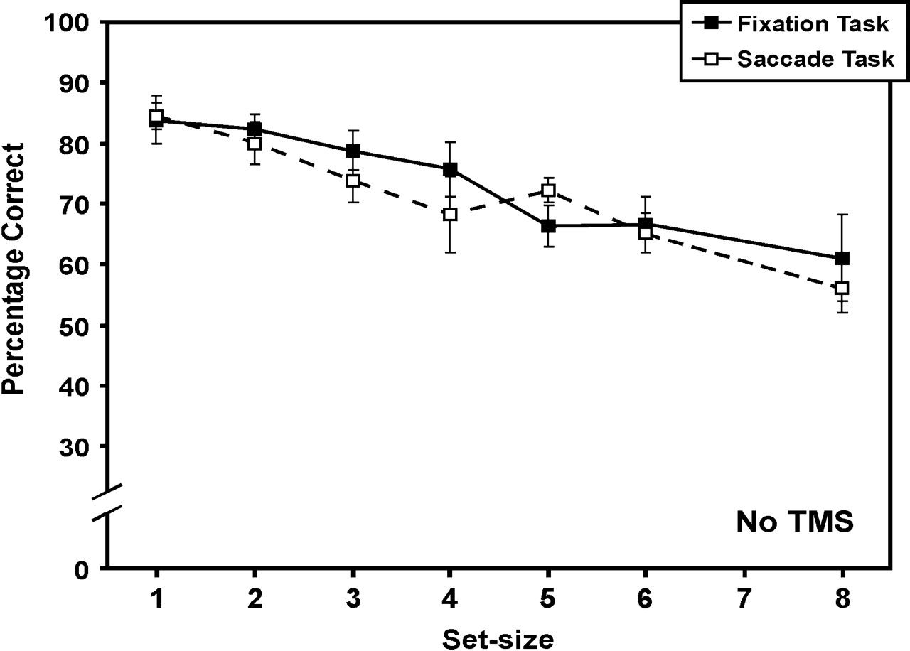
Figure 3. Results of the baseline No-TMS trials. This figure shows the mean percentage correct responses across all ...
Notes:
Figure 3. Results of the baseline No-TMS trials. This figure shows the mean percentage correct responses across all subjects (n = 6) in both the Saccade and Fixation tasks for different set-sizes. Fixation Task performance is represented by the solid curve with the closed squares. Saccade Task performance is represented by the dashed curve with the open squares. Performance in these tasks was found statistically the same. These data replicated our previous findings (Prime et al. 2007). Error bars represent standard error.
Unless provided in the caption above, the following copyright applies to the content of this slide: © The Author 2009. Published by Oxford University Press. All rights reserved. For permissions, please e-mail: journals.permissions@oxfordjournals.org

Slide 4
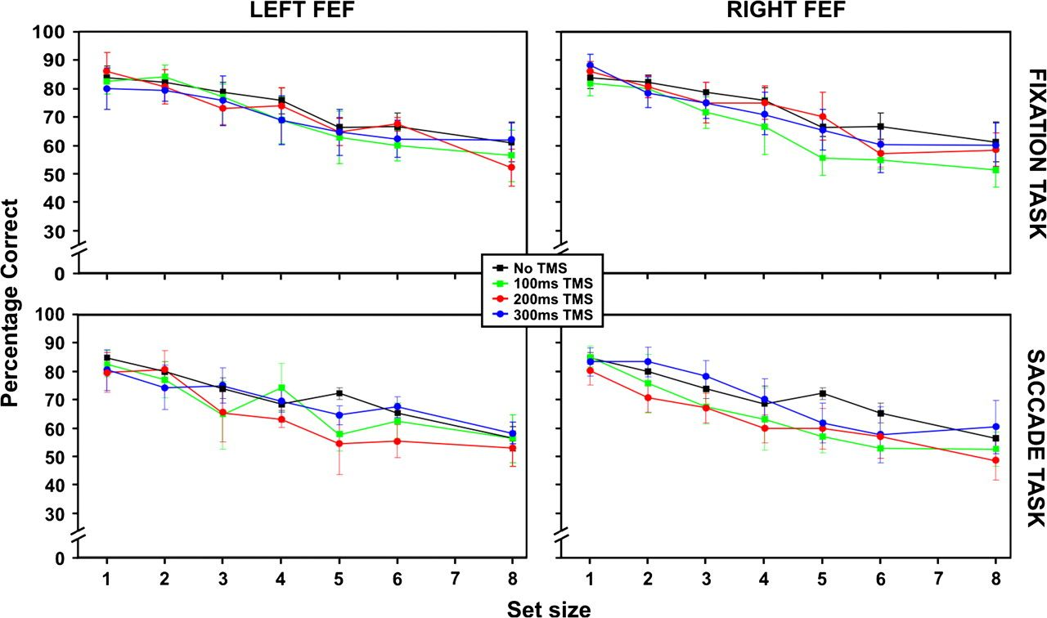
Figure 4. Main FEF TMS results. Left FEF TMS (A) and right FEF TMS (B) conditions for both the Fixation Task (top ...
Notes:
Figure 4. Main FEF TMS results. Left FEF TMS (A) and right FEF TMS (B) conditions for both the Fixation Task (top panels) and Saccade Task (bottom panels). These data are shown as mean percentage correct responses across all subjects (n = 6) against different set-sizes. Each colored data curve represents the different TMS time intervals in the TMS trials. The green curve represents the TMS data when TMS was delivered at the 100-ms time interval. Similarly, the red curve represents the 200-ms time interval and the blue curve represents the 300-ms time interval. As a comparison, we replotted the baseline No-TMS data curves from Figure 3 for each task (black curves). Error bars represent standard error.
Unless provided in the caption above, the following copyright applies to the content of this slide: © The Author 2009. Published by Oxford University Press. All rights reserved. For permissions, please e-mail: journals.permissions@oxfordjournals.org

Slide 5
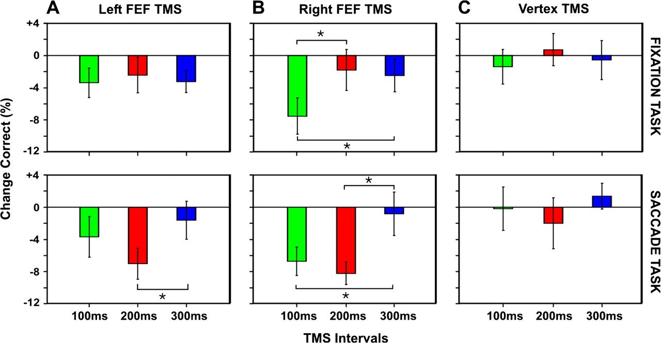
Figure 5. Magnitude of TMS effect. To determine the magnitude of the TMS effect we subtracted the TMS data curves of ...
Notes:
Figure 5. Magnitude of TMS effect. To determine the magnitude of the TMS effect we subtracted the TMS data curves of Figure 4 from their respective baseline No-TMS data from Fig3. The change in mean percentage correct is shown for the left FEF (A), the right FEF TMS (B), and the control site TMS aimed at the subjects’ vertex (C). The top panels represent the change in the Fixation Task and the bottom panels represent the change in the Saccade Task. Positive numbers reflect a greater percentage correct and negative numbers reflect a lesser percentage correct compared with baseline. The line at zero represents no change from baseline. Consistent with Figure 4, left FEF TMS only increased errors in the Saccade Task at the 200-ms time interval. Performance in the Fixation Task was only disrupted in the right FEF TMS condition when TMS was delivered at the 100-ms time interval relative to other time intervals. The most errors were found in the Saccade Task during right FEF TMS where accuracy declined at the 100- and 200-ms TMS time intervals. No disruption was found for the vertex TMS and neither the right sham nor left sham (not shown).
Unless provided in the caption above, the following copyright applies to the content of this slide: © The Author 2009. Published by Oxford University Press. All rights reserved. For permissions, please e-mail: journals.permissions@oxfordjournals.org

Slide 6
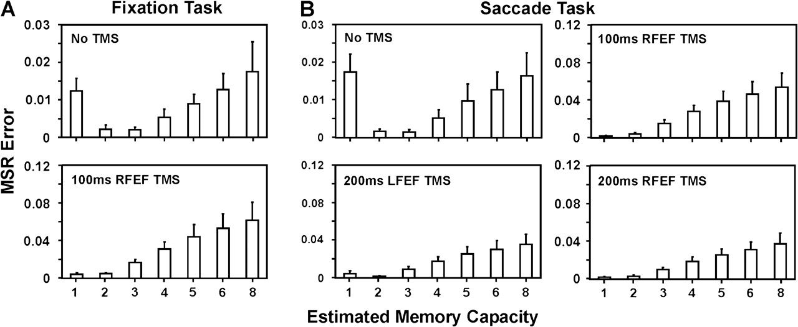
Figure 6. Estimating memory capacity during FEF stimulation. We used a simple predictive model from our previous study ...
Notes:
Figure 6. Estimating memory capacity during FEF stimulation. We used a simple predictive model from our previous study (Prime et al. 2007) for estimating the numerical memory capacity of trans-saccadic memory and simple working memory. To determine which predictive curve from our predictive model estimating a specific memory capacity best fit our data curves, we calculated the mean square residual errors (MSR errors) between the predictive curves and these data curves from Figure 4. Bar graphs represent the average MSR errors across all subjects after calculating the MSR errors for each subject individually. The least average MSR error indicates the best fit to a theoretical memory capacity according to our predictive model. For brevity we only show MSR errors for the FEF TMS conditions where we found significant effects. (A) MSR errors of the baseline No-TMS condition (top panel) and 100-ms right FEF TMS (bottom panel) in the Fixation Task. The average MSR errors of the No-TMS condition best fit our predictive model estimating a memory capacity of 3 items, replicating our previous results (Prime et al. 2007). MSR errors of the 100-ms right FEF TMS show a reduced capacity estimate to 1 item. (B) MSR errors of the baseline No-TMS condition (top left panel), 200-ms left FEF TMS (bottom left panel), 100-ms right FEF TMS (top right panel), and 200-ms right FEF TMS (bottom right panel) in the Saccade Task. MSR errors of the No-TMS best fit our predictive model estimating 3 items capacity. Again, this replicated our previous results. During 200-ms left FEF TMS in the Saccade Task, memory capacity was reduced to 2 items. Memory capacity in both the 100- and 200-ms right FEF TMS conditions was reduced to 1 item.
Unless provided in the caption above, the following copyright applies to the content of this slide: © The Author 2009. Published by Oxford University Press. All rights reserved. For permissions, please e-mail: journals.permissions@oxfordjournals.org

