Slide 1
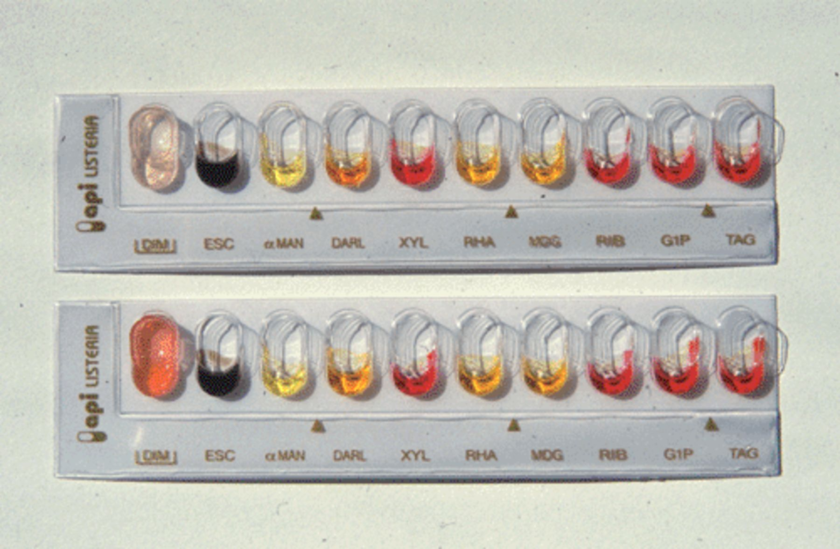
Figure 1 The ‘DIM’ test of API-Listeria (bioMérieux, Marcy-l'Etoile, France) distinguishes between L. monocytogenes ...
Notes:
Figure 1 The ‘DIM’ test of API-Listeria (bioMérieux, Marcy-l'Etoile, France) distinguishes between L. monocytogenes (NCTC 11994; above) and L. innocua (NCTC 11288; below) without considering the hemolytic activity of the test isolates.
Unless provided in the caption above, the following copyright applies to the content of this slide: © 2003 Federation of European Microbiological Societies.

Slide 2
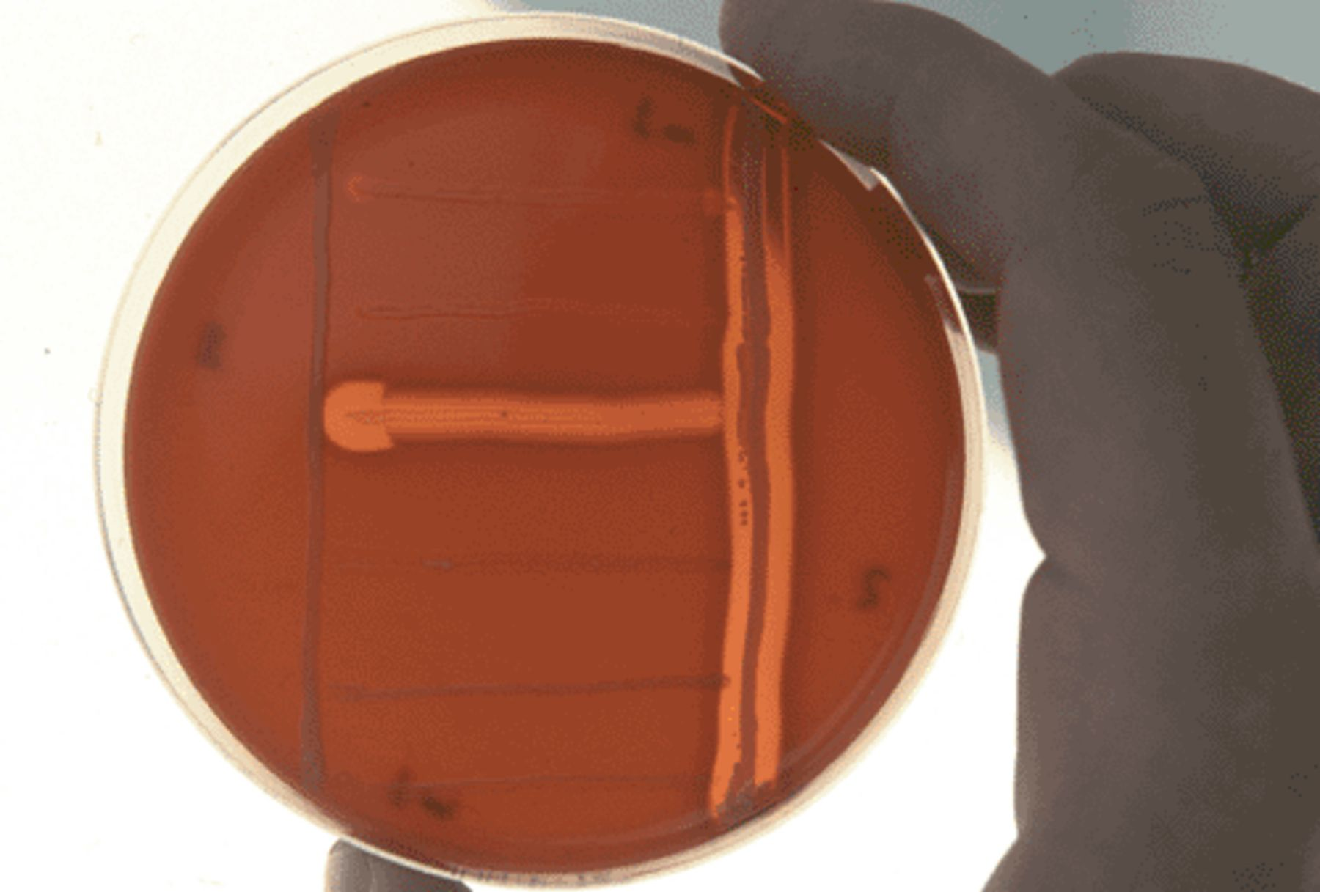
Figure 2 CAMP test performed on L. monocytogenes (NCTC 11994), L. seeligeri (DSM 20751), L. ivanovii (NCTC 11846), and ...
Notes:
Figure 2 CAMP test performed on L. monocytogenes (NCTC 11994), L. seeligeri (DSM 20751), L. ivanovii (NCTC 11846), and the non-hemolytic L. innocua (NCTC 11288), L. grayi (DSM 20596), and L. welshimeri (DSM 20650) (horizontal streaks, in descending order) using S. aureus (NCTC 1803; right vertical) and R. equi (NCTC 1621; left vertical).
Unless provided in the caption above, the following copyright applies to the content of this slide: © 2003 Federation of European Microbiological Societies.

Slide 3
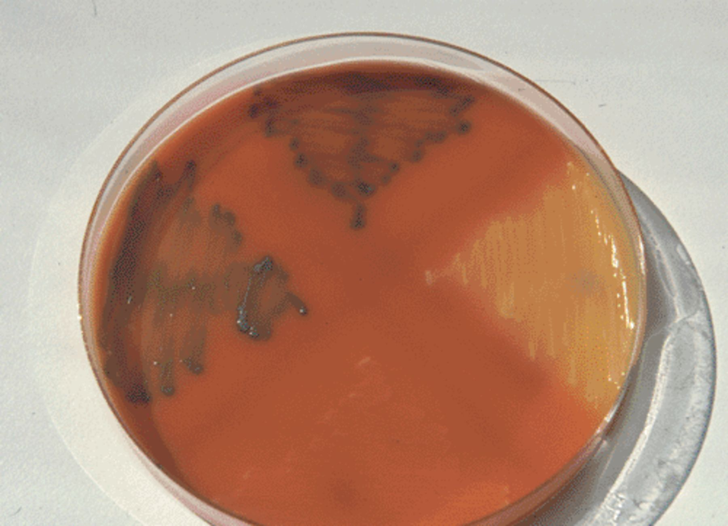
Figure 3 The chromogenic culture medium RAPID'L.MONO® (Bio-Rad, Marnes la Coquette, France) distinguishes between L. ...
Notes:
Figure 3 The chromogenic culture medium RAPID'L.MONO® (Bio-Rad, Marnes la Coquette, France) distinguishes between L. monocytogenes (NCTC 11994, above, blue colonies without halo), L. ivanovii (NCTC 11846, left quadrant, blue colonies with yellow halo) and the other Listeria spp. (e.g. L. innocua, NCTC 11288, below, white colonies; L. seeligeri, DSM 20751, right quadrant, yellow colonies).
Unless provided in the caption above, the following copyright applies to the content of this slide: © 2003 Federation of European Microbiological Societies.

