Slide 1
Fig. 1. Diagram showing the procedure for Test Phases for Temporal and Spatial conditions.
Notes:
Fig. 1. Diagram showing the procedure for Test Phases for Temporal and Spatial conditions.
Unless provided in the caption above, the following copyright applies to the content of this slide: © The Author 2012. Published by Oxford University Press. All rights reserved. For permissions, please e-mail: journals.permissions@oup.com

Slide 2
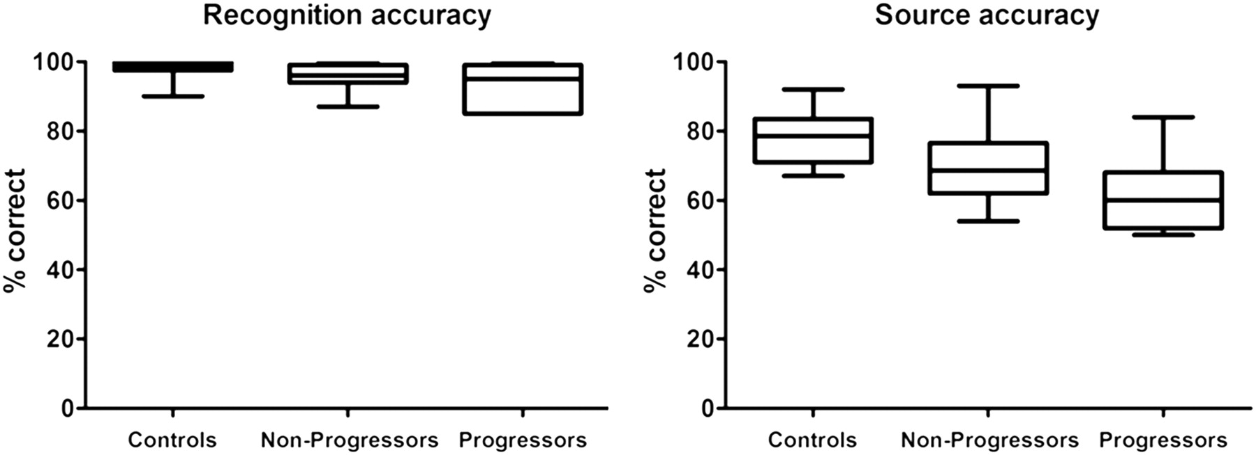
Fig. 2. Boxplots showing overall recognition and source accuracy (% correct) for progressive and non-progressive ...
Notes:
Fig. 2. Boxplots showing overall recognition and source accuracy (% correct) for progressive and non-progressive bvFTD patients and control participants. Whiskers indicate 5–95 percentile.
Unless provided in the caption above, the following copyright applies to the content of this slide: © The Author 2012. Published by Oxford University Press. All rights reserved. For permissions, please e-mail: journals.permissions@oup.com

