Slide 1
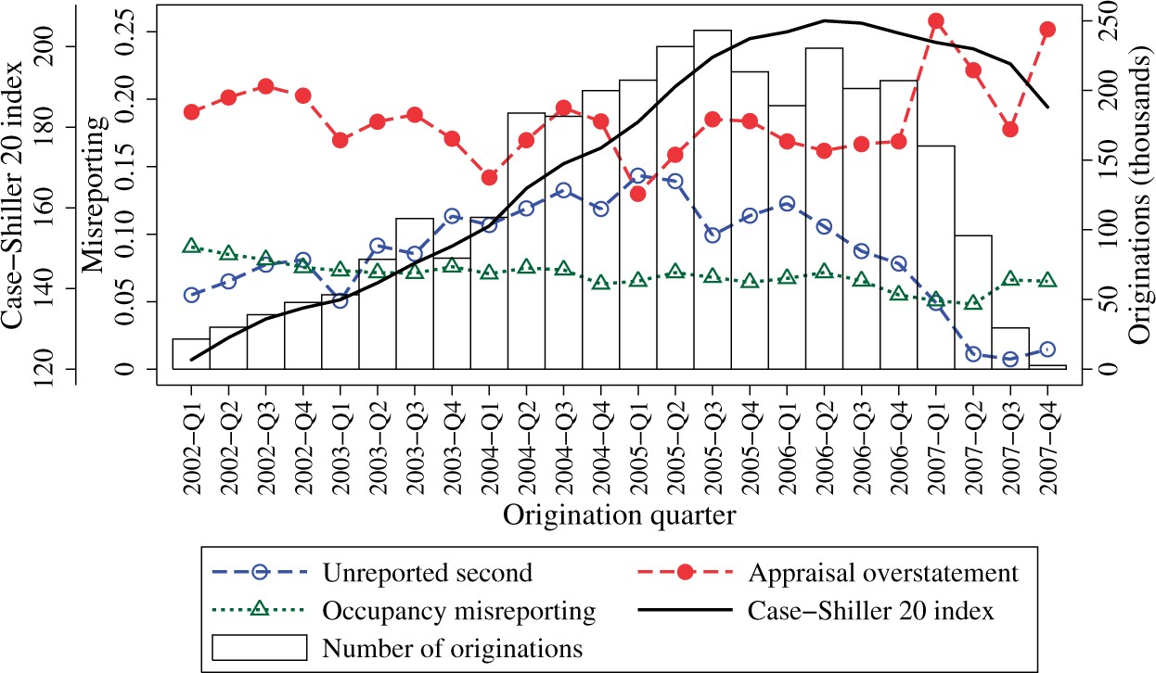
Figure 1 Misreporting indicators by quarter This figure shows the evolution of the different misreporting indicators ...
Notes:
Figure 1 Misreporting indicators by quarter This figure shows the evolution of the different misreporting indicators by quarter. The indicators Unreported second, Occupancy misreporting, and Appraisal overstatement are defined in Table 2. The bars represent the number of first-lien loan originations in each quarter, and the black line shows the evolution of housing prices as captured by the Case-Shiller 20 Index. The main sample consists of ABSNet-DataQuick-matched securitized first-lien loans used for the purchase or refinance of a home with an initial loan amount over $30k and a loan-to-value (LTV) ratio less than or equal to 103%. We drop loans associated with the largest 1% of the transactions in each state, loans reported as having more than one unit, and loans that belong to MBS deals in which all mortgages are recorded to have an LTV equal to their combined LTV.
Unless provided in the caption above, the following copyright applies to the content of this slide: © The Author 2016. Published by Oxford University Press on behalf of The Society for Financial Studies. All rights reserved. For Permissions, please e-mail: journals.permissions@oup.com.

Slide 2
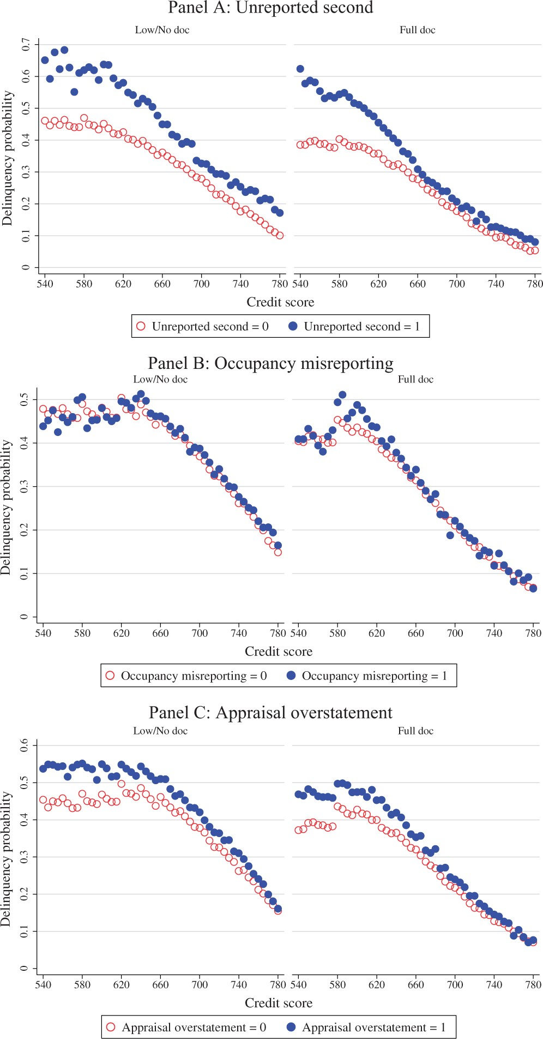
Figure 2 Probability of delinquency by credit score bin This figure compares the probability of delinquency by credit ...
Notes:
Figure 2 Probability of delinquency by credit score bin This figure compares the probability of delinquency by credit score bin of loans that exhibit misreporting (solid circles) and loans that do not exhibit misreporting (hollow circles). Each credit score bin has a size of five units. We construct three mortgage misreporting indicators to capture unreported second liens, occupancy status misreporting, and appraisal overstatements (the indicators are defined in Table 2). The comparisons based on unreported second liens, occupancy misreporting, and appraisal overstatements are shown in panels A, B, and C, respectively.
Unless provided in the caption above, the following copyright applies to the content of this slide: © The Author 2016. Published by Oxford University Press on behalf of The Society for Financial Studies. All rights reserved. For Permissions, please e-mail: journals.permissions@oup.com.

Slide 3
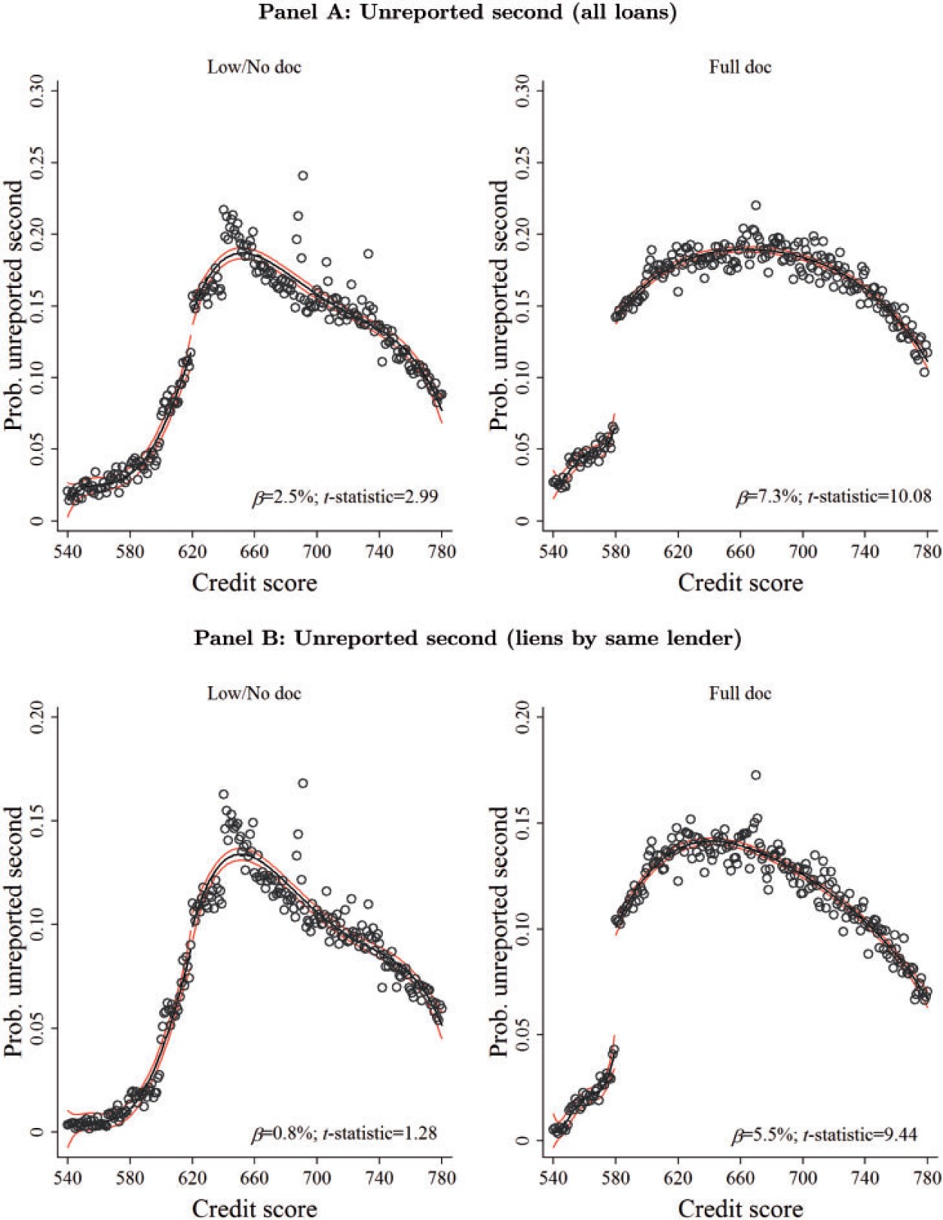
Figure 3 Probability of second-lien and occupancy status misreporting around credit score thresholds This figure shows ...
Notes:
Figure 3 Probability of second-lien and occupancy status misreporting around credit score thresholds This figure shows the probability of second-lien and occupancy status misreporting by credit score. The hollow circles represent the average probability of misreporting for each credit score. The dark black line fits a fourth-order polynomial approximation at both sides of the credit score threshold (620 for low/no documentation loans and 580 for full documentation loans). The light lines delimit the 95% confidence level interval for the approximation. Panel A considers second-lien misreporting when the first-second lien pair was originated either by the same lender or a different lender (all loans). Panels B and C present results for the decomposition of second-lien misreporting. Specifically, panel B shows the probability of second-lien misreporting when the first-second lien pair was originated by the same lender, and panel C shows the probability of second-lien misreporting when the first-second lien pair was originated by different lenders. Panel D shows results for occupancy misreporting. The exact magnitude of the jumps at the discontinuities (β) along with their t-statistics are also shown in the graphs. The corresponding regression results are shown in the Internet Appendix.
Unless provided in the caption above, the following copyright applies to the content of this slide: © The Author 2016. Published by Oxford University Press on behalf of The Society for Financial Studies. All rights reserved. For Permissions, please e-mail: journals.permissions@oup.com.

Slide 4
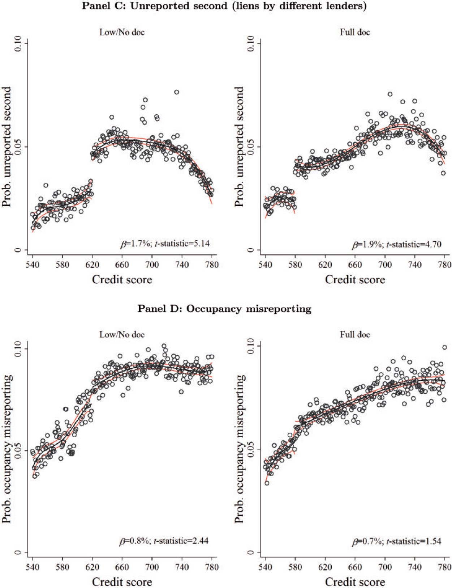
Figure 3 Probability of second-lien and occupancy status misreporting around credit score thresholds This figure shows ...
Notes:
Figure 3 Probability of second-lien and occupancy status misreporting around credit score thresholds This figure shows the probability of second-lien and occupancy status misreporting by credit score. The hollow circles represent the average probability of misreporting for each credit score. The dark black line fits a fourth-order polynomial approximation at both sides of the credit score threshold (620 for low/no documentation loans and 580 for full documentation loans). The light lines delimit the 95% confidence level interval for the approximation. Panel A considers second-lien misreporting when the first-second lien pair was originated either by the same lender or a different lender (all loans). Panels B and C present results for the decomposition of second-lien misreporting. Specifically, panel B shows the probability of second-lien misreporting when the first-second lien pair was originated by the same lender, and panel C shows the probability of second-lien misreporting when the first-second lien pair was originated by different lenders. Panel D shows results for occupancy misreporting. The exact magnitude of the jumps at the discontinuities (β) along with their t-statistics are also shown in the graphs. The corresponding regression results are shown in the Internet Appendix.
Unless provided in the caption above, the following copyright applies to the content of this slide: © The Author 2016. Published by Oxford University Press on behalf of The Society for Financial Studies. All rights reserved. For Permissions, please e-mail: journals.permissions@oup.com.

Slide 5
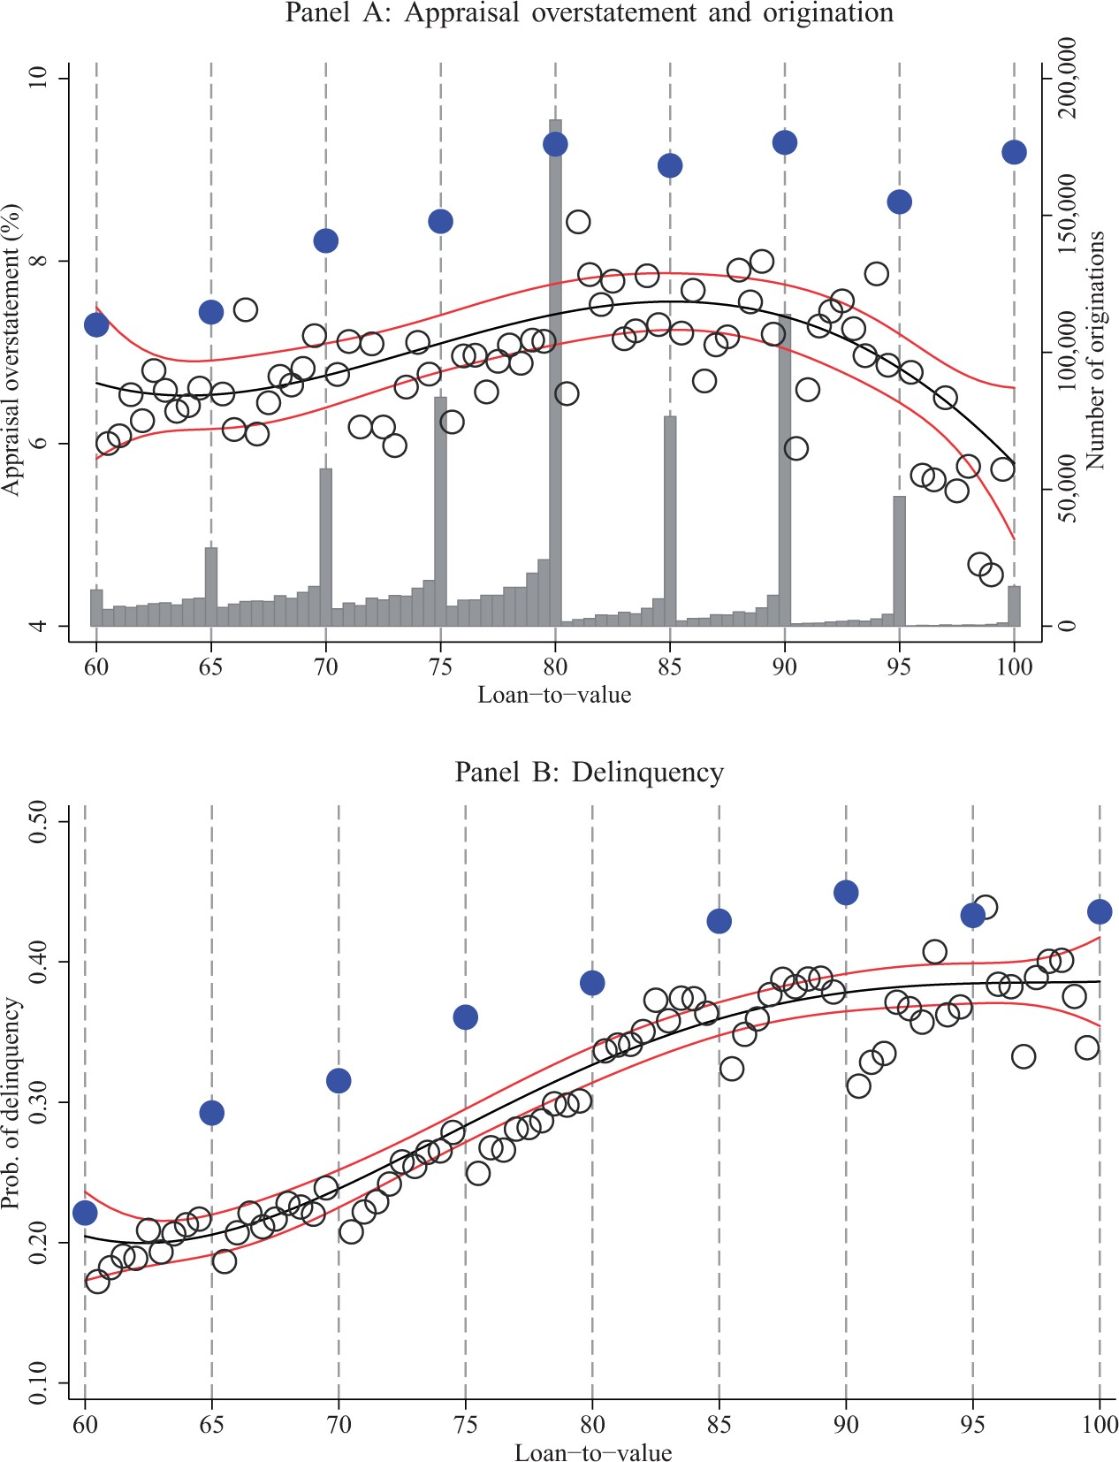
Figure 4 Appraisal overstatements in refinances with no second liens This figure summarizes various features of ...
Notes:
Figure 4 Appraisal overstatements in refinances with no second liens This figure summarizes various features of refinances with no second liens. Panel A shows the mean percentage overstatement of an appraisal compared to the AVM model for each LTV ratio. The black line fits a fourth-order polynomial for appraisal overstatements. The light lines delimit the 95% confidence interval. Solid circles highlight appraisal overstatements at five-unit LTVs. The bars show the amount of loan originations by LTV. Panel B shows the probability of delinquency by LTV. As in panel A, solid circles highlight delinquency probabilities at five-unit LTVs. Panel C shows the probability of delinquency for different levels of appraisal overstatements. The solid circles represent five-unit LTVs. In all panels, the hollow circles represent loans at the remaining LTV levels.
Unless provided in the caption above, the following copyright applies to the content of this slide: © The Author 2016. Published by Oxford University Press on behalf of The Society for Financial Studies. All rights reserved. For Permissions, please e-mail: journals.permissions@oup.com.

Slide 6
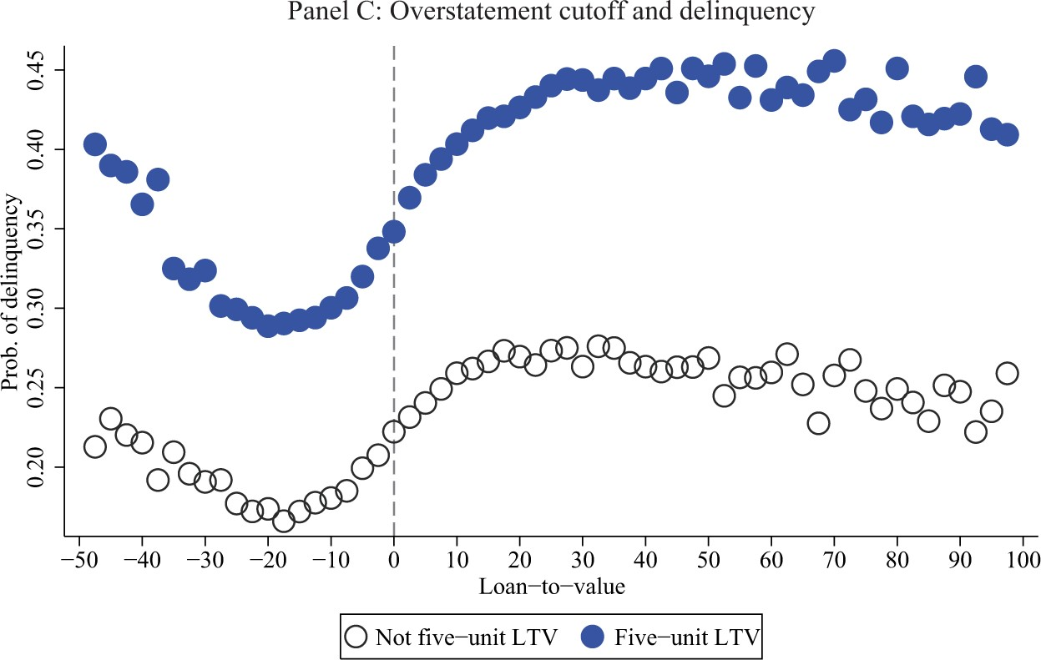
Figure 4 Appraisal overstatements in refinances with no second liens This figure summarizes various features of ...
Notes:
Figure 4 Appraisal overstatements in refinances with no second liens This figure summarizes various features of refinances with no second liens. Panel A shows the mean percentage overstatement of an appraisal compared to the AVM model for each LTV ratio. The black line fits a fourth-order polynomial for appraisal overstatements. The light lines delimit the 95% confidence interval. Solid circles highlight appraisal overstatements at five-unit LTVs. The bars show the amount of loan originations by LTV. Panel B shows the probability of delinquency by LTV. As in panel A, solid circles highlight delinquency probabilities at five-unit LTVs. Panel C shows the probability of delinquency for different levels of appraisal overstatements. The solid circles represent five-unit LTVs. In all panels, the hollow circles represent loans at the remaining LTV levels.
Unless provided in the caption above, the following copyright applies to the content of this slide: © The Author 2016. Published by Oxford University Press on behalf of The Society for Financial Studies. All rights reserved. For Permissions, please e-mail: journals.permissions@oup.com.

Slide 7
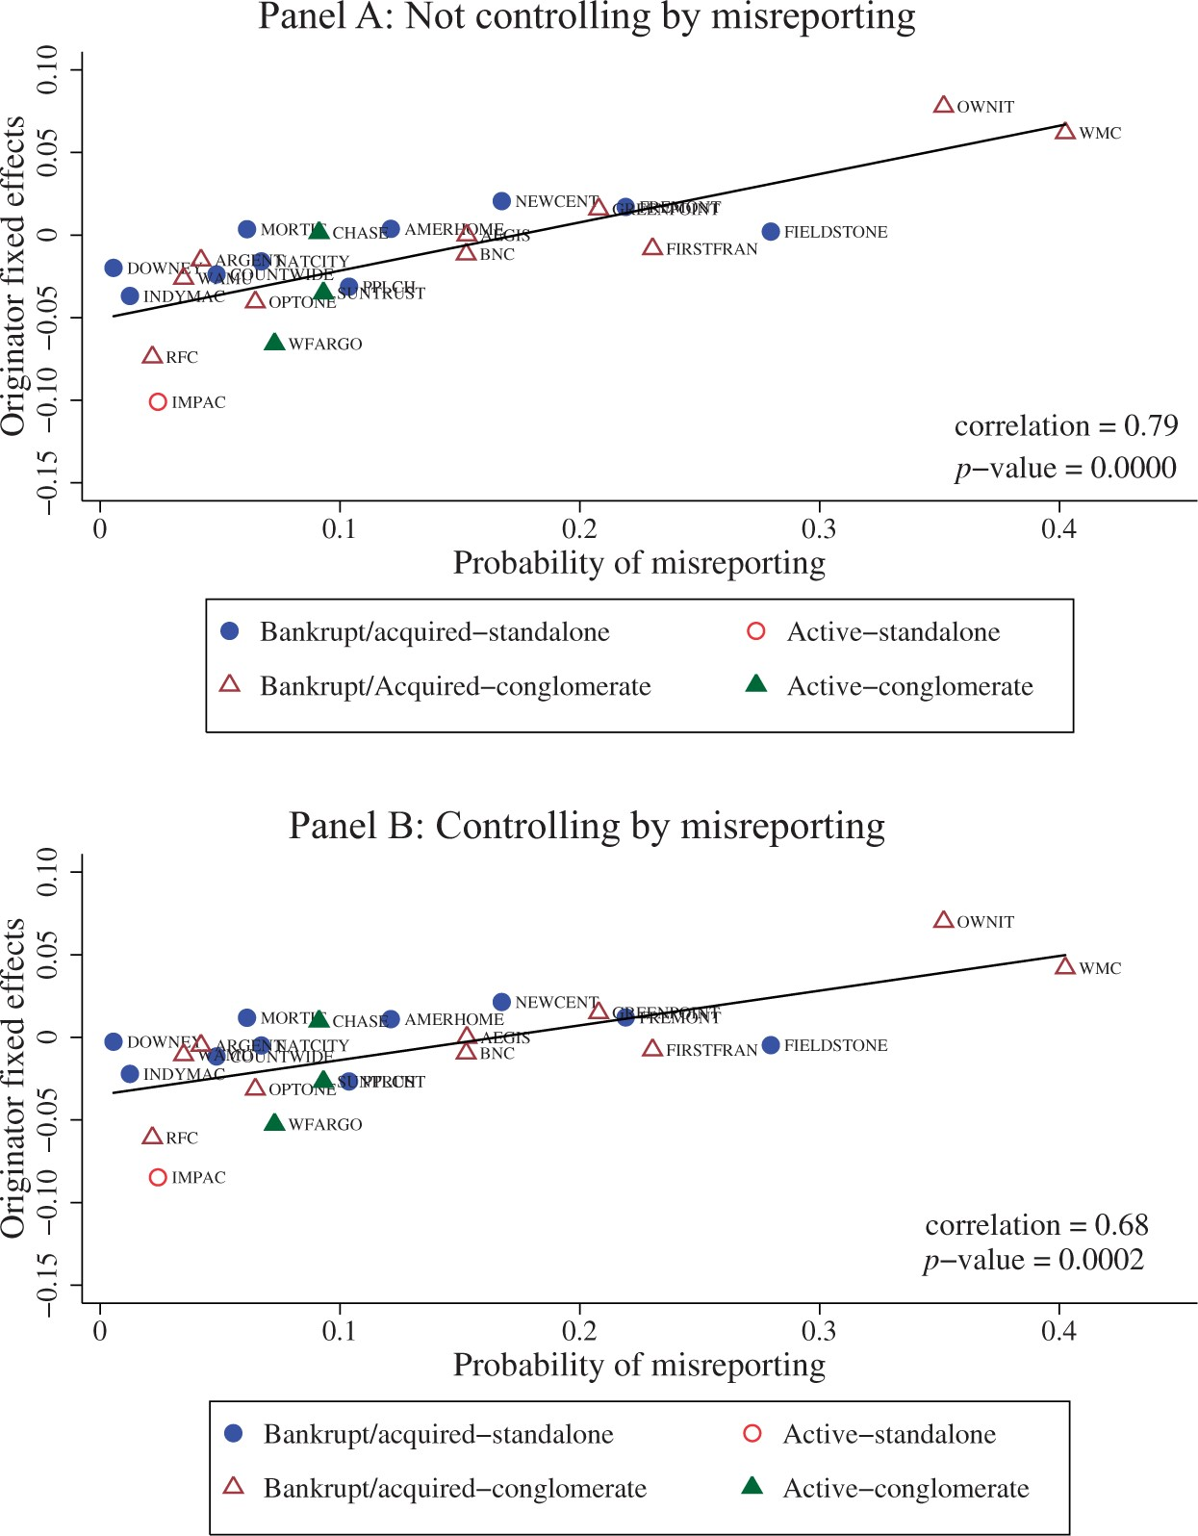
Figure 5 Originator fixed effects and misreporting We estimate an OLS regression in which the dependent variable is ...
Notes:
Figure 5 Originator fixed effects and misreporting We estimate an OLS regression in which the dependent variable is the delinquency dummy and the explanatory variables are the set of loan-level controls, CBSA × quarter fixed effects, and originator fixed effects. Panel A shows the relation between the originator fixed effect estimates and the percentage of loans that exhibit second-lien misreporting, by originator. Panel B shows the relation between the originator fixed effect estimates after adding the three misreporting indicators (second-lien misreporting, occupancy misreporting, and appraisal overstatement) as controls for the previous specification and the percentage of loans that exhibit second-lien misreporting, by originator. Solid circles represent originator fixed effects/probability of misreporting pairs of standalone originators that became bankrupt or were acquired during or soon after the recent financial crisis. Hollow circles correspond to standalone originators that are still active in business. Hollow triangles correspond to originators related to a large bank or conglomerate that became bankrupt or were acquired during or soon after the recent financial crisis. Solid triangles correspond to originators related to a large bank or conglomerate that are still active in business. The black line fits a linear regression and the correlation is shown at the bottom of each graph. The Internet Appendix lists the names that correspond to each originator's abbreviation.
Unless provided in the caption above, the following copyright applies to the content of this slide: © The Author 2016. Published by Oxford University Press on behalf of The Society for Financial Studies. All rights reserved. For Permissions, please e-mail: journals.permissions@oup.com.

Slide 8
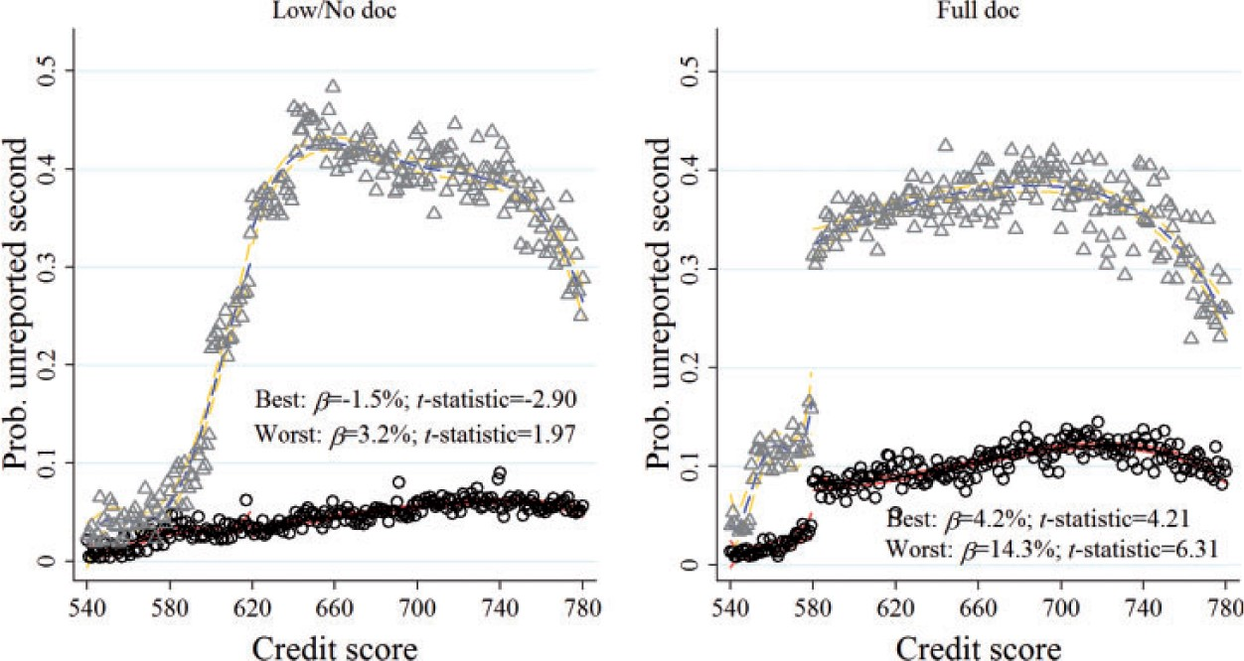
Figure 6 Misreporting around credit score thresholds, best and worst originators This figure shows the probability of ...
Notes:
Figure 6 Misreporting around credit score thresholds, best and worst originators This figure shows the probability of second-lien misreporting by credit score for the subset of loans originated by the best-performing originators and the worst-performing originators. The best performers correspond to the tercile of originators with the smallest fixed effect estimates from a regression of the delinquency dummy on loan-level controls, CBSA × quarter fixed effects, and originator fixed effects. The worst performers correspond to the tercile of originators with the largest fixed effects. We consider the 25 largest originators. The hollow circles represent the probability of second-lien misreporting of the best performers for each credit score. The black line fits a fourth-order polynomial approximation at both sides of the credit score threshold (620 for low/no documentation loans and 580 for full documentation loans). The light lines delimit the 95% confidence level interval for the approximation. The hollow triangles represent the probability of second-lien misreporting of the worst-performing originators for each credit score. The dashed dark line fits a fourth-order polynomial approximation at both sides of the threshold. The dashed light lines delimit the 95% confidence level interval for the approximation. The exact magnitude of the jumps at the discontinuities (β) along with their t-statistics are also shown in the graphs. The corresponding regression results are presented in the Internet Appendix.
Unless provided in the caption above, the following copyright applies to the content of this slide: © The Author 2016. Published by Oxford University Press on behalf of The Society for Financial Studies. All rights reserved. For Permissions, please e-mail: journals.permissions@oup.com.

Slide 9
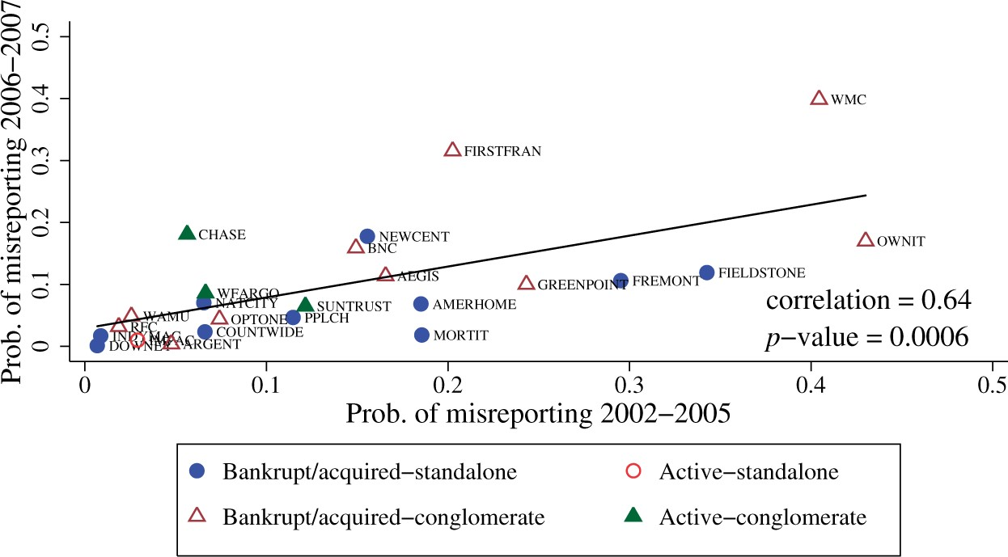
Figure 7 Misreporting persistence This figure shows the relation between the amount of second-lien misreporting by ...
Notes:
Figure 7 Misreporting persistence This figure shows the relation between the amount of second-lien misreporting by originator during the 2002 to 2005 period and the amount of second-lien misreporting by originator during the 2006 to 2007 period. Solid circles represent standalone originators that became bankrupt or were acquired during or soon after the recent financial crisis. Hollow circles correspond to standalone originators that are still active in business. Hollow triangles correspond to originators related to a large bank or conglomerate that became bankrupt or were acquired during or soon after the recent financial crisis. Solid triangles correspond to originators related to a large bank or conglomerate that are still active in business. The black line fits a linear regression, and the correlation is shown at the bottom of each graph. The Internet Appendix lists the names that corresponds to each originator's abbreviation.
Unless provided in the caption above, the following copyright applies to the content of this slide: © The Author 2016. Published by Oxford University Press on behalf of The Society for Financial Studies. All rights reserved. For Permissions, please e-mail: journals.permissions@oup.com.

Slide 10
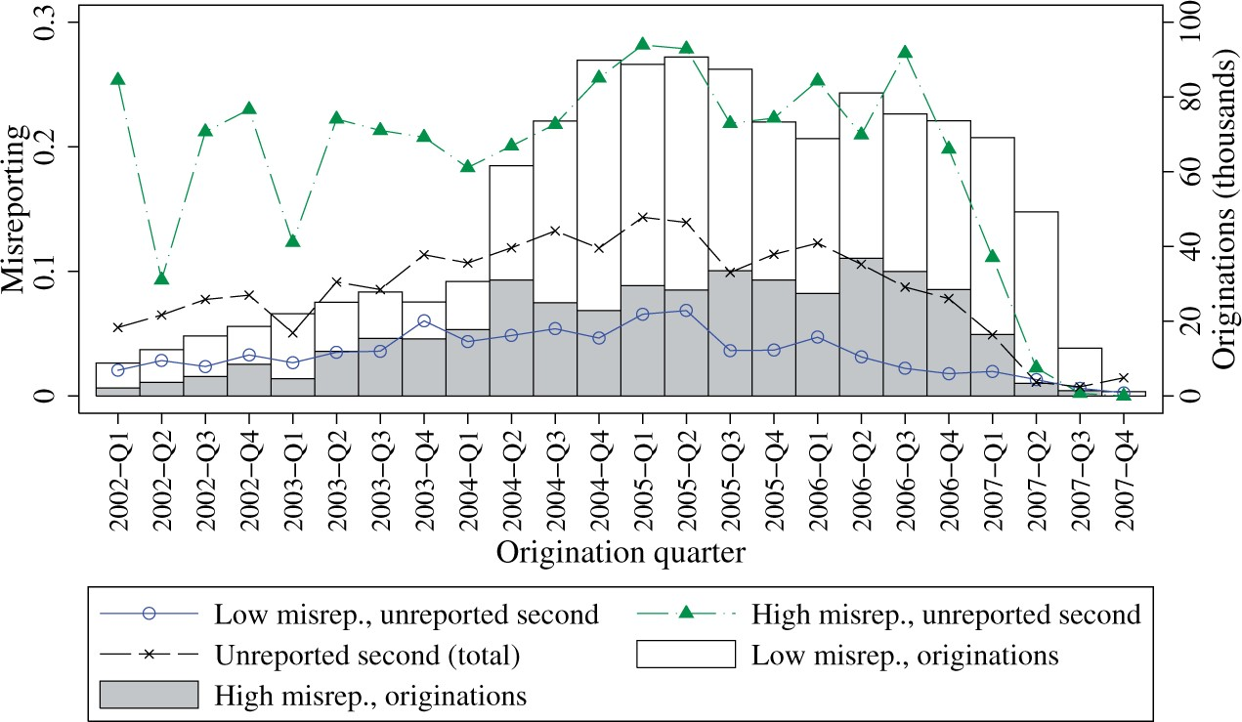
Figure 8 Unreported seconds by level of second-lien misreporting We rank originators based on the proportion of ...
Notes:
Figure 8 Unreported seconds by level of second-lien misreporting We rank originators based on the proportion of unreported second liens in 2006. The hollow circles show the level of second-lien misreporting of the originators in the lowest tercile (“Low misreporting”). The triangles show the level of second-lien misreporting of the originators in the top tercile (“High misreporting”). The black dashed line shows the total unreported second-lien level in the full sample (as in Figure 1). The hollow bars and gray bars represent the number of first-lien mortgage originations of low-misreporting and high-misreporting originators, respectively.
Unless provided in the caption above, the following copyright applies to the content of this slide: © The Author 2016. Published by Oxford University Press on behalf of The Society for Financial Studies. All rights reserved. For Permissions, please e-mail: journals.permissions@oup.com.

Slide 11
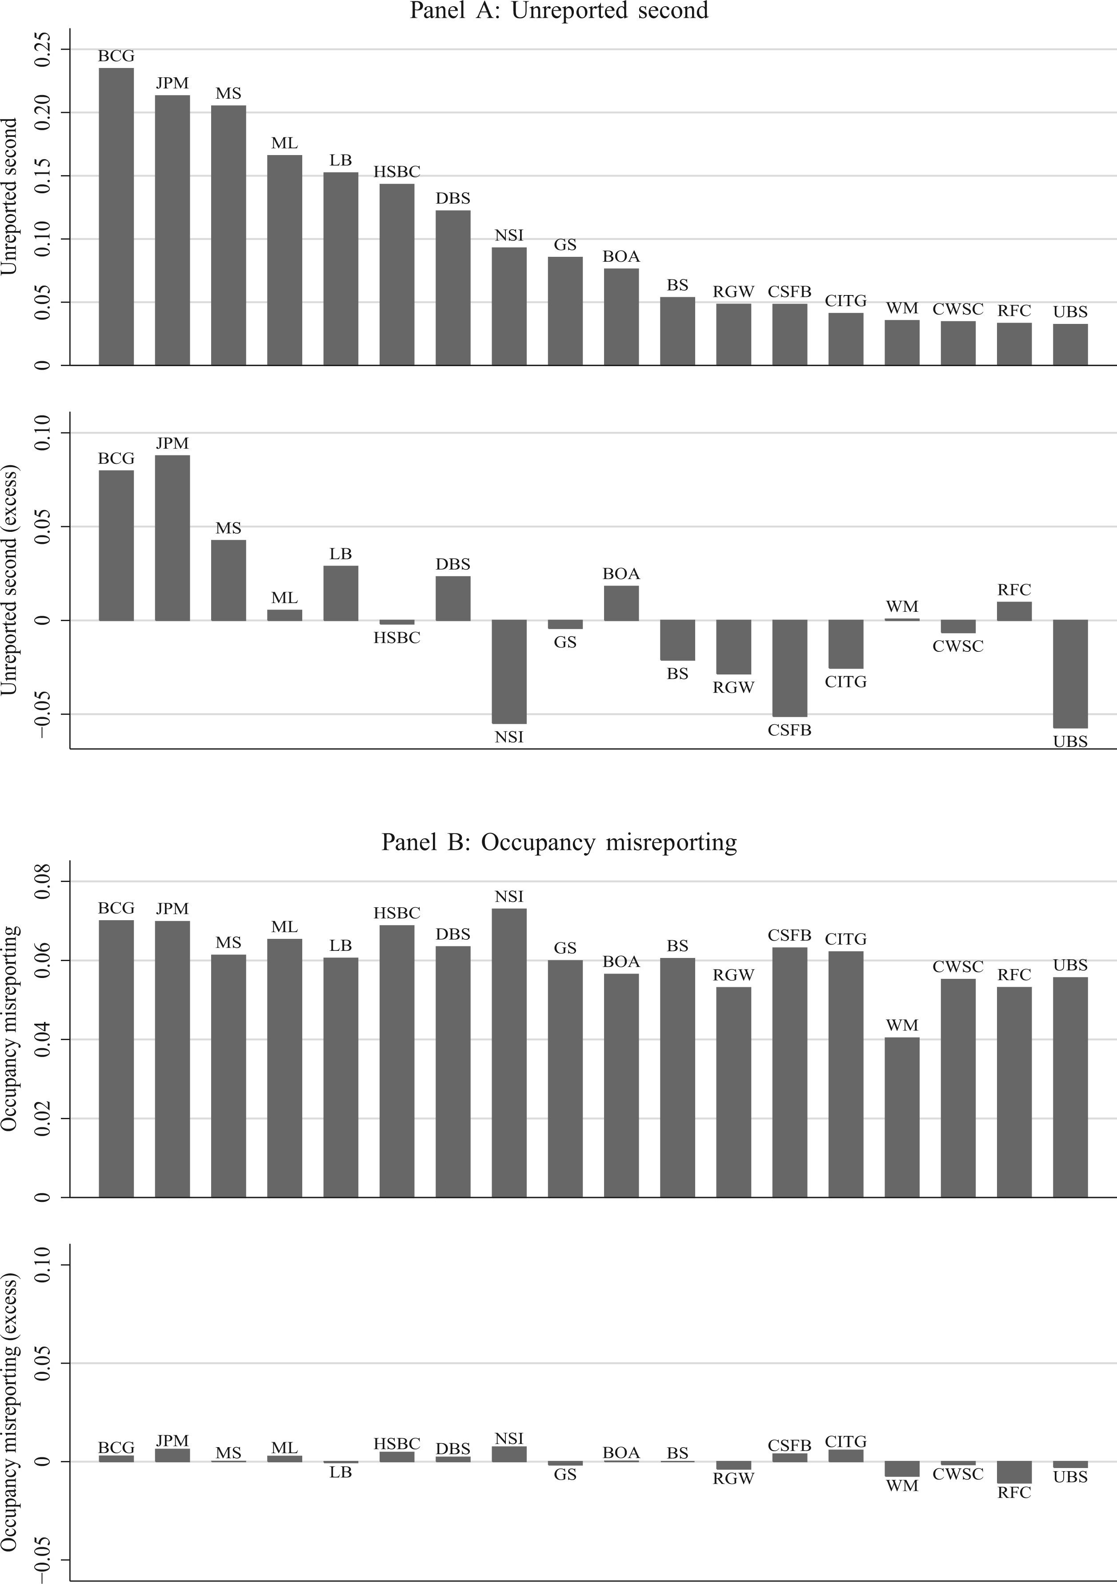
Figure 9 Misreporting by underwriter This figure examines differential reporting by underwriters. The top graph in ...
Notes:
Figure 9 Misreporting by underwriter This figure examines differential reporting by underwriters. The top graph in each panel shows misreporting by underwriters, and the bottom graph in each panel shows the excess misreporting compared to a benchmark based on the average amount of misreporting of each originator and the importance of each originator in the pools securitized by each underwriter. The comparisons for unreported second liens, occupancy misreporting, appraisal overstatements, and the aggregate misreporting indicator are shown in panels A, B, C, and D, respectively.
Unless provided in the caption above, the following copyright applies to the content of this slide: © The Author 2016. Published by Oxford University Press on behalf of The Society for Financial Studies. All rights reserved. For Permissions, please e-mail: journals.permissions@oup.com.

Slide 12
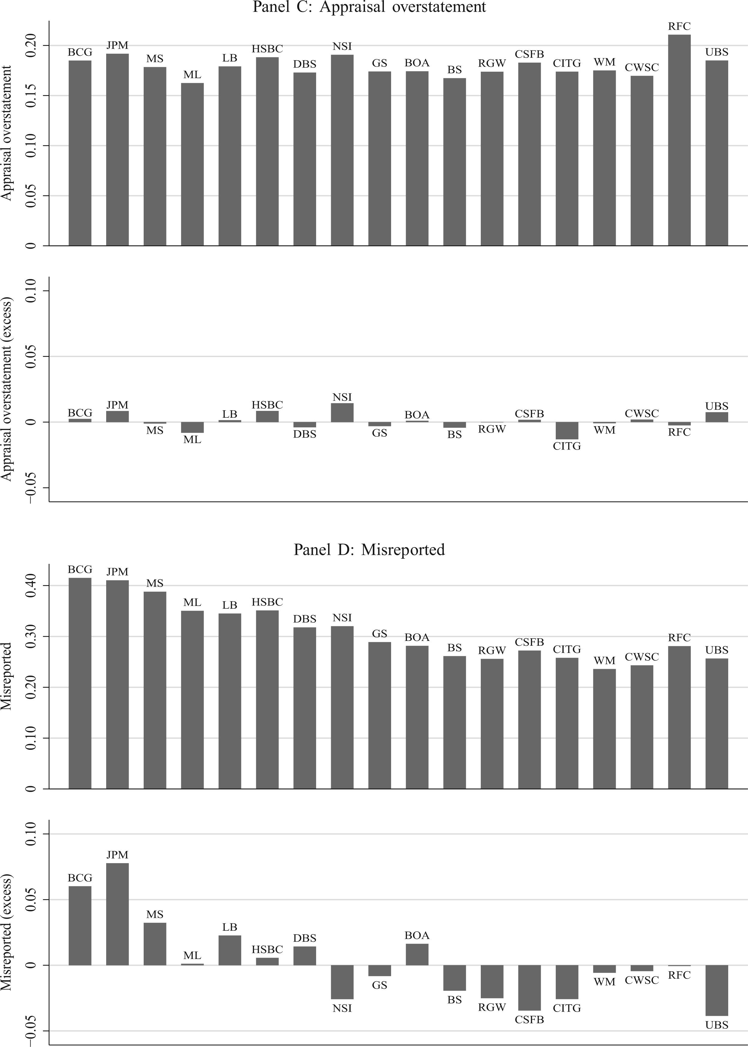
Figure 9 Misreporting by underwriter This figure examines differential reporting by underwriters. The top graph in ...
Notes:
Figure 9 Misreporting by underwriter This figure examines differential reporting by underwriters. The top graph in each panel shows misreporting by underwriters, and the bottom graph in each panel shows the excess misreporting compared to a benchmark based on the average amount of misreporting of each originator and the importance of each originator in the pools securitized by each underwriter. The comparisons for unreported second liens, occupancy misreporting, appraisal overstatements, and the aggregate misreporting indicator are shown in panels A, B, C, and D, respectively.
Unless provided in the caption above, the following copyright applies to the content of this slide: © The Author 2016. Published by Oxford University Press on behalf of The Society for Financial Studies. All rights reserved. For Permissions, please e-mail: journals.permissions@oup.com.

