Slide 1
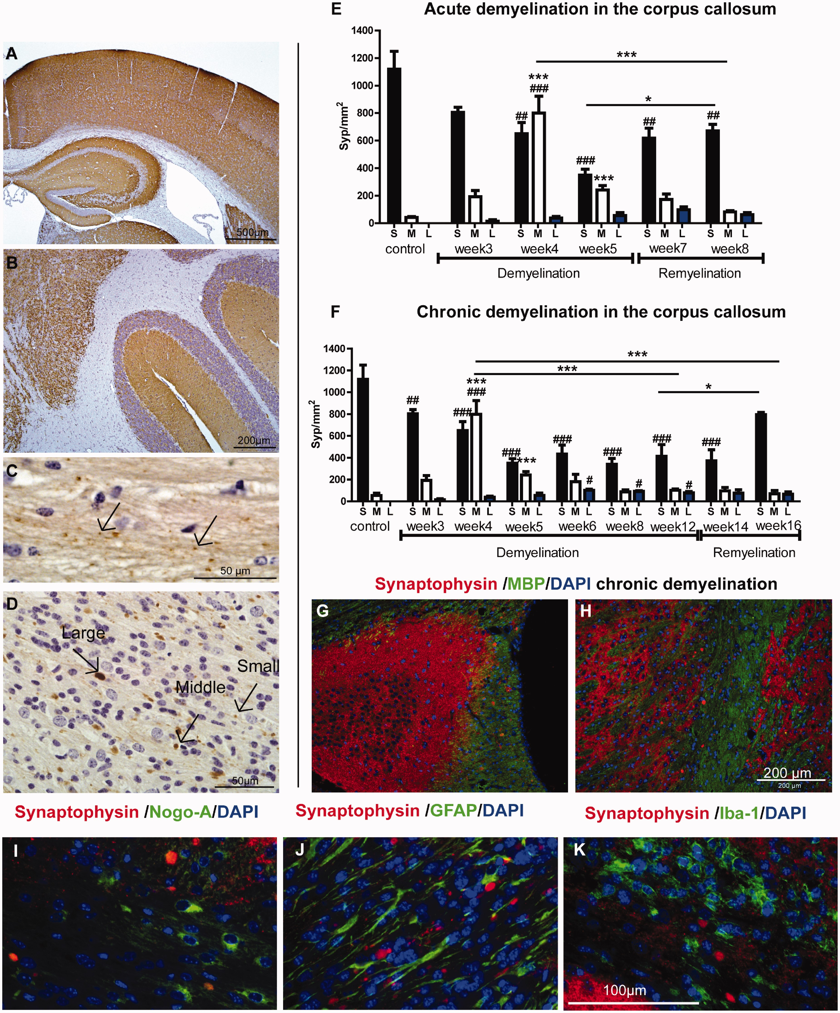
FIGURE 1 (A–C) Representative sections illustrate immunohistochemical staining for synaptophysin (Syp) in the cerebral ...
Notes:
FIGURE 1 (A–C) Representative sections illustrate immunohistochemical staining for synaptophysin (Syp) in the cerebral cortex and hippocampus (A), cerebellum (B), and corpus callosum (C) of untreated control mice. (D) Accumulation of synaptophysin-positive vesicles = spheroids/ovoids/bulbs in the corpus callosum of a cuprizone-treated mouse. Arrows indicate the different sizes of synaptophysin-positive-spheroids; small [S], <2 µm (as in panel C); middle-sized [M], 2–7.5 µm; large [L], 8–15 µm, pathological size. (E, F) Graphs show numbers of different sized synaptophysin-positive spheroids in the corpus callosum during acute (5 weeks, E) and chronic (12 weeks, F) demyelination followed by remyelination after stopping cuprizone. Significant effects between different time points were calculated separately for each type/size of bulbs (*p <0.05, **p < 0.01, **p < 0.001). Significant effects for different cuprizone time treatments in comparison to the untreated control: #p < 0.05, ##p < 0.01, ###p < 0.001), n = 4–6. (G, H) Representative images show synaptophysin-positive bulbs in the demyelinated hippocampus (G) and internal capsule (H). (I-K) Representative images show that synaptophysin does not colocalize with the oligodendroglial marker Nogo-A (I), the astrocytic marker GFAP (J), or with the microglial marker Iba-1 (K). Scale bar in (K) = 100 µm, applies to (I) and (J).
Unless provided in the caption above, the following copyright applies to the content of this slide: © 2017 American Association of Neuropathologists, Inc. All rights reserved.

Slide 2
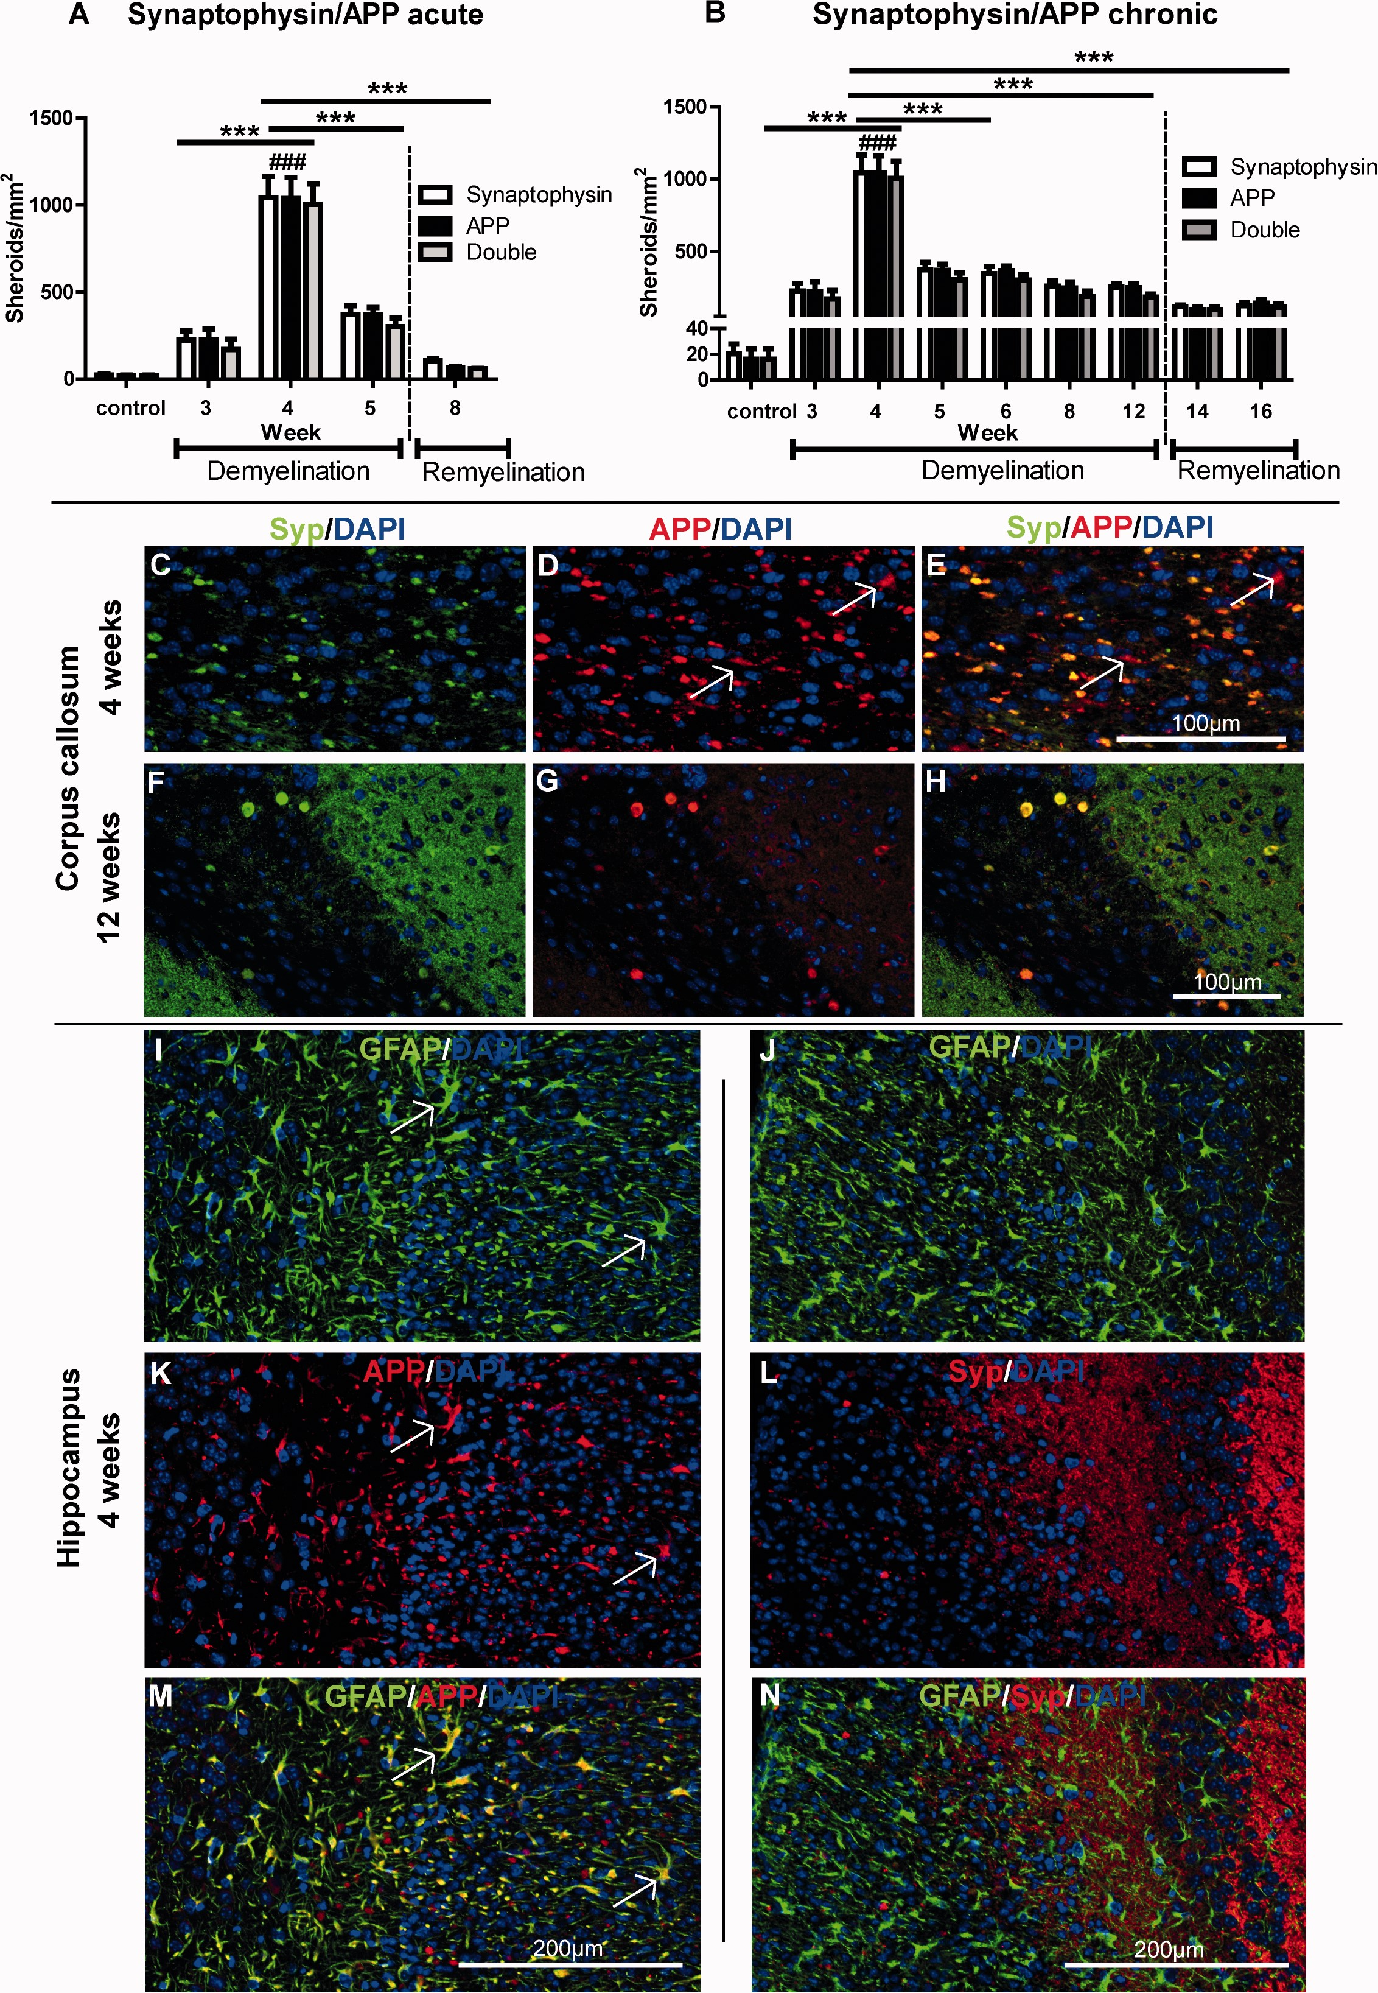
FIGURE 2 (A, B) Graphs represent the quantitative analysis of APP, synaptophysin (Syp), and double-positive spheroids ...
Notes:
FIGURE 2 (A, B) Graphs represent the quantitative analysis of APP, synaptophysin (Syp), and double-positive spheroids in the corpus callosum of cuprizone-treated mice with acute demyelination (A) and chronic demyelination (B). Two-way ANOVA analysis identify that there were no significant differences between numbers of APP- and synaptophysin-positive spheroids during both acute and chronic demyelination or during the remyelination periods. Significant effects between different time points are indicated by asterisks (*p < 0.05, **p < 0.01, **p < 0.001). Significant effects for different cuprizone time treatments in comparison to the untreated control were indicated by hatch marks (#p < 0.05, ##p < 0.01, ###p < 0.001), n = 4–6. (C–H) Representative pictures show colocalization in the corpus callosum of both markers at 4- and 12-week time points. Arrows in (D) and (E) indicate astrocytes expressing APP in the corpus callosum. (I–N) Representative images show that APP (MAB 348) was also expressed in reactive astrocytes in the hippocampus; GFAP and synaptophysin are not colocalized.
Unless provided in the caption above, the following copyright applies to the content of this slide: © 2017 American Association of Neuropathologists, Inc. All rights reserved.

Slide 3
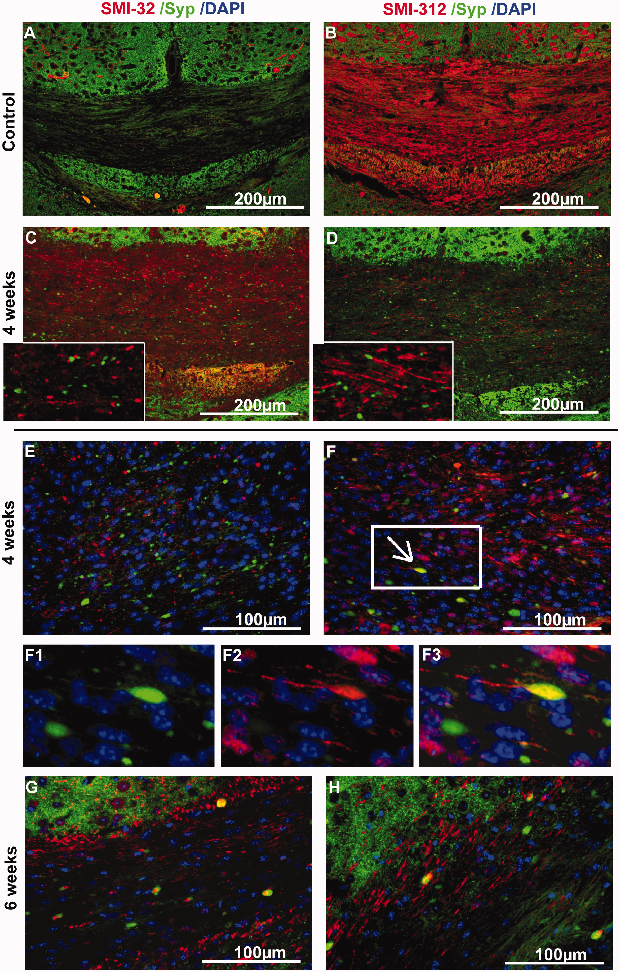
FIGURE 3 Immunohistochemical staining of the corpus callosum evaluating phosphorylation of neurofilaments and their ...
Notes:
FIGURE 3 Immunohistochemical staining of the corpus callosum evaluating phosphorylation of neurofilaments and their colocalization with synaptophysin (Syp) during cuprizone-induced demyelination. (A–H) SMI-32 detecting non-phosphorylated heavy neurofilaments are shown in panels (A, C, E, G). SMI-312 detecting phosphorylated neurofilaments H and M are illustrated in panels (B, D, F, H). Inserts in (C) and (D) show higher magnification images. Neurofilaments were highly phosphorylated in untreated control animals (B). During the course of demyelination, neurofilaments lost their phosphorylation (D, F, H). Moreover, mostly dephosphorylated neurofilaments (E) but also some phosphorylated neurofilaments (F) cannot be properly transported throughout axons and accumulate in numerous small bulbs. These neurofilament bulbs predominantly did not colocalize with synaptophysin-positive spheroids. However, during the progression of demyelination both markers were found in similar structures, i.e. large ovoids probably representing transected axons (G, H). F1, F2, F3 (from the boxed area in F) also show synaptophysin-positive transected axons.
Unless provided in the caption above, the following copyright applies to the content of this slide: © 2017 American Association of Neuropathologists, Inc. All rights reserved.

Slide 4
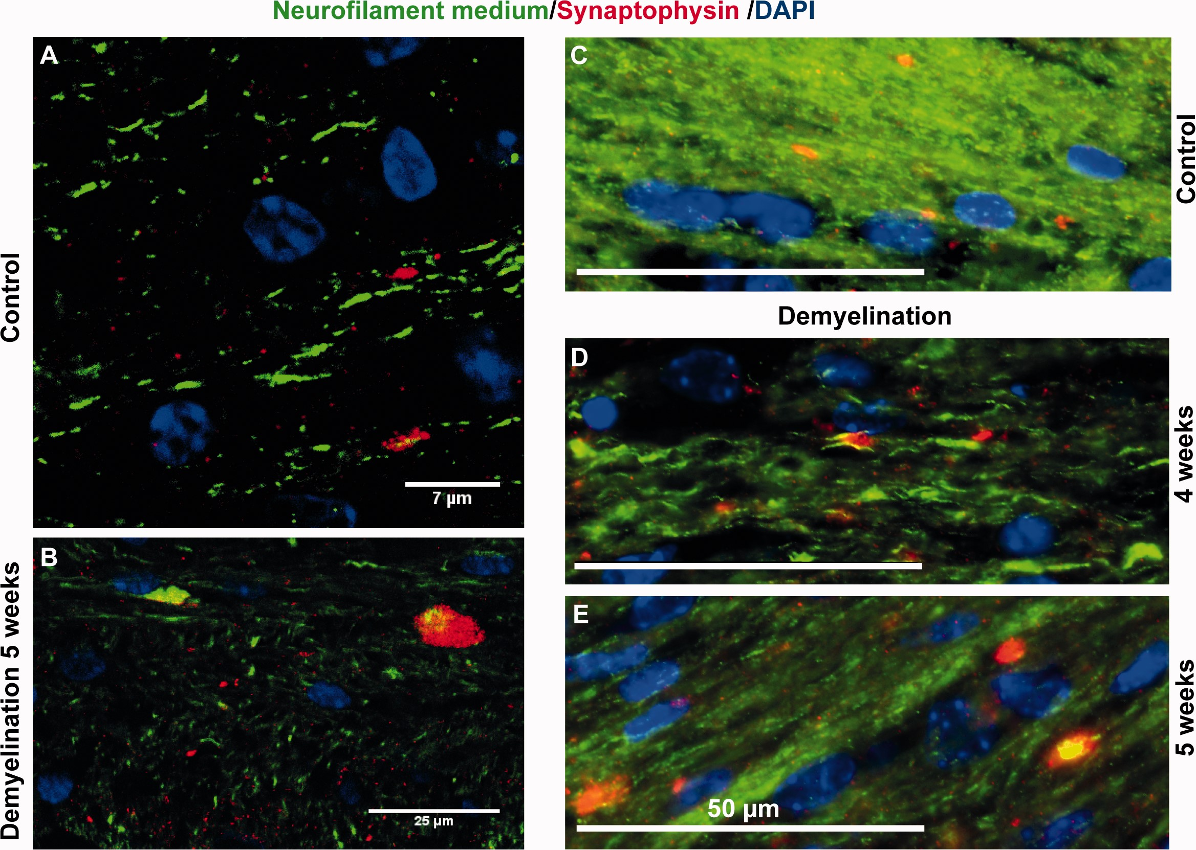
FIGURE 4 (A-E) Representative images show neurofilament medium chain staining in the corpus callosum of control mice ...
Notes:
FIGURE 4 (A-E) Representative images show neurofilament medium chain staining in the corpus callosum of control mice (A, C) and cuprizone-treated mice (B, D, E). Panels (A) and (B) are confocal images.
Unless provided in the caption above, the following copyright applies to the content of this slide: © 2017 American Association of Neuropathologists, Inc. All rights reserved.

Slide 5
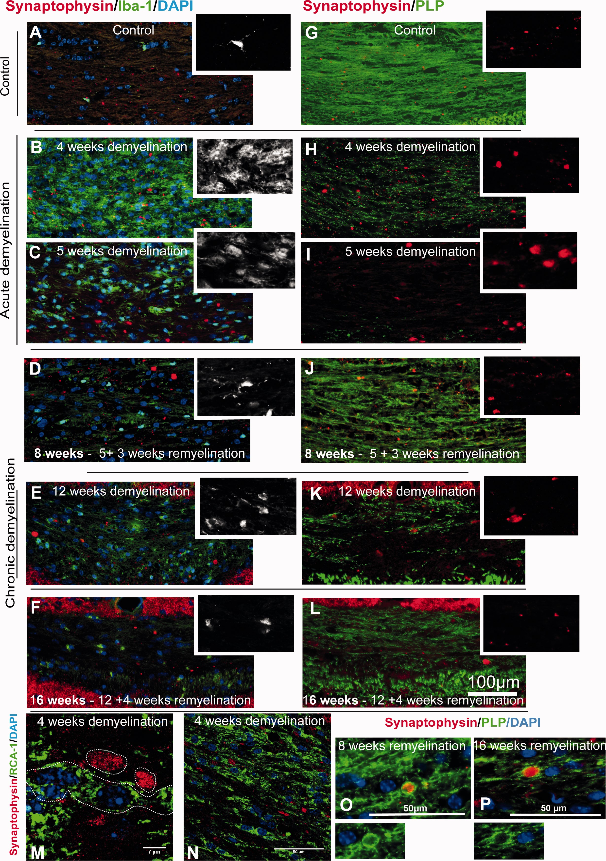
FIGURE 5 (A-P) Representative sections show immunostaining in the corpus callosum for synaptophysin/Iba-1 (A-F) and ...
Notes:
FIGURE 5 (A-P) Representative sections show immunostaining in the corpus callosum for synaptophysin/Iba-1 (A-F) and synaptophysin/PLP (G–L) during acute and chronic cuprizone induced demyelination and subsequent remyelination. Inserts in (A–F) show the morphology/shape of microglia identifying their activation state. Inserts in (G–L) show higher magnification of synaptophysin accumulations. Panels (M) and (N) are confocal images from RCA-1 (microglia activation marker, green) and synaptophysin (red) during inflammation in cuprizone-treated mice. Panels (O) and (P) show remyelinated axons (PLP, green) with internal synaptophysin accumulation (red).
Unless provided in the caption above, the following copyright applies to the content of this slide: © 2017 American Association of Neuropathologists, Inc. All rights reserved.

Slide 6
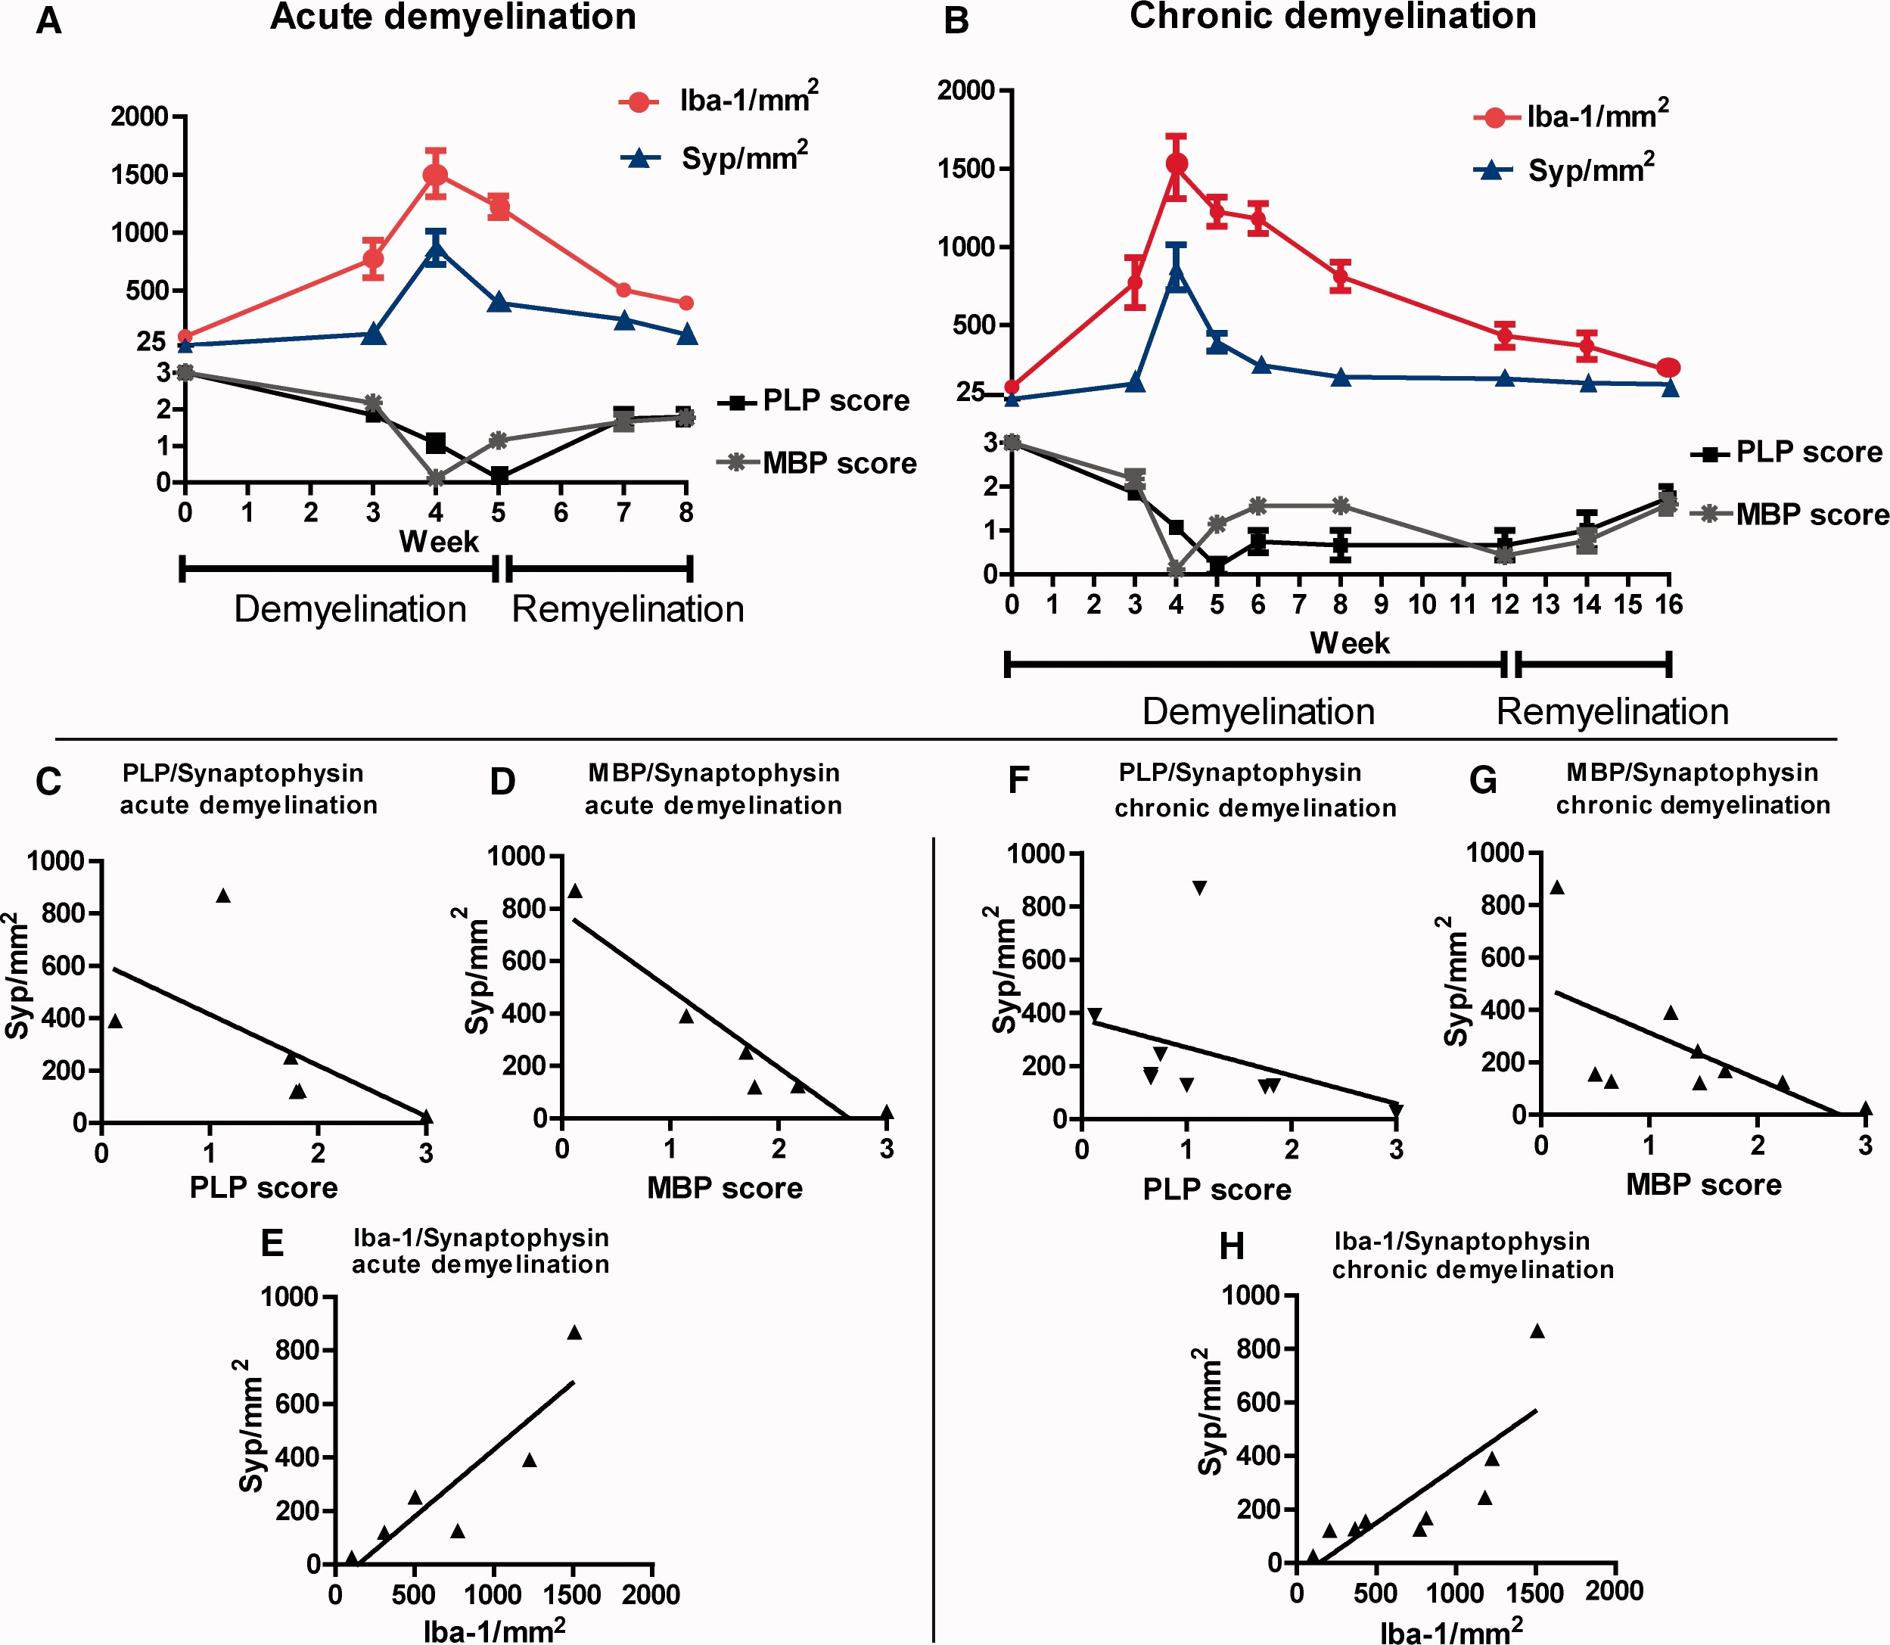
FIGURE 6 The appearance of synaptophysin (Syp)-positive pathological (medium-and large-sized) spheroids was compared ...
Notes:
FIGURE 6 The appearance of synaptophysin (Syp)-positive pathological (medium-and large-sized) spheroids was compared and correlated with the extent of demyelination (proteolipid protein: PLP, myelin basic protein: MBP) and microglia infiltration (Iba-1) induced by cuprizone feeding (acute or chronic). (A, B) Graphs show the extent of microglia accumulation, appearance of pathological synaptophysin bulbs and the extent of de- and remyelination as judged by scoring of MBP and PLP immunostaining. Score of 3 represents complete myelination; score of 0 represents complete demyelination. (C–H) Correlation analyses of synaptophysin-positive bulbs with the extent of de- and remyelination and microglia numbers (n = 5–6).
Unless provided in the caption above, the following copyright applies to the content of this slide: © 2017 American Association of Neuropathologists, Inc. All rights reserved.

Slide 7
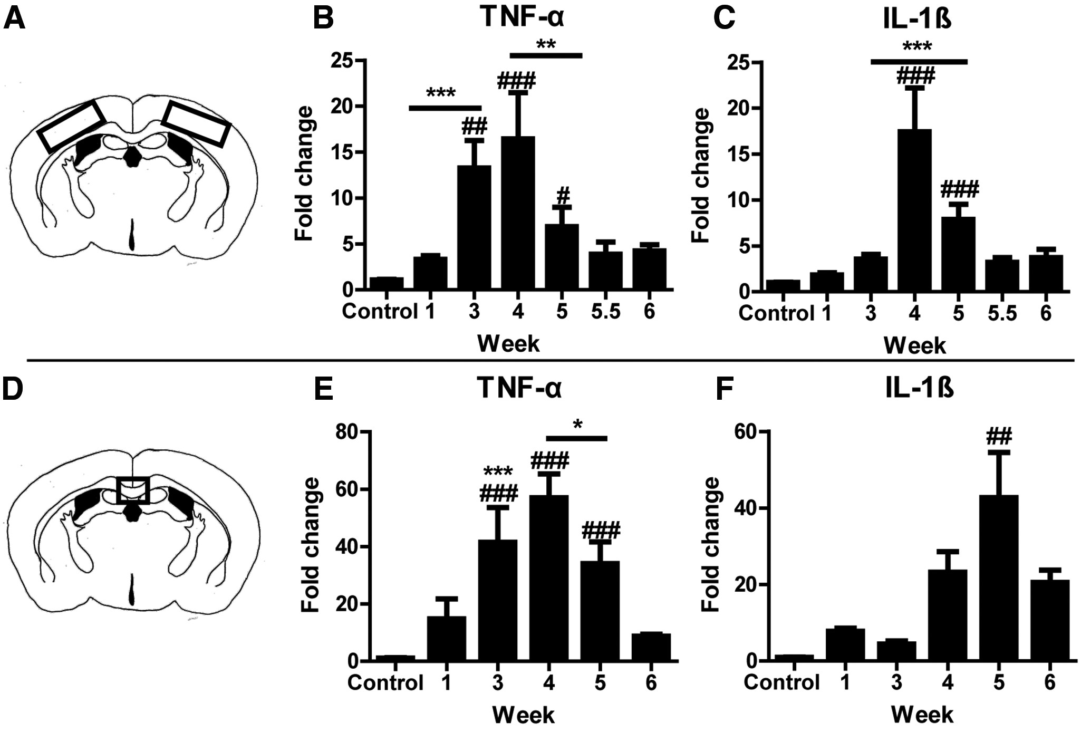
Figure 7 (A, D) Sketches of the mouse brain in coronal section. The marked areas in the cortex and corpus callosum ...
Notes:
Figure 7 (A, D) Sketches of the mouse brain in coronal section. The marked areas in the cortex and corpus callosum represent investigated regions. (B, C) Graphs indicate mRNA expression of the inflammatory cytokines TNF and IL-1β in the cerebral cortex. (E, F) mRNA expression of TNF and IL-1β in the corpus callosum, Significant effects between different time points are indicated as: *p < 0.05, **p < 0.01, **p < 0.001. Significant effects for different cuprizone time treatments in comparison to the untreated control are indicated as: #p < 0.05, ##p < 0.01, ###p < 0.001), n = 4–5.
Unless provided in the caption above, the following copyright applies to the content of this slide: © 2017 American Association of Neuropathologists, Inc. All rights reserved.

Slide 8
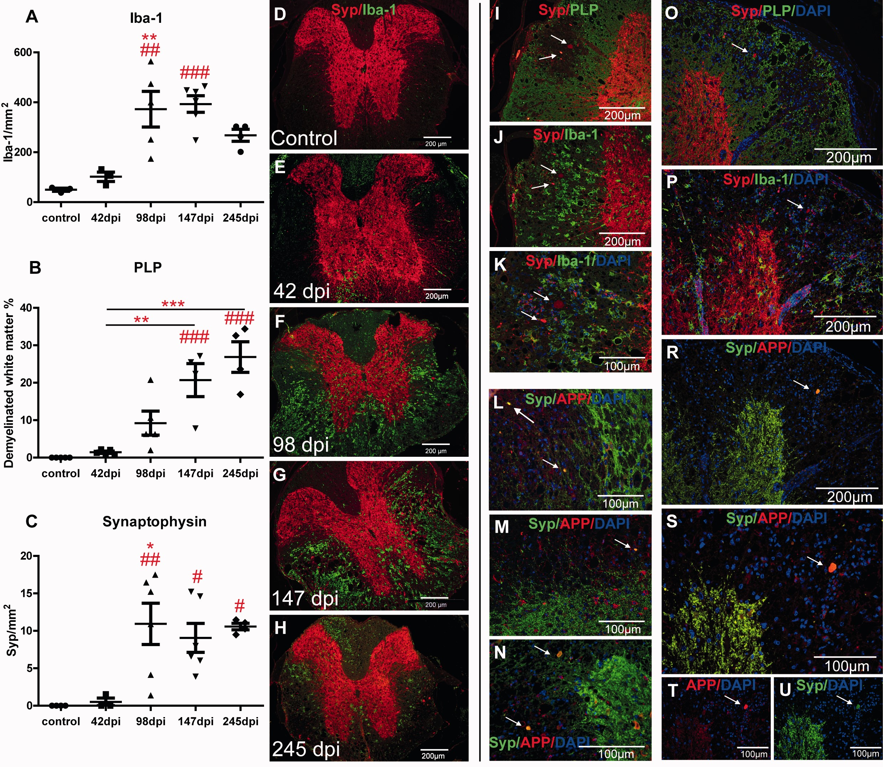
FIGURE 8 (A–C) Graphs show microglia/macrophage infiltration (A) and the course of demyelination (B) during Theiler’s ...
Notes:
FIGURE 8 (A–C) Graphs show microglia/macrophage infiltration (A) and the course of demyelination (B) during Theiler’s virus induced encephalomyelitis in the thoracic segment of murine spinal cord. (C) Panel shows the appearance of pathologic accumulation of synaptophysin (Syp). Significant effects between different time points were indicated as: *p < 0.05, **p < 0.01, **p < 0.001. Significant effects for different time treatments in comparison to the untreated control are indicated as: # p < 0.05, ## p < 0.01, ### p < 0.001), n = 4–6. (D–H) Representative images of thoracic spinal cord segment illustrate infiltration of microglia/macrophage at different days after the injection of Theiler’s murine encephalomyelitis virus. (I–U) Panel (I) shows the appearance of synaptophysin-positive bulbs exclusively in the demyelinated area; (J) and (K) illustrate the appearance of synaptophysin-positive spheroids surrounded by activated microglia/macrophages. (L–N) Colocalization of synaptophysin and APP in the spheroid structures. (O–U) Serial staining of the same spinal cord area during Theiler’s virus induced encephalomyelitis (O, synaptophysin/PLP double staining; P, synaptophysin/Iba-1 double staining; R, synaptophysin/APP double staining; S–U, higher magnification of area shown in R).
Unless provided in the caption above, the following copyright applies to the content of this slide: © 2017 American Association of Neuropathologists, Inc. All rights reserved.

Slide 9
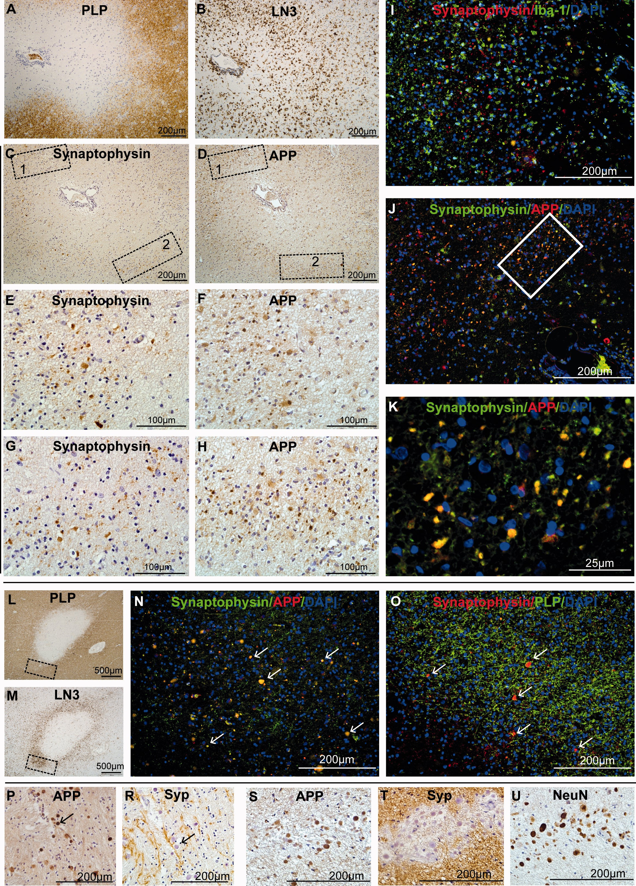
FIGURE 9 Representative images show the expression of synaptophysin (Syp) in CNS tissue of 2 different patients with ...
Notes:
FIGURE 9 Representative images show the expression of synaptophysin (Syp) in CNS tissue of 2 different patients with MS. (A–H) Different immunohistochemical stainings from a chronic active MS lesion (serial sections). Panels (E) and (F) show the higher magnifications from boxed areas 1 in (C) and (D). Panels (G) and (H) demonstrate higher magnification from boxed areas 2 in (C) and D. (I–K) Representative double immunostaining for synaptophysin and Iba-1 demonstrate microglia accumulation (I) and proving colocalization of APP and synaptophysin (J, K). (L–O) Demyelination/inflammation/axonal damage in another MS lesion. DAB staining in (L) and (M) illustrate the extent of demyelination (PLP) and inflammation (LN3 marks HLA-DR-positive cells: lymphocytes and macrophages) in this MS lesion. Panels N and O show higher magnification of the boxed are from this lesion in (L) and (M) demonstrating double expression of APP and synaptophysin in (N) and double staining of PLP and synaptophysin in (O). (P–U) Corpora amylacea are immunostain-positive for APP (P, S), and NeuN (U), but not synaptophysin (R, T).
Unless provided in the caption above, the following copyright applies to the content of this slide: © 2017 American Association of Neuropathologists, Inc. All rights reserved.

