Slide 1
Figure 1 LPS stimulation increased protein expression of TLR4 and PARP1 After HAECs were stimulated by 100 ng/ml LPS ...
Notes:
Figure 1 LPS stimulation increased protein expression of TLR4 and PARP1 After HAECs were stimulated by 100 ng/ml LPS for 24 h, the expression of TLR4 and PARP1 was assessed by western blot analysis. (A–C) Western blot analysis of TLR4 and PARP1 expression. Control: cells without stimulation. Values are expressed as mean ± SD from four separate experiments. *P < 0.05 vs. control.
Unless provided in the caption above, the following copyright applies to the content of this slide: © The Author 2012. Published by ABBS Editorial Office in association with Oxford University Press on behalf of the Institute of Biochemistry and Cell Biology, Shanghai Institutes for Biological Sciences, Chinese Academy of Sciences.

Slide 2
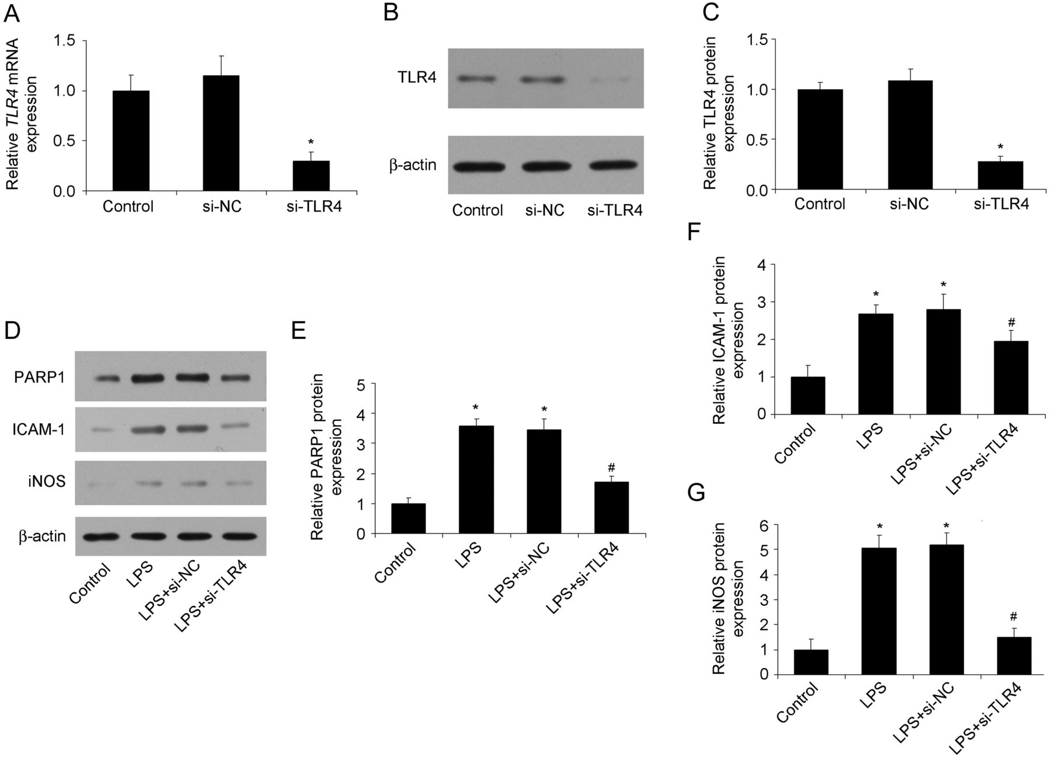
Figure 2 TLR4 inhibition reduced LPS-induced protein expression of PARP1 and inflammatory cytokines The mRNA and ...
Notes:
Figure 2 TLR4 inhibition reduced LPS-induced protein expression of PARP1 and inflammatory cytokines The mRNA and protein expression of TLR4 was determined by RT-PCR and western blot analysis after TLR4 siRNA transfection. After TLR4 was inhibited by siRNA, the protein expression of PARP1, ICAM-1, and iNOS was determined after cells were stimulated by LPS for 24 h. (A) RT-PCR analysis of TRL4 mRNA expression. (B, C) Western blot analysis of protein expression of TLR4. (D–G) Western blot analysis of protein expression of PARP1, ICAM-1 and iNOS. si-NC, negative control of siRNA of TLR4; si-TLR4, siRNA of TLR4. Control: cells without stimulation. Values are expressed as mean ± SD from three separate experiments. *P < 0.05 vs. control. #P < 0.05 vs. LPS.
Unless provided in the caption above, the following copyright applies to the content of this slide: © The Author 2012. Published by ABBS Editorial Office in association with Oxford University Press on behalf of the Institute of Biochemistry and Cell Biology, Shanghai Institutes for Biological Sciences, Chinese Academy of Sciences.

Slide 3
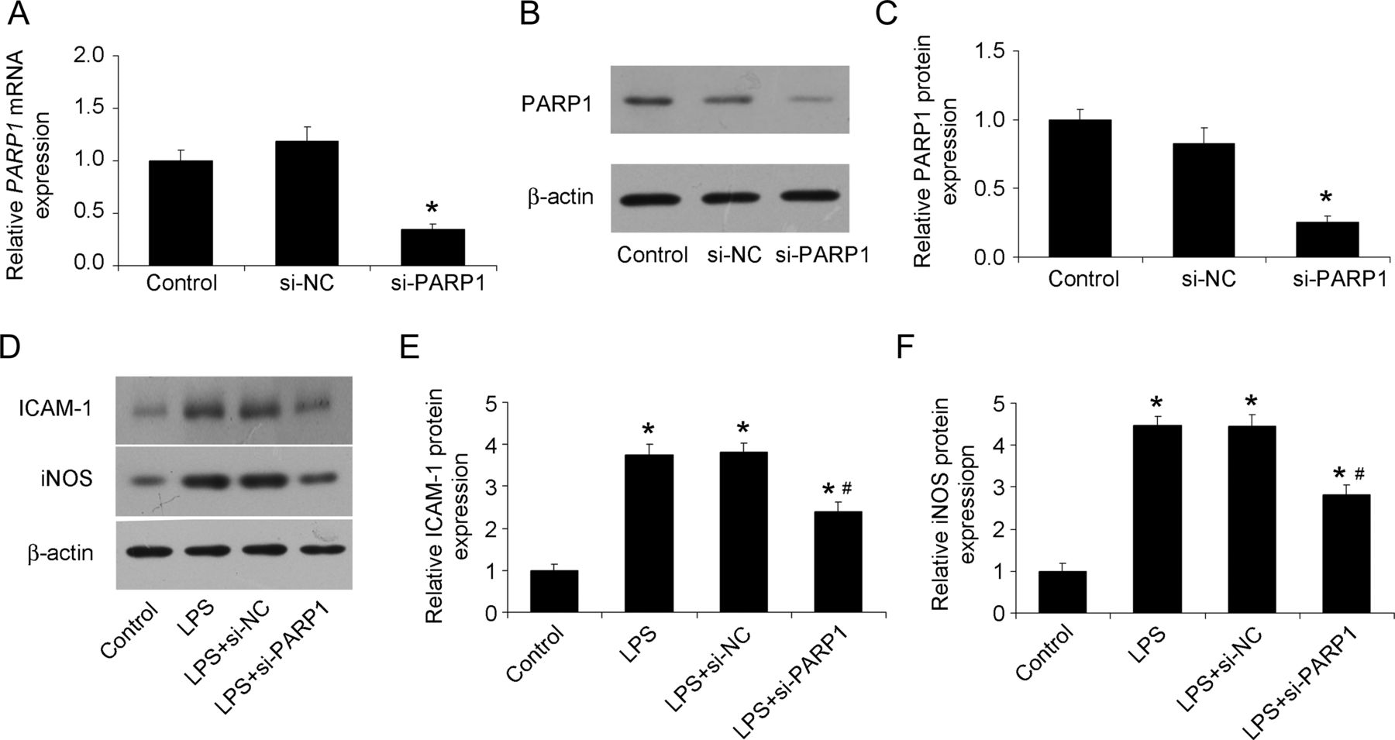
Figure 3 PARP1 inhibition reduced LPS-induced protein expression of ICAM-1 and iNOS The mRNA and protein expression of ...
Notes:
Figure 3 PARP1 inhibition reduced LPS-induced protein expression of ICAM-1 and iNOS The mRNA and protein expression of PARP1 was determined by RT-PCR and western blot analysis after PARP1 siRNA transfection. After PARP1 was inhibited by siRNA, the protein expression of ICAM-1 and iNOS was determined after cells were stimulated by LPS for 24 h. (A) RT-PCR analysis of PARP1 mRNA expression. (B, C) Western blot analysis of protein expression of PARP1. (D–F) Western blot analysis of protein expression of ICAM-1 and iNOS. si-NC, negative control of siRNA of PARP1; si-PARP1, siRNA of PARP1. Control: cells without stimulation. Values are expressed as mean ± SD from three separate experiments. *P < 0.05 vs. control. #P < 0.05 vs. LPS.
Unless provided in the caption above, the following copyright applies to the content of this slide: © The Author 2012. Published by ABBS Editorial Office in association with Oxford University Press on behalf of the Institute of Biochemistry and Cell Biology, Shanghai Institutes for Biological Sciences, Chinese Academy of Sciences.

Slide 4
Figure 4 NF-κB inhibition reduced the protein expression of ICAM-1 and iNOS After NF-κB inhibition by BAY 11-7082 (1 ...
Notes:
Figure 4 NF-κB inhibition reduced the protein expression of ICAM-1 and iNOS After NF-κB inhibition by BAY 11-7082 (1 μM), cells were stimulated by LPS, then the protein expression of ICAM-1 and iNOS was determined by western blot analysis. (A–C) Western blot analysis of protein expression of ICAM-1 and iNOS. BAY 11-7082, NF-κB inhibitor; control: cells without stimulation. Values are mean ± SD from two separate experiments. *P < 0.05 vs. control. #P < 0.05 vs. LPS.
Unless provided in the caption above, the following copyright applies to the content of this slide: © The Author 2012. Published by ABBS Editorial Office in association with Oxford University Press on behalf of the Institute of Biochemistry and Cell Biology, Shanghai Institutes for Biological Sciences, Chinese Academy of Sciences.

Slide 5
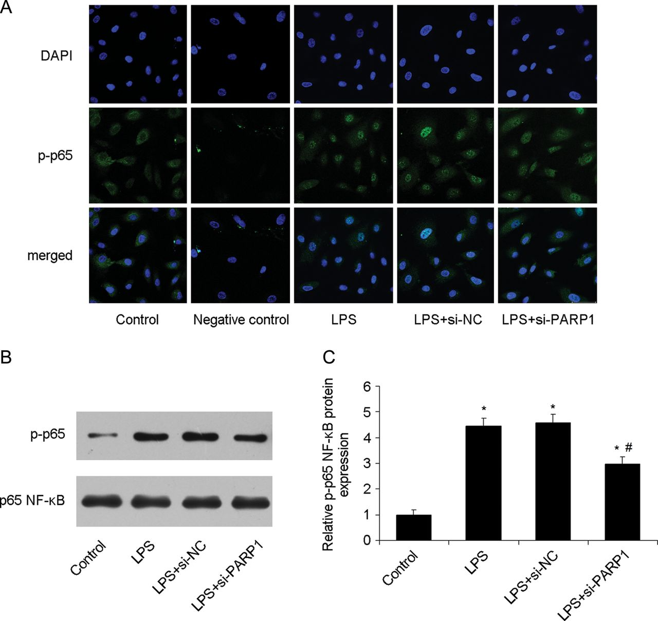
Figure 5 PARP1 inhibition suppressed NF-κB nuclear translocation in HAECs After PARP1 was inhibited by siRNA, p-p65 ...
Notes:
Figure 5 PARP1 inhibition suppressed NF-κB nuclear translocation in HAECs After PARP1 was inhibited by siRNA, p-p65 expression was determined by immunofluorescence and western blot analysis. (A) Immunoﬂuorescence analysis of p-p65 NF-κB (green) and DAPI (blue). Nuclei were labeled with DAPI (blue); p-p65 NF-κB was stained with mouse anti-p-p65 NF-κB primary antibody and Alexa 488-conjugated goat anti-mouse second antibody (green). (B, C) Western blot analysis of protein expression of p-p65 NF-κB. Control, cells without stimulation. Values are mean ± SD from three separate experiments. *P < 0.05 vs. control. #P < 0.05 vs. LPS.
Unless provided in the caption above, the following copyright applies to the content of this slide: © The Author 2012. Published by ABBS Editorial Office in association with Oxford University Press on behalf of the Institute of Biochemistry and Cell Biology, Shanghai Institutes for Biological Sciences, Chinese Academy of Sciences.

