Slide 1
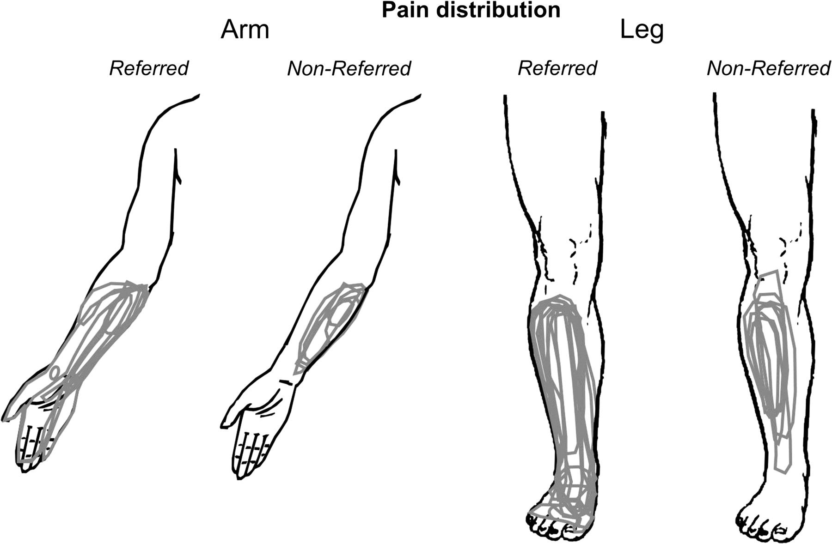
Figure 1. Line drawings of the leg and arm illustrating the extent of perceived pain in each subject following ...
Notes:
Figure 1. Line drawings of the leg and arm illustrating the extent of perceived pain in each subject following hypertonic saline injection into either the right FCR or TA muscle. Subjects were divided into 2 groups: those in which the pain was referred into the hand or foot (“referred”) and those in which the pain was not (“nonreferred”).
Unless provided in the caption above, the following copyright applies to the content of this slide: © The Author 2006. Published by Oxford University Press. All rights reserved. For permissions, please e-mail: journals.permissions@oxfordjournals.org

Slide 2
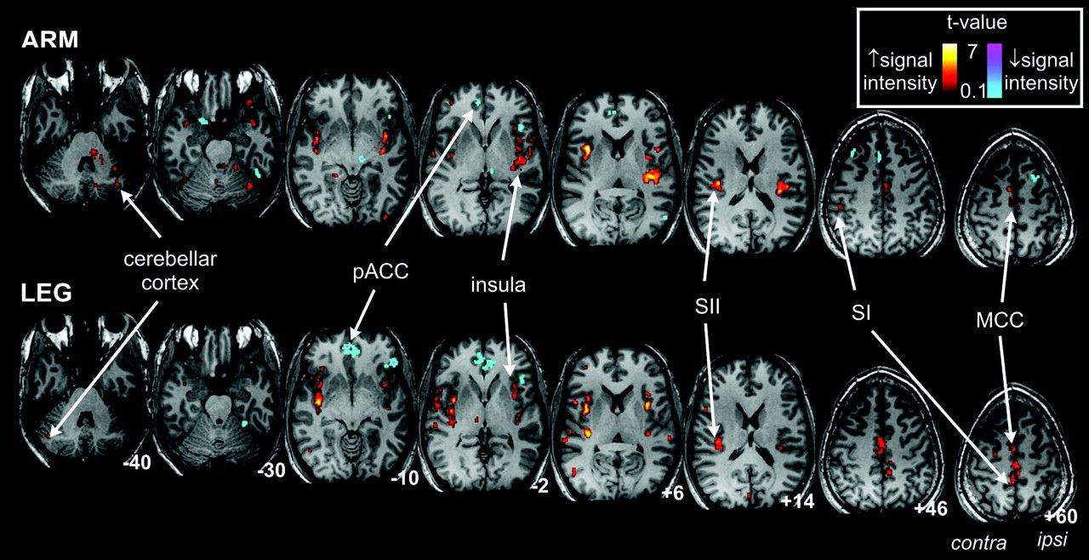
Figure 2. Significant fMRI signal intensity changes correlated to mean pain intensity profile during forearm and leg ...
Notes:
Figure 2. Significant fMRI signal intensity changes correlated to mean pain intensity profile during forearm and leg muscle pain overlaid onto an individual T1-weighted anatomical image set. The hot and cold color scales (coded for t-value) indicate regional signal intensity increases and decreases, respectively. Slice positions are indicated by MNI coordinates at the bottom right of each image. MCC, mid-cingulate cortex; pACC, perigenual anterior cingulate cortex.
Unless provided in the caption above, the following copyright applies to the content of this slide: © The Author 2006. Published by Oxford University Press. All rights reserved. For permissions, please e-mail: journals.permissions@oxfordjournals.org

Slide 3
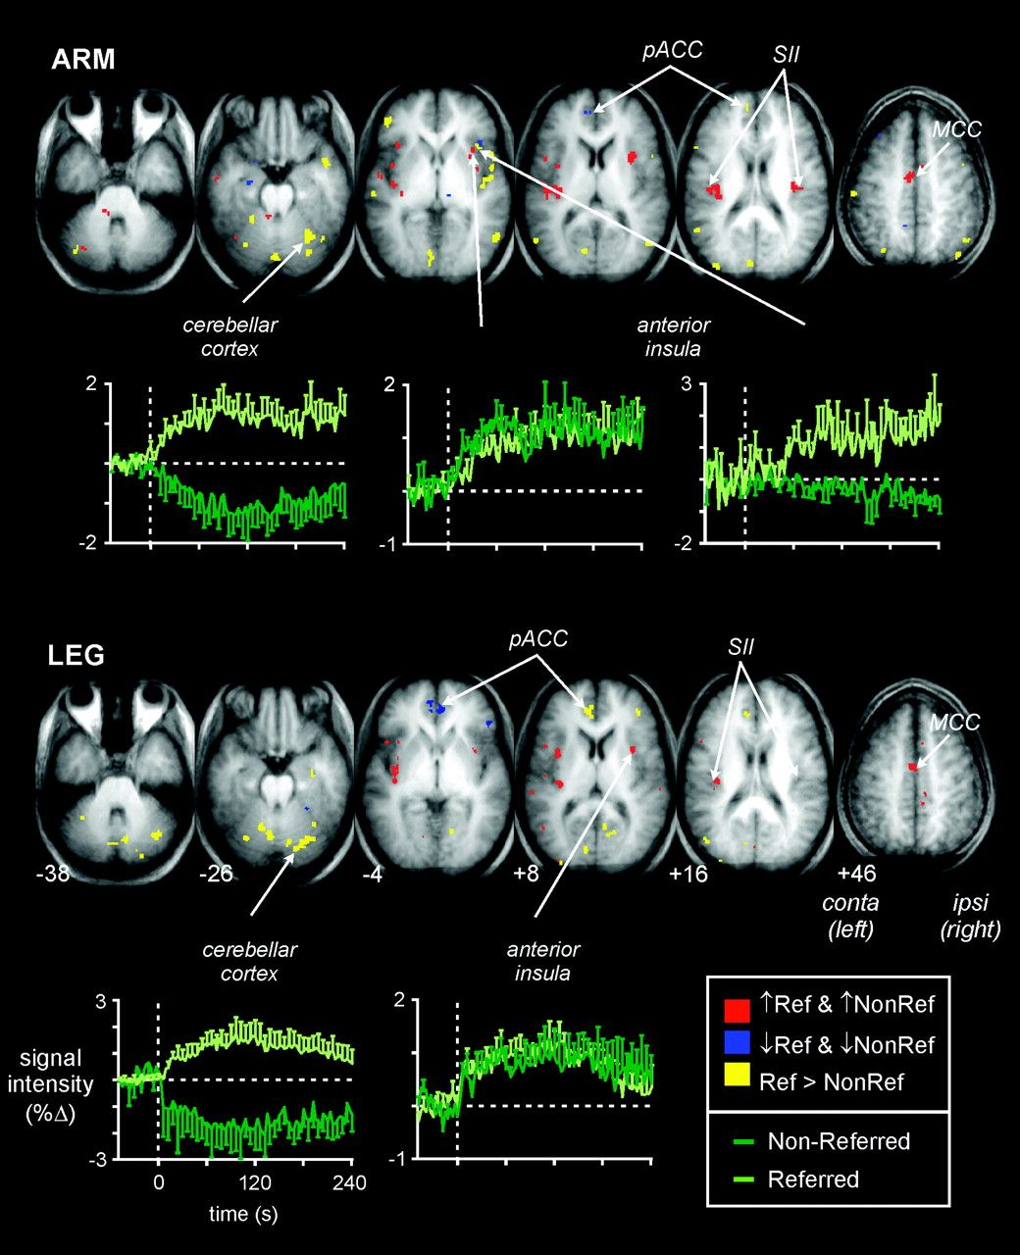
Figure 3. Significant fMRI signal intensity changes during arm and leg pain in the referred and nonreferred groups. ...
Notes:
Figure 3. Significant fMRI signal intensity changes during arm and leg pain in the referred and nonreferred groups. Significant signal intensity increases and decreases in both the referred and nonreferred groups are indicated by the red and blue shadings, respectively. Significant differences are indicated by the yellow shading. The mean percent (±SEM) change in signal intensity over time for a selection of significant clusters is also shown (light green, referred; dark green, nonreferred). The vertical dashed line indicates the onset of the hypertonic saline injection. Slice positions are indicated by MNI coordinates at the bottom left of the lower row of images. MCC, mid-cingulate cortex; pACC, perigenual anterior cingulate cortex.
Unless provided in the caption above, the following copyright applies to the content of this slide: © The Author 2006. Published by Oxford University Press. All rights reserved. For permissions, please e-mail: journals.permissions@oxfordjournals.org

Slide 4
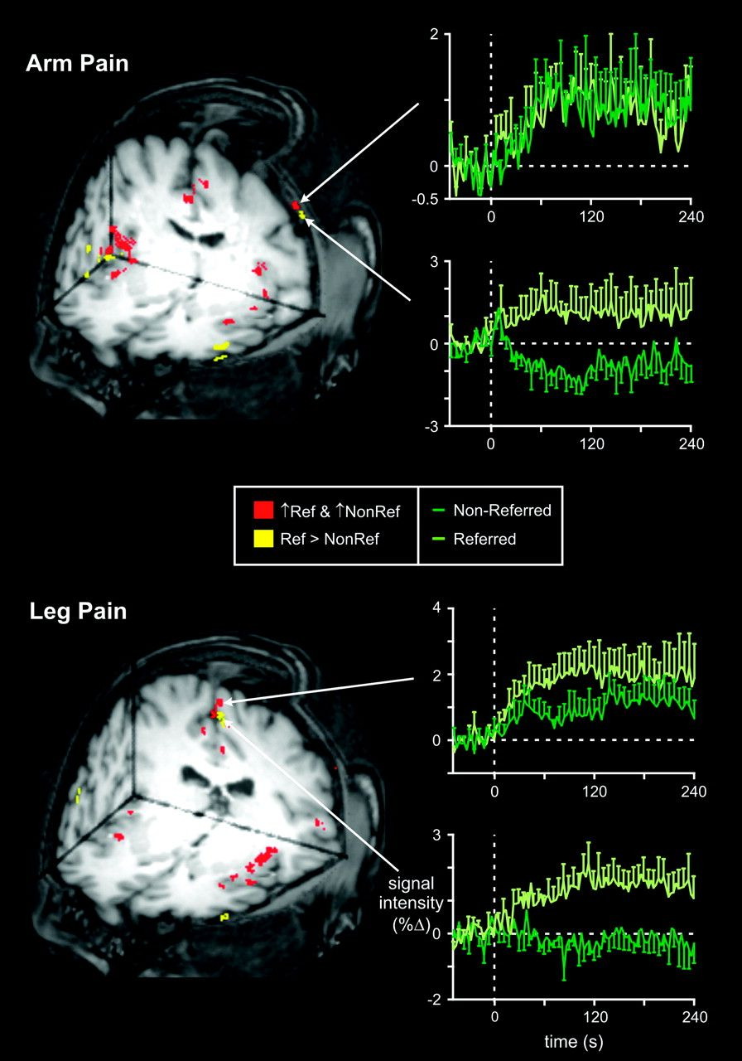
Figure 4. Significant fMRI signal intensity changes during arm and leg pain in the referred and nonreferred groups. ...
Notes:
Figure 4. Significant fMRI signal intensity changes during arm and leg pain in the referred and nonreferred groups. Significant signal intensity increases in both the referred and nonreferred groups are indicated by the red shading and significant differences by the yellow shading. The mean percent (±SEM) change in signal intensity over time for significant clusters in the SI is shown to the right (light green, referred; dark green, nonreferred). The vertical dashed line indicates the onset of the hypertonic saline injection.
Unless provided in the caption above, the following copyright applies to the content of this slide: © The Author 2006. Published by Oxford University Press. All rights reserved. For permissions, please e-mail: journals.permissions@oxfordjournals.org

Slide 5
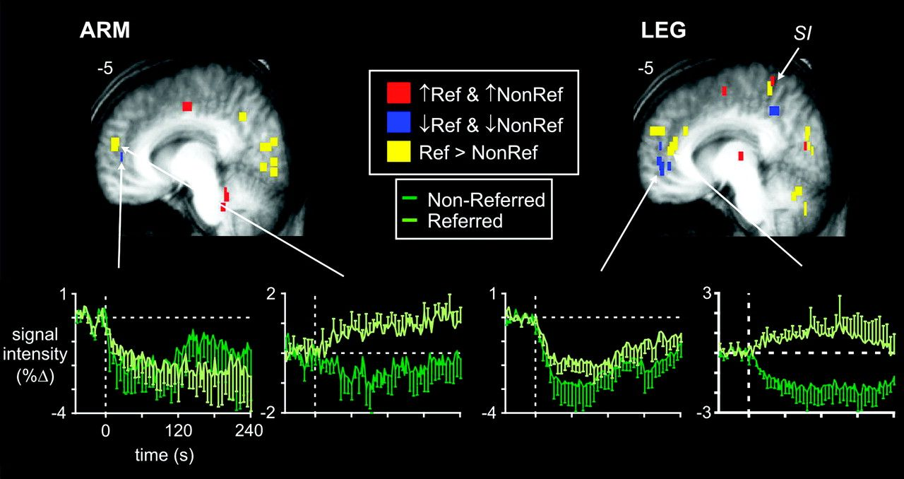
Figure 7. Significant fMRI signal intensity changes in the cingulate cortex during arm and leg pain in the referred and ...
Notes:
Figure 7. Significant fMRI signal intensity changes in the cingulate cortex during arm and leg pain in the referred and nonreferred groups. Significant signal intensity increases and decreases in both the referred and nonreferred groups are indicated by the red and blue shadings, respectively. Significant differences are indicated by the yellow shading. The mean percent (±SEM) change in signal intensity over time for significant clusters in the perigenual cingulate cortex is shown below (light green, referred; dark green, nonreferred). The vertical dashed line indicates the onset of the hypertonic saline injection. Slice positions are indicated by MNI coordinates at the top left of each image.
Unless provided in the caption above, the following copyright applies to the content of this slide: © The Author 2006. Published by Oxford University Press. All rights reserved. For permissions, please e-mail: journals.permissions@oxfordjournals.org

Slide 6
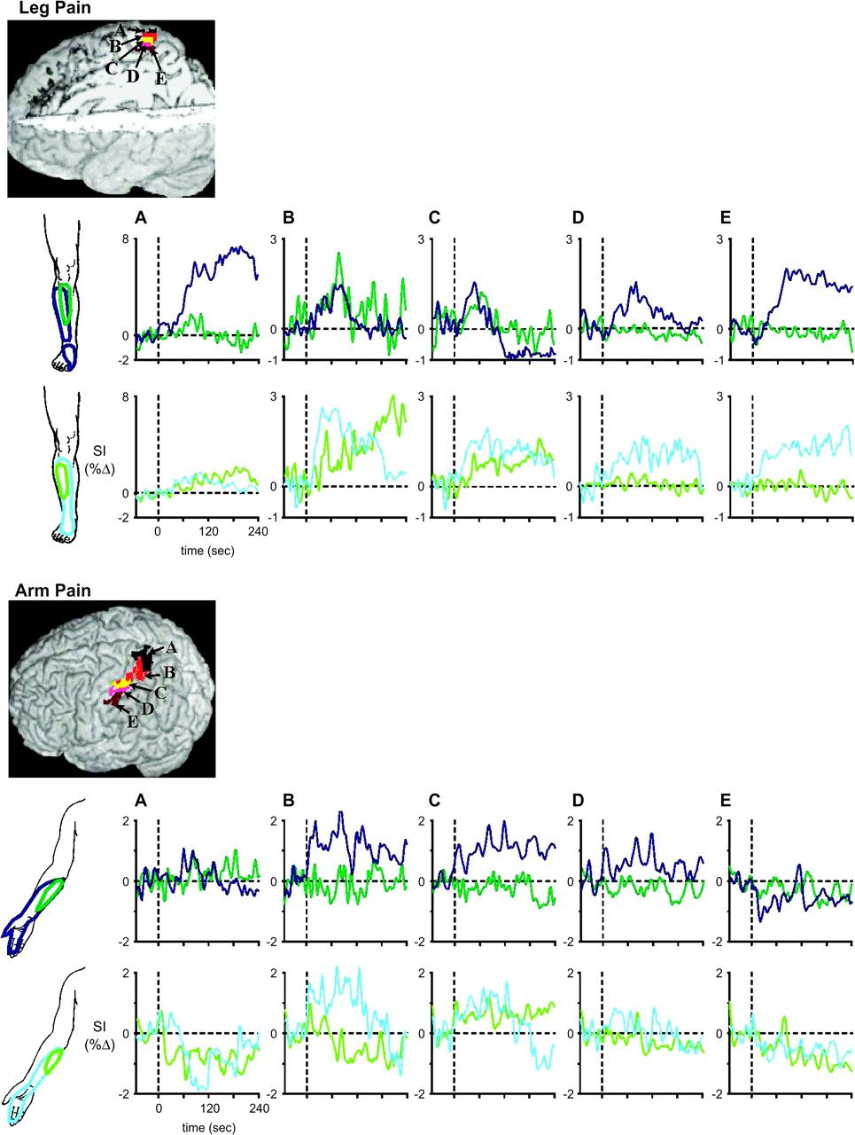
Figure 6. Individual subject signal intensity changes plotted over time, in 5 VOI's in the SI (A–E) during leg and arm ...
Notes:
Figure 6. Individual subject signal intensity changes plotted over time, in 5 VOI's in the SI (A–E) during leg and arm muscle pain. The location of the VOIs is indicated to the top right of each panel. The area of perceived pain is indicated to the left of each set of 5 time trends taken from VOIs (A–E). The vertical dashed line indicates the onset of the hypertonic saline injection. Note that in the subjects in whom the area of perceived pain is greater, the number of VOIs in which signal intensity increases is greater.
Unless provided in the caption above, the following copyright applies to the content of this slide: © The Author 2006. Published by Oxford University Press. All rights reserved. For permissions, please e-mail: journals.permissions@oxfordjournals.org

Slide 7
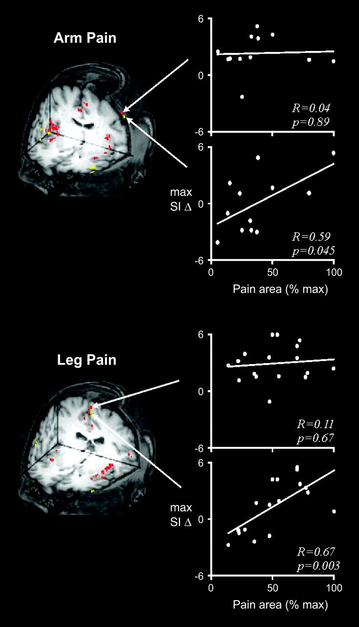
Figure 5. Maximum fMRI signal intensity changes in the SI plotted against area of perceived pain for each individual ...
Notes:
Figure 5. Maximum fMRI signal intensity changes in the SI plotted against area of perceived pain for each individual subject. The overlay on the left indicates the significant cluster from which the signal intensity changes were calculated. Note that in the region of SI in which both the referred and nonreferred groups displayed similar signal intensity increases (red) there was no significant correlation between signal intensity and area of perceived pain. However, in the SI regions in which the referred and nonreferred groups were significantly different (yellow), there was a significant positive correlation between the maximum signal intensity change and area of perceived pain.
Unless provided in the caption above, the following copyright applies to the content of this slide: © The Author 2006. Published by Oxford University Press. All rights reserved. For permissions, please e-mail: journals.permissions@oxfordjournals.org

