Slide 1
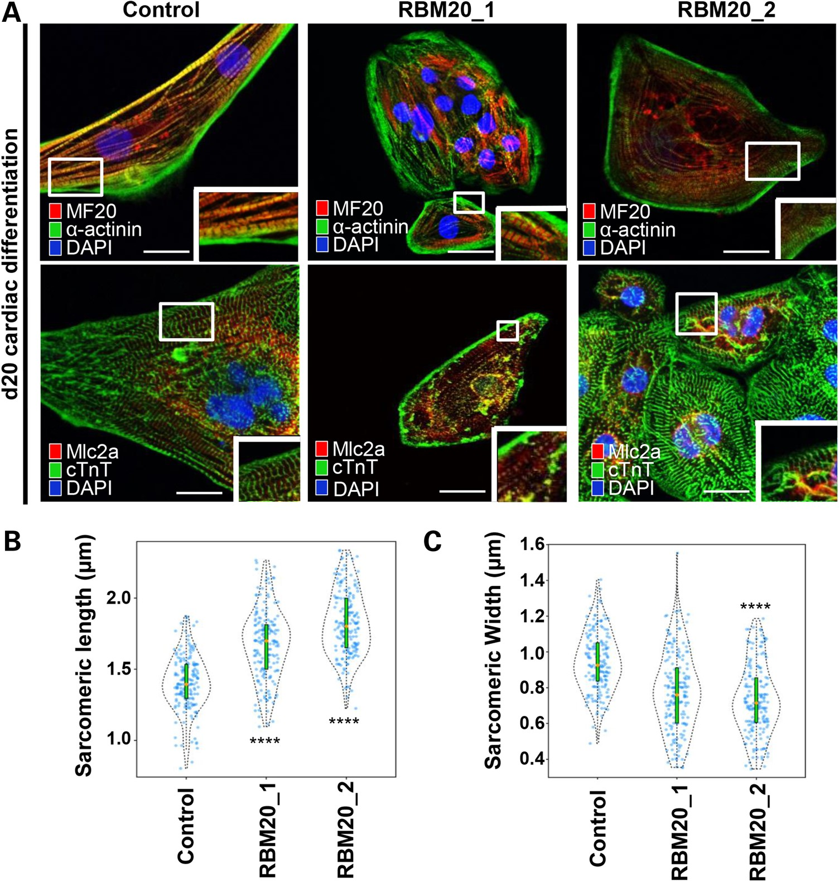
Figure 4. RBM20 familial DCM hiPSC-CMs display abnormal sarcomere geometry. (A) Immunostainings of RBM20 hiPSCs-derived ...
Notes:
Figure 4. RBM20 familial DCM hiPSC-CMs display abnormal sarcomere geometry. (A) Immunostainings of RBM20 hiPSCs-derived single-cell CMs for MF20, α-actinin, MLC2A and cTnT at Day 20. Note variable expression levels of cardiac-specific markers in control versus RBM20 DCM-hiPSCs-CMs (MF20 = Myosin II heavy chain; MLC2A = Myosin light chain 2A; cTnT = cardiac troponin T). Abnormal sarcomere geometry present in RBM20-deficient hiPSCs-CMs. Scale bars: 20 µm. (B) and (C) Violin plots show difference in sarcomere geometry of control versus RBM20 DCM hiPSCs-CMs. Orange dot = median of sarcomeric length and width (****P < 0.0001, n = 175). Scale bars: 0.5 µm.
Unless provided in the caption above, the following copyright applies to the content of this slide: © The Author 2015. Published by Oxford University Press. All rights reserved. For Permissions, please email: journals.permissions@oup.com

Slide 2
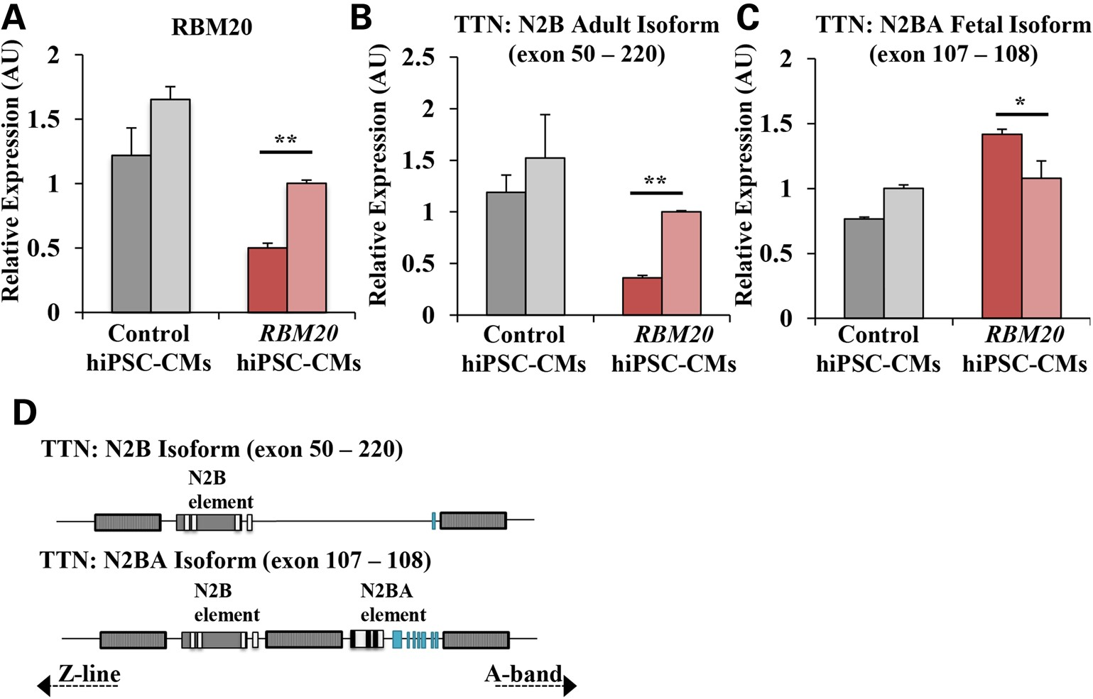
Figure 3. Isoform switching of structural sarcomeric gene, TTN, owing to alternative splicing defect in RBM20 familial ...
Notes:
Figure 3. Isoform switching of structural sarcomeric gene, TTN, owing to alternative splicing defect in RBM20 familial DCM hiPSC-CMs. (A) qRT-PCR showing endogenous expression of RBM20 in control and RBM20 hiPSC-CMs at Day 20. (B) qRT-PCR expression of TTN N2B isoform (exon 50–220). (C) qRT-PCR expression of TTN N2BA isoform (exon 107–108). Two distinct clones were examined for control and RBM20_1 hiPSC lines, represented as distinct bars. Values were normalized to the housekeeping gene GAPDH and expressed as mean ± SEM. Expression values are relative to control hiPSC-CMs (n = 3 biological repetitions with three technical replicates for each biological repetition). (D) Schematic representation of TTN N2B adult and N2BA fetal isoform, showing the region of alternative splicing (*P < 0.05; **P < 0.01; ***P < 0.001, paired Student's t test between control and RBM20).
Unless provided in the caption above, the following copyright applies to the content of this slide: © The Author 2015. Published by Oxford University Press. All rights reserved. For Permissions, please email: journals.permissions@oup.com

Slide 3
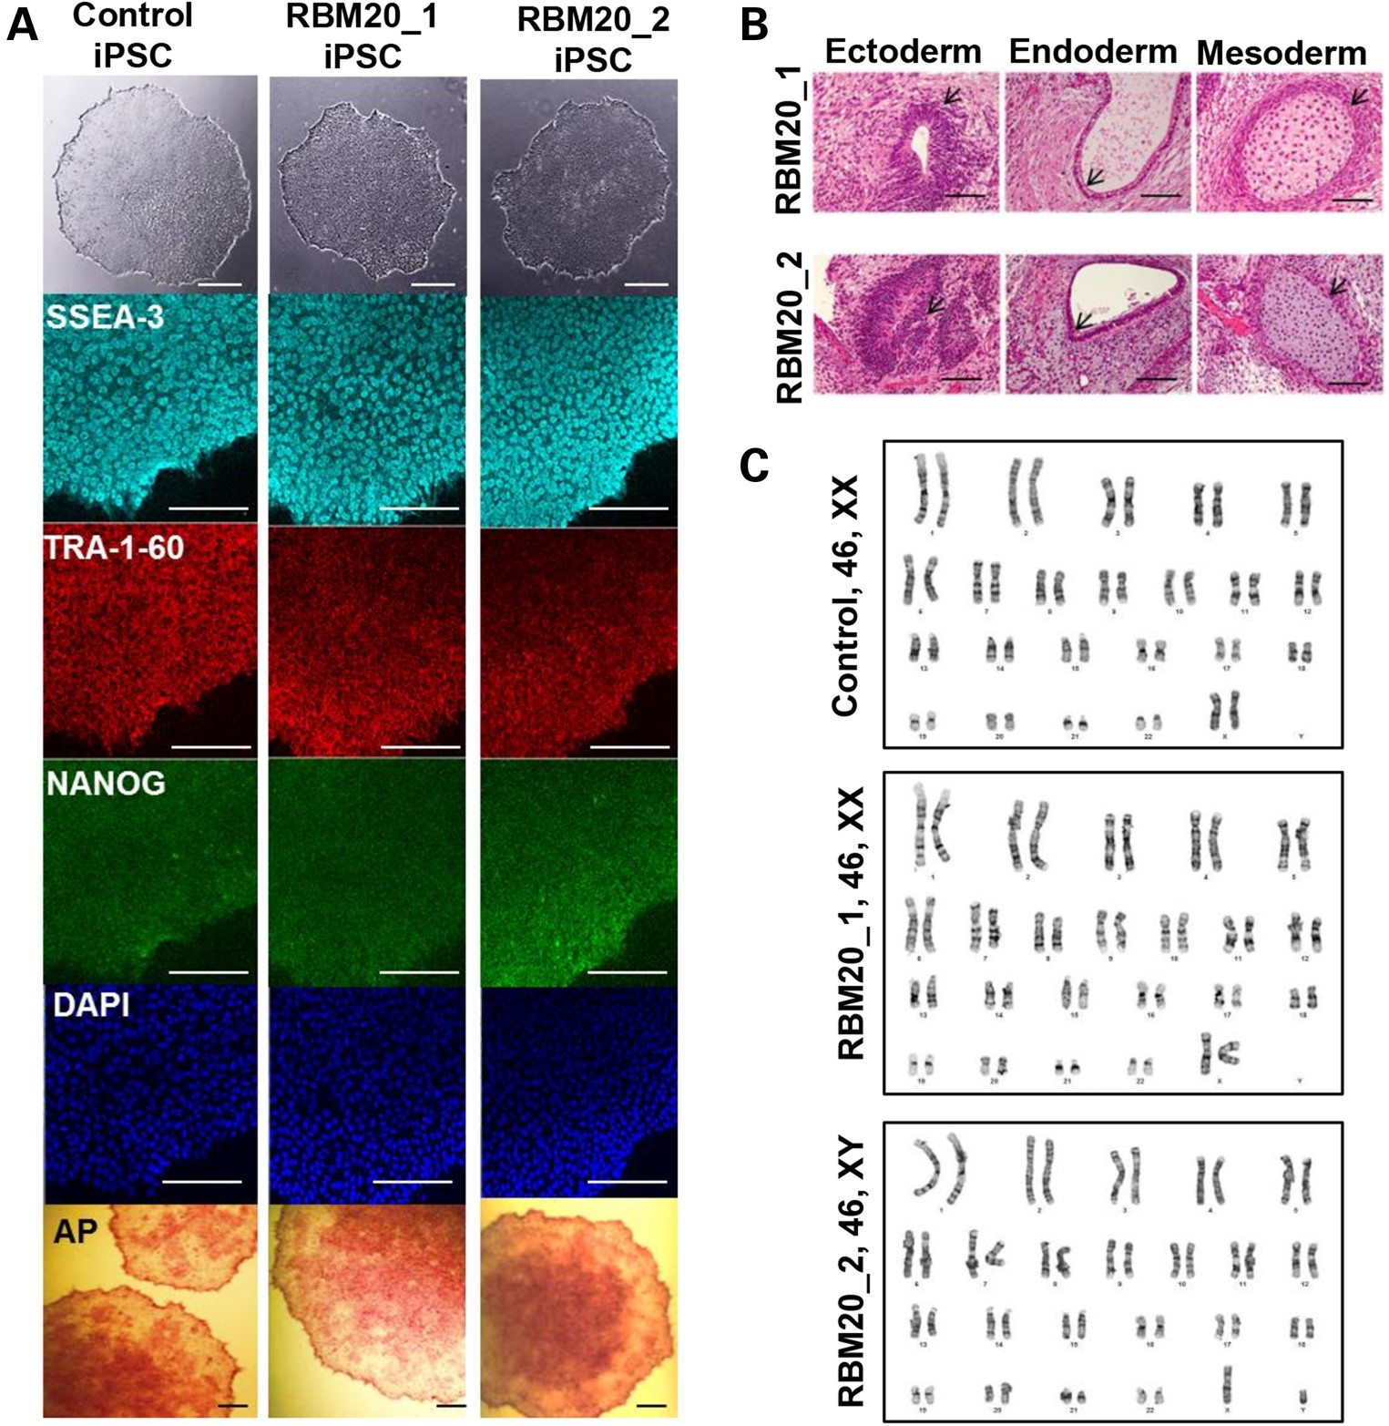
Figure 2. Derivation and characterization of RBM20 familial DCM-hiPSCs. (A) Phase contrast (top) and immunostaining of ...
Notes:
Figure 2. Derivation and characterization of RBM20 familial DCM-hiPSCs. (A) Phase contrast (top) and immunostaining of undifferentiated control and RBM20 familial DCM-hiPSC colonies for the pluripotent markers SSEA-3, TRA-1-60 and NANOG with DAPI nuclear staining. RBM20 DCM-iPSC colonies stained positive for alkaline phosphatase (bottom) (44). (B) Teratoma formation in immunocompromised mice after injection of RBM20 DCM-hiPSCs. Note pigmented epithelium (ectoderm), columnar-lining epithelium (endoderm) and hyaline cartilage (mesoderm). Scale bars for A and B, 50 µm. (C) Representative karyotype analysis of control and RBM20 DCM-hiPSC clones from Patients 1 and 2.
Unless provided in the caption above, the following copyright applies to the content of this slide: © The Author 2015. Published by Oxford University Press. All rights reserved. For Permissions, please email: journals.permissions@oup.com

Slide 4
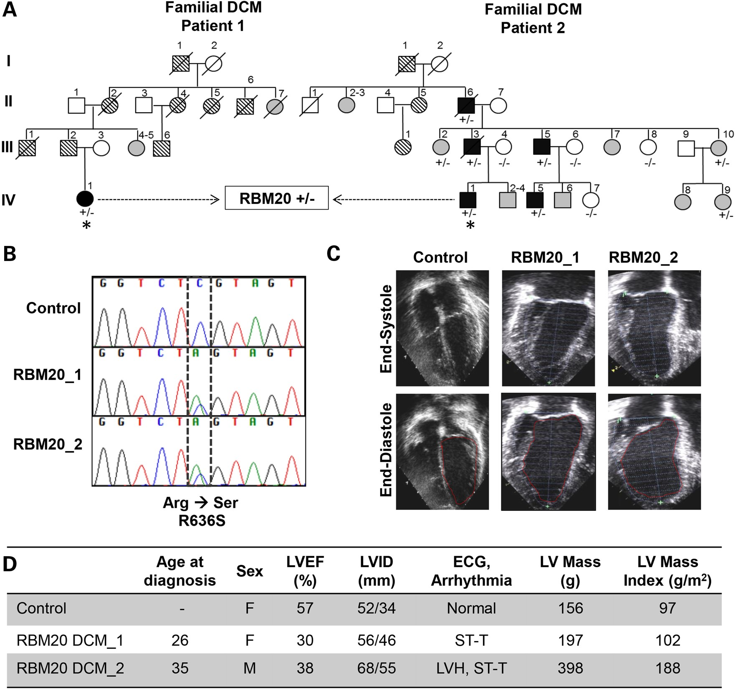
Figure 1. Clinical characteristics of RBM20 familial DCM. (A) Family pedigrees of two RBM20 DCM patients with an ...
Notes:
Figure 1. Clinical characteristics of RBM20 familial DCM. (A) Family pedigrees of two RBM20 DCM patients with an identical point mutation. Square = male; circle = female; black = affected; white = unaffected; gray = clinical status unknown; parallel diagonal lines = suspected DCM based on family history; slash through the symbol = deceased; + = mutant allele; − = wild-type allele; asterisk = proband whose skin fibroblasts were reprogrammed to hiPSCs. (B) Sequence chromatograms from RBM20 patients demonstrating the c.1906C>A, R636S missense mutation. (C) Representative four-chamber echocardiographic images of control (unaffected family member, IV-9) and patients with RBM20 DCM at end systole and diastole showing moderate LV dilatation. (D) Summary of clinical findings. LV, left ventricle; LVEF, left ventricular ejection fraction; LVID, left ventricular internal diameter; ECG, electrocardiogram; mm, millimeters; g, grams; g/m2, grams per millimeter squared; F, female; M, male; ST-T, nonspecific ST-T wave changes; LVH, left ventricular hypertrophy.
Unless provided in the caption above, the following copyright applies to the content of this slide: © The Author 2015. Published by Oxford University Press. All rights reserved. For Permissions, please email: journals.permissions@oup.com

Slide 5
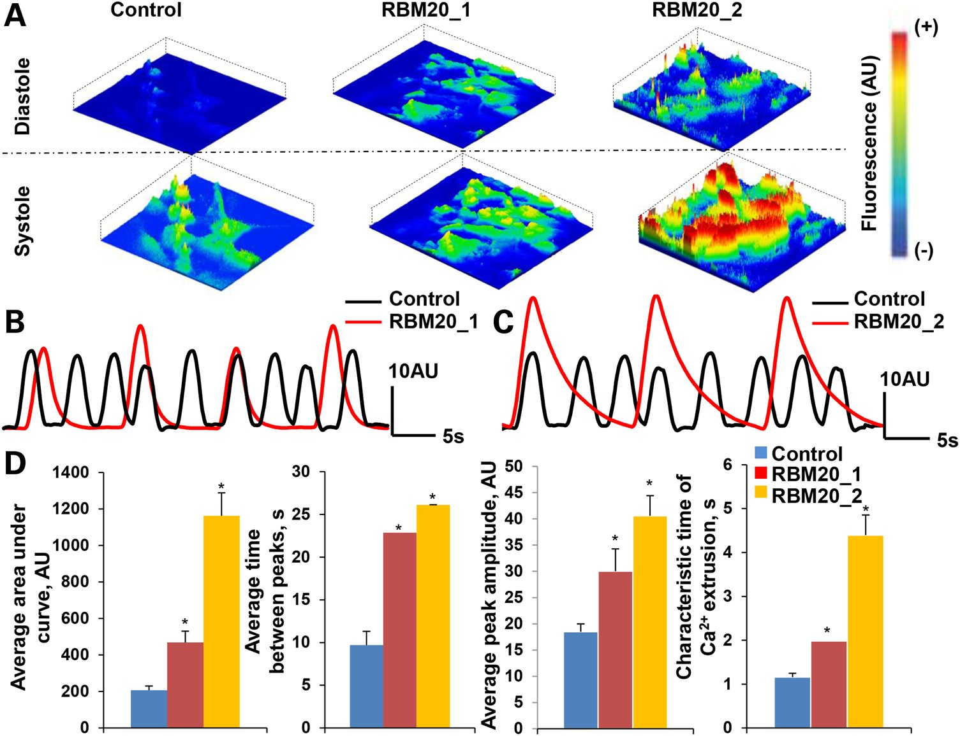
Figure 5. Defective calcium handling of RBM20 familial DCM hiPSC-CMs. (A) Representative images of spontaneous ...
Notes:
Figure 5. Defective calcium handling of RBM20 familial DCM hiPSC-CMs. (A) Representative images of spontaneous Ca2+ transients recorded from Fluo4-AM-labeled hiPSC-CMs during diastole and systole at Day 20. Scale: red = high fluorescence; blue = low fluorescence. (B) and (C) Measurements of spontaneous Ca2+ transients in control and RBM20 DCM hiPSCs-CMs from RBM20 patient 1 (b) and RBM20 patient 2 (c). (D) RBM20 DCM hiPSCs-CMs from both patients reveal abnormal Ca2+ handling as demonstrated by enhanced area under the curve and peak amplitude of calcium transients, as well as prolonged time between calcium spikes (*P < 0.05, n = 3). AU: arbitrary units; s: seconds.
Unless provided in the caption above, the following copyright applies to the content of this slide: © The Author 2015. Published by Oxford University Press. All rights reserved. For Permissions, please email: journals.permissions@oup.com

Slide 6
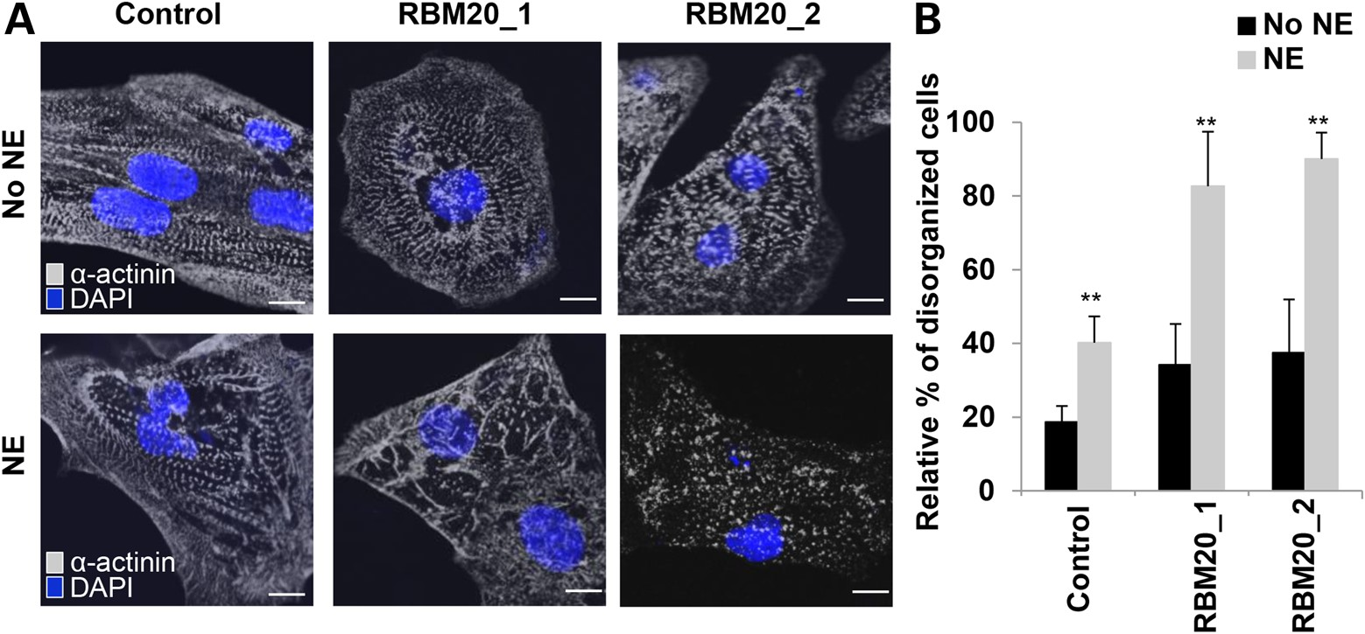
Figure 6. RBM20 familial DCM hiPSC-CMs are susceptible to structural damage upon β-adrenergic stimulation with ...
Notes:
Figure 6. RBM20 familial DCM hiPSC-CMs are susceptible to structural damage upon β-adrenergic stimulation with norepinephrine. (A) Representative images of sarcomeric α-actinin immunostaining of single control and RBM20 DCM hiPSCs-CMs after treatment with and without NE at Day 20. Compared with controls, NE treatment-induced sarcomeric disorganization in single RBM20 DCM hiPSCs-CMs. Scale bar: 20 μm. (B) Percentage of hiPSCs-CMs with disorganized sarcomeric α-actinin staining patterns (defined as ≥25% punctate appearance) with or without NE treatment (**P < 0.001). mm2, millimeters squared.
Unless provided in the caption above, the following copyright applies to the content of this slide: © The Author 2015. Published by Oxford University Press. All rights reserved. For Permissions, please email: journals.permissions@oup.com

Slide 7
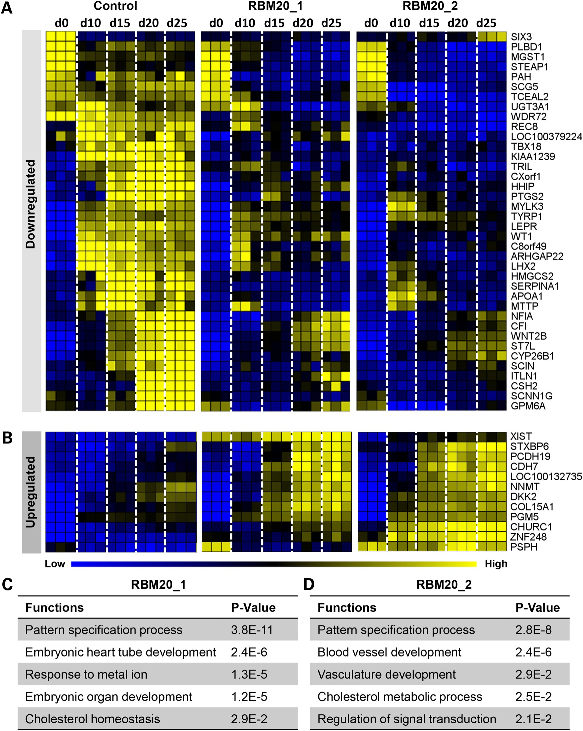
Figure 7. Aberrant transcriptome profile contributes to defective RBM20 cardiogenesis. (A) and (B) Comparative ...
Notes:
Figure 7. Aberrant transcriptome profile contributes to defective RBM20 cardiogenesis. (A) and (B) Comparative transcriptome analysis of control (n = 3, biological repetitions with three technical replicates for each biological repetition, at each time point) and RBM20 familial DCM (n = 3, biological repetitions with three technical replicates for each biological repetition, at each time point) hiPSC lines during in vitro cardiogenesis identified the top 50 divergent gene expression profiles that were downregulated (A) or upregulated (B) in the RBM20 DCM group compared with control. (C) and (D) GO enrichment analysis revealed corresponding functions in RBM20 patient 1 (C) and RBM20 patient 2 (D), showing a common function of the pattern specification process in both RBM20 familial DCM patients.
Unless provided in the caption above, the following copyright applies to the content of this slide: © The Author 2015. Published by Oxford University Press. All rights reserved. For Permissions, please email: journals.permissions@oup.com

