Slide 1
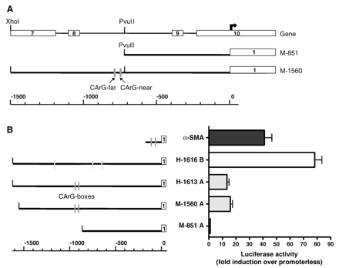
Fig. 2 A) Schematic representation of mouse smoothelin-A promoter constructs. The upper line represents the ...
Notes:
Fig. 2 A) Schematic representation of mouse smoothelin-A promoter constructs. The upper line represents the smoothelin gene structure, exons are indicated by white boxes and numbered. The bold arrow indicates the transcription start site of smoothelin-A, which resides inside exon 10 of smoothelin-B. The lower line shows the scale in bp. The CArG boxes are depicted as grey boxes. B) Comparison of activity of mouse smoothelin-A promoter fragments (M-1560 A and M-851 A) with human smoothelin-A (H-1613 A), human smoothelin-B (H-1616 B) and α-SMA promoters. Activity of the smoothelin-B construct is higher than activity of the smoothelin-A constructs. The active region in the mouse smoothelin-A promoter is located between − 1560 and − 851 nucleotides. Conserved CArG boxes are depicted as grey boxes, non-conserved CArG boxes as shaded grey boxes. The first exons of each gene are shown as white boxes.
Unless provided in the caption above, the following copyright applies to the content of this slide: Copyright © 2006, European Society of Cardiology

Slide 2
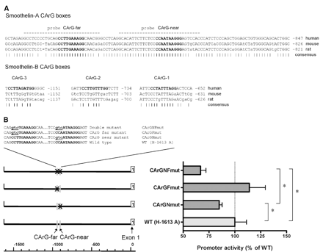
Fig. 3 A) Sequence comparison of CArG box-containing regions in the smoothelin-A and smoothelin-B promoters of ...
Notes:
Fig. 3 A) Sequence comparison of CArG box-containing regions in the smoothelin-A and smoothelin-B promoters of human, mouse and rat. Non-conserved nucleotides are indicated by small case letters. The CArG boxes are shown in bold. Dashes below the sequence indicate conserved nucleotides. Dashed lines indicate probes used for EMSA experiments. The numbers indicate the location of the sequence relative to the respective transcription start sites. B) Effect of CArG box mutations on the activity of the human smoothelin-A promoter construct H-1613 A. Mutation of the proximal CArG-near box caused a significant reduction in smoothelin-A promoter activity. Mutation of both CArG boxes simultaneously caused a further decrease. Statistically significant differences are indicated by an asterisk. The sequence of CArG mutations introduced into the human smoothelin-A promoter reporter construct are shown. CArG boxes are shown in bold, mutations are underlined and in small case.
Unless provided in the caption above, the following copyright applies to the content of this slide: Copyright © 2006, European Society of Cardiology

Slide 3
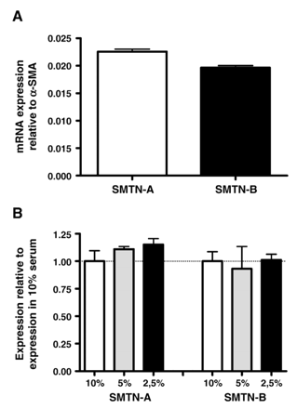
Fig. 1 A) Expression of smoothelin-A and smoothelin-B mRNA in PAC1 SMCs. Expression levels were assayed by Q-PCR and ...
Notes:
Fig. 1 A) Expression of smoothelin-A and smoothelin-B mRNA in PAC1 SMCs. Expression levels were assayed by Q-PCR and normalized to α-SMA expression. PAC1 cells express both smoothelin isoforms at the mRNA level. B) No significant effect of serum concentration on smoothelin-A and smoothelin-B mRNA expression in PAC1 cells. Expression levels were assayed by Q-PCR and normalized to expression at 10% serum.
Unless provided in the caption above, the following copyright applies to the content of this slide: Copyright © 2006, European Society of Cardiology

Slide 4
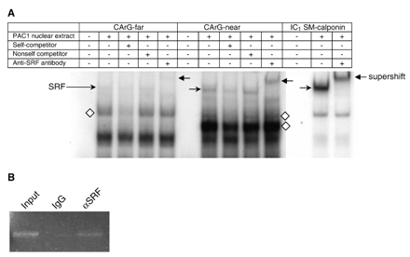
Fig. 4 A) Electrophoretic mobility shift assay of smoothelin-A CArG-far and CArG-near boxes and of the intronic ...
Notes:
Fig. 4 A) Electrophoretic mobility shift assay of smoothelin-A CArG-far and CArG-near boxes and of the intronic SM-calponin CArG box (IC1 SM-calponin). Both smoothelin-A CArG boxes bound several nucleoprotein complexes, including a SRF-containing complex. Supershifted complexes are indicated by a left pointing arrow, SRF bound to CArG boxes is indicated by a right pointing arrow, additional specific complexes binding the smoothelin-A CArG boxes are indicated by diamonds. B) ChIP assay results showing an enriched PCR product from PAC1 SMC nucleoprotein encompassing SRF and the tandem smoothelin-A CArG boxes following immunoprecipitation with antibody to SRF (αSRF). Control IgG shows little to no PCR product. The input lane represents genomic DNA prior to immunoprecipitation.
Unless provided in the caption above, the following copyright applies to the content of this slide: Copyright © 2006, European Society of Cardiology

Slide 5
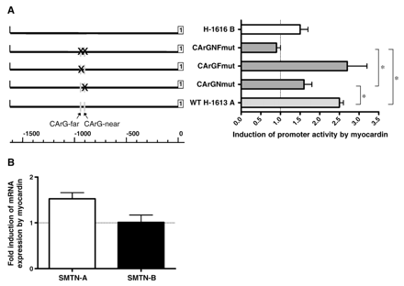
Fig. 5 A) Effect of myocardin overexpression on wild type (WT H-1613 A) and mutated (CArG–NF; CArG–F; CArG–N) human ...
Notes:
Fig. 5 A) Effect of myocardin overexpression on wild type (WT H-1613 A) and mutated (CArG–NF; CArG–F; CArG–N) human smoothelin-A and smoothelin-B (H-1616 B) promoter activity. The ability of myocardin to increase smoothelin-A promoter activity is reduced when SRF cannot bind CArG-near. Aberration of SRF-binding to both CArG-boxes causes a further decrease in promoter activity. Conserved CArG boxes are indicated by grey boxes. The first exons of each transcript are shown as white boxes. Statistically significant differences are indicated by an asterisk. B) Effect of myocardin overexpression on endogenous expression of smoothelins in PAC1 cells. Transfection with myocardin increased endogenous smoothelin-A expression, but did not affect smoothelin-B mRNA levels.
Unless provided in the caption above, the following copyright applies to the content of this slide: Copyright © 2006, European Society of Cardiology

