Slide 1
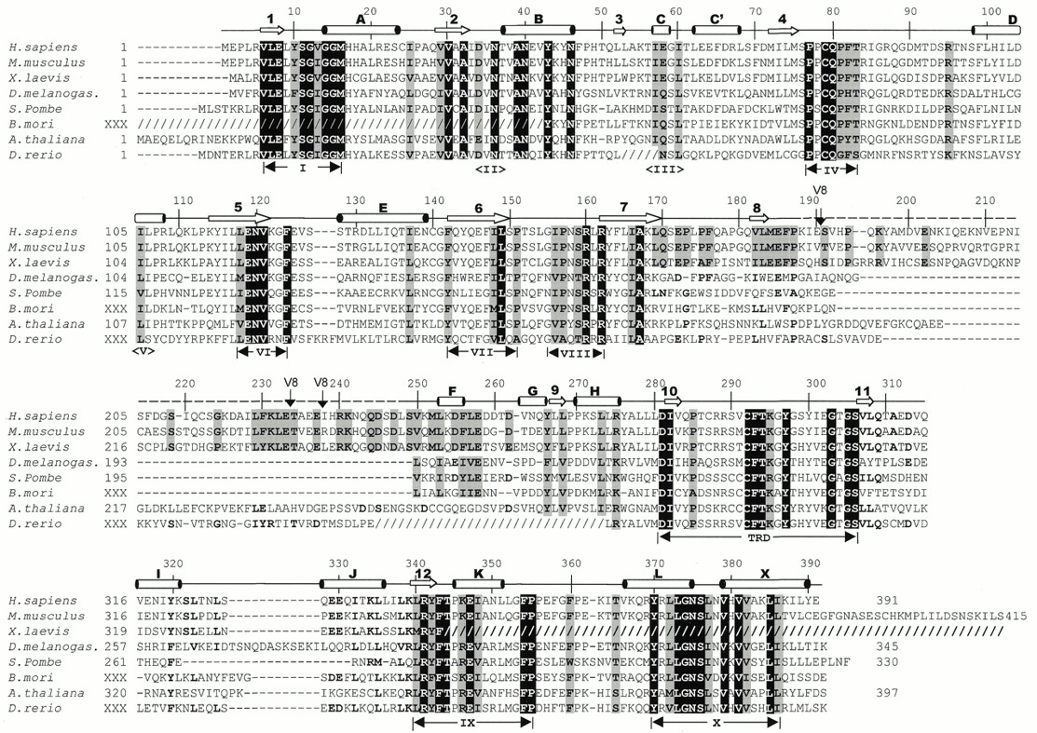
Figure 1. Alignment of Dnmt2 homologs. The slashed lines indicate sequences missing from the available ESTs ...
Notes:
Figure 1. Alignment of Dnmt2 homologs. The slashed lines indicate sequences missing from the available ESTs and dashed lines indicate gaps introduced to optimize alignments. The human DNMT2 residue numbering is shown above the sequence alignment. Amino acids highlighted are either invariant (white against black) among the proteins or similar (shaded), as defined by the following groupings: V, L, I and M; F, Y and W; K and R; E and D; Q and N; S and T; A, G and P. The secondary structural elements of DNMT2 (helices A–X and strands 1–11) and conserved sequence motifs are labeled. Complete Dnmt2 sequences are available in GenBank for human (AAC39764), mouse (AAC53529) and S.pombe (CAA57824). The two Dnmt2 sequences of D.melanogaster currently deposited in GenBank, AAF03835 and AAF53163, contain a single exon and lack the consensus motif I. We used the sequence reported by Tweedie et al. (24), which includes an additional upstream exon and contains motif I. The A.thaliana sequence was assembled from genomic sequence AC006601 between nucleotides 29989 and 27859. Two of the eight splicing junctions are confirmed by EST sequences. The X.laevis Dnmt2 sequence was assembled from two overlapping ESTs (AW639976 and AW636415) and lacks the C-terminus of the protein. The D.rerio sequence was assembled by jointing four ESTs (AI331437, AI618465, AI331180 and AI331323). The B.mori sequence was assembled from three ESTs (AU005443, AV399933 and AV400288). Shown in dashed overline and labeled V8 are the sequences (from 191 to 237) deleted to make a version of DNMT2 that could be crystallized. Note that these sequences are normally absent from the D.melanogaster, S.pombe and B.mori Dnmt2 homologs.
Unless provided in the caption above, the following copyright applies to the content of this slide:

Slide 2
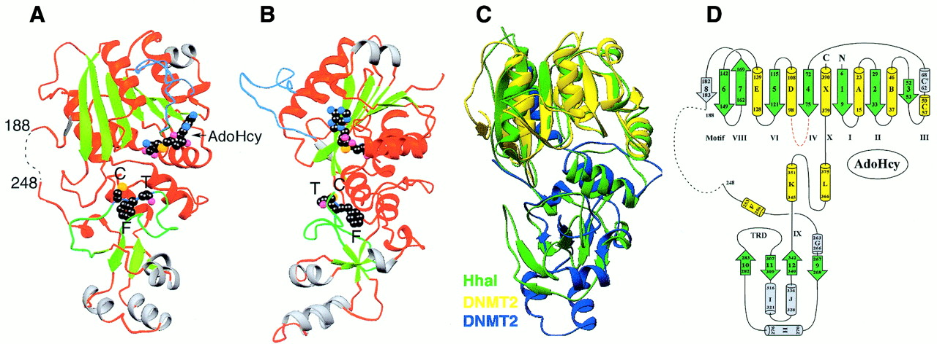
Figure 2. Ribbon (42) diagrams of the DNMT2Δ47–AdoHcy complex. (A) Front view. (B) Right side view (the point ...
Notes:
Figure 2. Ribbon (42) diagrams of the DNMT2Δ47–AdoHcy complex. (A) Front view. (B) Right side view (the point of view of an observer from the right side of Fig. 2A). Helices and loops are colored red (unique helices of DNMT2 gray), strands in green, the PC loop in light blue and the TRD loop in green. The bound AdoHcy and CFT of the TRD are shown as balls, with carbon atoms in black, nitrogen atoms in light blue, oxygen atoms in magenta and sulfur atoms in orange. (C) Superimposition of DNMT2Δ47, colored yellow (residues 1–188) and blue (residues 248–391), and M.HhaI (pdb 1HMY), colored green. (D) Topology of DNMT2.
Unless provided in the caption above, the following copyright applies to the content of this slide:

Slide 3
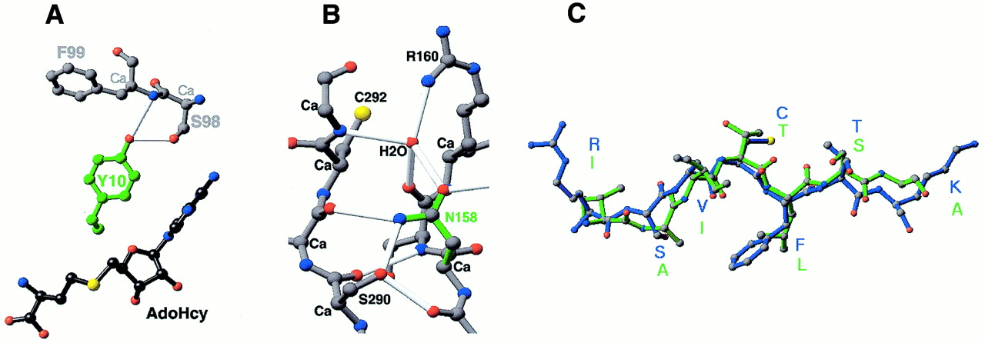
Figure 3. Detailed plots of interactions centered on (A) Tyr10 of motif I and (B) Asn158 of motif VIII. (C) ...
Notes:
Figure 3. Detailed plots of interactions centered on (A) Tyr10 of motif I and (B) Asn158 of motif VIII. (C) Superimposition of the TRD loop containing Cys292-Phe293-Thr294 of DNMT2 (blue) and Thr250-Leu251 of M.HhaI (green).
Unless provided in the caption above, the following copyright applies to the content of this slide:

Slide 4
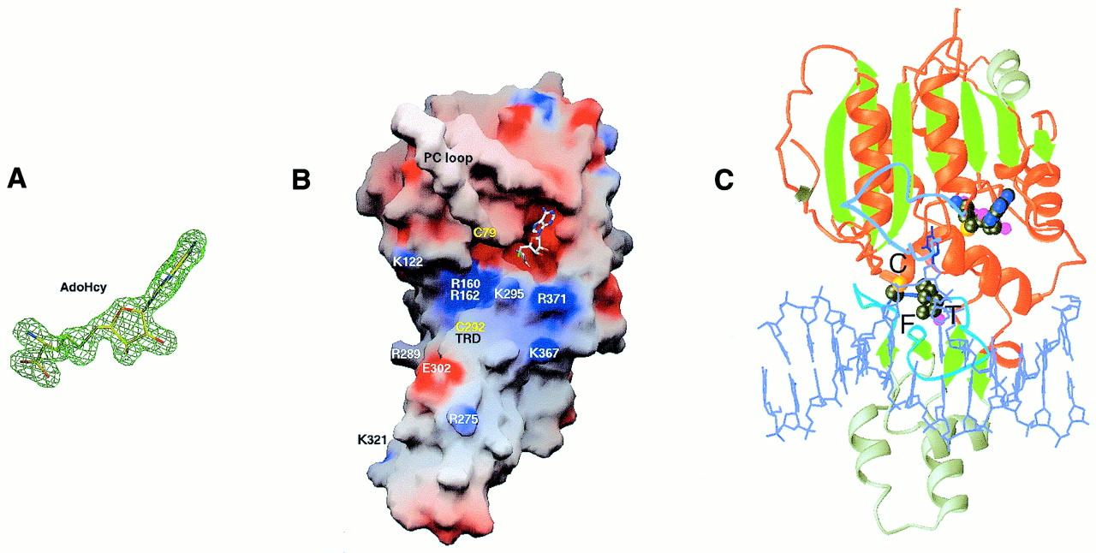
Figure 4. (A) AdoHcy is shown in stick form and is superimposed on a F_{o} – F_{c} omit ...
Notes:
Figure 4. (A) AdoHcy is shown in stick form and is superimposed on a Fo – Fc omit electron density map. (B) Solvent-accessible molecular GRASP surface (30) of the electrostatic potential of DNMT2Δ47. The surface is colored blue for positive (10 kT), red for negative (–10 kT) and white for neutral, where k is the Boltzmann constant and T is the temperature. (C) Model of DNMT2Δ47–AdoHcy bound to DNA. The DNA model is from the structure of the M.HhaI–AdoHcy–DNA complex (pdb 3MHT; 31).
Unless provided in the caption above, the following copyright applies to the content of this slide:

Slide 5
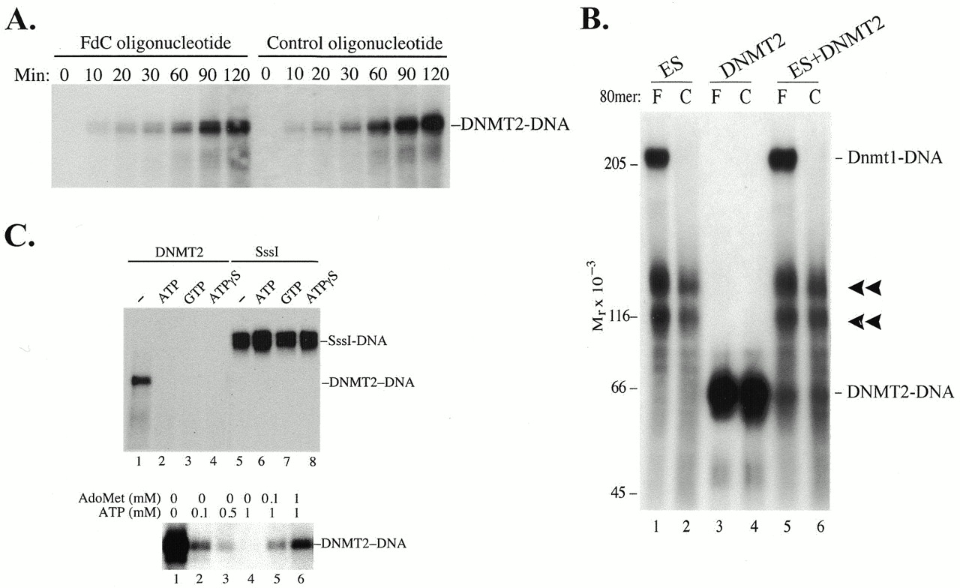
Figure 5. (A) Formation of denaturant-resistant DNMT2–DNA complexes. DNMT2 (4 µg/ml) was incubated at 37°C ...
Notes:
Figure 5. (A) Formation of denaturant-resistant DNMT2–DNA complexes. DNMT2 (4 µg/ml) was incubated at 37°C with oligonucleotides (1 µg/ml) in 20 mM Tris–HCl pH 8.0, 1 mM EDTA, 25 mM NaCl, 0.2 mM PMSF, 0.5 mM DTT and 40 µM AdoMet. Reactions were terminated at the indicated times by addition of SDS to 2% and glycerol to 12% and heating to 65°C for 10 min, subjected to 6% SDS–PAGE, transferred to nitrocellulose and autoradiographed. Oligonucleotides were of sequence 5′-CCTTTACAAATTTCCAATGCNNNNFGNNNNNNNNFNNNNNNNNNFGNNNNCCTGAAAAAAGACTAATTAAATTCATGGTA-3′, where N is a random base. The synthesis, radioactive labeling and purification of FdC oligonucleotides have been described (16). The control oligonucleotide duplexes were not methylated, while FdC duplexes were hemimethylated (16). Methylation status did not affect formation of complexes (data not shown). Lanes headed F contain FdC oligonucleotides and lanes headed C contain control oligonucleotides with C replacing FdC. (B) Effect of ES cell lysates on formation of DNMT2–DNA complexes. Aliquots of 70 µg ES cell lysate were incubated with 0.1 µg internally labeled FdC or control oligonucleotide in 100 µl of 20 mM Tris–HCl pH 7.4, 10% glycerol, 1 mM EDTA, 0.5 mM DTT, 0.2 mM PMSF and 40 µM AdoMet. Where indicated, purified DNMT2 (0.4 µg) was added at the beginning of the reaction. Reactions were terminated after 3 h at 37°C by addition of SDS to 2% and heating to 65°C for 10 min, subjected to 6% SDS–PAGE, transferred to nitrocellulose and autoradiographed. (C) Inhibition of DNMT2–DNA complex formation by nucleoside triphosphates. Incubation of DNMT2 with FdC oligonucleotide and 1 mM ATP, GTP or ATPγS prevented complex formation but had no effect on the reaction of M.SssI with the FdC oligonucleotide. The inhibitory effect could be largely overcome by addition of equimolar amounts of AdoMet (lanes 5 and 6). In all cases electrophoresis was halted just after unbound oligonucleotides migrated off the lower end of the gel.
Unless provided in the caption above, the following copyright applies to the content of this slide:

