Slide 1
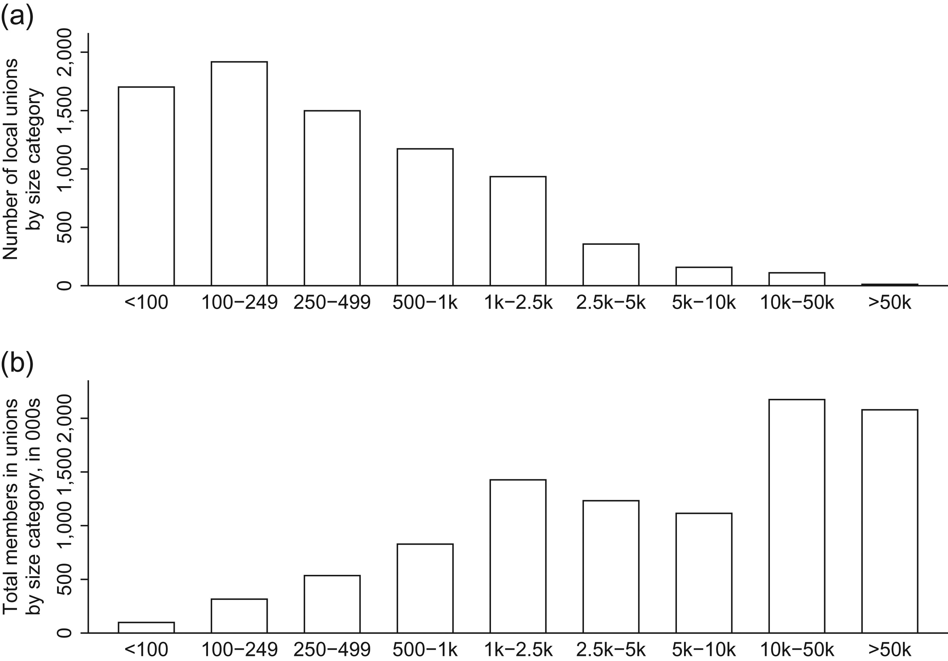
Figure 2. (a) Size distribution of US union locals (2014) and (b) distribution of union members by size of union ...
Notes:
Figure 2. (a) Size distribution of US union locals (2014) and (b) distribution of union members by size of union (2014) Note: Data from Office of Labor-Management Standards.
Unless provided in the caption above, the following copyright applies to the content of this slide: © The Author 2017. Published by Oxford University Press on behalf of the University of North Carolina at Chapel Hill. All rights reserved. For permissions, please e-mail: journals.permissions@oup.com.

Slide 2
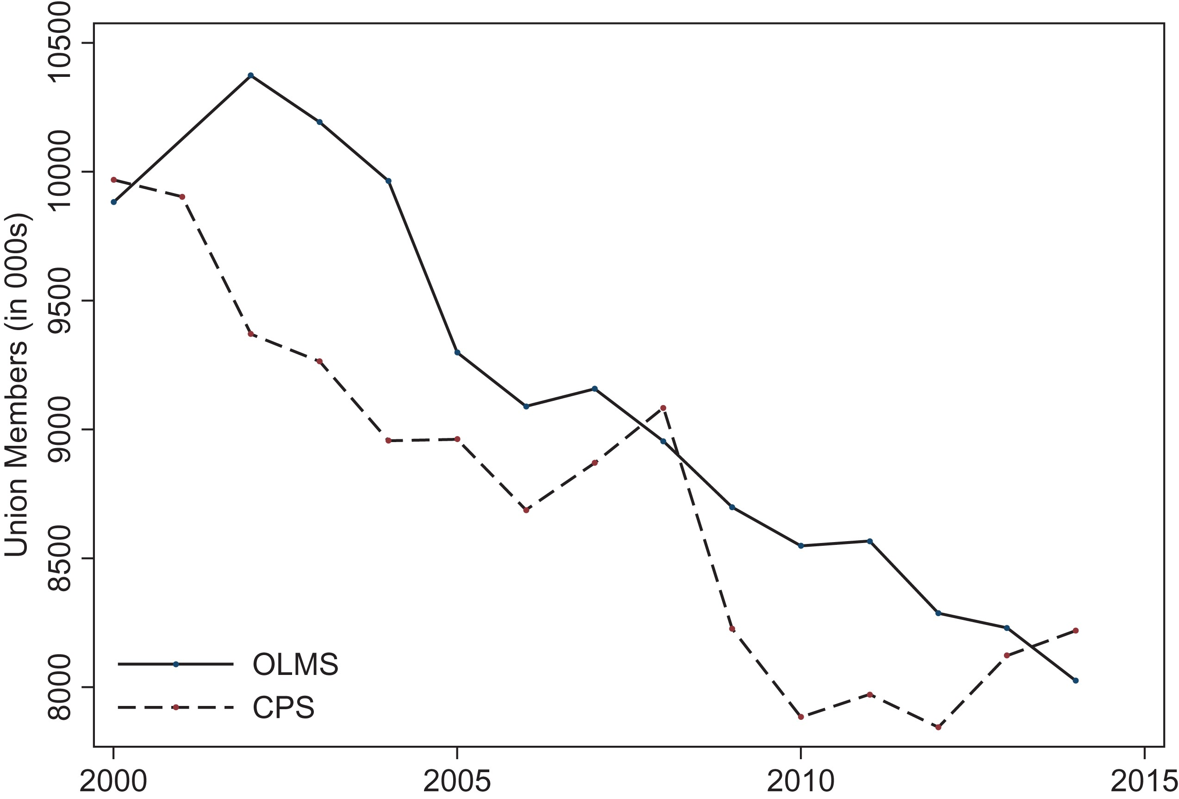
Figure 1. Private sector union decline, 2000–2014
Notes:
Figure 1. Private sector union decline, 2000–2014 Note: Data from Office of Labor-Management Standards (OLMS) and Current Population Survey Outgoing Rotation Groups (CPS).
Unless provided in the caption above, the following copyright applies to the content of this slide: © The Author 2017. Published by Oxford University Press on behalf of the University of North Carolina at Chapel Hill. All rights reserved. For permissions, please e-mail: journals.permissions@oup.com.

Slide 3
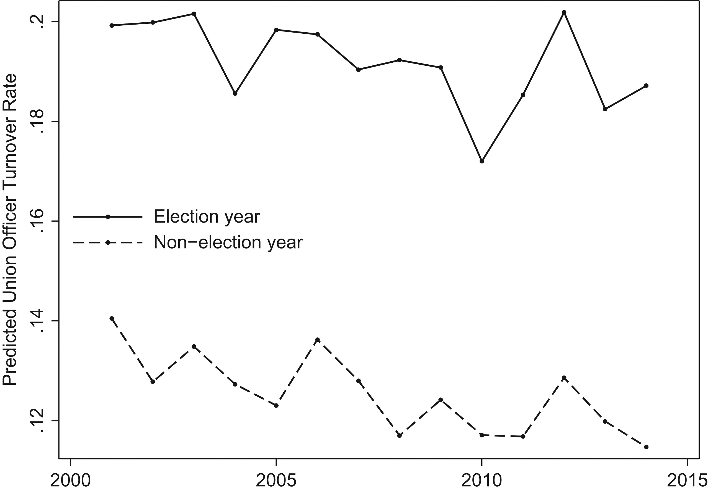
Figure 3. Union officer turnover in election and non-election years
Notes:
Figure 3. Union officer turnover in election and non-election years Note: Union officer turnover rate predicted in union fixed-effects model with election and year dummies. Data from Office of Labor-Management Standards, 2000–2014.
Unless provided in the caption above, the following copyright applies to the content of this slide: © The Author 2017. Published by Oxford University Press on behalf of the University of North Carolina at Chapel Hill. All rights reserved. For permissions, please e-mail: journals.permissions@oup.com.

Slide 4
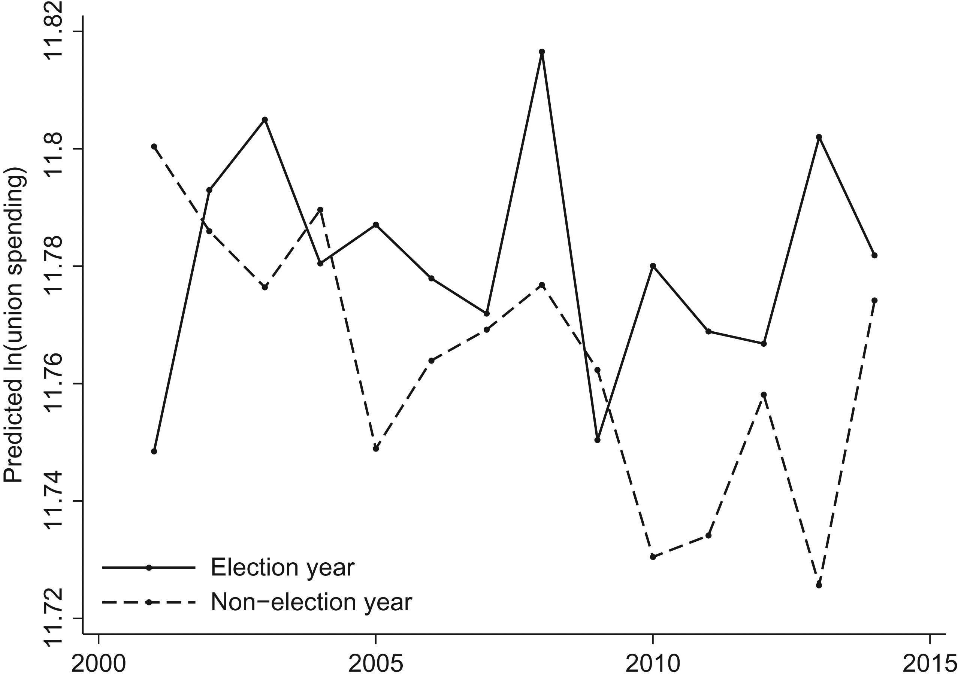
Figure 4. Union spending in election and non-election years
Notes:
Figure 4. Union spending in election and non-election years Note: Union spending predicted in union fixed-effects model with election and year dummies. Data from Office of Labor-Management Standards, 2000–2014.
Unless provided in the caption above, the following copyright applies to the content of this slide: © The Author 2017. Published by Oxford University Press on behalf of the University of North Carolina at Chapel Hill. All rights reserved. For permissions, please e-mail: journals.permissions@oup.com.

