Slide 1
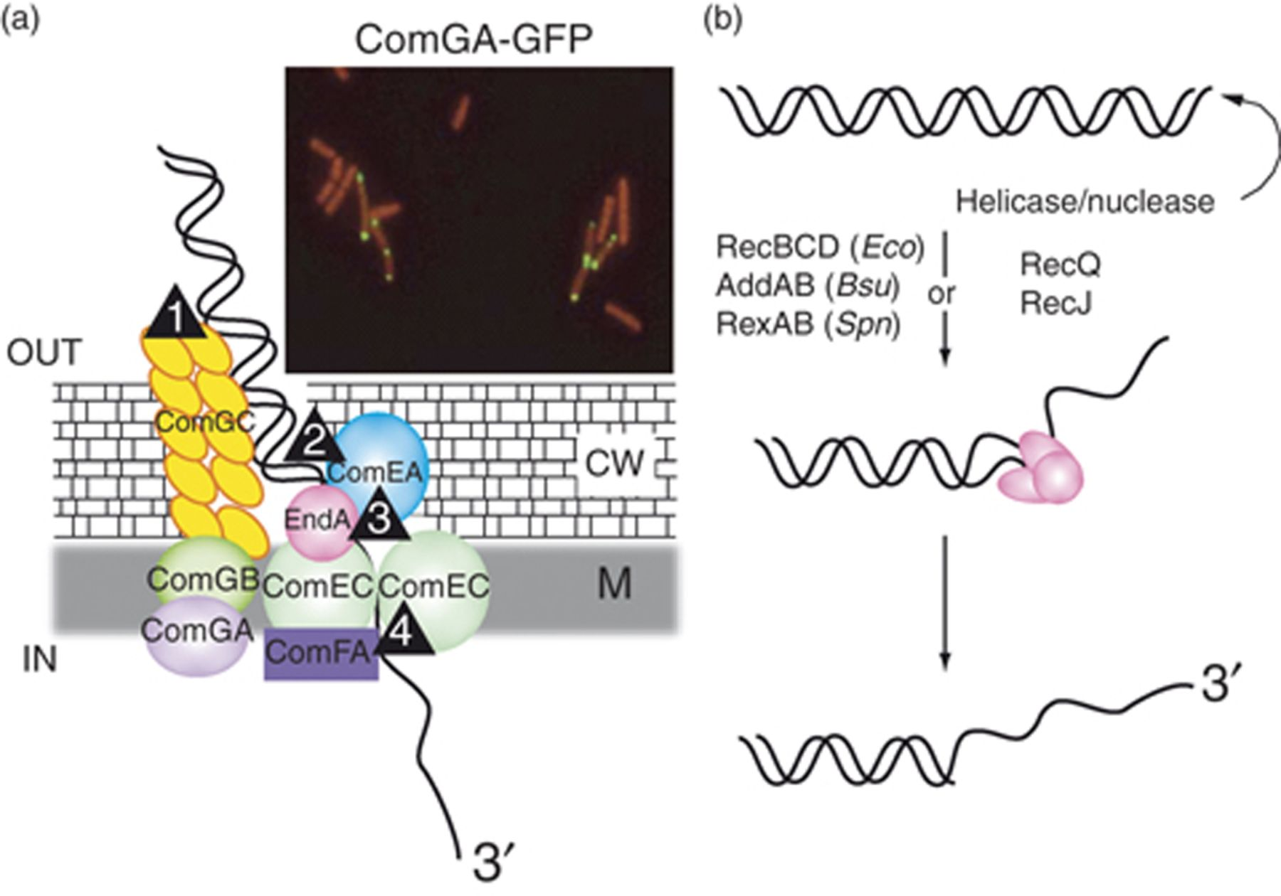
Figure 1 A DNA uptake machine is assembled at the cell poles. (a) Uptake of exogenous dsDNA directly produces ssDNA in ...
Notes:
Figure 1 A DNA uptake machine is assembled at the cell poles. (a) Uptake of exogenous dsDNA directly produces ssDNA in competent cells. Accumulation of ComGA-GFP was observed in a Bacillus subtilis strain carrying an ectopic copy of comGA-gfp [reproduced with permission from Fig. 1b (Hahn et al., 2005)]. Numbers within triangles refer to steps in the process as discussed in the text. CW, cell wall; M, membrane. (b) In vegetative cells creation of ssDNA from a dsDNA break can be achieved by the concerted action of DNA helicases and exonucleases (e.g. Escherichia coli RecBCD or RecQ-RecJ). Bsu, B. subtilis; Eco, E. coli; Spn, Streptococcus pneumoniae.
Unless provided in the caption above, the following copyright applies to the content of this slide: © 2009 Federation of European Microbiological Societies.

Slide 2
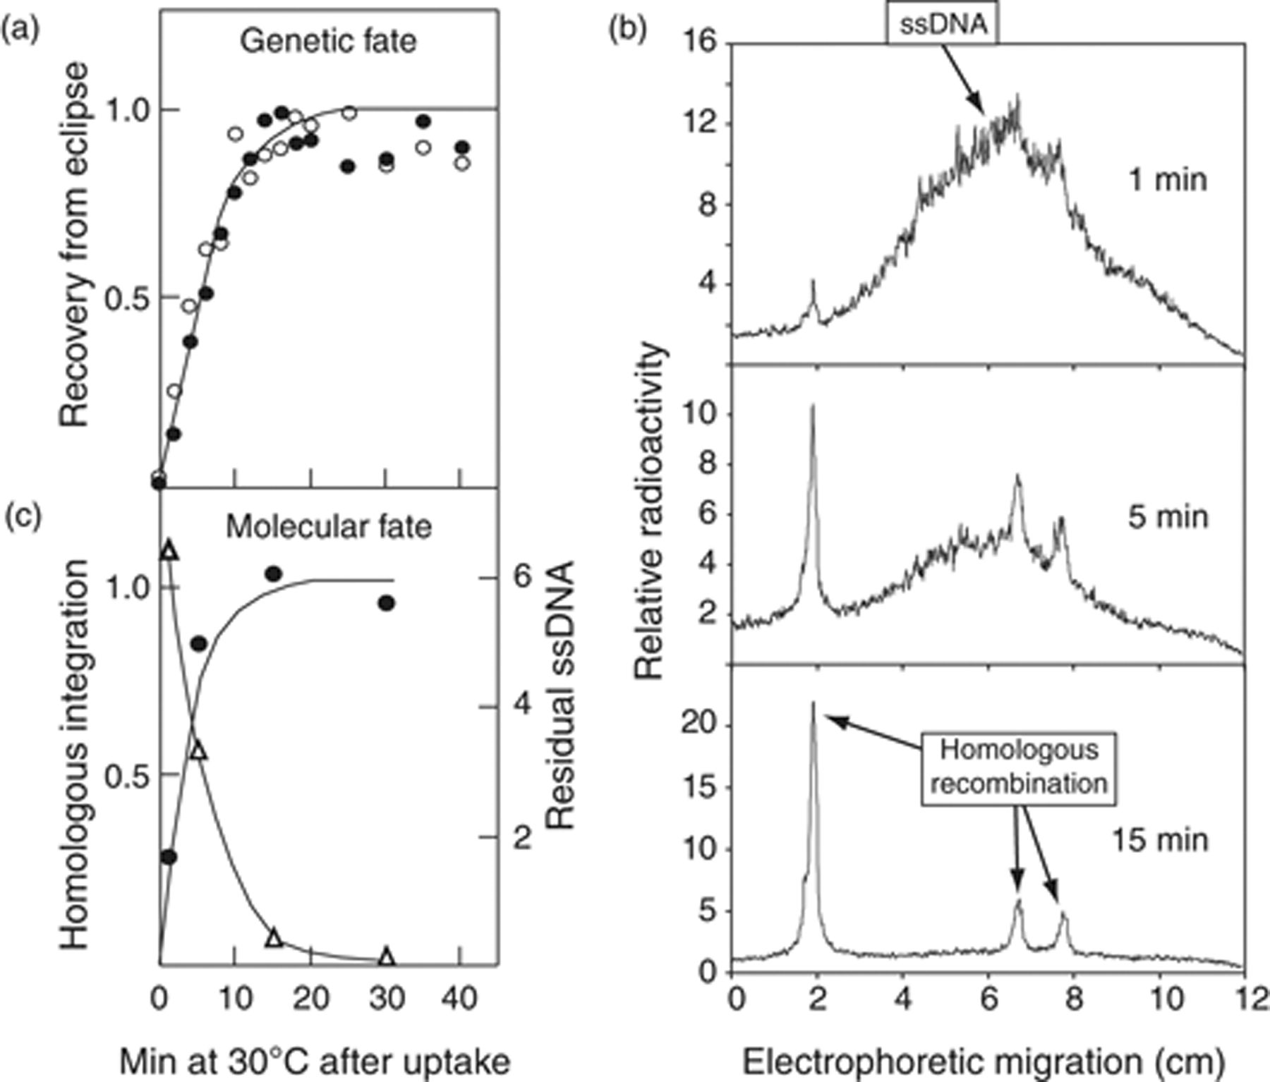
Figure 2 Processing of internalized ssDNA. (a) Recovery from eclipse. In the initial transformation, competent cells ...
Notes:
Figure 2 Processing of internalized ssDNA. (a) Recovery from eclipse. In the initial transformation, competent cells were transformed with chromosomal DNA carrying a mal+ (closed circles) and an str-r marker (open circles) for 5 min at 30°C (DNA uptake was terminated with DNAse I). Recovery of these markers was assayed by extracting total DNA from transformed cells, which had been incubated at 30°C various times after uptake, and transforming a test culture (secondary transformation). Reproduced from Ghei & Lacks (1967, fig. 2) with permission. (b) Analysis of the fate of radioactively labelled donor DNA (in the presence of 100 μM HpUra to prevent reincorporation of degraded nucleotides). Adapted from Bergé et al. (2003, fig. 3). (c) Kinetics of integration (circles) and of degradation (open triangles) of radioactively labelled DNA (5 min uptake at 30°C). Adapted from Méjean & Claverys (1984, fig. 3d).
Unless provided in the caption above, the following copyright applies to the content of this slide: © 2009 Federation of European Microbiological Societies.

Slide 3
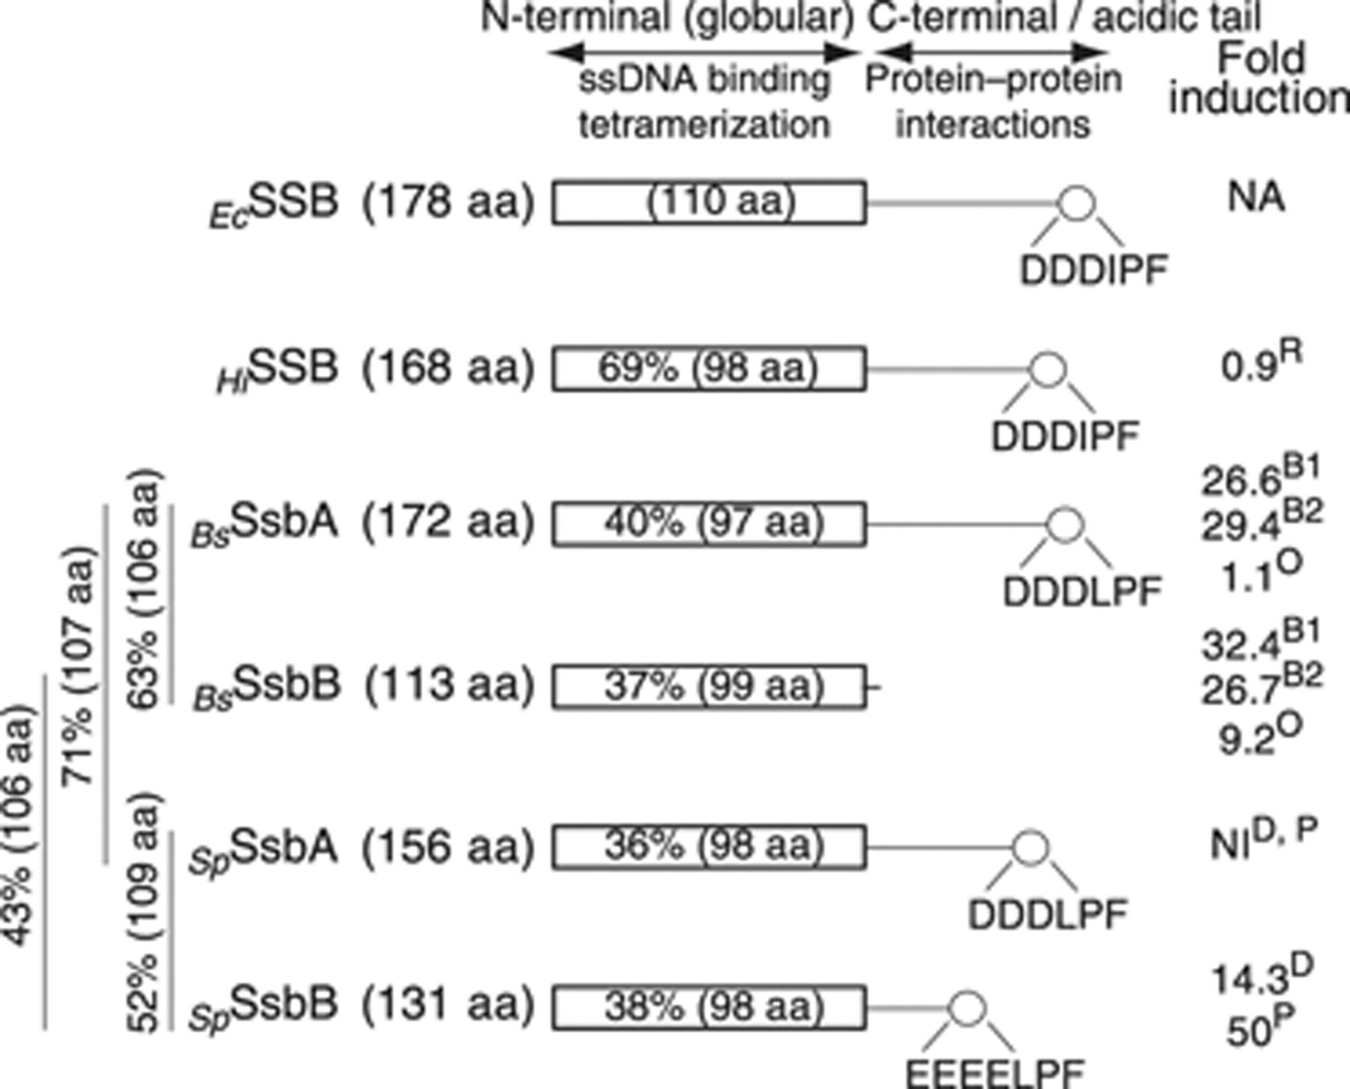
Figure 3 SSB homologues of the naturally transformable species Bacillus subtilis, Streptococcus pneumoniae, and ...
Notes:
Figure 3 SSB homologues of the naturally transformable species Bacillus subtilis, Streptococcus pneumoniae, and Haemophilus influenzae. EcSSB (the Escherichia coli SSB paradigm) comprises two domains, an N-terminal globular domain (c. 110 aa) involved in tetramerization and in nonspecific interaction with ssDNA; and a C-terminal unstructured domain (also called the acidic tail because it is enriched in acidic amino acids), which is the site for specific protein–protein interactions with various partners involved in DNA metabolism (Lecointe et al., 2007; Lu & Keck, 2008; and references therein). Bacterial SSBs display high sequence identity in the N-terminal domain and a similar tip at the C-terminus, the hexapeptide DDD(L/I)PF. Percent identity (over the number of amino acids between parenthesis) indicated within the N-terminal domain rectangle are given with respect to EcSSB. Percent identity between B. subtilis and S. pneumoniae proteins are indicated vertically on the left side of the figure (Note that BsSsbA was previously called SSB.). Fold increase in expression in competent cells (expressed as % of the maximum value observed in the competence regulon in the corresponding experiment) are indicated on the right; values were calculated from the following references: B1, B2, Type 1 and type 2 comparisons, respectively (Berka et al., 2002); D, Dagkessamanskaia et al. (2004); O, Ogura et al. (2002); P, Peterson et al. (2004); R, Redfield et al. (2005); NA, not applicable; NI, noninduced.
Unless provided in the caption above, the following copyright applies to the content of this slide: © 2009 Federation of European Microbiological Societies.

Slide 4
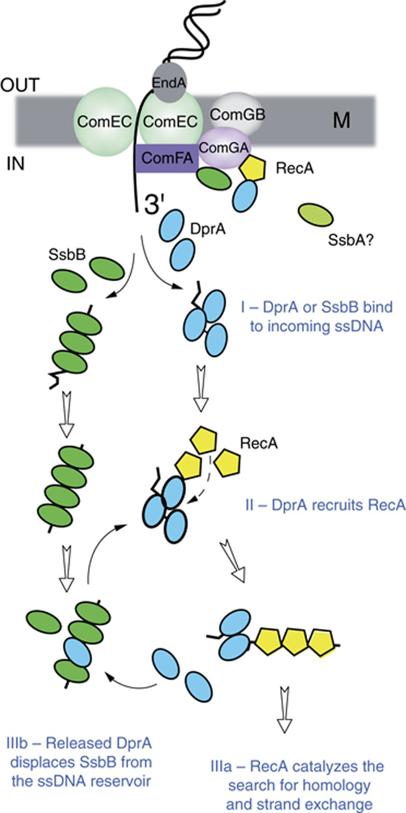
Figure 4 Diagrammatic representation of the interplay of DprA, RecA, and SsbB. For clarity, only two pathways are ...
Notes:
Figure 4 Diagrammatic representation of the interplay of DprA, RecA, and SsbB. For clarity, only two pathways are illustrated, the direct loading of RecA on nascent ssDNA assisted by DprA and the loading of SsbB on incoming ssDNA to create a reservoir for further access by RecA/DprA. See text for alternative possibilities.
Unless provided in the caption above, the following copyright applies to the content of this slide: © 2009 Federation of European Microbiological Societies.

Slide 5
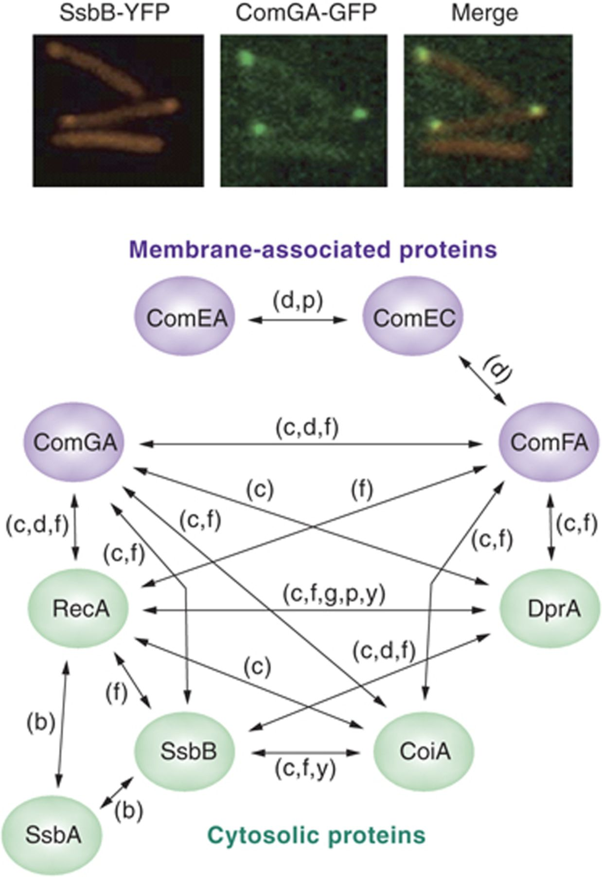
Figure 5 Interaction network suggesting the existence of a transformasome. (Top) Illustration of the colocalization of ...
Notes:
Figure 5 Interaction network suggesting the existence of a transformasome. (Top) Illustration of the colocalization of SsbB and ComGA in Bacillus subtilis cells coexpressing a ComGA-CFP and an SsbB-YFP constructs [reproduced with permission from Hahn et al. (2005, fig. 3e). (Bottom) The network was constructed using available information (see Table 3) inferred from (b) molecular or biochemical data, (c) colocalization of fluorescent signals, (d) stability or localization dependencies, (f) FRET analysis, (g) the existence of genetic relationships, (p) pull-down data, or (y) Y2H. Note that this network does not include genetic and biochemical data concerning interactions between components of the DNA uptake machine [see Dubnau (1999); Chen & Dubnau (2004); Chen (2005)].
Unless provided in the caption above, the following copyright applies to the content of this slide: © 2009 Federation of European Microbiological Societies.

