Slide 1
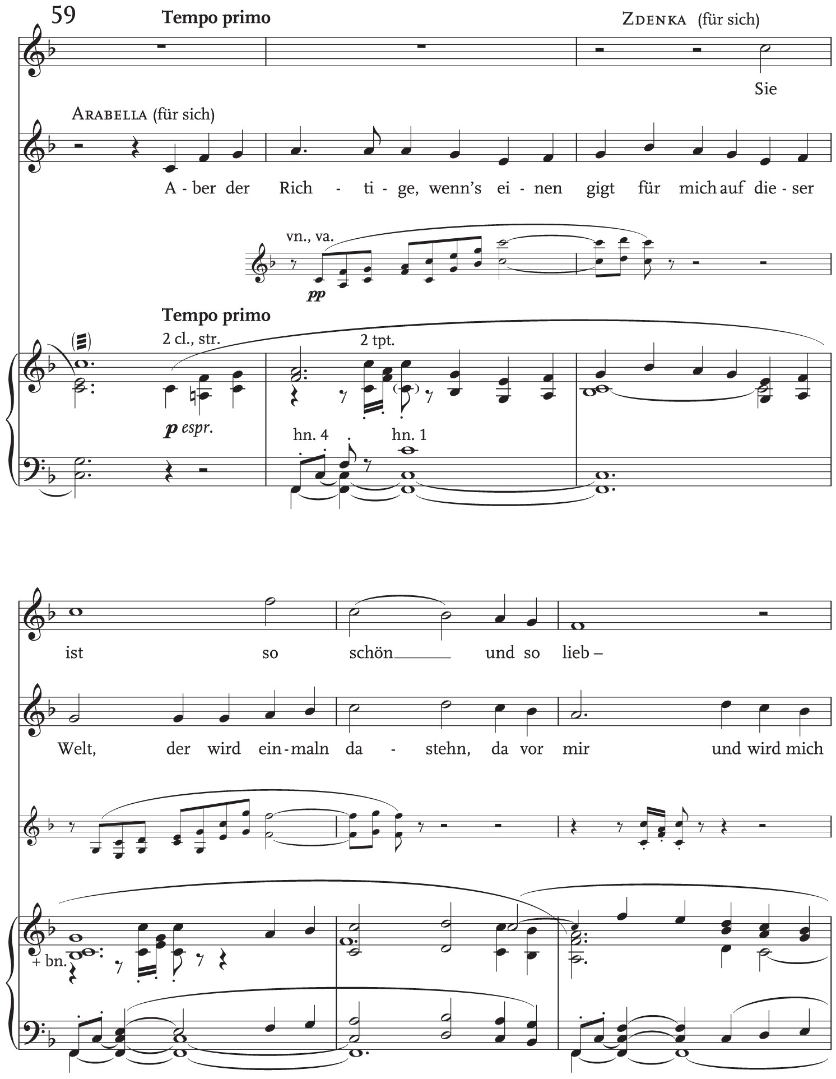
Example 1 Continued
Notes:
Example 1 Continued
Unless provided in the caption above, the following copyright applies to the content of this slide: © The Author 2015. Published by Oxford University Press. All rights reserved.For permissions, please e-mail: journals.permissions@oup.com

Slide 2
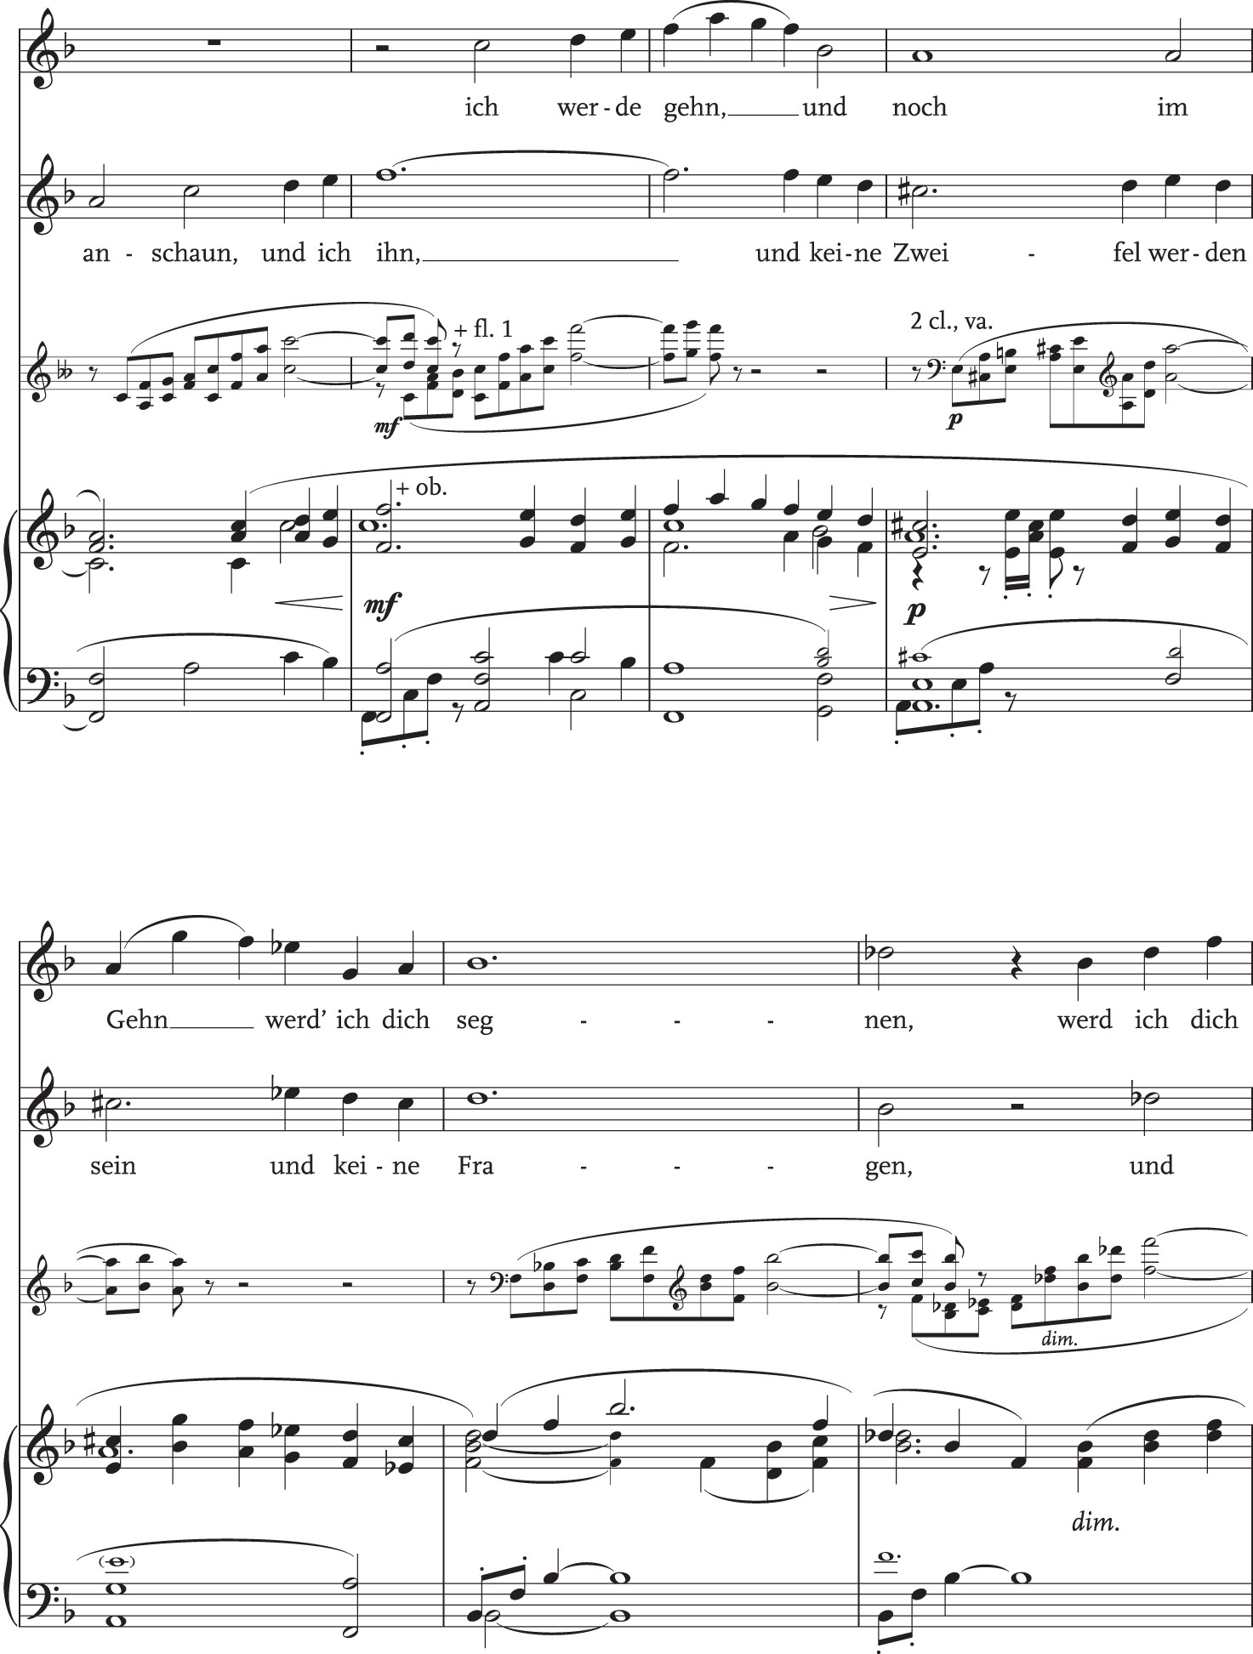
Example 1 (Continued) Arabella, Op. 79 by Richard Strauss © Copyright 1933 by Richard Strauss U.S. Copyright Renewed. ...
Notes:
Example 1 (Continued) Arabella, Op. 79 by Richard Strauss © Copyright 1933 by Richard Strauss U.S. Copyright Renewed. Sole Agents for All Countries of the World Except Germany, Italy, Portugal, and the Former Countries of the U.S.S.R. (Excluding Estonia, Latvia & Lithuania): Hawkes & Son (London) Ltd. (a Boosey & Hawkes Company) Reprinted by permission.
Unless provided in the caption above, the following copyright applies to the content of this slide: © The Author 2015. Published by Oxford University Press. All rights reserved.For permissions, please e-mail: journals.permissions@oup.com

Slide 3
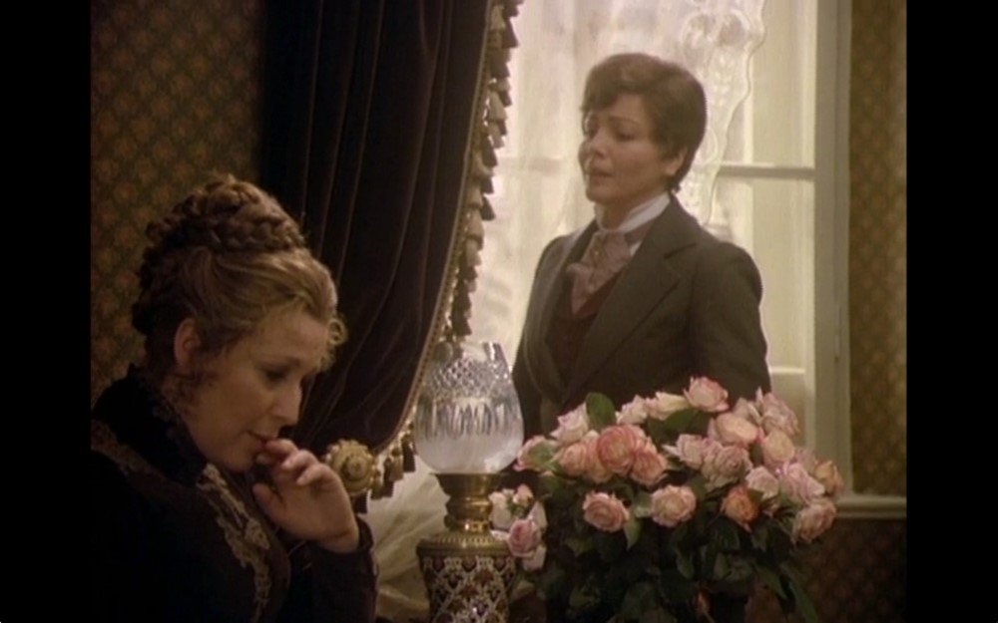
Figure 1 Arabella (Otto Schenk, 1976), timing 19:01.
Notes:
Figure 1 Arabella (Otto Schenk, 1976), timing 19:01.
Unless provided in the caption above, the following copyright applies to the content of this slide: © The Author 2015. Published by Oxford University Press. All rights reserved.For permissions, please e-mail: journals.permissions@oup.com

Slide 4
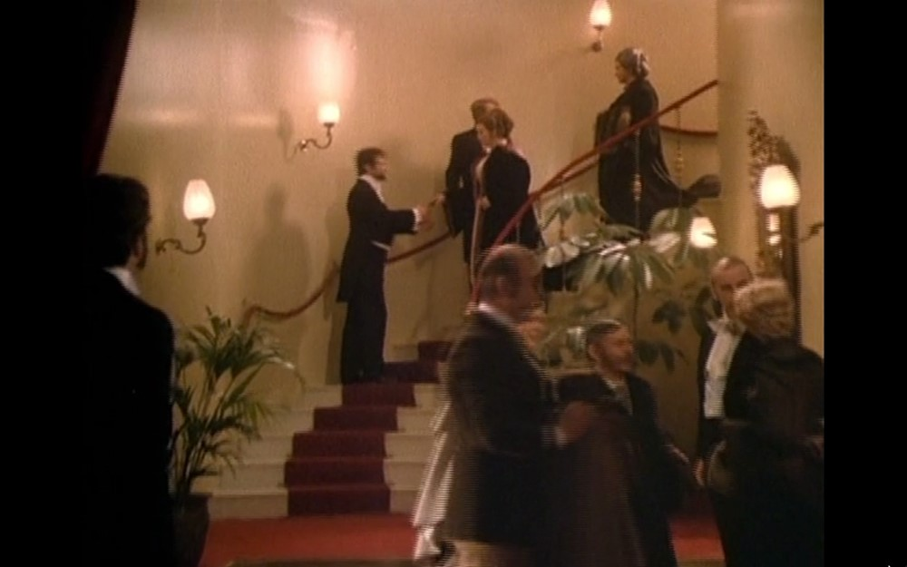
Figure 2 Arabella (Otto Schenk, 1976), timing 58:12.
Notes:
Figure 2 Arabella (Otto Schenk, 1976), timing 58:12.
Unless provided in the caption above, the following copyright applies to the content of this slide: © The Author 2015. Published by Oxford University Press. All rights reserved.For permissions, please e-mail: journals.permissions@oup.com

