Slide 1
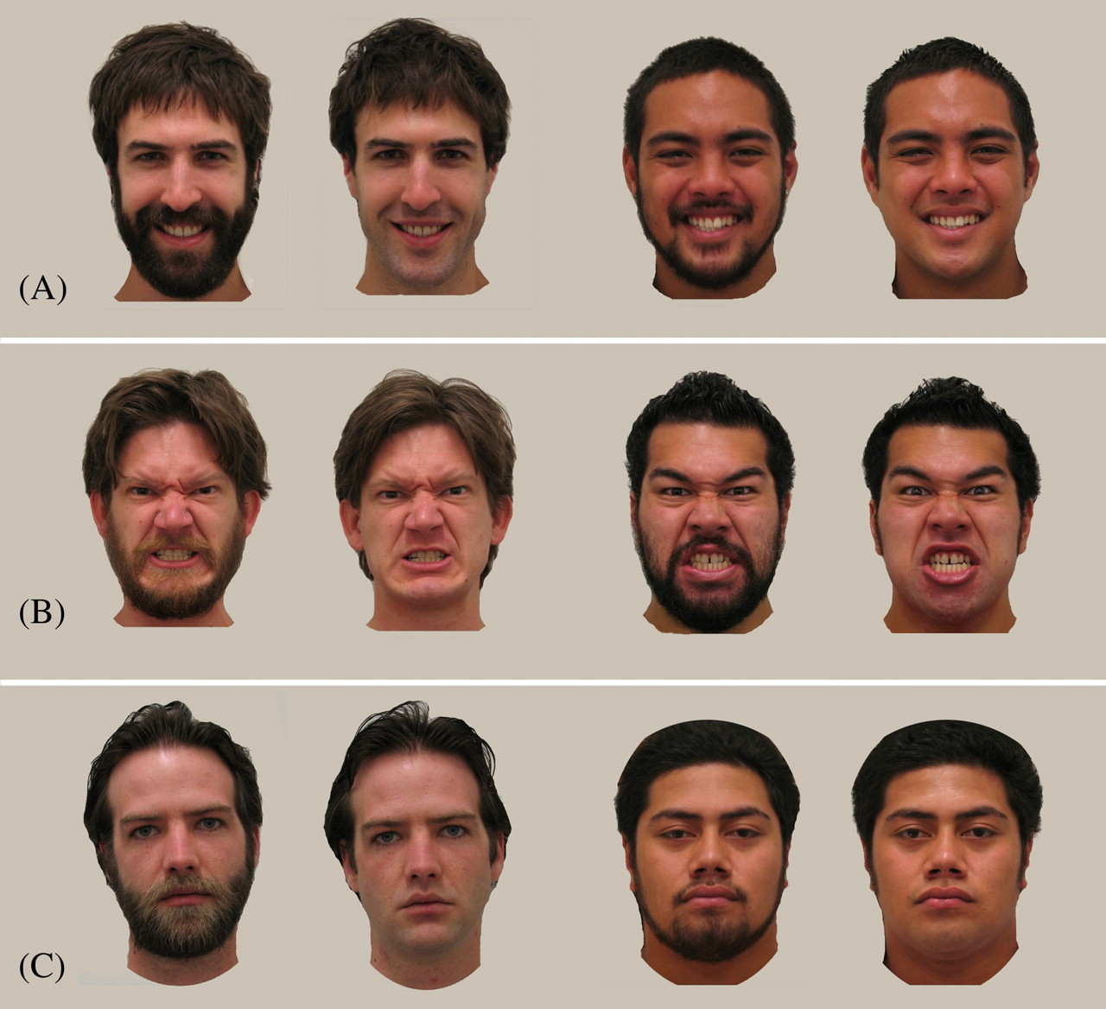
Figure 1 Examples of the facial expressions used to test the effect of the beard on perceptions of attractiveness (A), ...
Notes:
Figure 1 Examples of the facial expressions used to test the effect of the beard on perceptions of attractiveness (A), aggressiveness (B), and social status and perceived age (C) in New Zealand and Samoa.
Unless provided in the caption above, the following copyright applies to the content of this slide: © The Author 2012. Published by Oxford University Press on behalf of the International Society for Behavioral Ecology. All rights reserved. For permissions, please e-mail: journals.permissions@oup.com

Slide 2
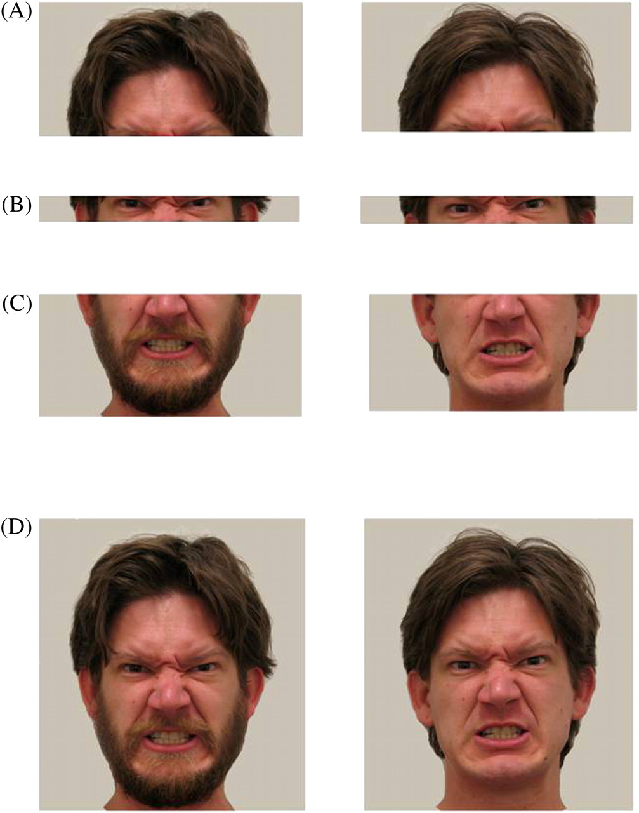
Figure 2 The FACS was used to pose angry facial expressions. Participants were asked to draw their eyebrows medially ...
Notes:
Figure 2 The FACS was used to pose angry facial expressions. Participants were asked to draw their eyebrows medially and down (A), while retaining open eyes and a wrinkled nose (B). Participants were also asked to part their lips while drawing them down and clenching their teeth (C). This combination of movements was repeated in the same participants when clean-shaven and fully bearded (D).
Unless provided in the caption above, the following copyright applies to the content of this slide: © The Author 2012. Published by Oxford University Press on behalf of the International Society for Behavioral Ecology. All rights reserved. For permissions, please e-mail: journals.permissions@oup.com

Slide 3
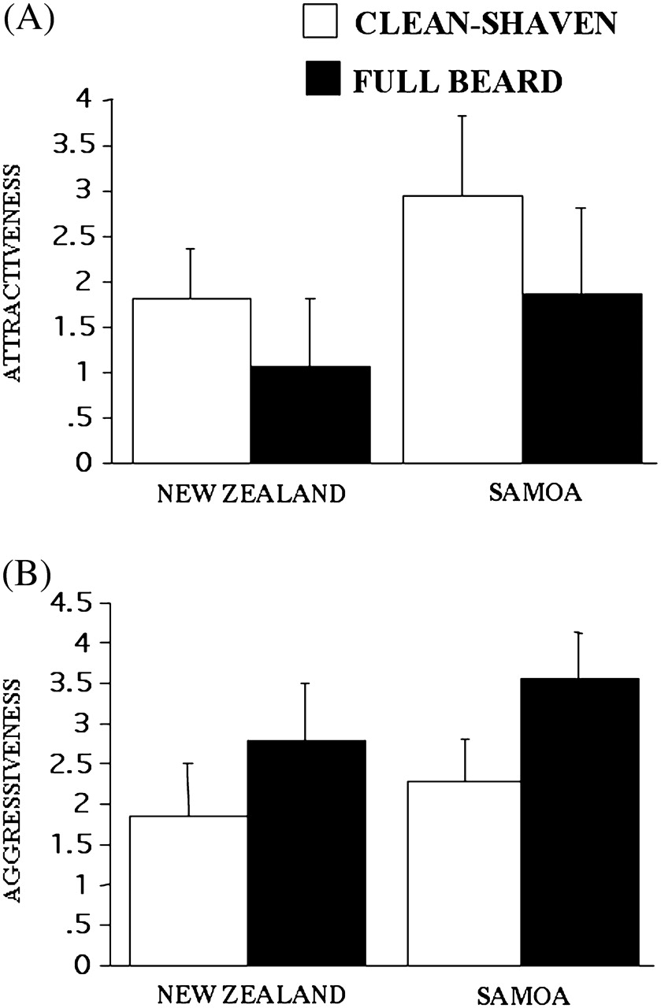
Figure 3 (A) Mean attractiveness scores (±1 SD) made by women for faces posing smiling facial expressions when ...
Notes:
Figure 3 (A) Mean attractiveness scores (±1 SD) made by women for faces posing smiling facial expressions when clean-shaven and bearded. (B) Mean aggressiveness scores (±1 SD) made by men for faces depicting angry facial expressions when clean-shaven and bearded.
Unless provided in the caption above, the following copyright applies to the content of this slide: © The Author 2012. Published by Oxford University Press on behalf of the International Society for Behavioral Ecology. All rights reserved. For permissions, please e-mail: journals.permissions@oup.com

Slide 4
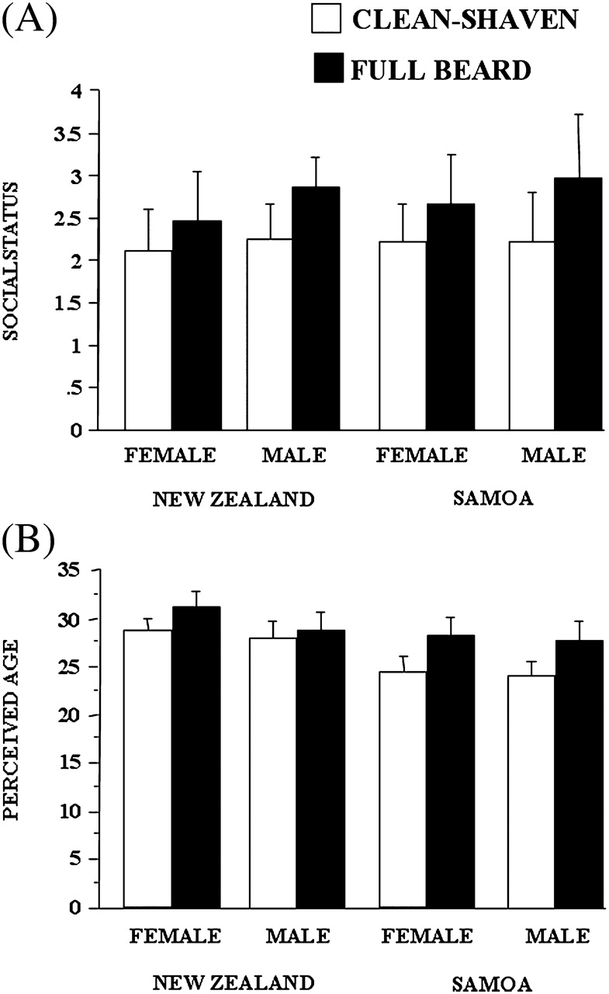
Figure 4 (A) Mean social status scores (±1 SD) made by men and women for faces depicting neutral facial expressions ...
Notes:
Figure 4 (A) Mean social status scores (±1 SD) made by men and women for faces depicting neutral facial expressions when clean-shaven and bearded. (B) Mean perceived age scores (±1 SD) made by men and women for faces depicting neutral facial expressions when clean-shaven and bearded.
Unless provided in the caption above, the following copyright applies to the content of this slide: © The Author 2012. Published by Oxford University Press on behalf of the International Society for Behavioral Ecology. All rights reserved. For permissions, please e-mail: journals.permissions@oup.com

