Slide 1
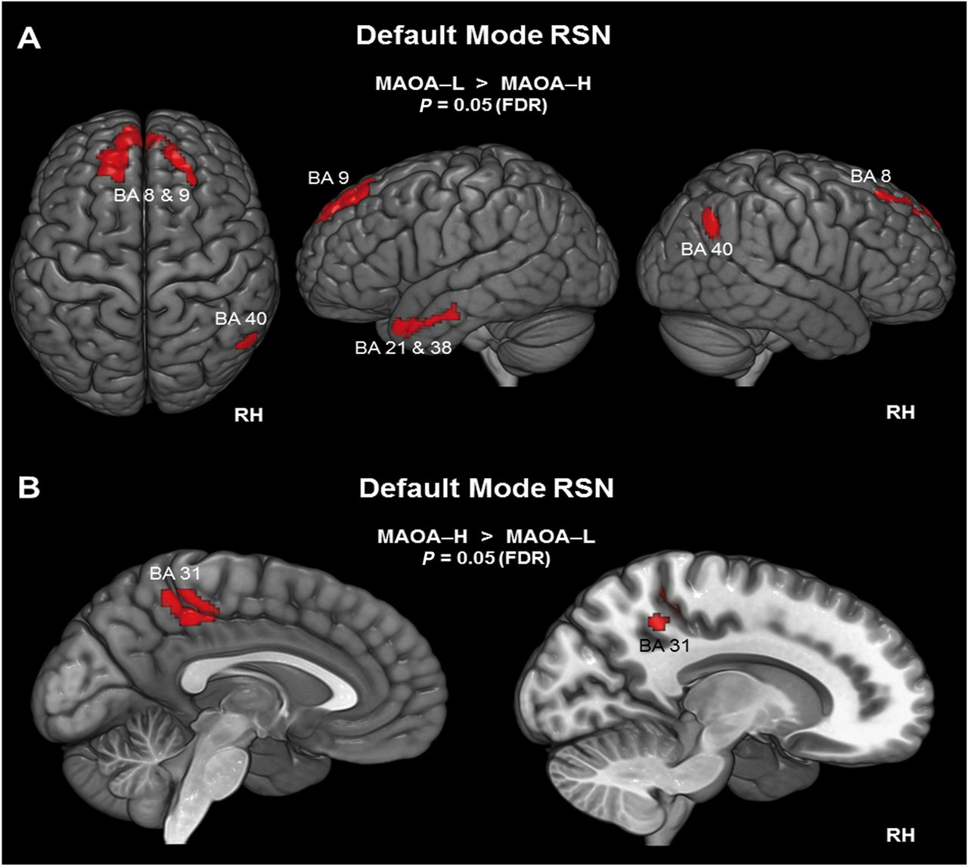
Figure 1. Voxel-wise difference maps for the DMN. Activity is displayed at a cluster-level threshold of P < 0.05 (FDR ...
Notes:
Figure 1. Voxel-wise difference maps for the DMN. Activity is displayed at a cluster-level threshold of P < 0.05 (FDR corrected) and projected on the MNI template brain (ICBM 152). Panel (A) shows areas within the DMN for which the MAOA-L group exhibited increased activity and (B) shows the reverse: areas within the DMN for which the MAOA-L group exhibited decreased activity. BA, Brodmann area; FDR, false discovery rate; MAOA-H, high-activity allele group; MAOA-L, low-activity allele group; RH, right hemisphere; RSN, resting-state network.
Unless provided in the caption above, the following copyright applies to the content of this slide: © The Author 2014. Published by Oxford University Press. All rights reserved. For Permissions, please e-mail: journals.permissions@oup.com

Slide 2
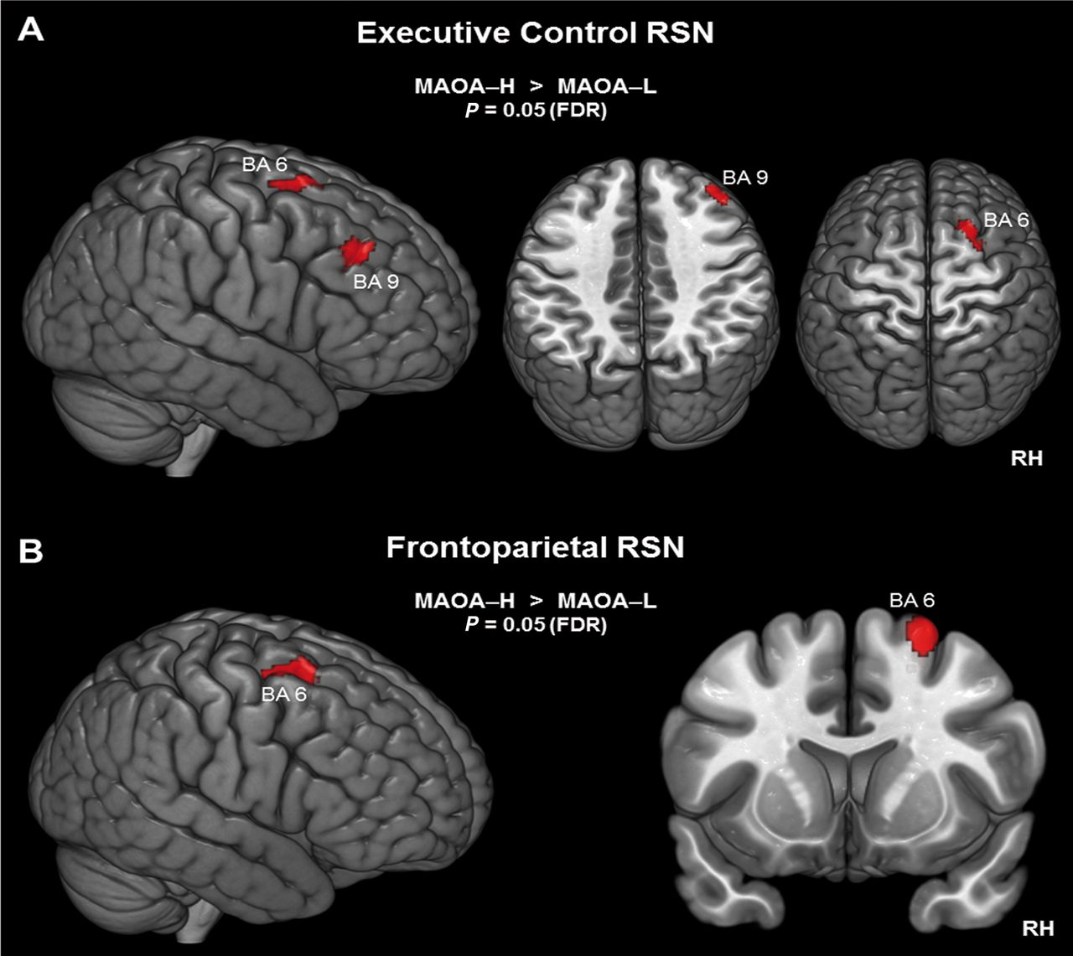
Figure 2. Voxel-wise difference maps for executive control and right frontoparietal RSN. Activity is displayed at a ...
Notes:
Figure 2. Voxel-wise difference maps for executive control and right frontoparietal RSN. Activity is displayed at a cluster-level threshold of P < 0.05 (FDR corrected) and projected on the MNI template brain (ICBM 152). Panel (A) depicts 2 right frontal areas of the executive control RSN for which activity was reduced in the MAOA-L group. Panel (B) shows a right frontal area in the middle frontal gyrus (MFG), which is part of the frontoparietal RSN, for which activity was reduced in the MAOA-L group. BA, Brodmann area; FDR, false discovery rate; MAOA-H, high-activity allele group; MAOA-L, low-activity allele group; RH, right hemisphere; RSN = resting-state network.
Unless provided in the caption above, the following copyright applies to the content of this slide: © The Author 2014. Published by Oxford University Press. All rights reserved. For Permissions, please e-mail: journals.permissions@oup.com

Slide 3
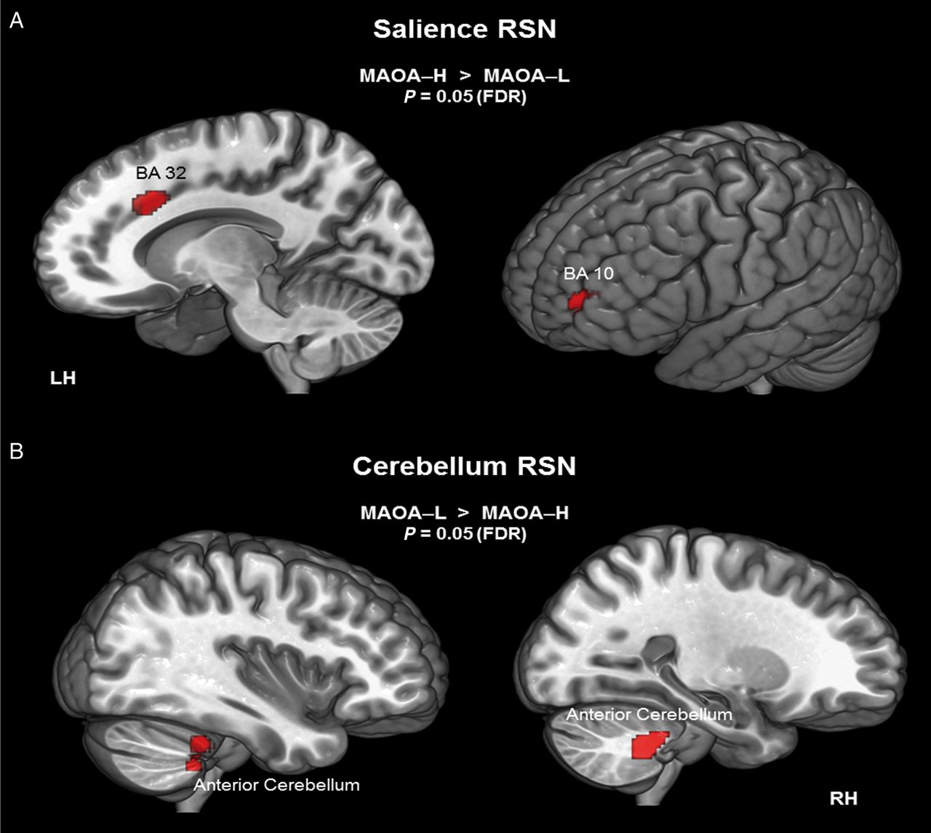
Figure 3. Voxel-wise difference maps for cerebellum and salience RSN. Activity is displayed at a cluster-level ...
Notes:
Figure 3. Voxel-wise difference maps for cerebellum and salience RSN. Activity is displayed at a cluster-level threshold of P < 0.05 (FDR corrected) and projected on the MNI template brain (ICBM 152). Panel (A) shows, within the salience RSN, the dorsal anterior cingulate cortex (dACC) and the anterior frontal cortex at BA 10. For both areas, activity was reduced for the MAOA-L group. Panel (B) shows a cerebellar cluster at the anterior lobe of the cerebellum, showing increased activity for the MAOA-L group. BA, Brodmann area; FDR, false discovery rate; LH, left hemisphere; MAOA-H, high-activity allele group; MAOA-L, low-activity allele group; RH, right hemisphere; RSN, resting-state network.
Unless provided in the caption above, the following copyright applies to the content of this slide: © The Author 2014. Published by Oxford University Press. All rights reserved. For Permissions, please e-mail: journals.permissions@oup.com

