Slide 1
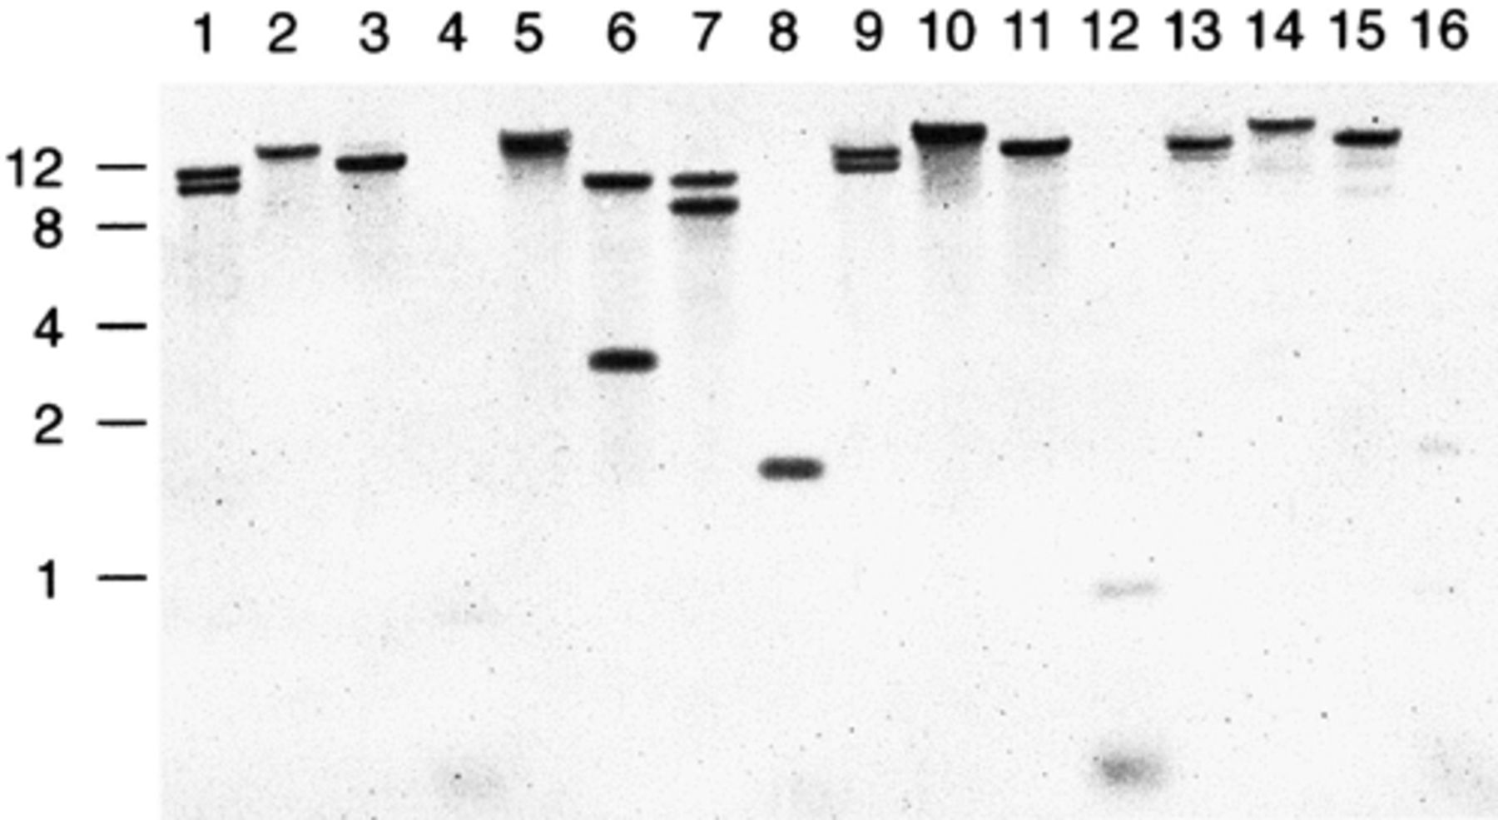
Figure 1 Distribution of 5′-(CAAC)_{n}-3′ repeats in various M. catarrhalis strains. Southern blot of M. ...
Notes:
Figure 1 Distribution of 5′-(CAAC)n-3′ repeats in various M. catarrhalis strains. Southern blot of M. catarrhalis chromosomal DNA restriction digests hybridised with the DIG-labelled oligonucleotide 5′-(CAAC)6-3′ probe. Each M. catarrhalis ATCC strain is digested with Hin cII, Cla I, Mfe I, and Apo I respectively. Lanes 1–4, strain 8913; 5–8, strain 23246; 9–12, strain 25238; 13–16, strain 25839. Molecular mass standards are indicated in kb.
Unless provided in the caption above, the following copyright applies to the content of this slide: © 2002 Federation of European Microbiological Societies.

Slide 2
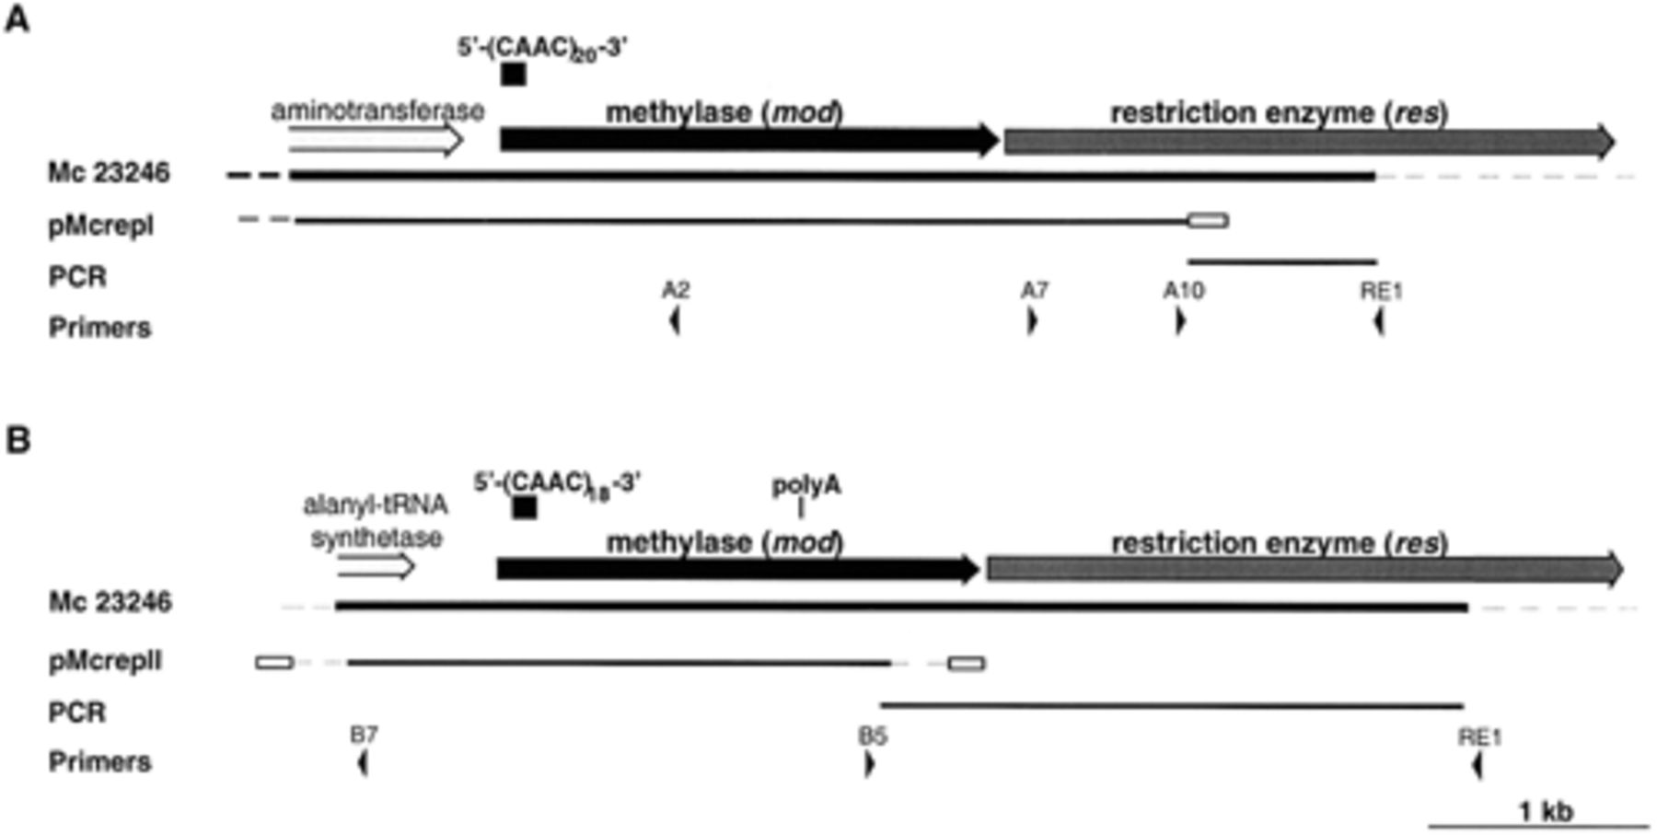
Figure 2 Schematic representation of (A) the Mca RI and (B) the Mca RII type III R–M systems identified in M. ...
Notes:
Figure 2 Schematic representation of (A) the Mca RI and (B) the Mca RII type III R–M systems identified in M. catarrhalis. The lines labelled Mc 23246 represent the double stranded sequence obtained from the M. catarrhalis ATCC strain 23246 (GenBank entries AY049056, AY049057). The arrows above the line indicate the location, orientation and predicted function of the ORFs identified in the sequence. The location of the 5′-(CAAC)n-3′ repeats are shown above the methylase ORF. The pMcrepI and pMcrepII lines represent the clones obtained from the Cla I/Mfe I genomic library screened with the 5′-(CAAC)6-3′ oligonucleotide probe. The vector backbone for these plasmids (pUC19) is represented by a box. The sequence obtained by PCR and inverse PCR is indicated and the primers used are represented by arrowheads.
Unless provided in the caption above, the following copyright applies to the content of this slide: © 2002 Federation of European Microbiological Societies.

Slide 3
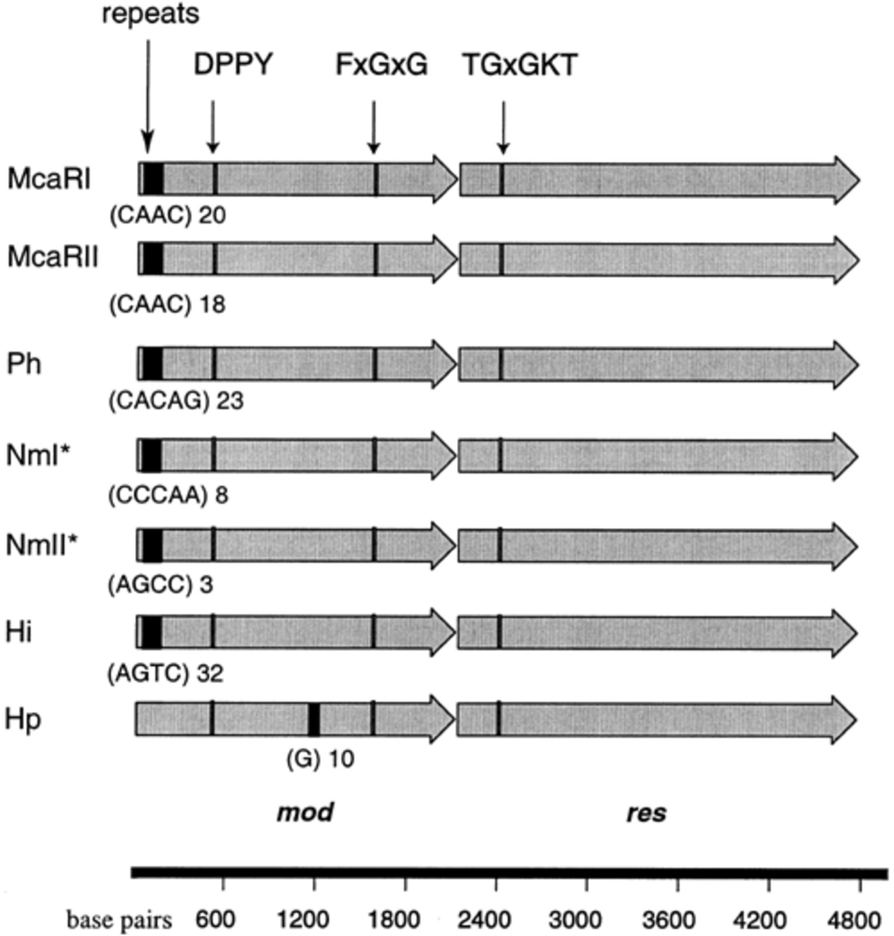
Figure 3 Schematic representation of repetitive DNA within potentially phase variable type III R–M systems. The ...
Notes:
Figure 3 Schematic representation of repetitive DNA within potentially phase variable type III R–M systems. The methylase (mod) genes, restriction endonuclease (res) genes and the repeat regions are indicated. McaRI, M. catarrhalis (AY049056); McaRII, M. catarrhalis (AY049057); Ph, P. haemolytica (AF060119) [48]; NmI, N. meningitidis Z2491 (NMA1467, CAB84700) [49]; NmII, N. meningitidis Z2491 (CAB84817, CAB84818) [49]; Hi, H. influenzae Rd (AAC22721, AAC22720) [50]; Hp, H. pylori 26695 (AAD07659, AAD07657) [51]. *These genes are also found in N. meningitidis MC58 (NMB1261, AAF41638; NMB1375) [52] and Neisseria gonorrhoeae (University of Oklahoma's Advanced Centre for Genome Technology, OK, USA). Conserved regions within type III R–M systems are also shown. The DPPY motif is involved in catalysis of the methylation reaction [20], the FxGxG motif is involved in binding of the methyl donor (AdoMet) [20,21], and the TGxGKT motif is involved in ATP binding [20,53].
Unless provided in the caption above, the following copyright applies to the content of this slide: © 2002 Federation of European Microbiological Societies.

