Slide 1
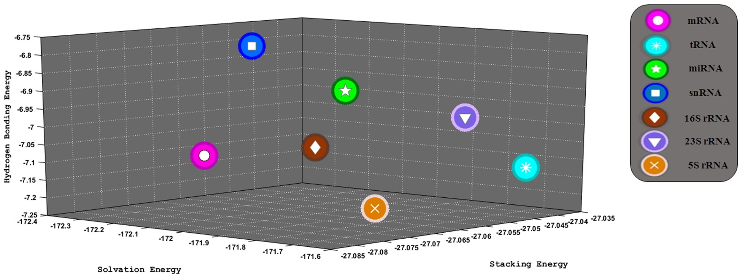
Figure 1. Differentiation of RNA genes obtained on the basis of physico-chemical properties. Average values of hydrogen ...
Notes:
Figure 1. Differentiation of RNA genes obtained on the basis of physico-chemical properties. Average values of hydrogen bonding energy per bp (kcal/mol), stacking energy per bp (kcal/mol) and solvation energy per bp (kcal/mol), of ∼7.6 million RNA genes comprising ∼7.3 million mRNA (magenta, circle), 255 524 tRNA (cyan, star), 5250 miRNA (green, pentagon), 3747 snRNA (blue, square), 13 997 16S rRNA (brown, diamond), 13 745 23S rRNA (purple, triangle) and 12 907 5S rRNA (orange, cross) genes are shown for 9282 prokaryotic and eukaryotic genomes.
Unless provided in the caption above, the following copyright applies to the content of this slide: © The Author(s) 2016. Published by Oxford University Press on behalf of Nucleic Acids Research.This is an Open Access article distributed under the terms of the Creative Commons Attribution License (http://creativecommons.org/licenses/by-nc/4.0/), which permits non-commercial re-use, distribution, and reproduction in any medium, provided the original work is properly cited. For commercial re-use, please contact journals.permissions@oup.com

Slide 2
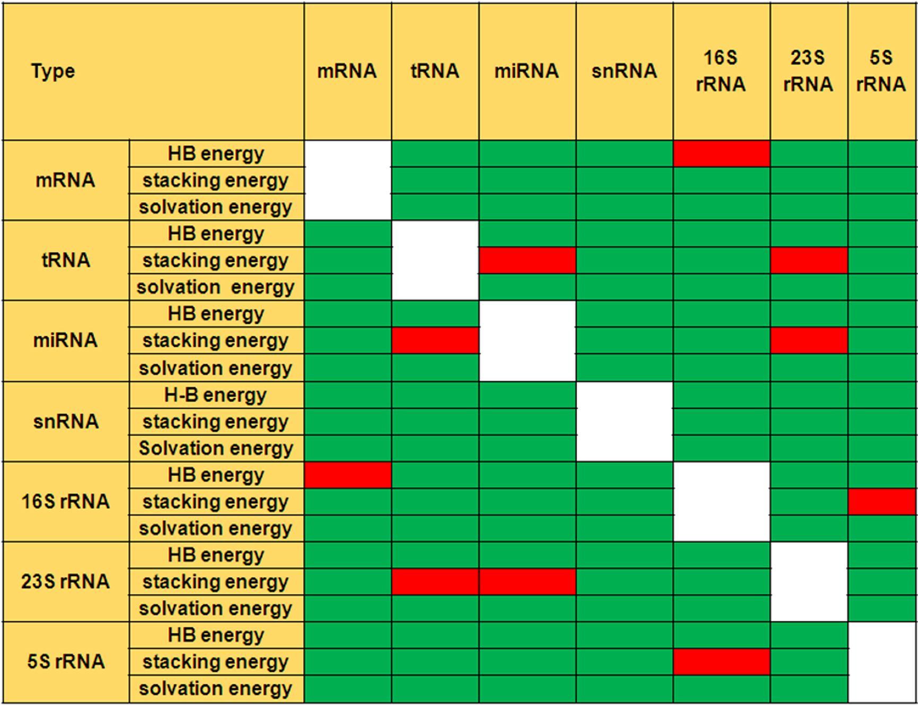
Figure 2. Results of two sample t-test for comparing means of each physico-chemical property considered (hydrogen ...
Notes:
Figure 2. Results of two sample t-test for comparing means of each physico-chemical property considered (hydrogen bonding, stacking and solvation energies) for each pair of RNAs. Green represents that the separation in the mean values is statistically significant and red represents that it is statistically insignificant.
Unless provided in the caption above, the following copyright applies to the content of this slide: © The Author(s) 2016. Published by Oxford University Press on behalf of Nucleic Acids Research.This is an Open Access article distributed under the terms of the Creative Commons Attribution License (http://creativecommons.org/licenses/by-nc/4.0/), which permits non-commercial re-use, distribution, and reproduction in any medium, provided the original work is properly cited. For commercial re-use, please contact journals.permissions@oup.com

