Slide 1
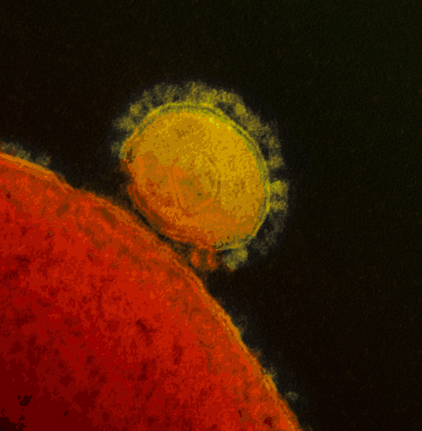
Graphical Abstract Figure. Excellent review on timely and newly emerging infectious diseases.
Notes:
Graphical Abstract Figure. Excellent review on timely and newly emerging infectious diseases.
Unless provided in the caption above, the following copyright applies to the content of this slide: © 2014 Federation of European Microbiological Societies.

Slide 2
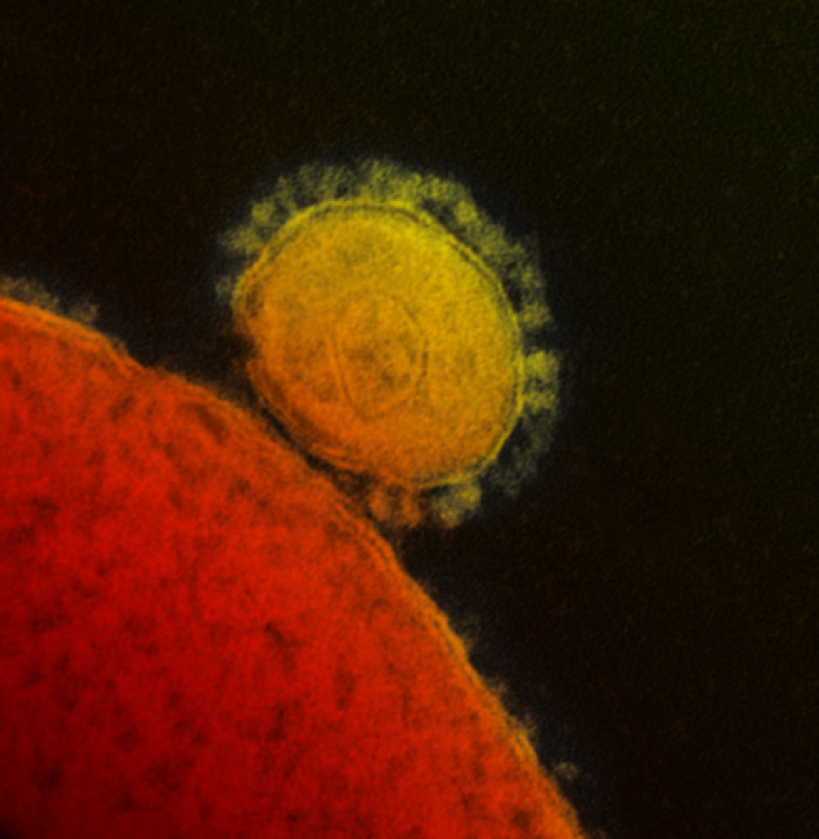
Figure 1 False color MERS CoV particle visualized by electron microscopy. A MERS CoV particle (yellow) attached to the ...
Notes:
Figure 1 False color MERS CoV particle visualized by electron microscopy. A MERS CoV particle (yellow) attached to the surface of a cell (red). The characteristic MERS CoV spike glycoproteins are clearly visible on the surface of the MERS CoV particle.
Unless provided in the caption above, the following copyright applies to the content of this slide: © 2014 Federation of European Microbiological Societies.

Slide 3
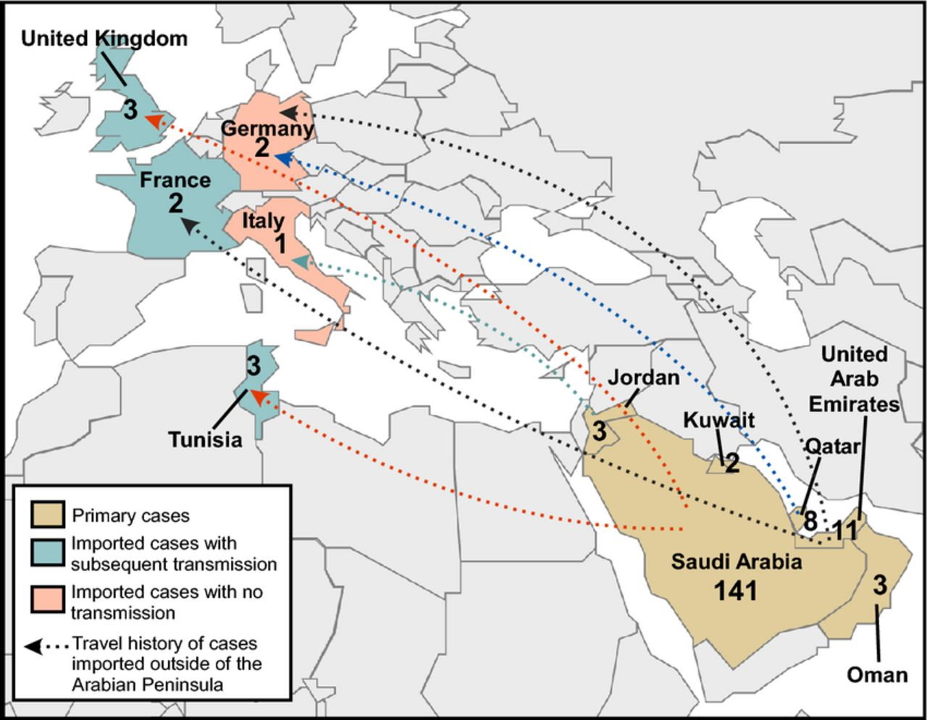
Figure 2 Geographic distribution of the MERS CoV outbreak. The geographic distribution of MERS CoV cases up to ...
Notes:
Figure 2 Geographic distribution of the MERS CoV outbreak. The geographic distribution of MERS CoV cases up to February 1, 2014 is shown. Travel history of cases imported outside of the Arabian Peninsula is indicated with dotted arrows. Countries with primary MERS CoV cases are shown in brown, countries with imported MERS CoV cases and no confirmed human to human transmission are shown in pink, and countries with imported MERS CoV cases and subsequent human to human transmission are shown in green.
Unless provided in the caption above, the following copyright applies to the content of this slide: © 2014 Federation of European Microbiological Societies.

Slide 4
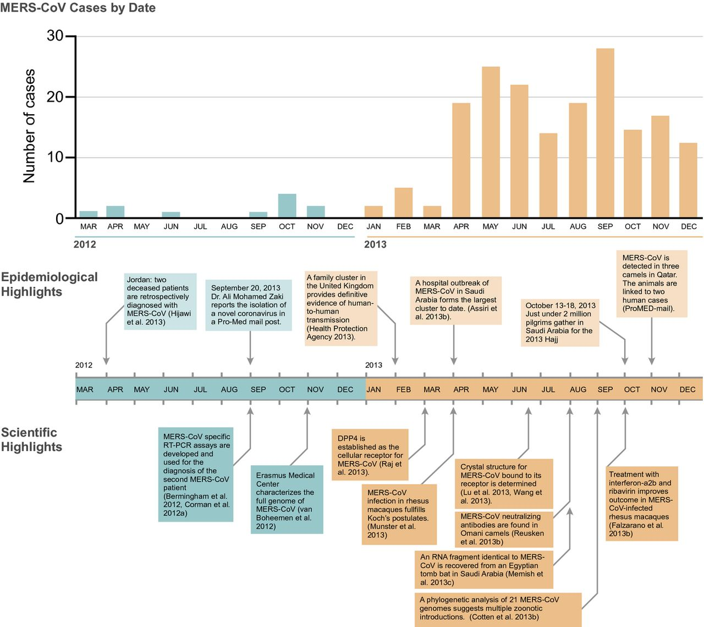
Figure 3 Timeline of the MERS CoV outbreak. Temporal distribution of MERS CoV cases from March 2012 through December ...
Notes:
Figure 3 Timeline of the MERS CoV outbreak. Temporal distribution of MERS CoV cases from March 2012 through December 2013. Significant outbreak events and scientific advances during this time period are highlighted below.
Unless provided in the caption above, the following copyright applies to the content of this slide: © 2014 Federation of European Microbiological Societies.

Slide 5
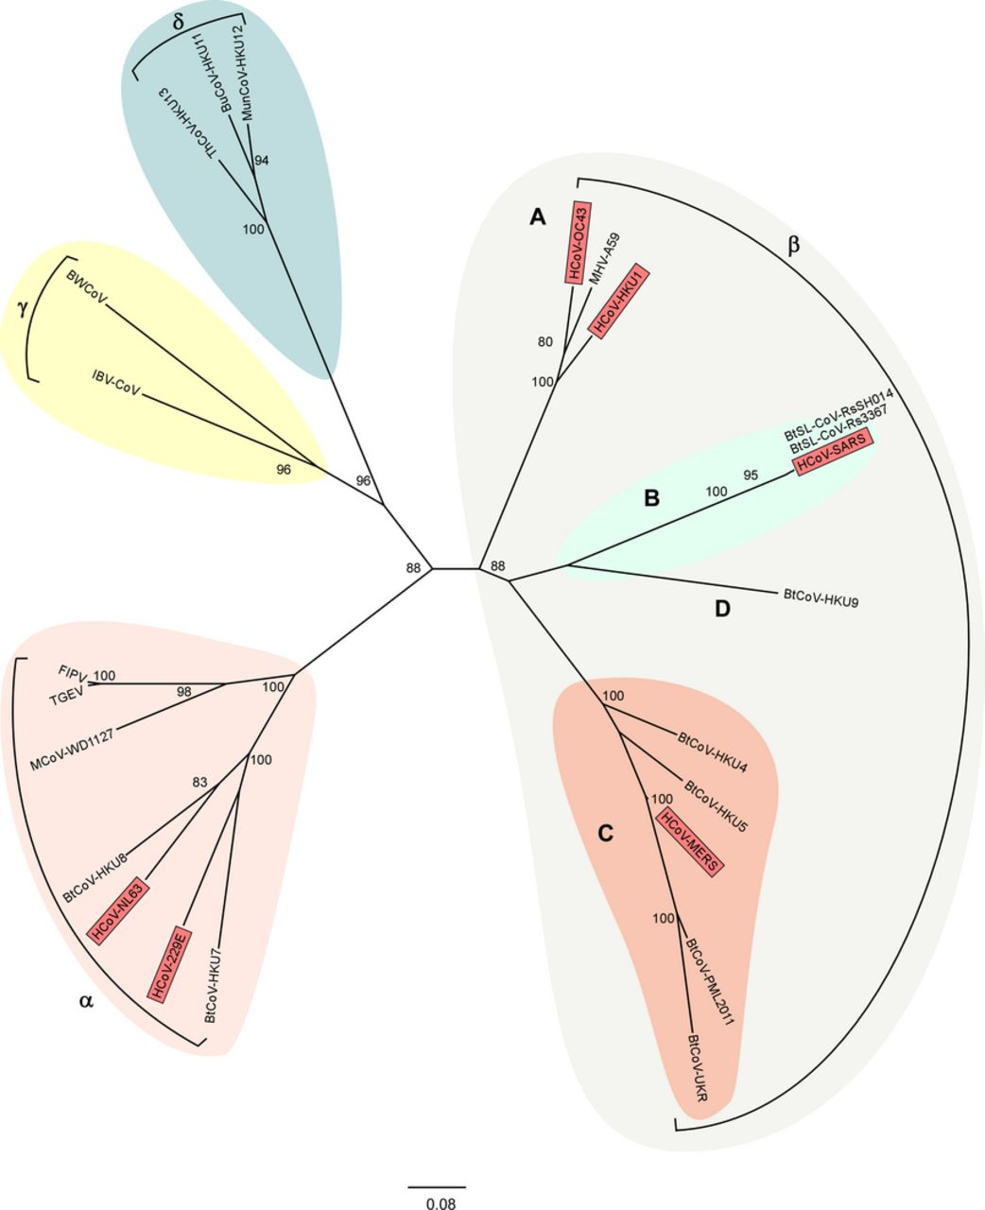
Figure 4 Coronavirus phylogeny. Phylogenetic tree of coronaviruses with representatives of each of the four genera; ...
Notes:
Figure 4 Coronavirus phylogeny. Phylogenetic tree of coronaviruses with representatives of each of the four genera; Alpha (pink), Beta (gray), Delta (blue), and Gammacoronavirus (yellow). Betacoronaviruses are further subdivided into clades A through D, with clade B (green) containing SARS CoV and clade C (orange) containing MERS CoV. All known human coronaviruses are represented in red. Maximum likelihood trees were generated with the MEGA5 software package using a 1231 nucleotide segment within the RdRp. Trees were visualized using Figtree. Bootstrap values above 75 are shown. CoV isolation origin abbreviations as follows: H: human; Bt: bat; BtSL: bat SARS like; BW: beluga whale; IBV: chicken; FIPV: feline; TGEV: swine; M: mink; MHV: murine; Th: thrush; Bu: bulbul; Mun: munia.
Unless provided in the caption above, the following copyright applies to the content of this slide: © 2014 Federation of European Microbiological Societies.

Slide 6
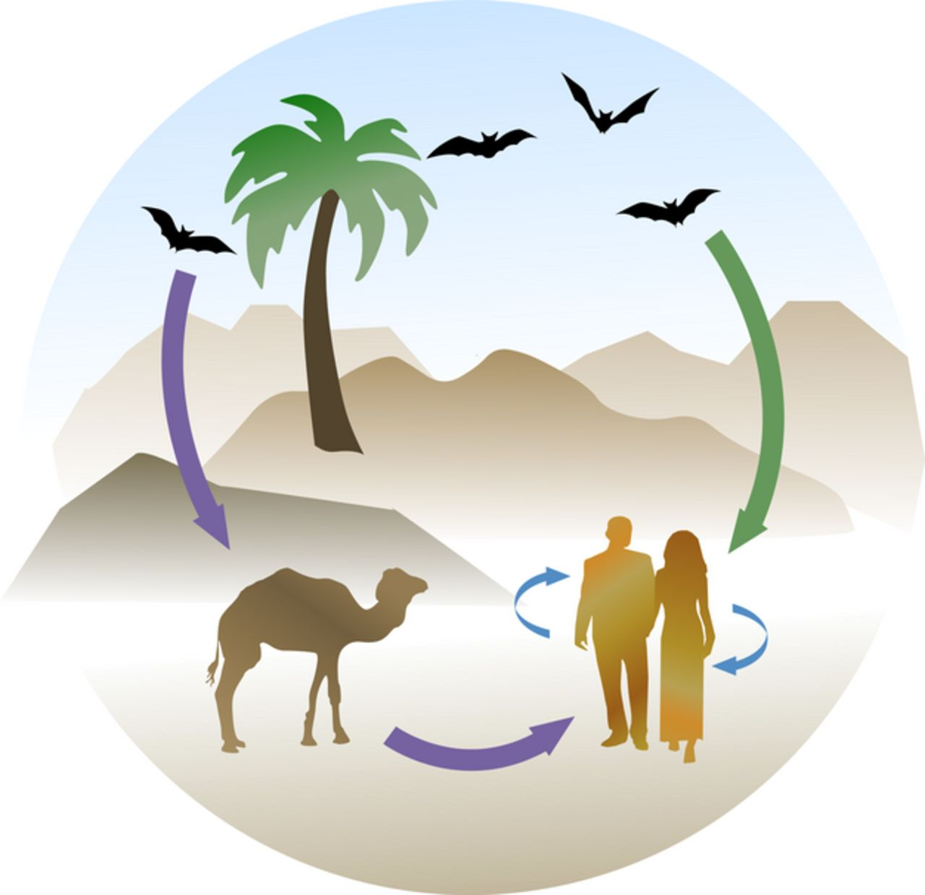
Figure 5 Putative MERS CoV transmission cycle. The putative transmission cycle for MERS CoV. MERS CoV likely ...
Notes:
Figure 5 Putative MERS CoV transmission cycle. The putative transmission cycle for MERS CoV. MERS CoV likely originated from bats, acting as the natural reservoir. From the natural reservoir, MERS CoV spilled either directly over to humans (green arrow) or via an intermediate host (dromedary camels, purple arrow). Currently, the exact route of zoonotic transmission of MERS CoV into the human population remains unknown although the presence of MERS CoV neutralizing antibodies and the detection of MERS CoV in dromedary camels suggest that this species is likely to play a major role in the emergence of MERS CoV. Phylogenetic analysis suggests that multiple introductions of MERS CoV into the human population have occurred and both zoonotic transmission events and human to human transmission (blue arrows) drive the current MERS CoV outbreak.
Unless provided in the caption above, the following copyright applies to the content of this slide: © 2014 Federation of European Microbiological Societies.

Slide 7
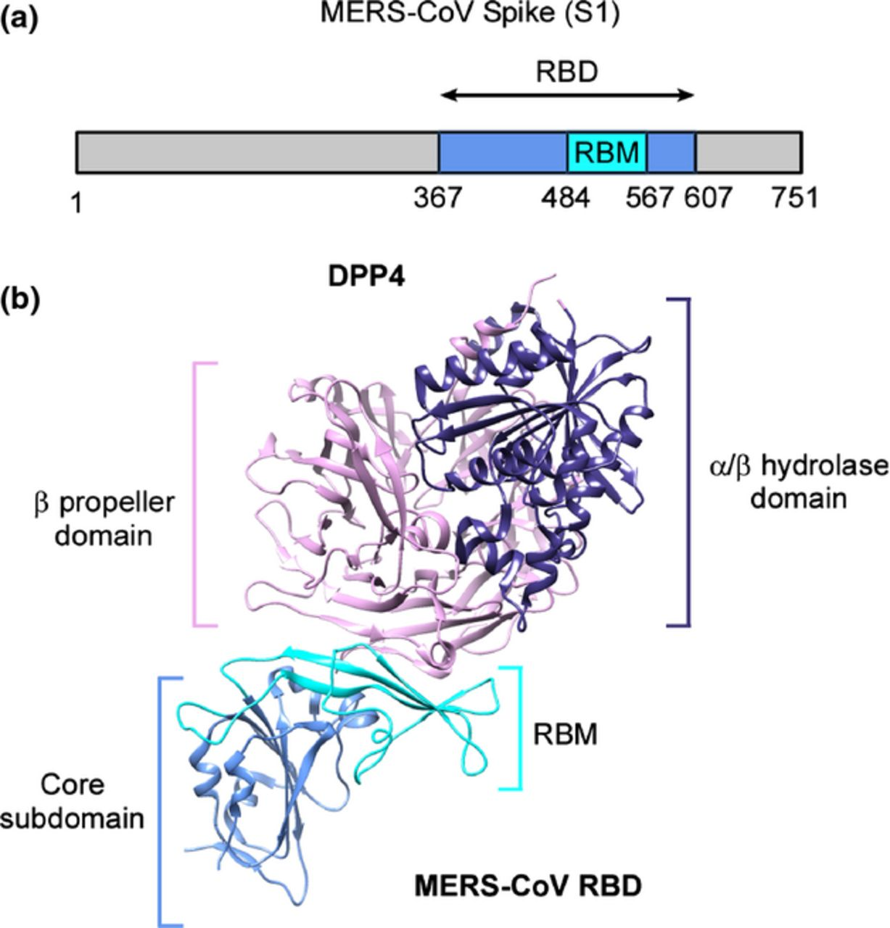
Figure 6 MERS CoV spike glycoprotein and DPP4 receptor interaction. (a) The linear organization of the S1 subunit of ...
Notes:
Figure 6 MERS CoV spike glycoprotein and DPP4 receptor interaction. (a) The linear organization of the S1 subunit of MERS CoV spike glycoprotein with the variable RBD located at amino acid residues 367–607, with a RBM containing the critical amino acid residues for binding at residues 484–567. (b) The crystal structure of the MERS CoV RBD coupled with the receptor dipeptidyl peptidase IV (DPP4). DPP4 is structurally divided into an alpha and beta hydrolase domain, and a beta propeller domain. The beta propeller domain of DPP4 (pink) interacts with the RBM region (light blue) of the MERS CoV spike protein RBD. The schematic representation of the DPP4 – MERS CoV spike protein RBD structure was generated using chimera and protein accession number 4KR0 (Lu et al., 2013).
Unless provided in the caption above, the following copyright applies to the content of this slide: © 2014 Federation of European Microbiological Societies.

Slide 8
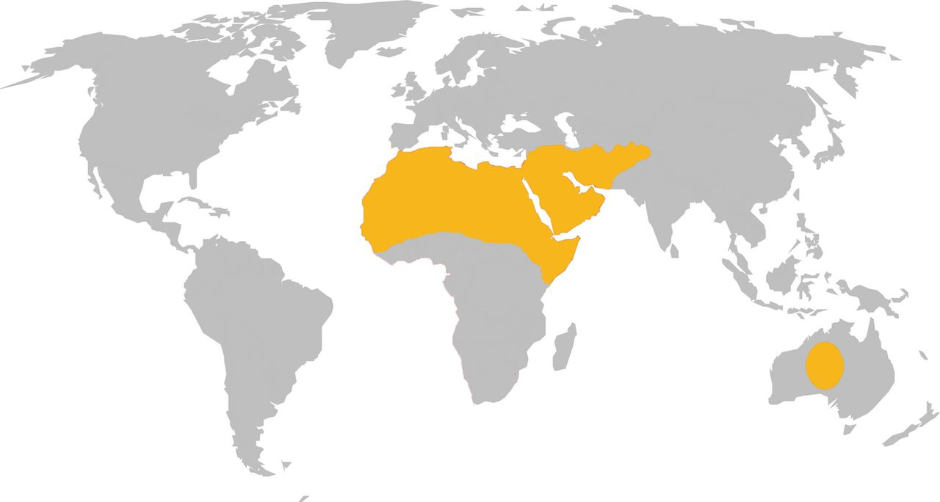
Figure 7 Geographic distribution of dromedary camels. The global distribution of dromedary camels is indicated by ...
Notes:
Figure 7 Geographic distribution of dromedary camels. The global distribution of dromedary camels is indicated by yellow shading (Mukasa Mugerwa, 1981).
Unless provided in the caption above, the following copyright applies to the content of this slide: © 2014 Federation of European Microbiological Societies.

