Slide 1
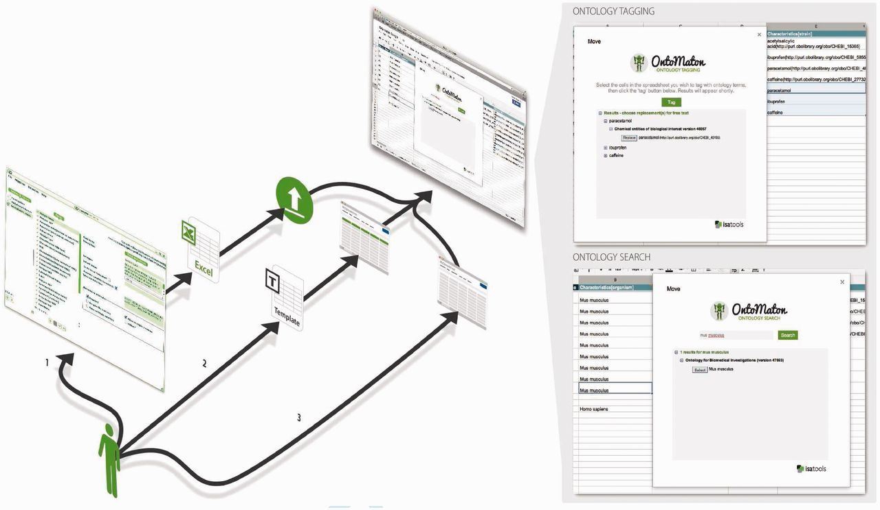
Fig. 1. Uses of OntoMaton: (1) open the OntoMaton-enabled Google Spreadsheet template from the online gallery; (2) ...
Notes:
Fig. 1. Uses of OntoMaton: (1) open the OntoMaton-enabled Google Spreadsheet template from the online gallery; (2) create a standard Google Spreadsheet and install OntoMaton within that; or (3) as part of the ISA suite, export an Excel template from ISAconfigurator and upload it into Google Spreadsheets
Unless provided in the caption above, the following copyright applies to the content of this slide: © The Author 2012. Published by Oxford University Press on behalf of The Society for Financial Studies.This is an Open Access article distributed under the terms of the Creative Commons Attribution License (http://creativecommons.org/licenses/by/3.0/), which permits unrestricted reuse, distribution, and reproduction in any medium, provided the original work is properly cited

