Slide 1
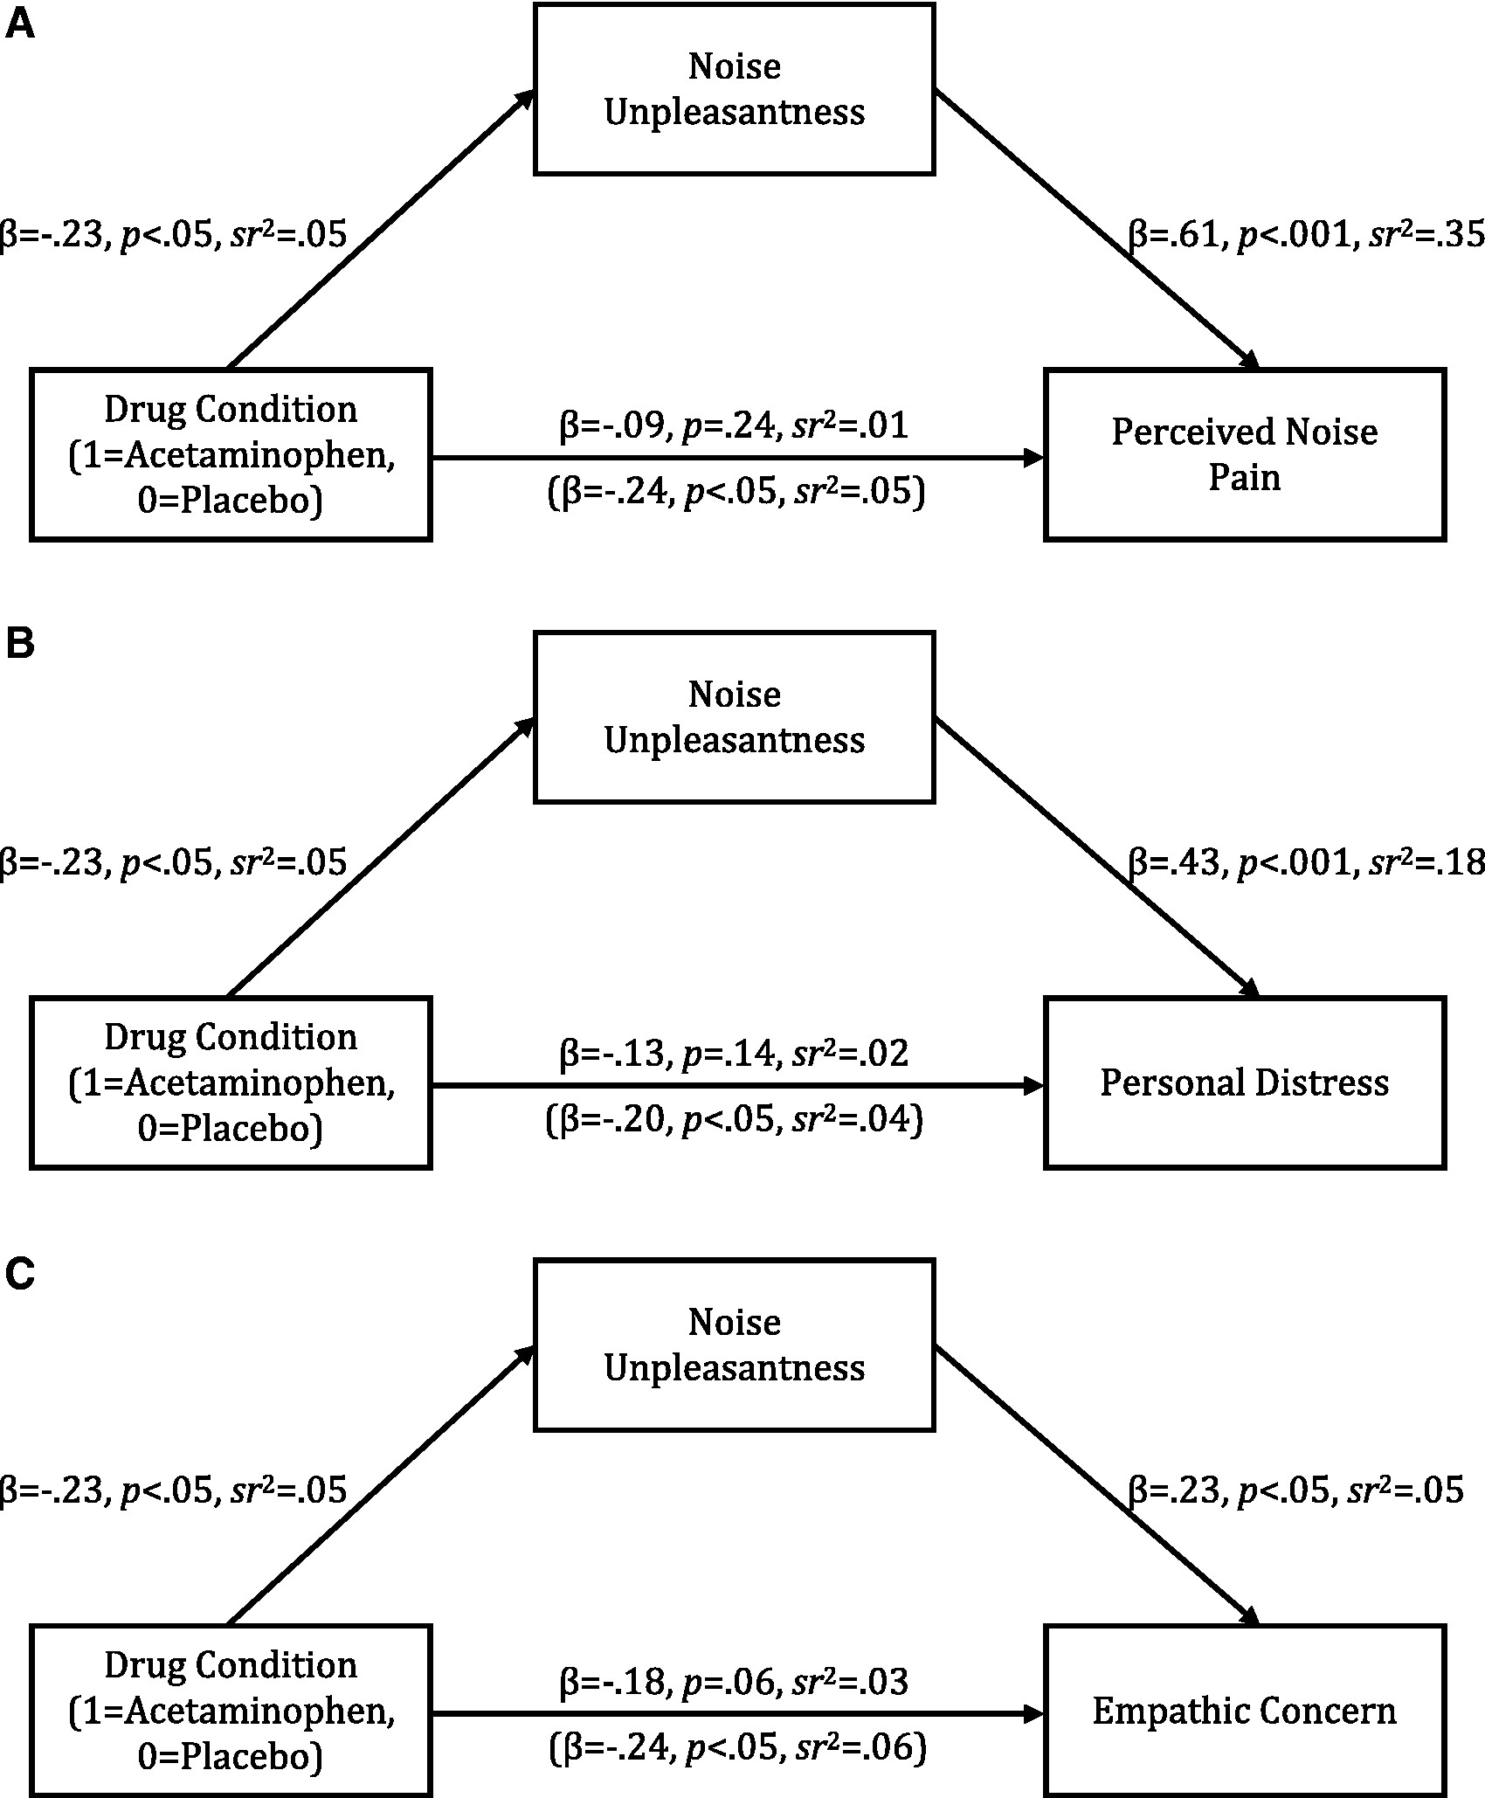
Fig. 1 Model of the effect of drug condition on (A) perceived noise pain, (B) personal distress and (C) empathic ...
Notes:
Fig. 1 Model of the effect of drug condition on (A) perceived noise pain, (B) personal distress and (C) empathic concern through noise unpleasantness (Experiment 2). Statistics in parentheses indicate the effect of drug condition on empathy measures while controlling for noise unpleasantness.
Unless provided in the caption above, the following copyright applies to the content of this slide: © The Author(s) (2016). Published by Oxford University Press.This is an Open Access article distributed under the terms of the Creative Commons Attribution Non-Commercial License (http://creativecommons.org/licenses/by-nc/4.0/), which permits non-commercial re-use, distribution, and reproduction in any medium, provided the original work is properly cited. For commercial re-use, please contact journals.permissions@oup.com

