Slide 1
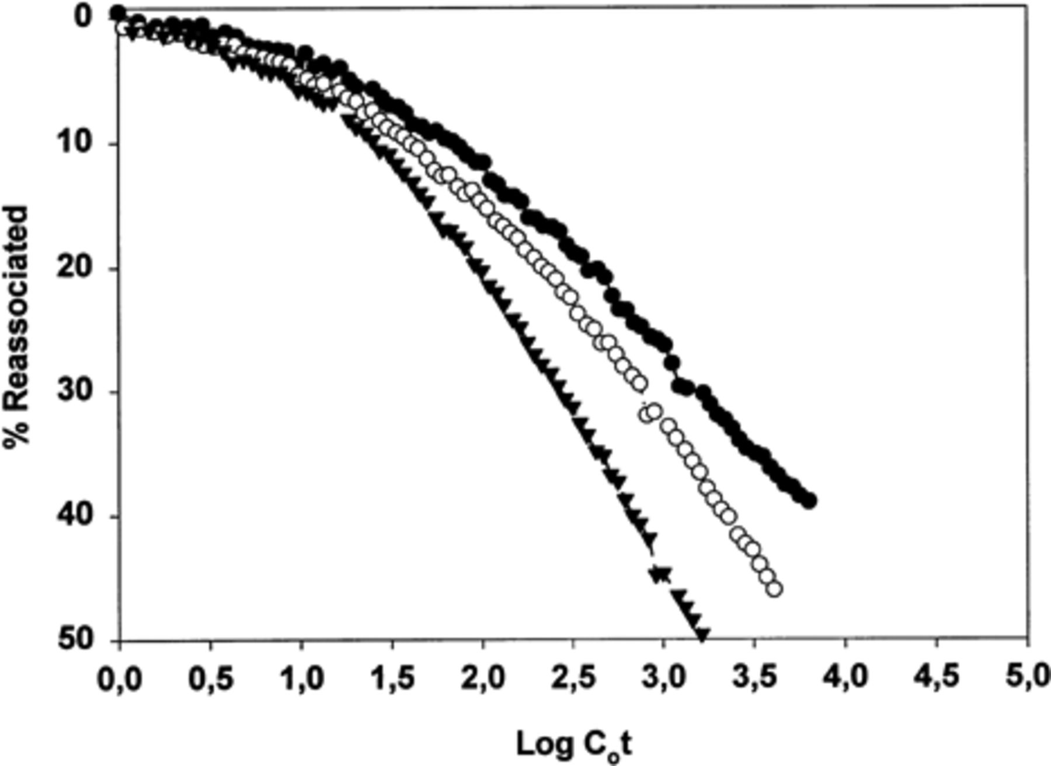
1 Reassociation (C_{o}t plot) of DNA from the non-contaminated soil (▾) and soils with low metal (○) or ...
Notes:
1 Reassociation (Cot plot) of DNA from the non-contaminated soil (▾) and soils with low metal (○) or high metal (●) amendments. The abscissa gives the logarithm of the initial concentration of single-stranded DNA (in mole nucleotides per litre) multiplied by time in seconds. The ordinate gives the per cent reassociated DNA.
Unless provided in the caption above, the following copyright applies to the content of this slide: © 1999 Federation of European Microbiological Societies. Published by Elsevier Science B.V. All rights reserved

Slide 2
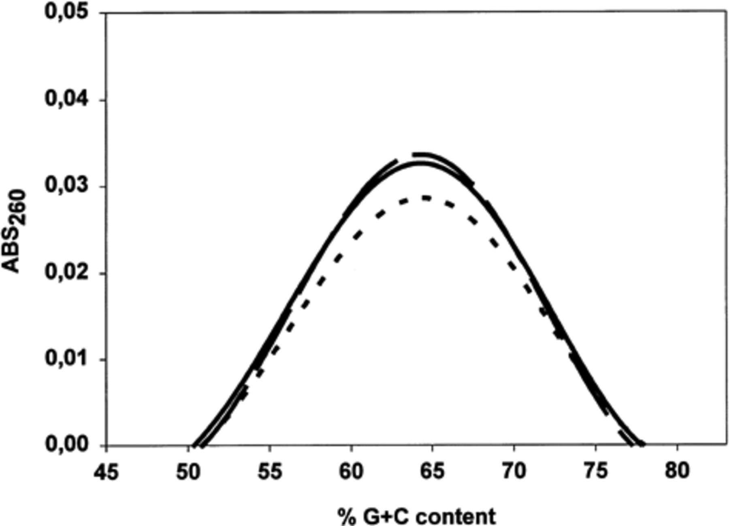
2 %G+C distribution in DNA from the non-contaminated soil (solid line;) and soils with low metal (dotted line) ...
Notes:
2 %G+C distribution in DNA from the non-contaminated soil (solid line;) and soils with low metal (dotted line) or high metal (dashed line) amendments, derived by fitting the formula by Mandel et al. [21].
Unless provided in the caption above, the following copyright applies to the content of this slide: © 1999 Federation of European Microbiological Societies. Published by Elsevier Science B.V. All rights reserved

Slide 3
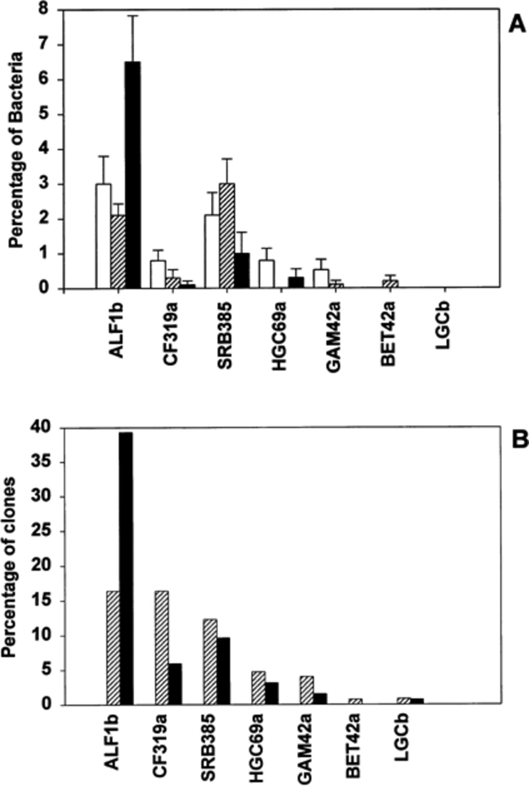
3 Analysis of larger phylogenetic groups with oligonucleotide probes ALF1b, BET42a, GAM42a, SRB385, CF319a, ...
Notes:
3 Analysis of larger phylogenetic groups with oligonucleotide probes ALF1b, BET42a, GAM42a, SRB385, CF319a, LGCb and HGC69a by in situ hybridisation in soil slurries (A) and by dot blot hybridisation in 16S and 23S rDNA libraries (B). Bars represent bacteria in % of detectable Bacteria (after hybridisation with probe EUB338) and % of the total number of clones analysed in non-contaminated soil (◻) and soils with low metal (▨) and high metal (■) amendments. Error bars represent standard deviation.
Unless provided in the caption above, the following copyright applies to the content of this slide: © 1999 Federation of European Microbiological Societies. Published by Elsevier Science B.V. All rights reserved

Slide 4
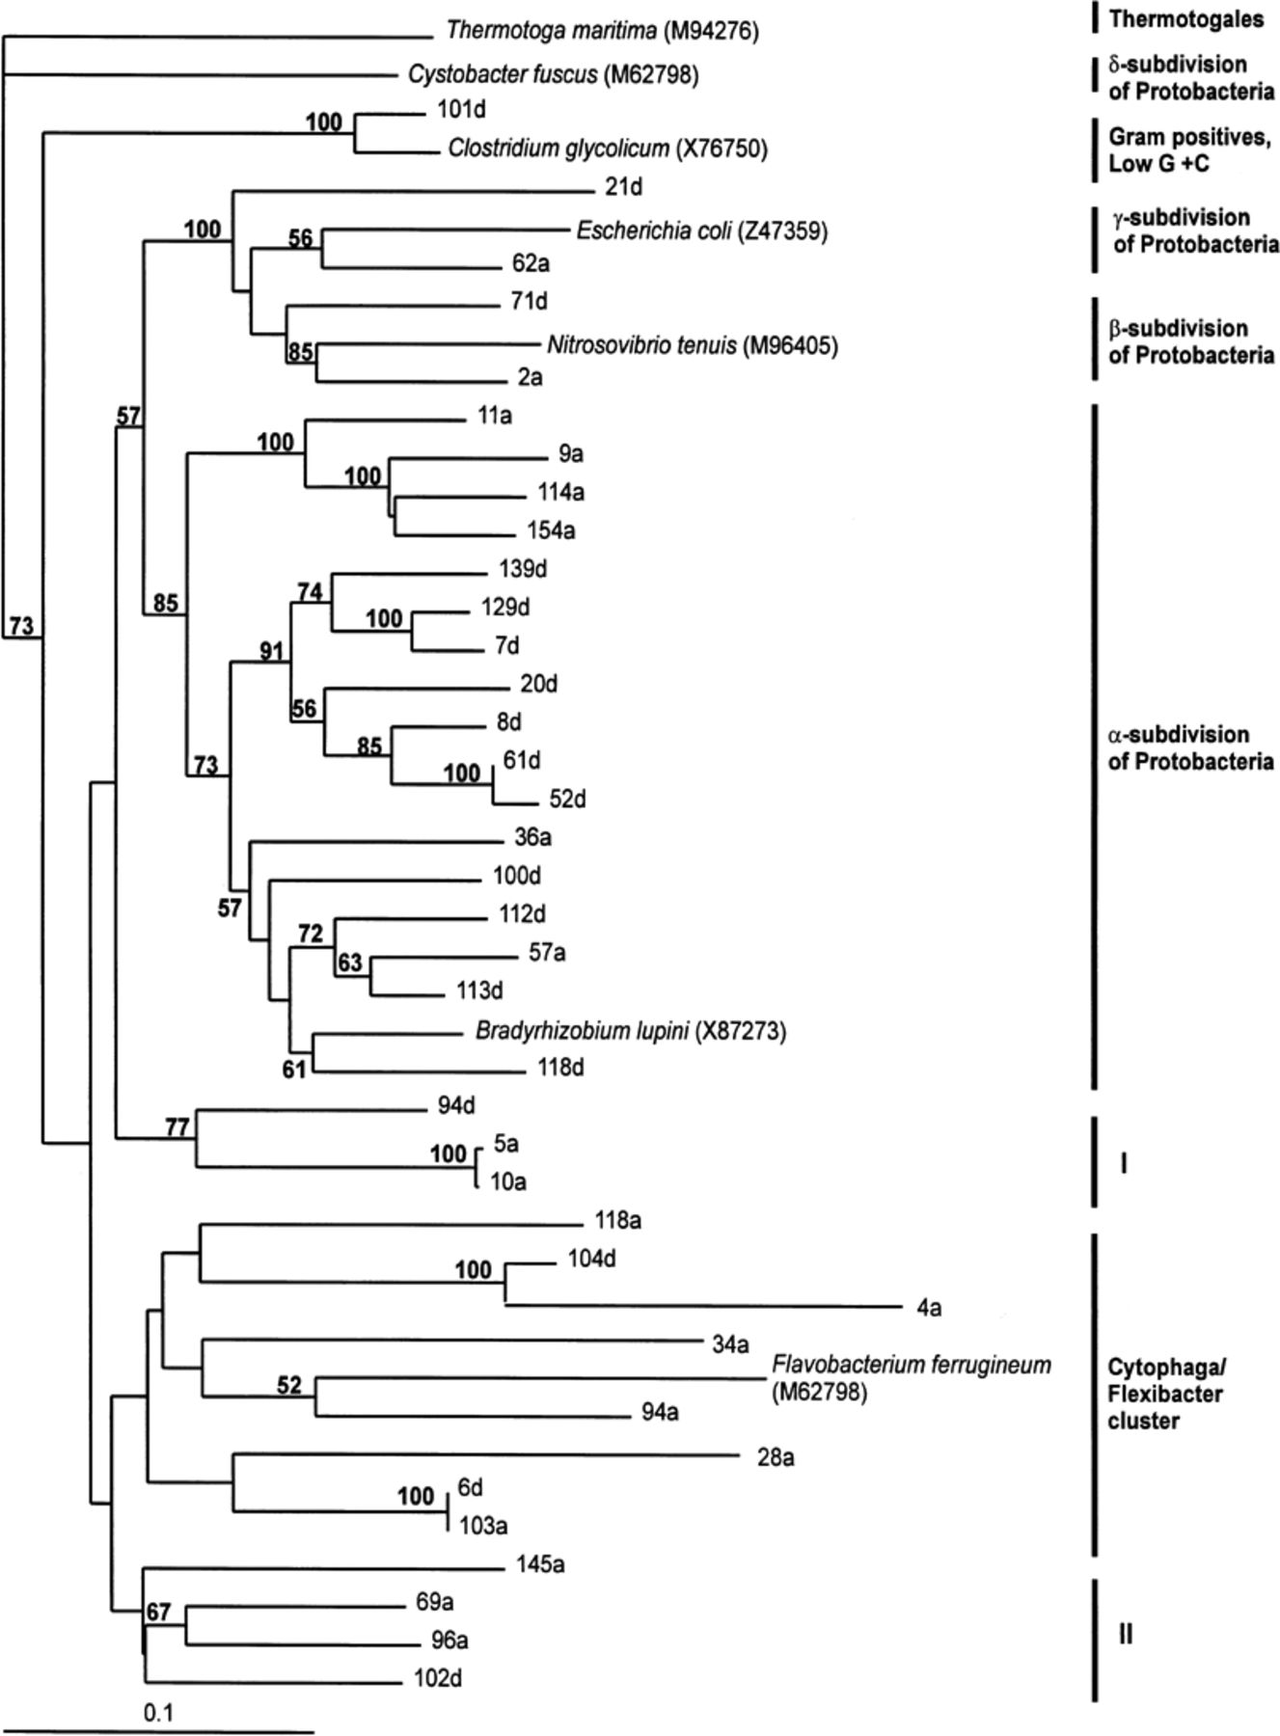
4 Neighbour-joining tree assigning 37 partial sequences from 16S rDNA libraries from bacteria in soils with low ...
Notes:
4 Neighbour-joining tree assigning 37 partial sequences from 16S rDNA libraries from bacteria in soils with low metal (with suffix a) and high metal (with suffix d) amendment to the α-, β-, γ- and δ subdivision of Proteobacteria, the Cytophaga-Flavobacterium cluster of the CFB phylum and Gram-positive bacteria with a low DNA G+C content. Clades I and II represent groups that could not be assigned to a known group within the domain Bacteria. Small numbers indicate the percentage of 100 bootstrap resamplings that support some of the major topological elements. Scale bar represents number of substitutions per site.
Unless provided in the caption above, the following copyright applies to the content of this slide: © 1999 Federation of European Microbiological Societies. Published by Elsevier Science B.V. All rights reserved

Slide 5
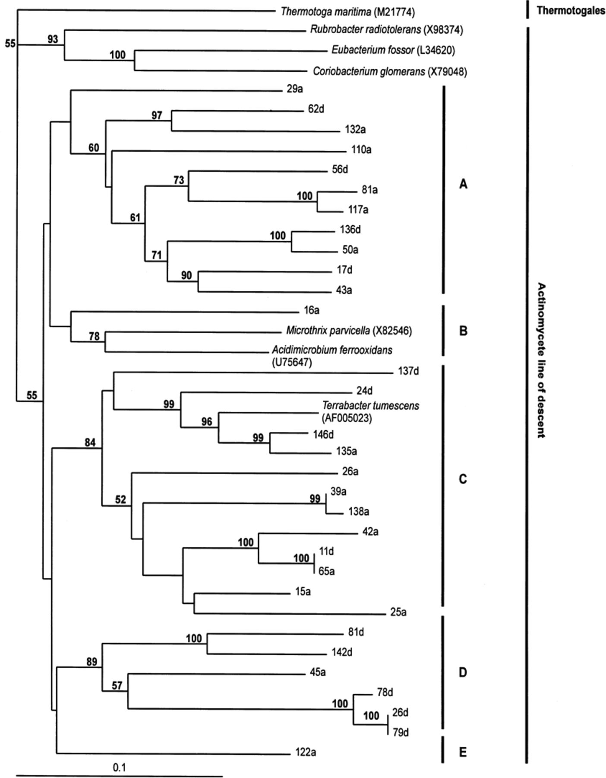
5 Neighbour-joining tree assigning 31 partial sequences from 16S rDNA libraries from bacteria in soils with low ...
Notes:
5 Neighbour-joining tree assigning 31 partial sequences from 16S rDNA libraries from bacteria in soils with low metal (with suffix a) and high metal (with suffix d) amendment to the Gram-positive bacteria with a high DNA G+C content. Clades denoted A–E represent the phylogenetic positions of the clones within the actinomycete line of descent. Small numbers indicate the percentage of 100 bootstrap resamplings that support some of the major topological elements. Scale bar represents number of substitutions per site.
Unless provided in the caption above, the following copyright applies to the content of this slide: © 1999 Federation of European Microbiological Societies. Published by Elsevier Science B.V. All rights reserved

