Slide 1
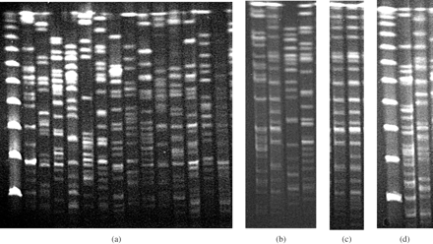
Figure 1. PFGE patterns of XbaI-digested total DNAs of E. coli isolates harbouring ESBL- or plasmidic ...
Notes:
Figure 1. PFGE patterns of XbaI-digested total DNAs of E. coli isolates harbouring ESBL- or plasmidic cephalosporinase-encoding genes. (a) Lane 1, ladder marker; lanes 2–15, blaCTX-M-14-containing isolates. (b) Lanes 1–4, blaCTX-M-9-containing isolates. (c) Lanes 1 and 2, blaTEM-52-containing isolates. (d) Lane 1, ladder marker; lanes 2 and 3, blaCMY-2-containing isolates.
Unless provided in the caption above, the following copyright applies to the content of this slide: © The Author 2005. Published by Oxford University Press on behalf of the British Society for Antimicrobial Chemotherapy. All rights reserved. For Permissions, please e-mail: journals.permissions@oxfordjournals.org

