Slide 1
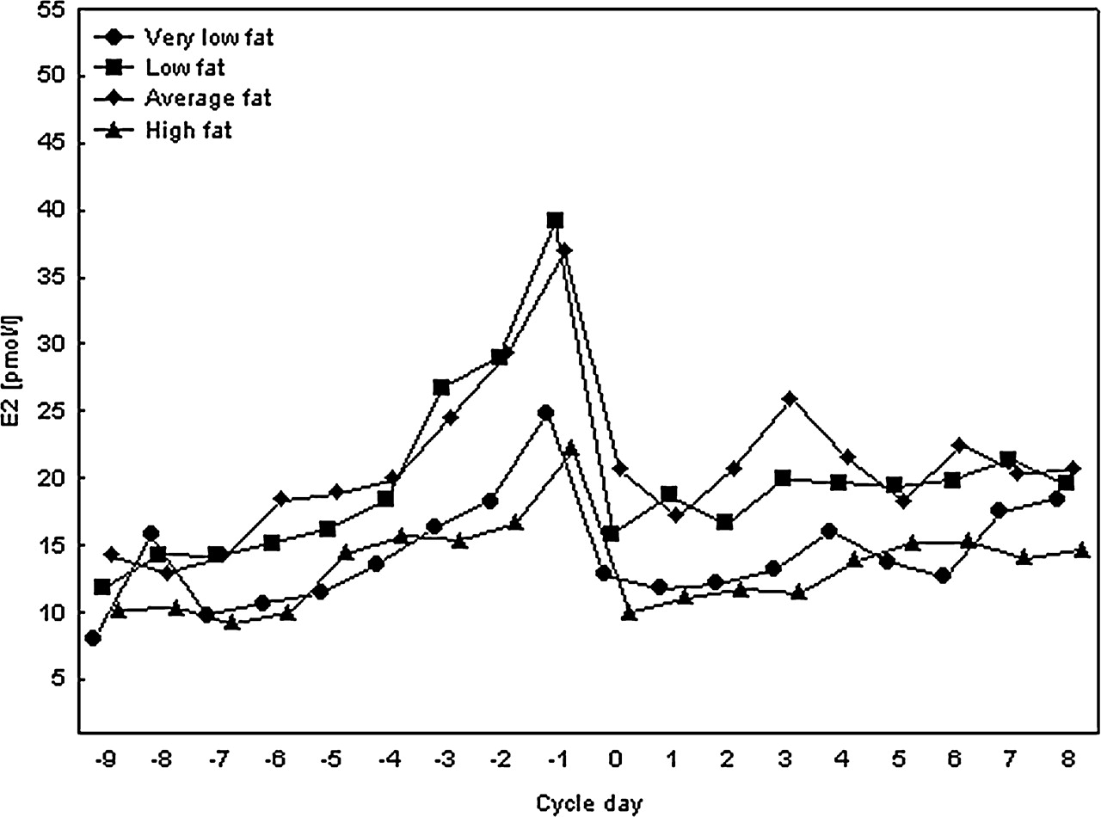
Figure 1: The association between E2 and body fat. E2 profiles in very low, low, average and high body fat groups of ...
Notes:
Figure 1: The association between E2 and body fat. E2 profiles in very low, low, average and high body fat groups of women with positive energy balance.
Unless provided in the caption above, the following copyright applies to the content of this slide: © The Author 2008. Published by Oxford University Press on behalf of the European Society of Human Reproduction and Embryology. All rights reserved. For Permissions, please email: journals.permissions@oxfordjournals.org

Slide 2
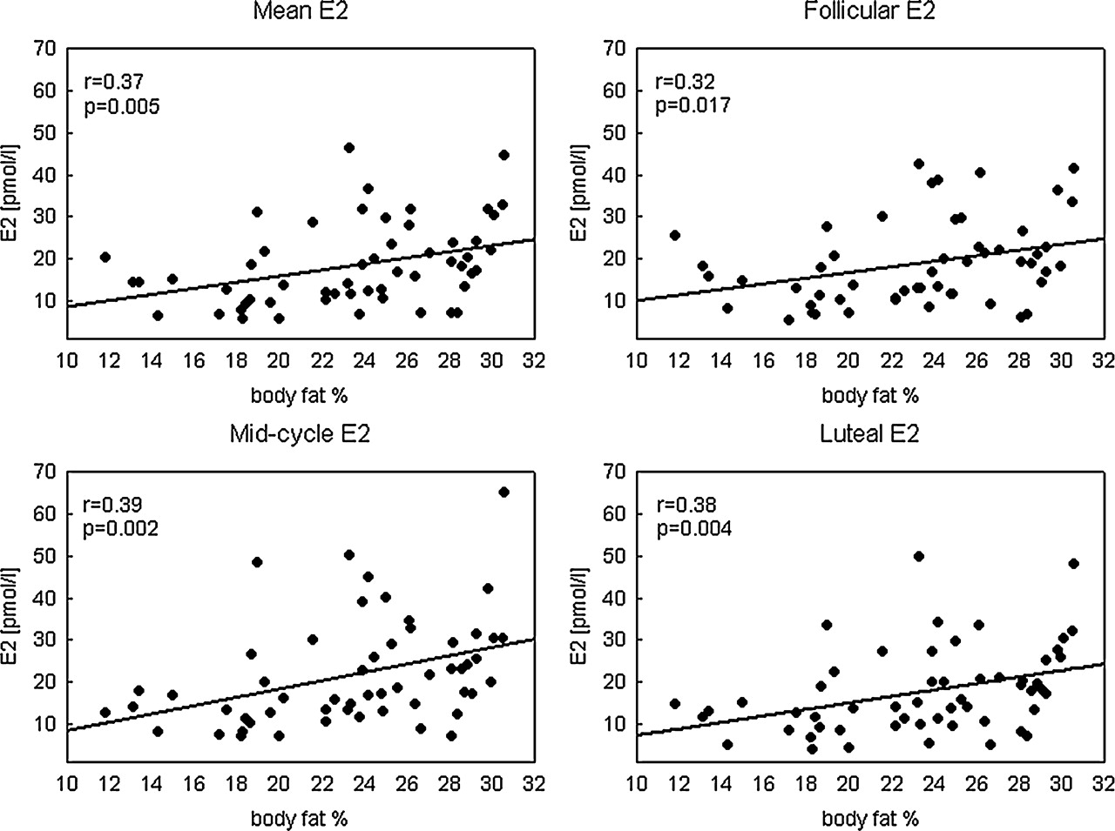
Figure 2: The association between body fat percentage and E2 levels in women with positive energy balance and body fat ...
Notes:
Figure 2: The association between body fat percentage and E2 levels in women with positive energy balance and body fat below 31%.
Unless provided in the caption above, the following copyright applies to the content of this slide: © The Author 2008. Published by Oxford University Press on behalf of the European Society of Human Reproduction and Embryology. All rights reserved. For Permissions, please email: journals.permissions@oxfordjournals.org

