Slide 1
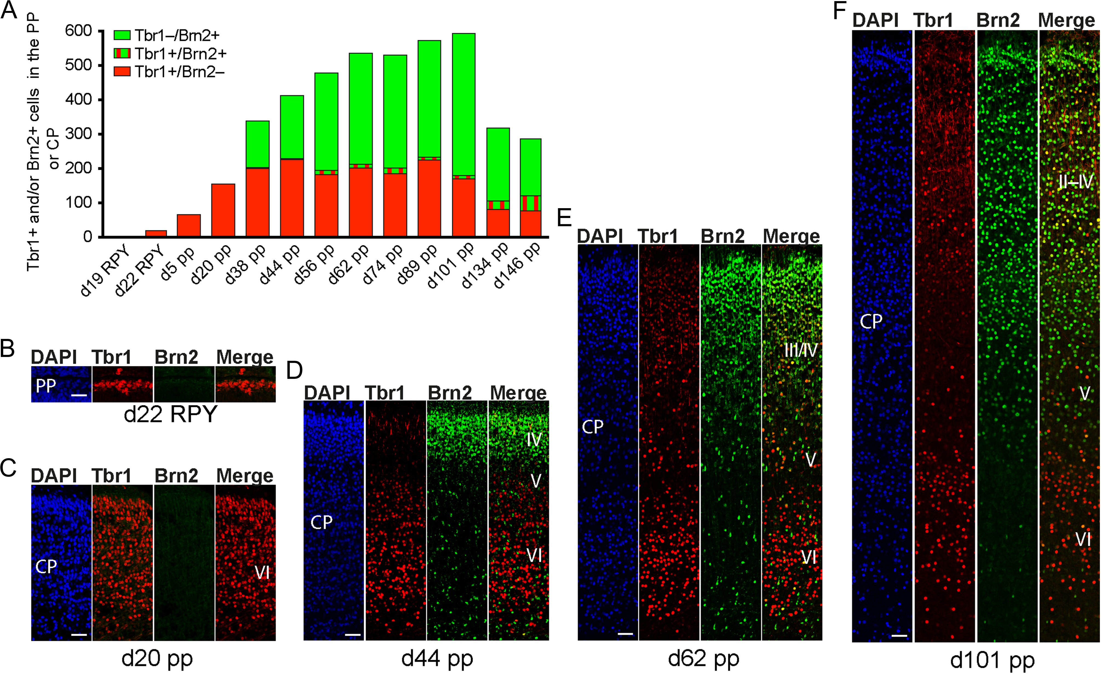
Figure 1. Tbr1 and Brn2 expression in the developing tammar neocortex. (A) Quantification of Tbr1+/Brn2– (red), ...
Notes:
Figure 1. Tbr1 and Brn2 expression in the developing tammar neocortex. (A) Quantification of Tbr1+/Brn2– (red), Tbr1+/Brn2+ (red/green), and Tbr1–/Brn2+ (green) nuclei within the full thickness of the PP or CP of d19 RPY–d146 pp neocortex, expressed as number of cells per 100- µm ventricular surface. PP or CP corresponding to a total ventricular surface of 0.5–1.4 mm was analyzed. Data were from one brain each. (B–F) Double immunofluorescence for Tbr1 (red), Brn2 (green), and DAPI (blue) staining on 30-µm cryosections of d22 RPY–101 pp tammar neocortex. The merge images show combined immunofluorescence for Tbr1 and Brn2. The bottom margin corresponds to the apical boundary of the PP (B) or the transition zone CP/SP (C–F). Cortical layers II–VI are indicated in the merge image. Scale bars, 50 μm.
Unless provided in the caption above, the following copyright applies to the content of this slide: © The Author 2016. Published by Oxford University Press. All rights reserved. For Permissions, please email: journals.permissions@oup.com

Slide 2
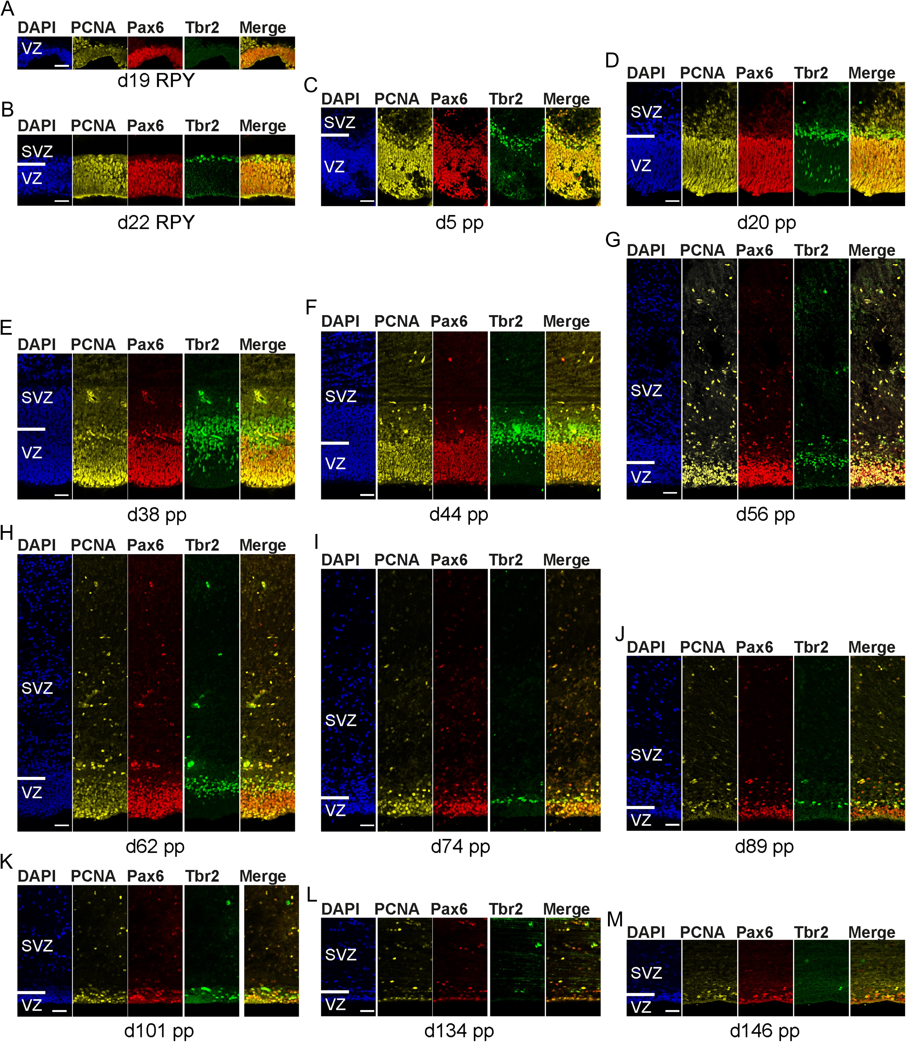
Figure 2. Pax6 and Tbr2 expression in neural progenitors of the developing tammar neocortex. (A–M) Triple ...
Notes:
Figure 2. Pax6 and Tbr2 expression in neural progenitors of the developing tammar neocortex. (A–M) Triple immunofluorescence for Pax6 (red), Tbr2 (green), PCNA (yellow), and DAPI (blue) staining on 30-µm cryosections of the d19 RPY–146 pp tammar neocortex. The merge images show combined immunofluorescence for Pax6, Tbr2, and PCNA. (A, B) Complete cortical wall is shown. (C–M) The top margin of the image corresponds to the transition zone SVZ/IZ. Scale bars, 50 μm.
Unless provided in the caption above, the following copyright applies to the content of this slide: © The Author 2016. Published by Oxford University Press. All rights reserved. For Permissions, please email: journals.permissions@oup.com

Slide 3
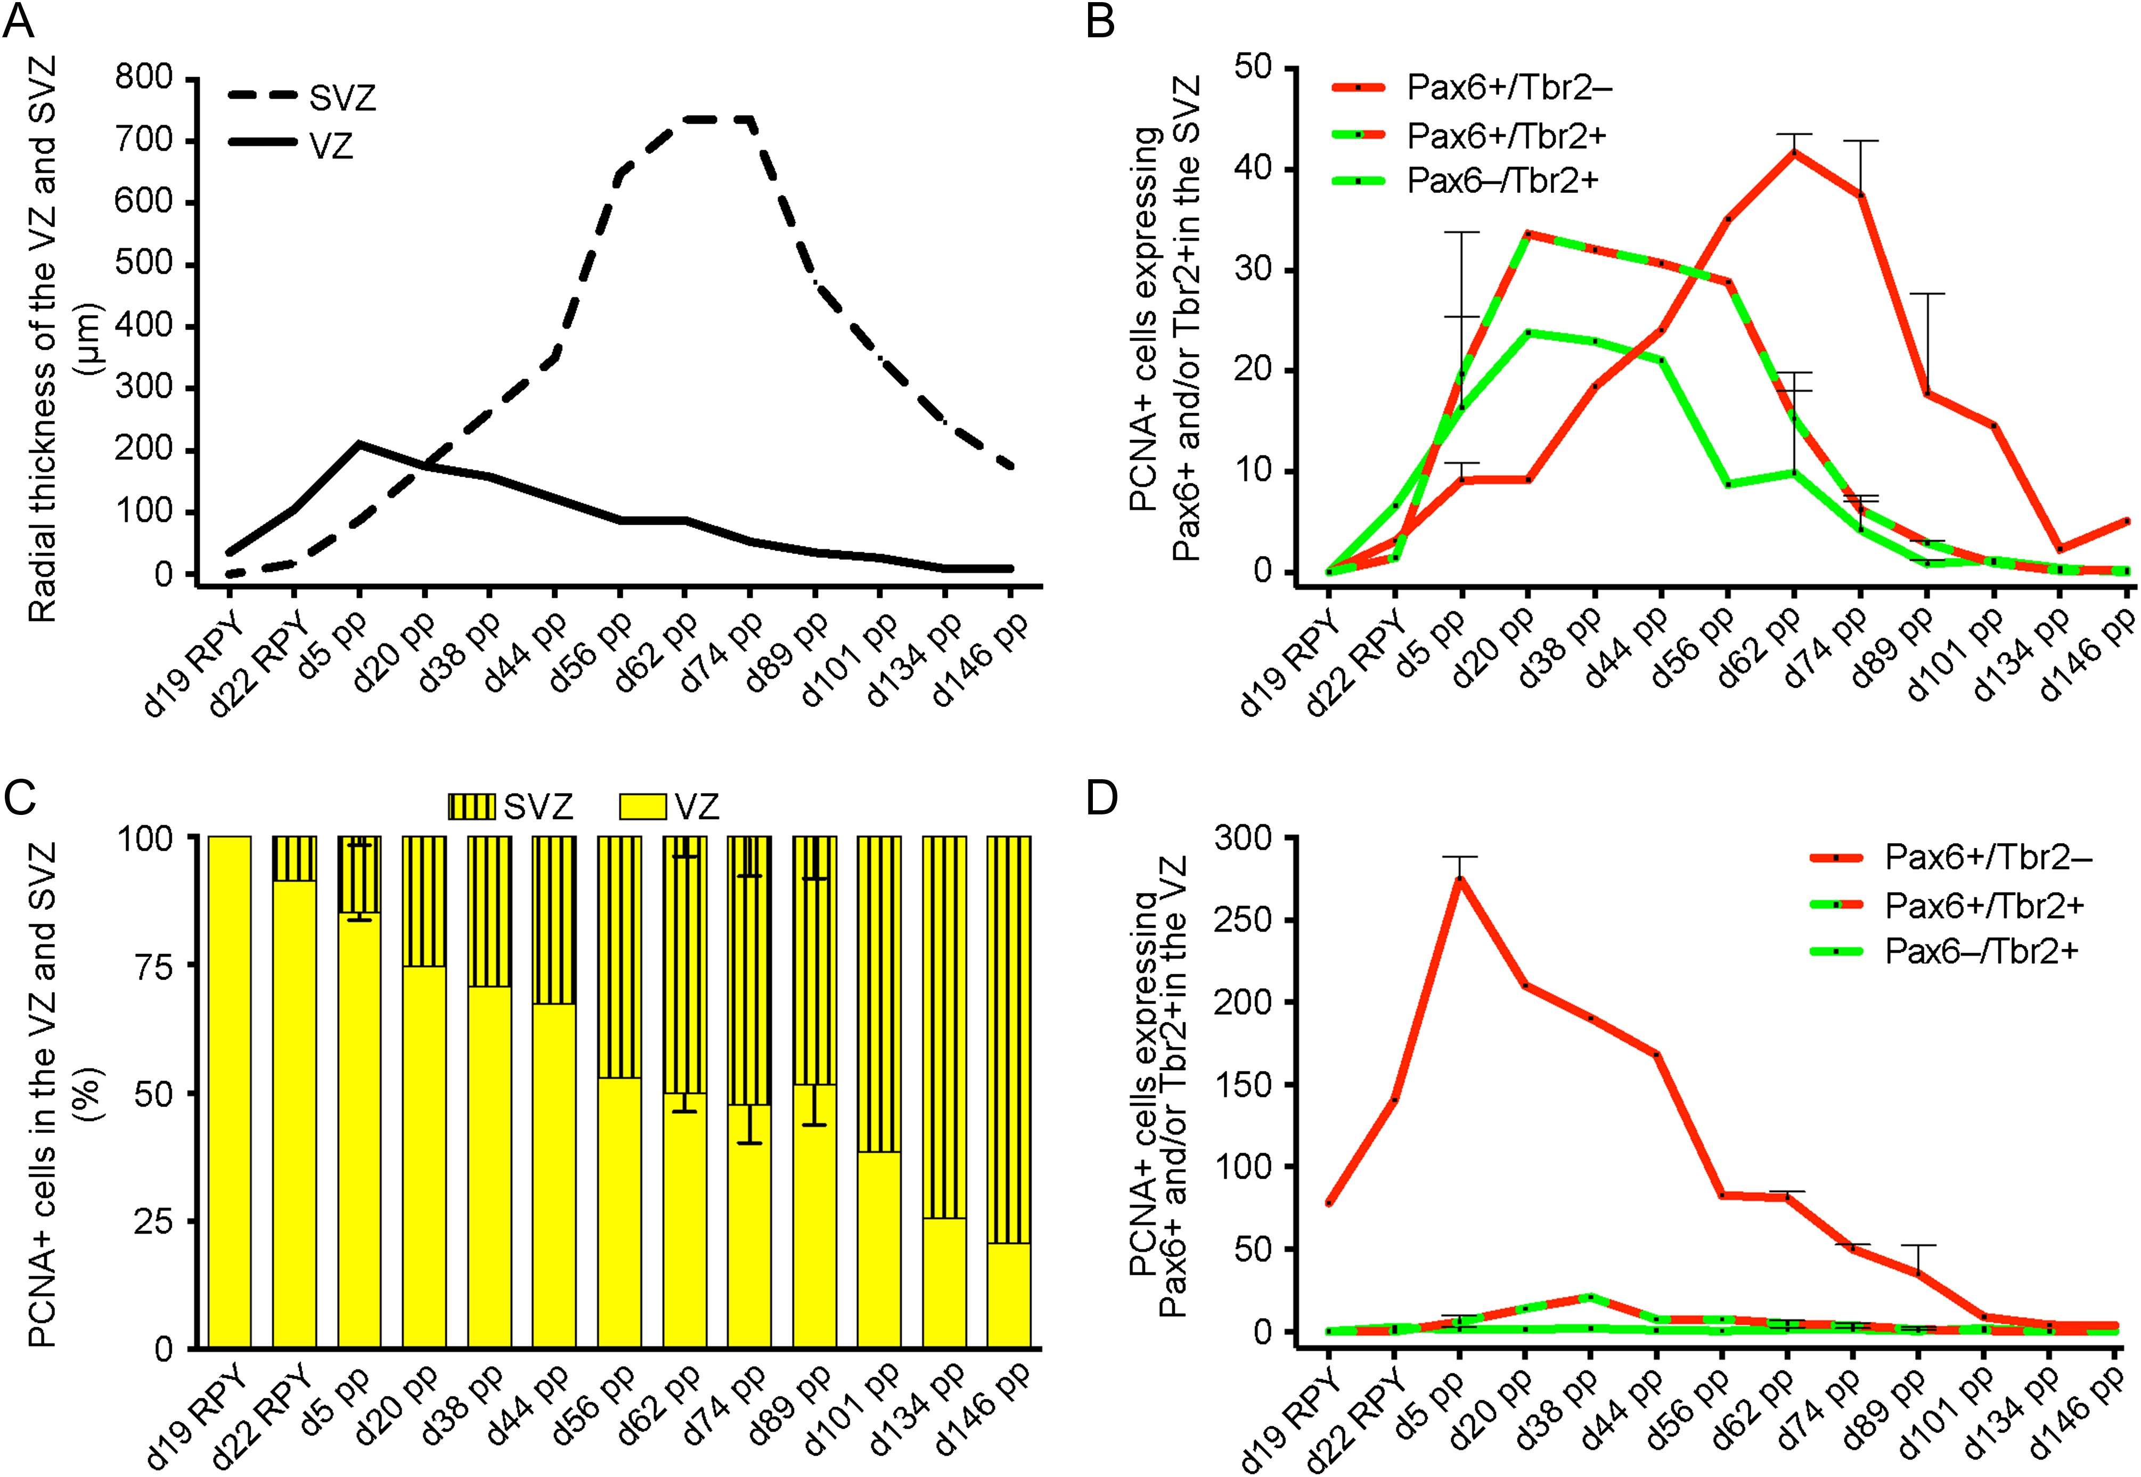
Figure 3. Quantitative determination of neural progenitors expressing Pax6+ and/or Tbr2+ in the developing tammar ...
Notes:
Figure 3. Quantitative determination of neural progenitors expressing Pax6+ and/or Tbr2+ in the developing tammar neocortex. (A) Quantification of the radial thickness of the VZ (solid line) and SVZ (dashed line) of the d19 RPY–d146 pp neocortex. Data were obtained from the images shown in Figure 2. (B) Quantification of Pax6+/Tbr2– (red solid line), Pax6+/Tbr2+ (red/green dashed line), and Pax6–/Tbr2+ (green solid line) PCNA+ cells in the SVZ of the d19 RPY–d146 pp neocortex, expressed as number of cells per 100-µm ventricular surface. (C) Quantification of PCNA+ cells in the VZ (yellow column) and SVZ (black/yellow striped column) of the d19 RPY–d146 pp neocortex, expressed as percentage of the sum of VZ and SVZ. (D) Quantification of Pax6+/Tbr2– (red solid line), Pax6+/Tbr2+ (red/green dashed line), and Pax6–/Tbr2+ (green solid line) PCNA+ cells in the VZ of the d19 RPY–d146 pp neocortex, expressed as number of cells per 100-µm ventricular surface. (A–D) Cortical wall corresponding to a total ventricular surface of 0.4–1.4 mm was analyzed. Data are from 1 brain (d19, 22 RPY and d20, 38, 44, 56, 101, 134, 146 pp) or 2 (d5, 62, 74, 89 pp) brains each. Bars indicate variation of individual values from the mean.
Unless provided in the caption above, the following copyright applies to the content of this slide: © The Author 2016. Published by Oxford University Press. All rights reserved. For Permissions, please email: journals.permissions@oup.com

Slide 4
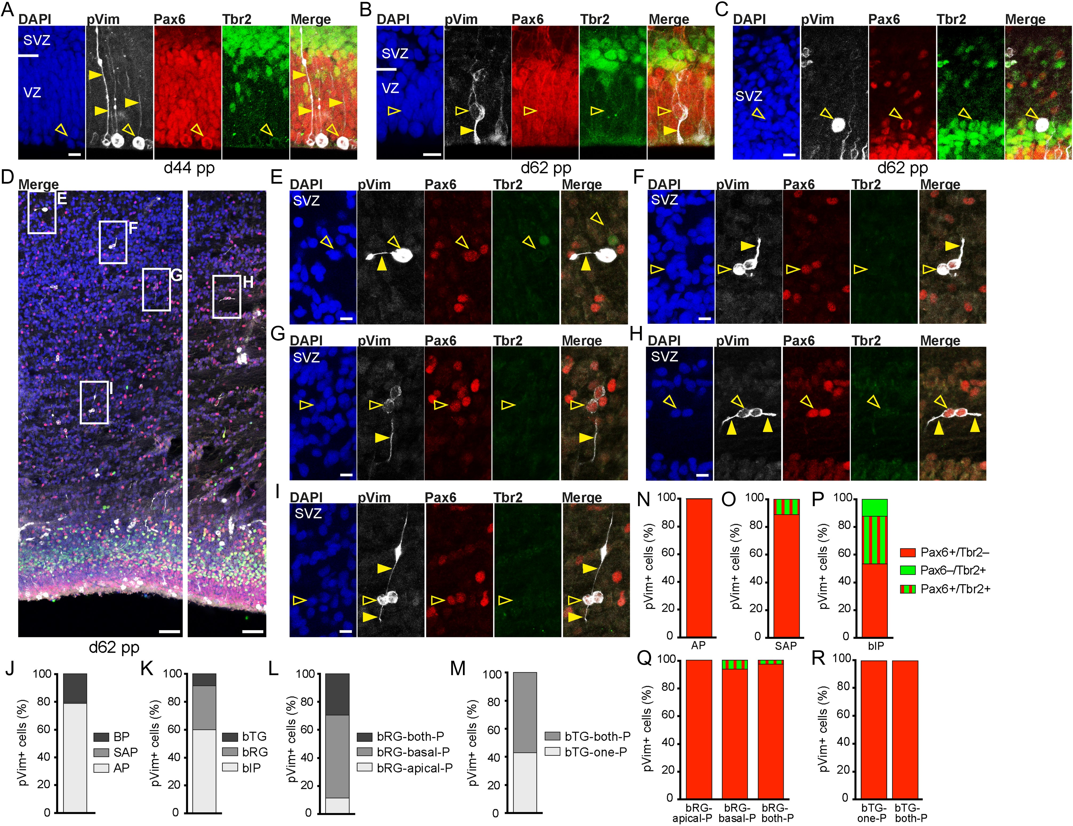
Figure 4. Neural progenitors in the tammar VZ and SVZ retain processes through M-phase. (A–I) Triple immunofluorescence ...
Notes:
Figure 4. Neural progenitors in the tammar VZ and SVZ retain processes through M-phase. (A–I) Triple immunofluorescence for phosphovimentin (pVim, white), Pax6 (red), Tbr2 (green), and DAPI (blue) staining on 75-µm vibratome sections of the d44 pp and d62 pp tammar neocortex. The merge images show combined immunofluorescence for pVim, Pax6, and Tbr2 (A–C, E–I) or DAPI, pVim, Pax6, and Tbr2 (D). Boxed areas in (D) are shown in higher magnification in (E–I). Open arrowheads, cell bodies; solid arrowheads, pVim+ processes. Images represent stacks of 5–9 optical sections. Scale bars, 50 µm (D) and 10 μm (A–C, E–I). (J–M) Quantification of the distinct progenitor cell types at M-phase, identified by their location of mitosis and morphology at M-phase, in the d44–74 pp tammar neocortex, expressed as the percentage of total pVim+ cells. Data are the sum of 4 brains (d44, 56, 62, 74 pp). See Supplementary Information for the total number of cells quantified. (N–R) Quantification of the distinct progenitor cell types at M-phase, identified by pVim staining, that are Pax6+/Tbr2– (red), Pax6+/Tbr2+ (red/green), or Pax6–/Tbr2+ (green) in the d44–74 pp tammar neocortex. Data are the sum of 4 brains (d44, 56, 62, 74 pp). The number of pVim+ mitoses analyzed were as in (J–M).
Unless provided in the caption above, the following copyright applies to the content of this slide: © The Author 2016. Published by Oxford University Press. All rights reserved. For Permissions, please email: journals.permissions@oup.com

Slide 5
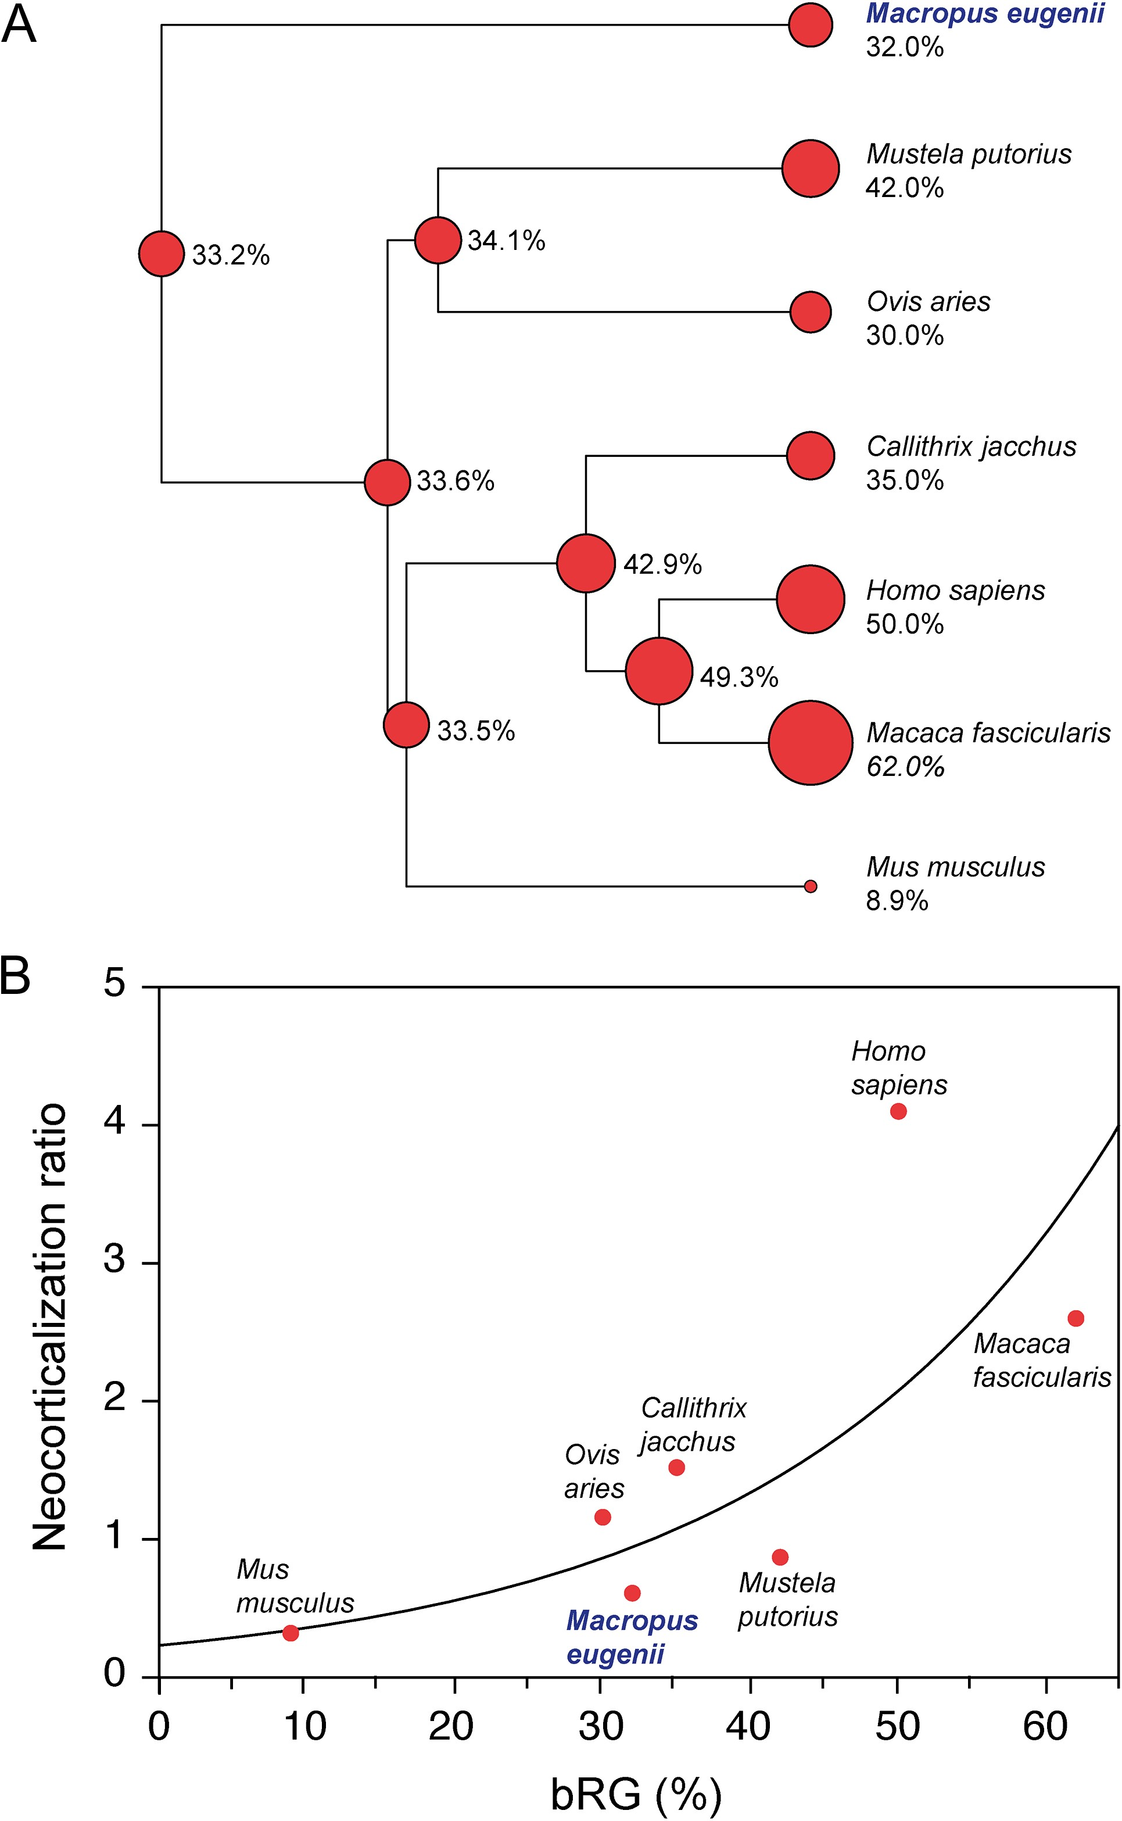
Figure 5. bRG were estimated to emerge before the metatherian–eutherian split. (A) Phylogenetic tree representing ...
Notes:
Figure 5. bRG were estimated to emerge before the metatherian–eutherian split. (A) Phylogenetic tree representing observed relative bRG abundance in marsupial, that is, Macropus eugenii, and eutherian species, that is, Mustela putorius, Ovis oris, Callithrix jacchus, Homo sapiens, Macaca fascicularis, Mus musculus, and estimated relative bRG abundance for ancestral species. Size of the bubble charts correlates with the level of relative bRG abundance. Numbers represent relative bRG abundance expressed as %. Branch lengths are proportional to time. (B) Plot of the relationship between relative bRG abundance expressed as % and neocorticalization ratio across marsupial and eutherian species as indicated. The regression curve is plotted: y = 2.8704e(0.01246917x)-3.0274; Chi Square = 4.5915; P < 0.05. (A, B) The marsupial species (Macropus eugenii) analyzed in this study is highlighted in blue. For details, see Materials and Methods.
Unless provided in the caption above, the following copyright applies to the content of this slide: © The Author 2016. Published by Oxford University Press. All rights reserved. For Permissions, please email: journals.permissions@oup.com

Slide 6
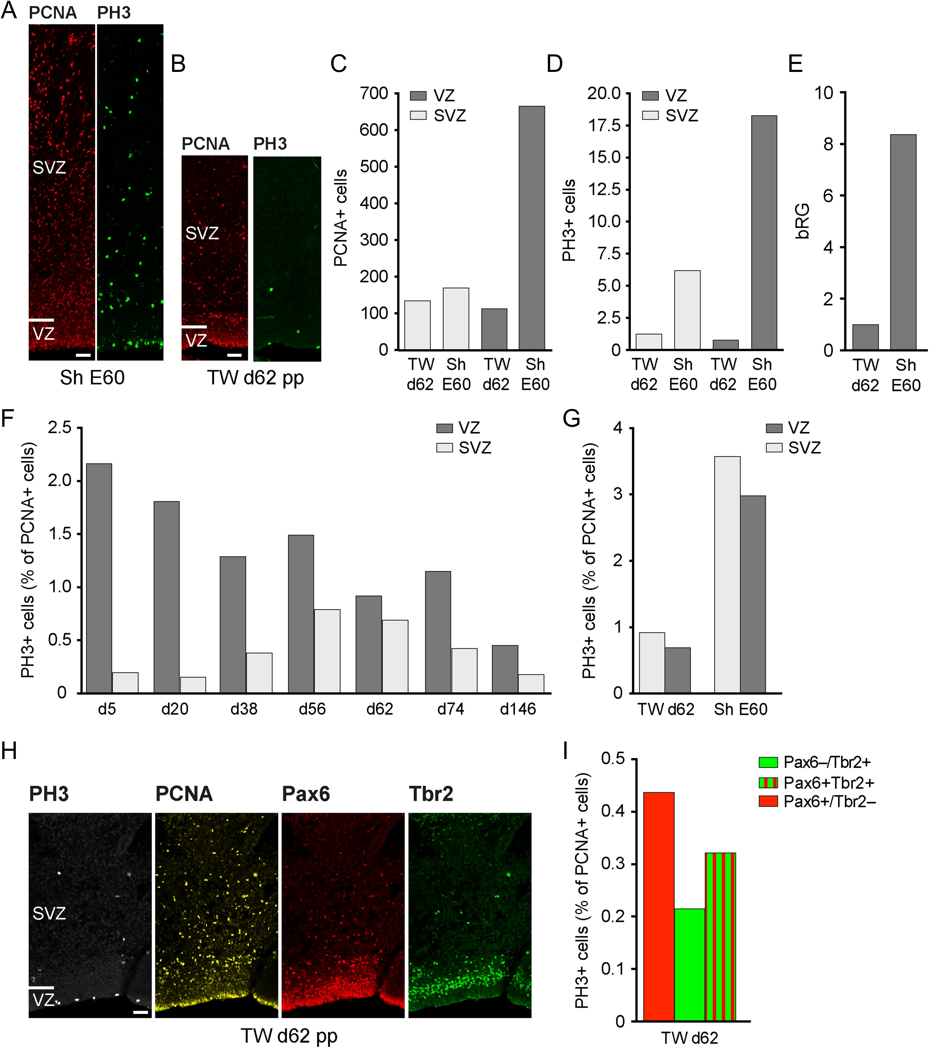
Figure 6. Low abundance of cycling cells and cells in M-phase in the developing tammar SVZ. (A,B) Double ...
Notes:
Figure 6. Low abundance of cycling cells and cells in M-phase in the developing tammar SVZ. (A,B) Double immunofluorescence for PCNA (red) and PH3 (green) on 30-µm cryosections of the d62 pp tammar neocortex and the E60 sheep neocortex. Scale bars, 50 µm. (C,D) Quantification of PCNA+ cells (C) or PH3 (D) in the VZ (light gray) and SVZ (dark gray) of the tammar d62 pp and sheep E60 neocortex. Data are expressed as number of cells per 200-µm ventricular surface. Cortical wall corresponding to a total ventricular surface of 3.6–6.2 mm was analyzed. Data are from one brain each. (E) Quantification of bRG identified by immunofluorescence for pVim in the tammar d62 pp and sheep E60 SVZ. Data were obtained from stack images of 75-µm vibratome sections (4–5 optical sections) and are expressed as number of cells per 200-µm ventricular surface. Cortical wall corresponding to a total ventricular surface of 1.7–6.7 mm was analyzed. Data are from one brain each. (F) Quantification of cells in M-phase, expressed as a percentage of cycling cells in the VZ (light gray) and SVZ (dark gray) of the tammar d5–146 pp neocortex. (G) Quantification of cells in M-phase, expressed as a percentage of cycling cells in the VZ (light gray) and SVZ (dark gray) of the tammar d62 pp and sheep E60 neocortex. (H) Quadruple immunofluorescence for PH3 (white), PCNA (yellow), Pax6 (red), and Tbr2 (green) on a 30-µm cryosection of the d62 pp tammar neocortex. Scale bars, 50 µm. (I) Quantification of Pax6+/Tbr2– (red), Pax6+/Tbr2+ (red/green), and Pax6–/Tbr2+ (green) cells in M-phase, expressed as a percentage of Pax6+/Tbr2–, Pax6+/Tbr2+, or Pax6–/Tbr2+ cycling cells in the tammar d62 pp SVZ. (F, G, I) See Supplementary Information for the total number of cells quantified.
Unless provided in the caption above, the following copyright applies to the content of this slide: © The Author 2016. Published by Oxford University Press. All rights reserved. For Permissions, please email: journals.permissions@oup.com

