Slide 1
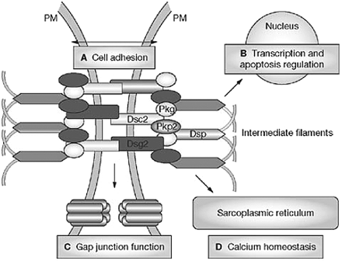
Figure 1 The cardiac desmosome and proposed roles of the desmosome in (A) supporting structural stability through ...
Notes:
Figure 1 The cardiac desmosome and proposed roles of the desmosome in (A) supporting structural stability through cell–cell adhesion, (B) regulating transcription of genes involved in adipogenesis and apoptosis, and maintaining proper electrical conductivity through regulation of (C) gap junctions and (D) calcium homeostasis. Dsc2 indicates desmocollin-2; Dsg2, desmoglein-2; Dsp, desmoplakin; Pkg, plakoglobin; Pkp2, plakophilin-2; and PM, plasma membrane. Reprinted by permission from Macmillan Publishers Ltd: Nat Clin Pract Cardiovasc Med11, © 2008.
Unless provided in the caption above, the following copyright applies to the content of this slide: © 2010 American Heart Association, Inc. and European Society of Cardiology.

Slide 2
Figure 2 Endomyocardial biopsy findings in a proband affected by a diffuse form of ARVC/D. All 3 biopsy samples are ...
Notes:
Figure 2 Endomyocardial biopsy findings in a proband affected by a diffuse form of ARVC/D. All 3 biopsy samples are from different regions of the RV free wall. There is extensive fibrofatty tissue replacement with myocardial atrophy, which is a major criterion (i.e. residual myocytes <60% by morphometric analysis or <50% if estimated). Contributed by C. Basso, Padua, Italy.
Unless provided in the caption above, the following copyright applies to the content of this slide: © 2010 American Heart Association, Inc. and European Society of Cardiology.

Slide 3
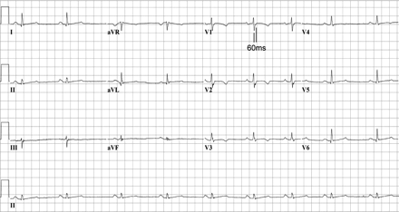
Figure 3 ECG from proband with T-wave inversion in V₁ through V₄ and prolongation of the ...
Notes:
Figure 3 ECG from proband with T-wave inversion in V1 through V4 and prolongation of the terminal activation duration ≥55 ms measured from the nadir of the S wave to the end of the QRS complex in V1. Contributed by M.G.P.J. Cox, Utrecht, The Netherlands.
Unless provided in the caption above, the following copyright applies to the content of this slide: © 2010 American Heart Association, Inc. and European Society of Cardiology.

