Slide 1
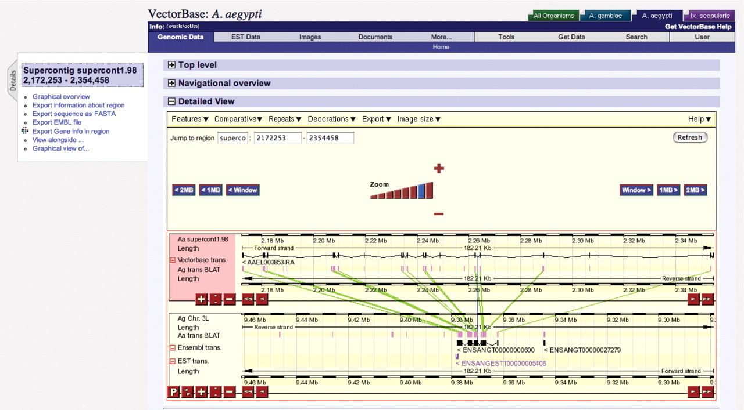
Figure 1 Comparative display of Aedes aegypti gene AAEL003853 (upper panel) with the Anopheles gambiae orthologue ...
Notes:
Figure 1 Comparative display of Aedes aegypti gene AAEL003853 (upper panel) with the Anopheles gambiae orthologue (lower panel). Green lines join blocks of similarity between the two genomes and highlights the expansion of intron size due to an increased frequency of repeat sequences.
Unless provided in the caption above, the following copyright applies to the content of this slide: © 2006 The Author(s)This is an Open Access article distributed under the terms of the Creative Commons Attribution Non-Commercial License (http://creativecommons.org/licenses/by-nc/2.0/uk/) which permits unrestricted non-commercial use, distribution, and reproduction in any medium, provided the original work is properly cited.

