Slide 1
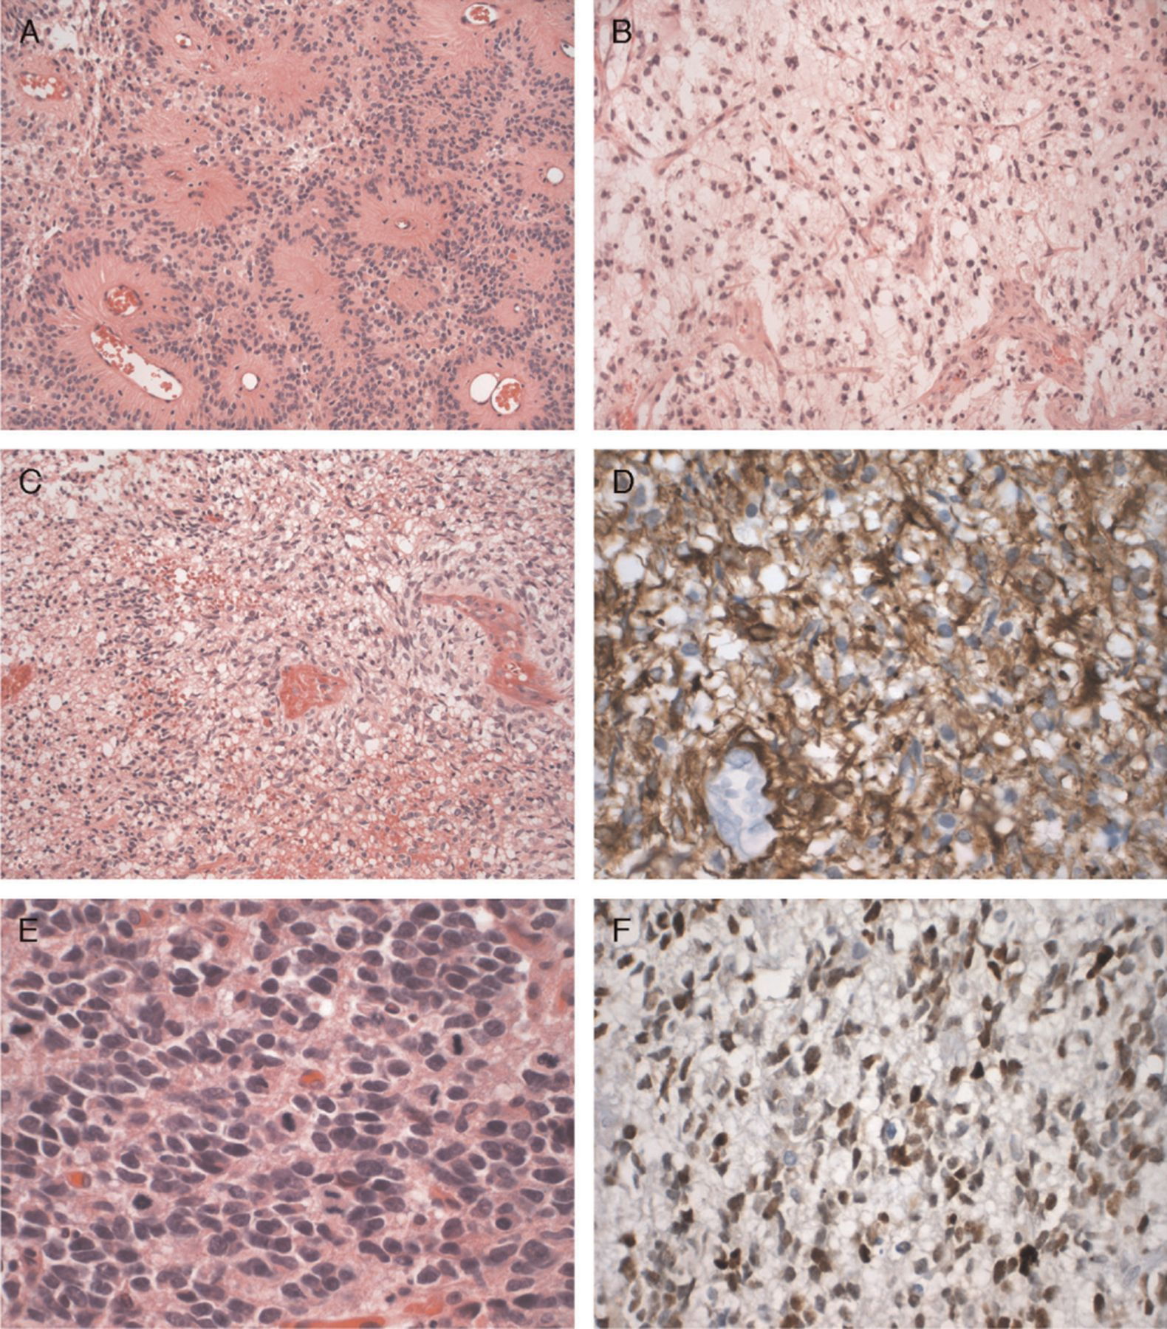
FIGURE 1. Immunohistochemical characterization of radiation-induced glioblastoma (RIG). (A) Low-power photomicrograph ...
Notes:
FIGURE 1. Immunohistochemical characterization of radiation-induced glioblastoma (RIG). (A) Low-power photomicrograph illustrates the characteristic histologic features of the ependymoma that was the original tumor for which the patient received radiotherapy in 1993. Patient 478 is illustrated. Hematoxylin and eosin (H&E); original magnification: 200×. (B) Photomicrograph taken at the same magnification underscores the difference in the histology of the RIG glioblastoma that occurred 13 years later in the same patient's brainstem, within the radiation portals. H&E; original magnification: 200×. (C) Low-power photomicrograph of a typical RIG with pseudopalisading necrosis (left). Patient 145 is illustrated. H&E; original magnification: 200×. (D) The same tumor illustrated in (C), when immunostained for glial fibrillary acidic protein (GFAP), highlights the fibrillary astrocytic tumor population. Immunostaining for GFAP with light hematoxylin counterstain; original magnification: 600×. (E) High-power photomicrograph of another radiation-induced tumor in the series, from Patient #12, who had a small cell glioblastoma. Note the irregularity of nuclear profiles and numerous mitotic figures. (F) The tumor illustrated in (D), when immunostained for TP53, manifested 3+ nuclear reactivity. The cell cycle labeling index was also very high in this case. Immunostaining for TP53 with light hematoxylin counterstain; original magnification: 600×.
Unless provided in the caption above, the following copyright applies to the content of this slide: Copyright © 2007 by the American Association of Neuropathologists, Inc.

Slide 2
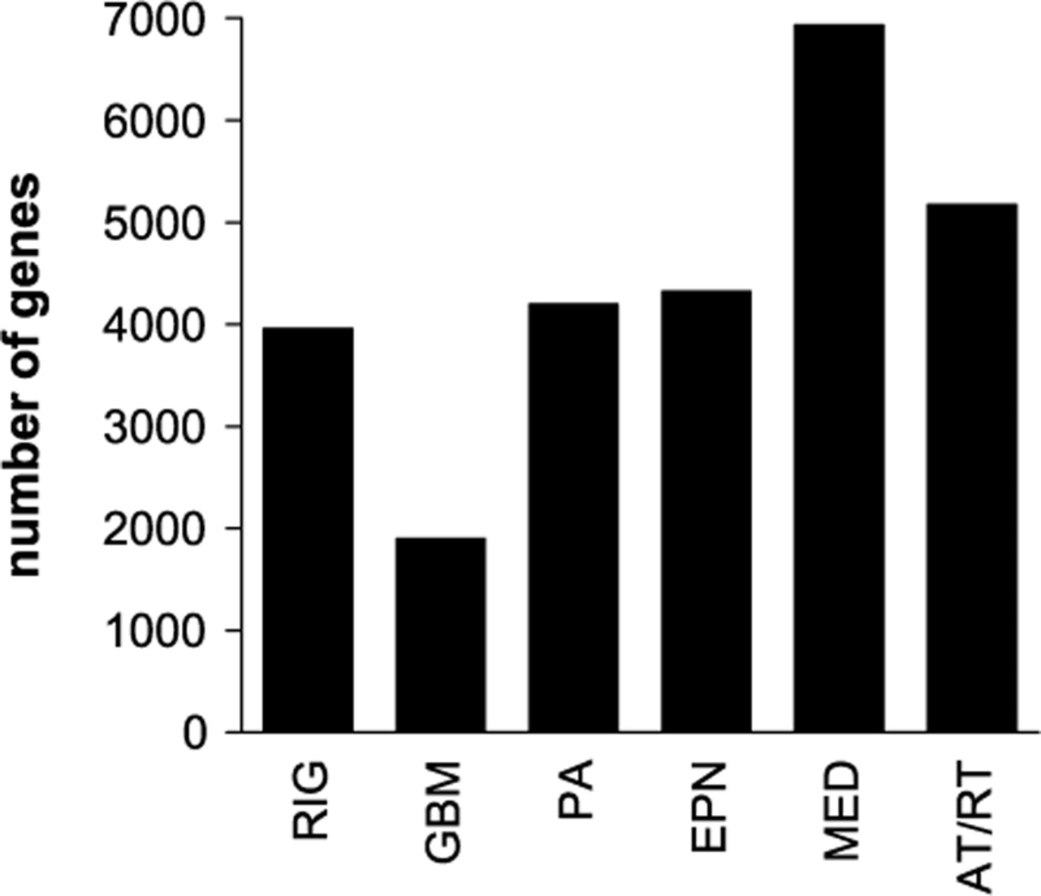
FIGURE 2. Homogeneity pediatric brain tumor gene expression profiles. The numbers of conserved signature genes that ...
Notes:
FIGURE 2. Homogeneity pediatric brain tumor gene expression profiles. The numbers of conserved signature genes that were over- and underexpressed in radiation-induced glioblastoma (RIG), glioblastoma (GBM), pilocytic astrocytoma (PA), ependymoma (EPN), medulloblastoma (MED), and atypical teratoid/rhabdoid tumor (AT/RT) were measured. The number of signature genes correlates inversely with variability of gene expression profiles, or heterogeneity, for a given tumor.
Unless provided in the caption above, the following copyright applies to the content of this slide: Copyright © 2007 by the American Association of Neuropathologists, Inc.

Slide 3
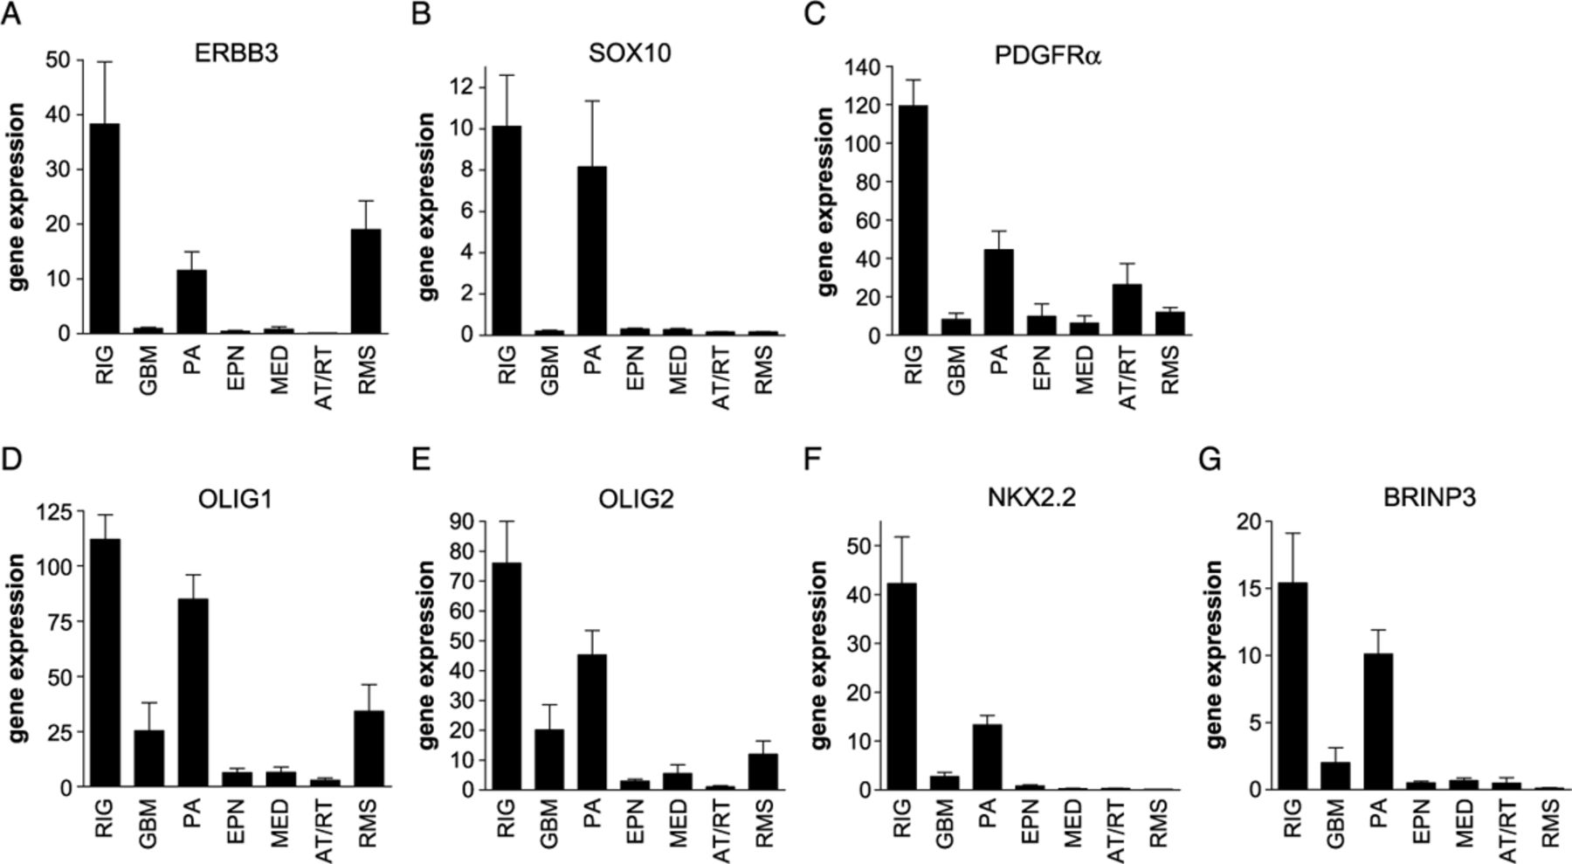
FIGURE 3. Comparison of gene expression in pediatric tumors. Genes that had been implicated in neuronal development ...
Notes:
FIGURE 3. Comparison of gene expression in pediatric tumors. Genes that had been implicated in neuronal development and/or tumorigenesis were selected from those genes that were overexpressed in radiation-induced glioblastoma (RIG). Bars indicate gene expression, measured as average normalized hybridization intensity of ERBB3 (A), SOX10 (B), platelet-derived growth factor receptor-α (PDGFRα) (C), oligodendrocyte transcription factor 1 (OLIG1) (D), oligodendrocyte transcription factor 2 (OLIG2) (E), NK2 transcription factor-related locus 2 (NKX2.2) (F), and BMP/retinoic acid-inducible neural-specific protein 3 (BRINP3) (G) from microarray analysis of 5 RIGs, 5 glioblastomas (GBMs), 6 pilocytic astrocytomas (PAs), 15 ependymomas (EPNs), 9 medulloblastomas (MEDs), 5 atypical teratoid/rhabdoid tumors (AT/RTs), and 8 rhabdomyosarcoma (RMSs). Error bars represent SEM.
Unless provided in the caption above, the following copyright applies to the content of this slide: Copyright © 2007 by the American Association of Neuropathologists, Inc.

Slide 4
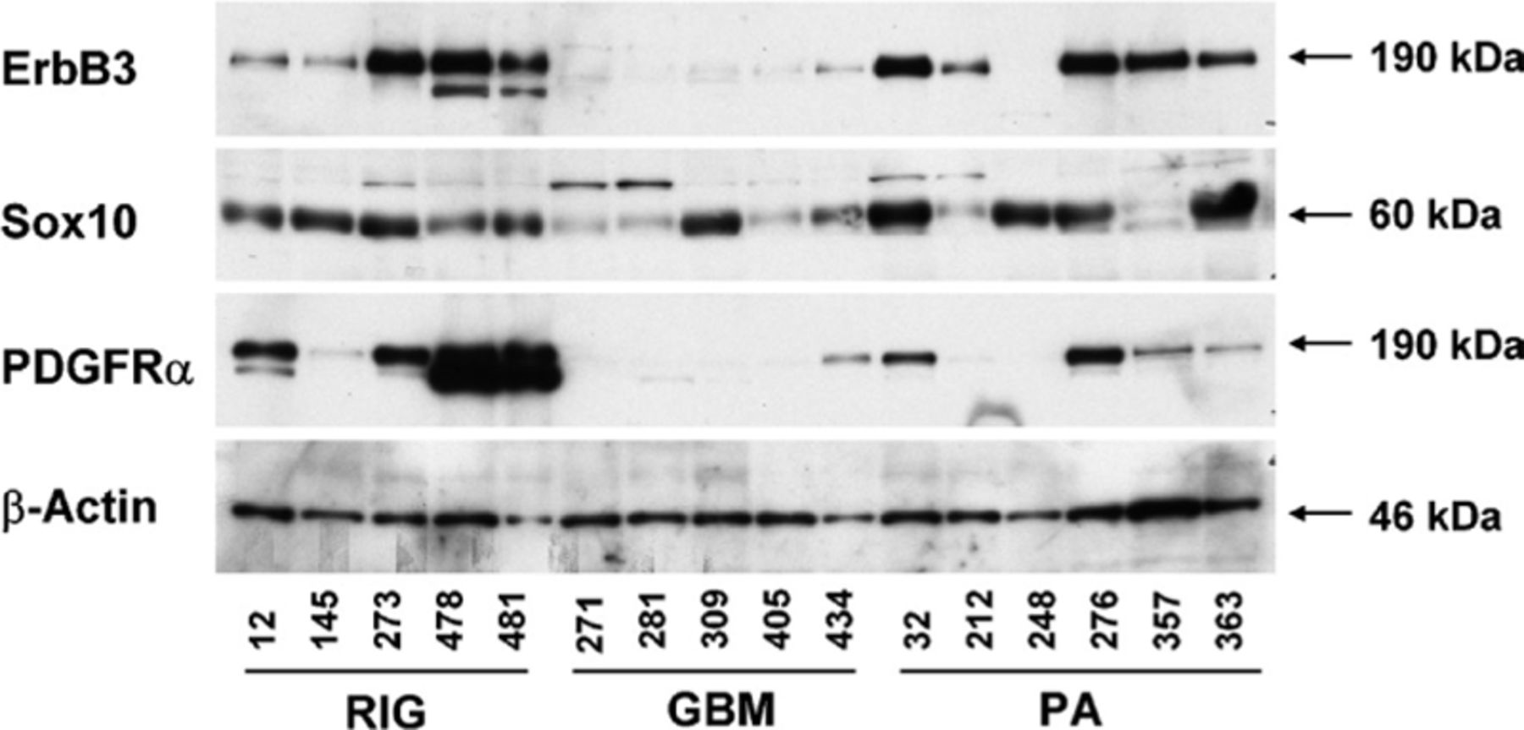
FIGURE 4. Western blot analysis of ErbB3, Sox10, and platelet-derived growth factor receptor-α (PDGFRα). Protein lysate ...
Notes:
FIGURE 4. Western blot analysis of ErbB3, Sox10, and platelet-derived growth factor receptor-α (PDGFRα). Protein lysate (25 μg) from 5 radiation-induced glioblastomas (RIGs), 5 pediatric glioblastomas (GBMs), and 6 pilocytic astrocytomas (PAs) were probed successively with anti-ErbB3, anti-Sox10, and anti-PDGFRα antibodies. Anti-β-actin antibody was used as an internal control for protein loading.
Unless provided in the caption above, the following copyright applies to the content of this slide: Copyright © 2007 by the American Association of Neuropathologists, Inc.

