Slide 1
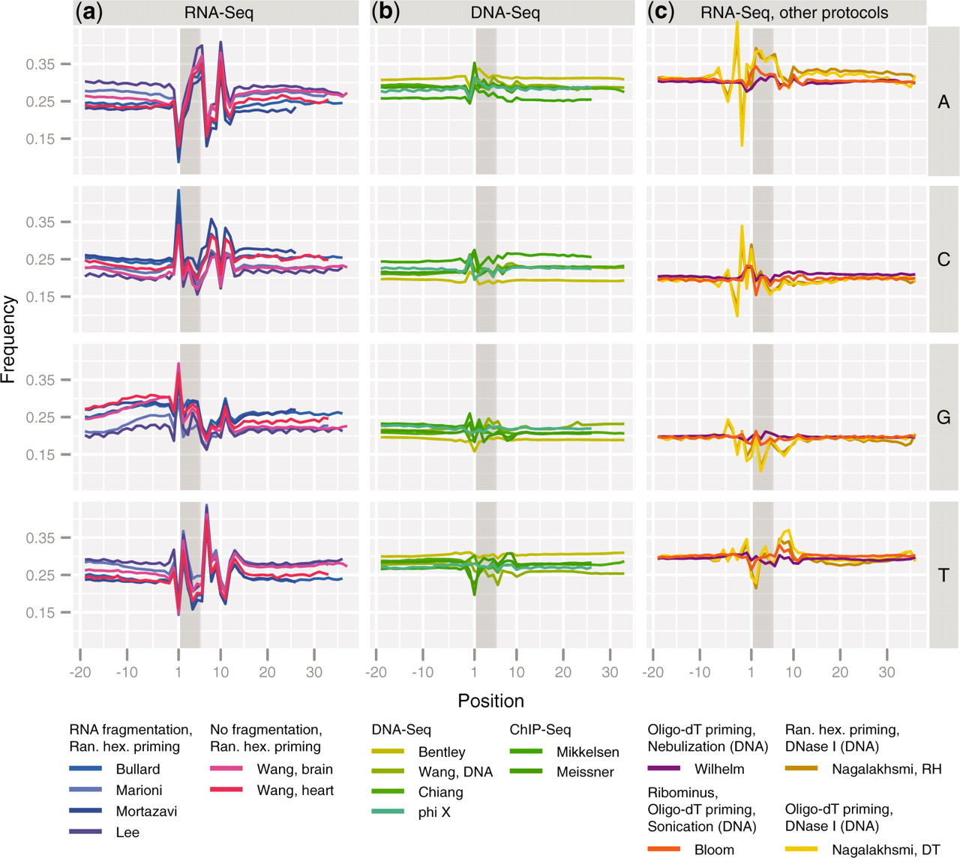
Figure 1. Nucleotide frequencies versus position for stringently mapped reads. For each experiment, mapped reads were ...
Notes:
Figure 1. Nucleotide frequencies versus position for stringently mapped reads. For each experiment, mapped reads were extended upstream of the 5′-start position, such that the first position of the actual read is 1 and positions 0 to −20 are obtained from the genome. The first hexamer of the read is shaded. Brief experimental protocols are indicated in the key. (a) RNA-Seq experiments conducted using priming with random hexamers, with and without RNA fragmentation. (b) DNA resequencing and ChIP-Seq experiments. (c) RNA-Seq experiments with alternative library preparation protocols, including priming with random hexamers followed by fragmentation using DNase I and priming with oligo(dT) followed by fragmentation using either DNase I, nebulization or sonication.
Unless provided in the caption above, the following copyright applies to the content of this slide: © The Author(s) 2010. Published by Oxford University Press.This is an Open Access article distributed under the terms of the Creative Commons Attribution Non-Commercial License (http://creativecommons.org/licenses/by-nc/2.5), which permits unrestricted non-commercial use, distribution, and reproduction in any medium, provided the original work is properly cited.

Slide 2
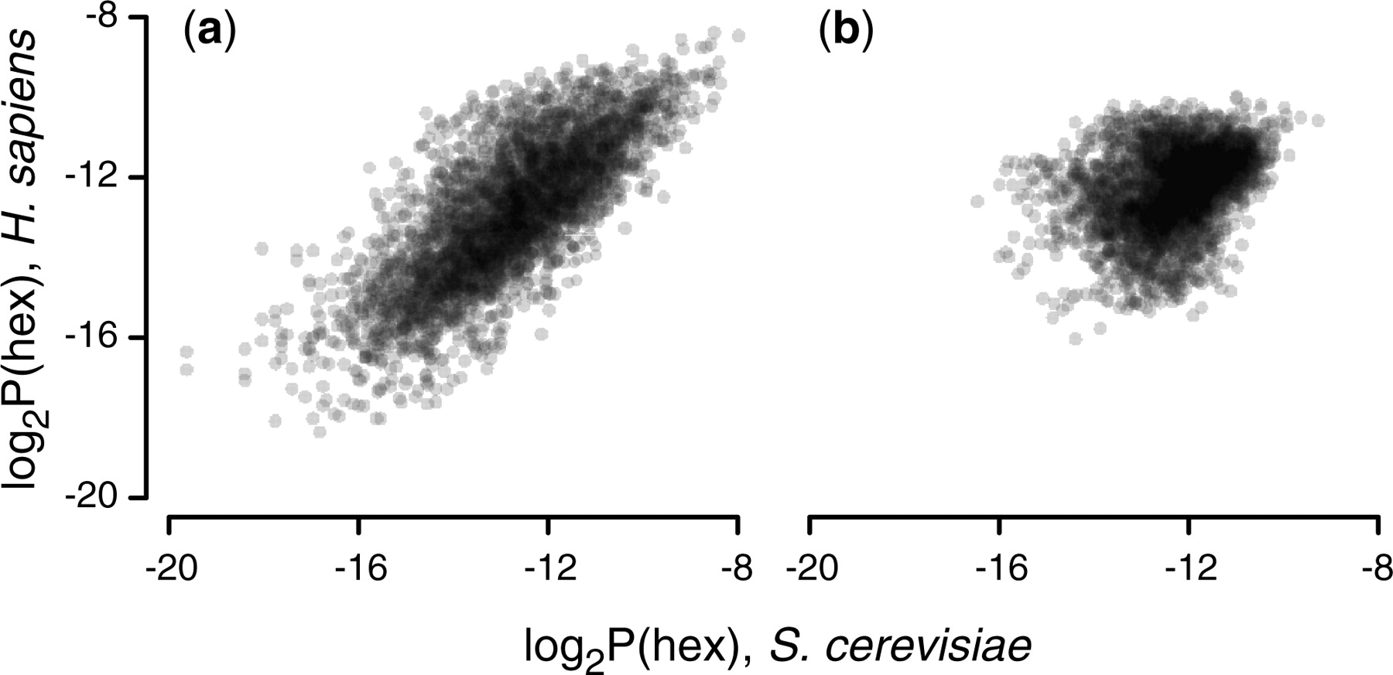
Figure 2. Hexamer frequencies. ( a ) The logarithm (base 2) of all (4096) observed hexamer frequencies computed using ...
Notes:
Figure 2. Hexamer frequencies. ( a ) The logarithm (base 2) of all (4096) observed hexamer frequencies computed using positions 1–6 of the aligned reads for an experiment in H. sapiens ( 8 ) versus an experiment in S. cerevisiae ( 9 ). The two distributions have a correlation of . ( b ) As in (a), but the hexamers correspond to positions 25–30 of the aligned reads, with a correlation of .
Unless provided in the caption above, the following copyright applies to the content of this slide: © The Author(s) 2010. Published by Oxford University Press.This is an Open Access article distributed under the terms of the Creative Commons Attribution Non-Commercial License (http://creativecommons.org/licenses/by-nc/2.5), which permits unrestricted non-commercial use, distribution, and reproduction in any medium, provided the original work is properly cited.

Slide 3
Figure 3. Nucleotide frequencies versus position for stringently mapped stranded reads for the A nucleotide. ( a and b ...
Notes:
Figure 3. Nucleotide frequencies versus position for stringently mapped stranded reads for the A nucleotide. ( a and b ) As in Figure 1 a, but split according to whether reads map to the sense or antisense strand. ( c ) Difference between the frequencies in (a and b).
Unless provided in the caption above, the following copyright applies to the content of this slide: © The Author(s) 2010. Published by Oxford University Press.This is an Open Access article distributed under the terms of the Creative Commons Attribution Non-Commercial License (http://creativecommons.org/licenses/by-nc/2.5), which permits unrestricted non-commercial use, distribution, and reproduction in any medium, provided the original work is properly cited.

Slide 4
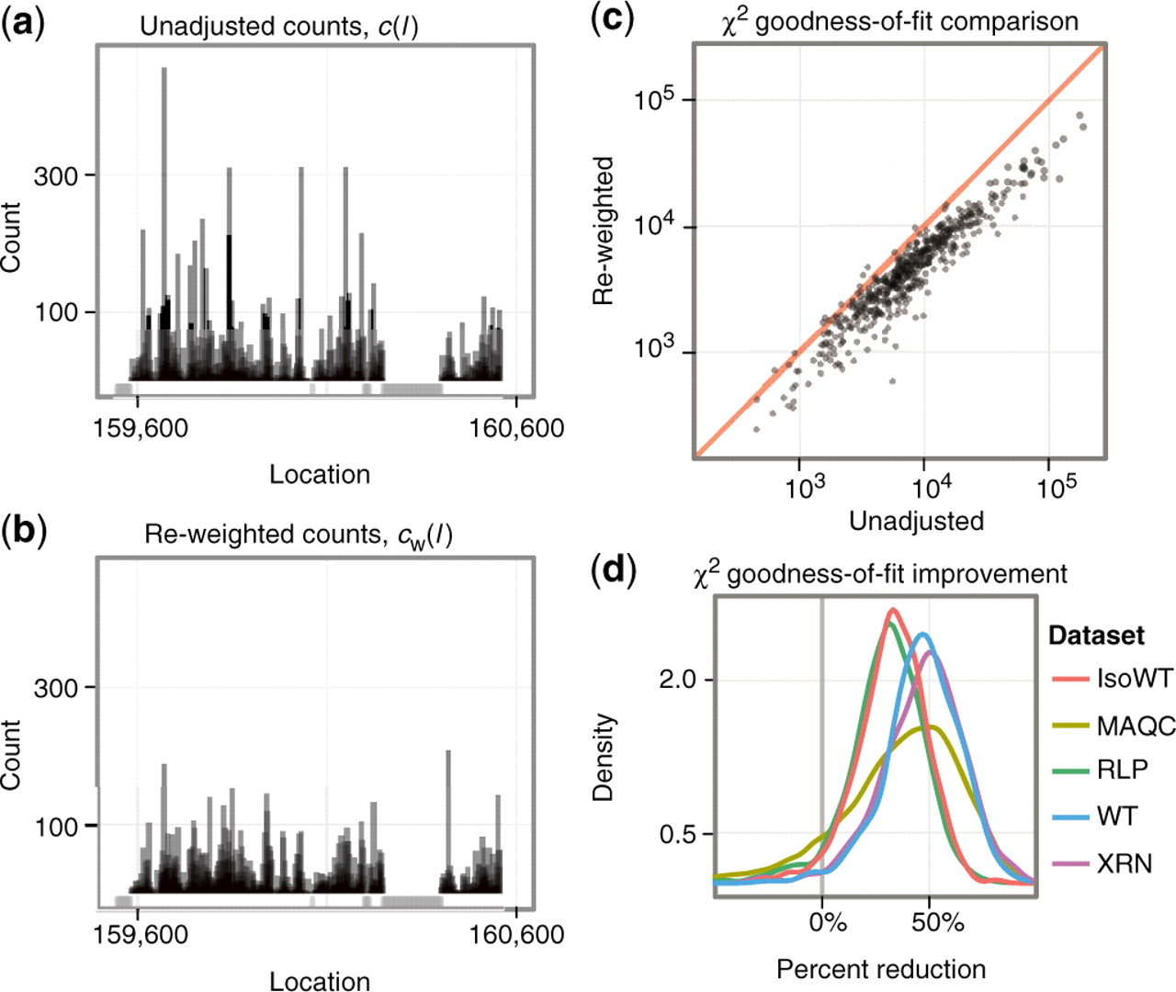
Figure 4. Evaluation of the reweighting scheme. ( a and b ) Unadjusted and re-weighted base-level counts for reads ...
Notes:
Figure 4. Evaluation of the reweighting scheme. ( a and b ) Unadjusted and re-weighted base-level counts for reads from the WT experiment mapped to the sense strand of a 1-kb coding region in S. cerevisiae (YOL086C). The graey bars near the x -axis indicate unmappable genomic locations. ( c ) The goodness-of-fit statistics based on unadjusted and reweighted counts for 552 highly expressed regions of constant expression. ( d ) Smoothed histograms of the reduction in goodness-of-fit statistics when using the re-weighting scheme, evaluated in five different experiments. Values greater than zero indicate that the re-weighting scheme improves the uniformity of the read distribution.
Unless provided in the caption above, the following copyright applies to the content of this slide: © The Author(s) 2010. Published by Oxford University Press.This is an Open Access article distributed under the terms of the Creative Commons Attribution Non-Commercial License (http://creativecommons.org/licenses/by-nc/2.5), which permits unrestricted non-commercial use, distribution, and reproduction in any medium, provided the original work is properly cited.

